Slide 1
COP2073C
Introduction to Statistical Programming with R
Module 7: Basic Statistics in R
Reading (Book of R):
Ch. 13 Elementary Statistics
Ch. 14 Basic Data Visualization
Ch. 15 Probability
Ch. 16 Common Probability Distributions

Slide 2
Ch. 13 Elementary Statistics

Slide 3
Numeric Variables
There are two basic types of numeric variables in statistics:
continuous variables: any value in some interval, up to any number of decimals (which technically gives an infinite number of possible values) e.g.
1.1, -3.0, 1678.5323
discrete variables: only distinct numeric values
If the range is restricted, then the number of possible values is finite
e.g.
1, -27, 101, 3108

Slide 4
Univariate and Multivariate Data
Univariate data refers to the use of a single relevant variable
e.g. the weight of a car
Multivariate data consist of multiple variables, where their individual components aren't useful in a particular statistical analysis
Bivariate is sometimes considered a sub-category of multivariate, referring specifically to two variables considered together, but can also considered distinct from a multivariate analysis which requires three or more variables
Bivariate can be easily plotted on an x- and y- axis
Multivariate depends on analysis context
e.g. an analysis requires height and weight as dependent variables
e.g. a geographic location measured in three dimensions (latitude, longitude, and altitude)

Slide 5
Parameters vs. Statistics
Statistics as a discipline is concerned with understanding features of an entire collection of individuals or entities of interest, known as a population
Parameters are the characteristics of a population (e.g. μ – the population mean)
Researchers typically collect a sample of data to represent a population and use models to derive relevant information from that data
Statistics are characteristics of the sample
Statistics are estimated parameters derived from the sample (e.g. x̅ – the sample mean)
population
sample
data
collection
μ (population mean)
x̅ (sample mean)

Slide 6
Summary Statistics
Measurements which summarize data include
Centrality: describe how large collections of data are centered
e.g. mean, median, mode
Range, Variance, Standard Deviation
measure the spread of the data
Counts, Percentages, and Proportions
useful for categorical data
Quantiles, Percentiles, and the Five-Number Summary
describe the distribution of a dataset
Covariance and Correlation
demonstrate the relationship between two variables

Slide 7
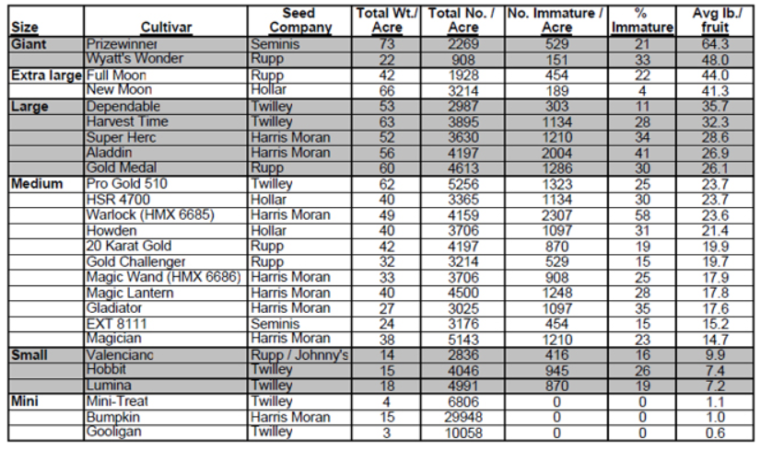
Summary Data Examples: Pumpkin Data!
Given the weight (in lbs) for various pumpkin samples in the "Medium" size category, use R to calculate various summary data values
"2007 Evaluation of Pumpkin Varieties for the Southeast"
http://vegetables.tennessee.edu/Pumpkin/pumpkin2007_1.html
- (note: this link is now broken)
- Immature pumpkins are unripe pumpkins

Slide 8
Summary Data: Examples
> # weights vector is Medium category only
> weights <- c(23.7,23.7,23.6,21.4,19.9,19.7,
17.9,17.8,17.6,15.2,14.7)
> meanw <- mean(weights) # mean
> medw <- median(weights) # median ("middle")
> cat("mean=", meanw, "median=", medw)
mean= 19.56364 median= 19.7
> sd(weights) # standard deviation
[1] 3.262598
> range <- max(weights) - min(weights) # range
> range
[1] 9

Slide 9
Summary Data: Examples
The mode is the value that appears most frequently in a data set.
R has no statistical "mode" function
mode() in R is not the same (look it up)
A custom mode function can be written, many examples are available on the web
They all work in a similar fashion:
create a vector of unique values
count the number of indices for each unique value
get the element value of the maximum of the index with the highest count
> getmode <- function(v) {
uv <- unique(v)
uv[which.max(tabulate(match(v, uv)))]
}
> getmode(weights)
[1] 23.7

Slide 10
tapply() for Summary Statistics
In calculating simple summary statistics, the R tapply function can be used to compute statistics grouped by a specific categorical variable.
e.g. calculate the mean miles per gallon (mpg) for each cylinder value in the mtcars database
> tapply(mtcars$mpg,INDEX=mtcars$cyl,FUN=mean)
4 6 8
26.66364 19.74286 15.10000

Slide 11
> # read the pumpkin data
> pumpkin <- read.csv("pumpkin.csv")
> # set the column names
> names(pumpkin) <- c("Size","Num_Immature_Acre",
"Percent_Immature","Avg_lb")
> # find the mean per size category
> result <- tapply(pumpkin$Avg_lb,INDEX=pumpkin$Size,FUN=mean)
> # it's alphabetical, sort it numerically
> sort(result,decreasing=TRUE)
Giant Extra large Large Medium Small Mini
56.150000 42.650000 29.920000 19.563636 8.166667 0.900000
> # use the custom getmode function to find the mode per size category
> result <- tapply(pumpkin$Avg_lb,INDEX=pumpkin$Size,FUN=getmode)
> # sort it
> sort(result,decreasing=TRUE)
Giant Extra large Large Medium Small Mini
64.3 44.0 35.7 23.7 9.9 1.1

Slide 12
Quantiles
A quantile is a value computed from a collection of numeric measurements that indicates an observation’s rank when compared to all the other observations
The median is a quantile which gives you a value below which half of the measurements lie, the 0.5th quantile
Quantiles are commonly expressed as a percentile on a “percent scale” of 0 to 100
> quantile(pumpkin$Avg_lb)
0% 25% 50% 75% 100%
0.600 14.825 20.650 28.175 64.300

Slide 13
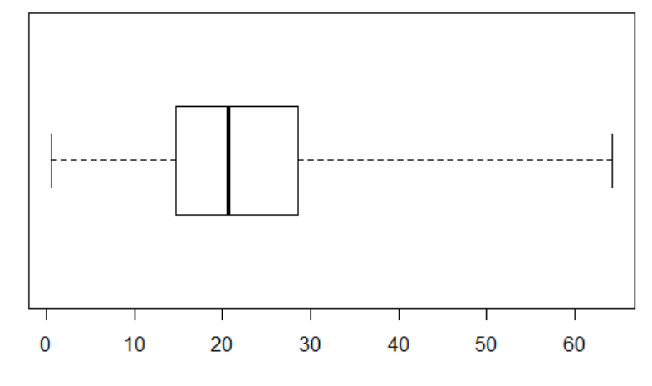
Using boxplot() to Show Quantiles
Box plots (also known as "box and whisker" plots) are frequently used to represent percentiles (also known as "Five Number Summary Box Plots")
> boxplot(pumpkin$Avg_lb, horizontal=T, range=0)
Median
(50th Percentile)
25th
Percentile)
75th
Percentile)
Minimum
Maximum

Slide 14
Variance
Variance ("spread") measures dispersion of a dataset, ie. how spread out points are from the mean and one another
Variance of 0 means points are all the same
The var() function calculates sample variance
var() result is the square of the original sample data unit
e.g. if data is in feet, var() unit is square feet
as sample size increases, var() approaches population variance
var() is the square of the standard deviation sd() (we'll use this later!)
> var(weights) # variance of medium pumpkin category
[1] 10.64455
> var(pumpkin$Avg_lb) # variance of all pumpkin weight categories
[1] 230.9658

Slide 15
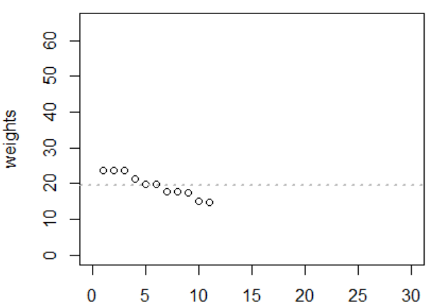
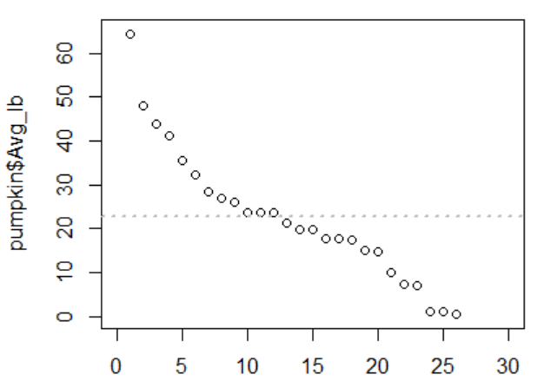
Variance
Plot the data to visualize
> plot(weights, xlim=c(0,30), ylim=c(0,65))
> abline(h=mean(weights),lwd=2,lty=3, col="gray")
> plot(pumpkin$Avg_lb, xlim=c(0,30), ylim=c(0,65))
> abline(h=mean(pumpkin$Avg_lb),lwd=2,lty=3, col="gray")

Slide 16
Covariance and Correlation
Covariance expresses how much two numeric variables “change together”
A positive covariance result shows that there is a positive linear relationship between the variables: as x increases, y increases
A negative covariance result shows a negative linear relationship: as x increases, y decreases
A covariance of 0 indicates no relationship
To calculate covariance, use the cov() function
Correlation allows you to interpret covariance by identifying both the direction and the strength of any association
To calculate correlation, use the cor() function

Slide 17
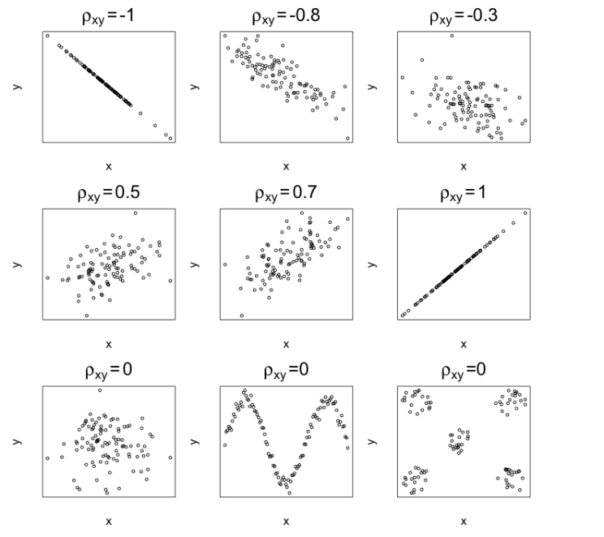
Correlation Value Examples
ρ_{xy} labels represent calculated correlation values

Slide 18
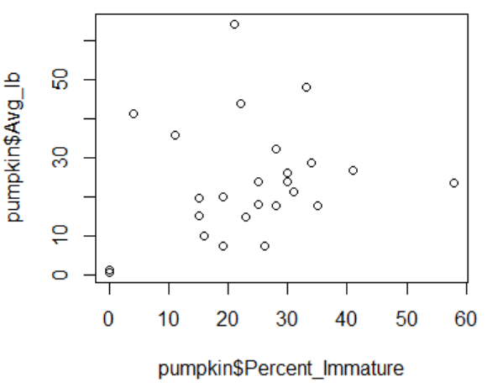
Covariance and Correlation
# show covariance, correlation and scatter plot for all pumpkins
# percent immature vs. weight
cov(pumpkin$Percent_Immature,pumpkin$Avg_lb)
cor(pumpkin$Percent_Immature,pumpkin$Avg_lb)
plot(pumpkin$Percent_Immature,pumpkin$Avg_lb)

Slide 19
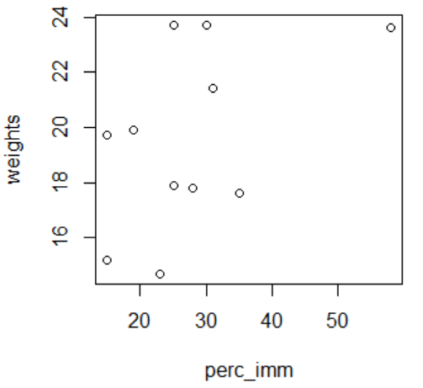
Covariance and Correlation
# show covariance, correlation and scatter plot for medium category
# percent immature vs. weight
perc_imm <- pumpkin[10:20,3]
cov(perc_imm,weights)
cor(perc_imm,weights)
plot(perc_imm,weights)

Slide 20
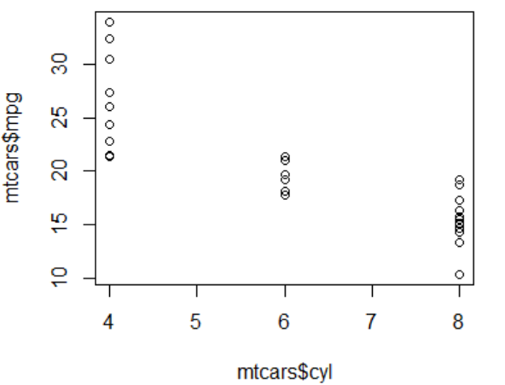
Covariance and Correlation
> cov(mtcars$cyl,mtcars$mpg)
[1] -9.172379
> cor(mtcars$cyl,mtcars$mpg)
[1] -0.852162
> plot(mtcars$cyl, mtcars$mpg)

Slide 21
Outliers
An outlier is an observation that does not fit with the rest of the data
A noticeable extreme when compared with the bulk of the data
Outliers can occur naturally, where the outlier is an accurate observation recorded from the population, or unnaturally, where something has "contaminated" the sample, such as incorrect input
It is common to omit any outliers occurring through unnatural sources prior to analysis if they can be found
Identifying outliers is important because of the potential impact they can have on any statistical calculation
Researchers try to identify possible outliers before computing results by conducting an exploratory analysis of their data using basic summary statistics and data visualization tools
In some cases, researchers conduct their analysis both ways, presenting results including and excluding perceived outliers

Slide 22
Ch. 14 Basic Data Visualization

Slide 23
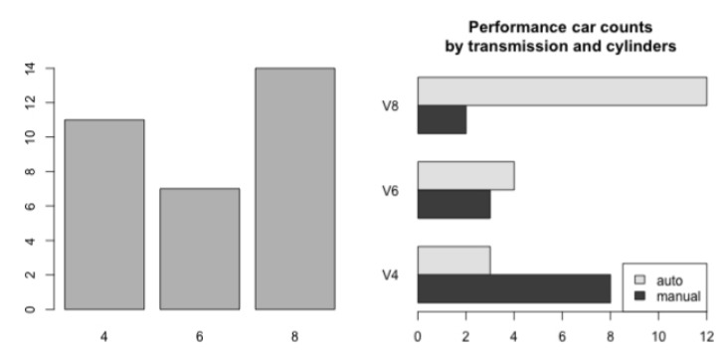
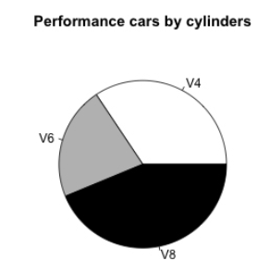
Barplots (bar charts) and Pie Charts
Barplots and pie charts are commonly used to visualize qualitative data by category frequency.
A barplot draws either vertical or horizontal bars, typically separated by white space, to visualize frequencies according to the relevant categories.
The pie chart is an alternative option for visualizing frequency-based quantities across levels of categorical variables, with appropriately sized “slices” representing the relative counts of each categorical variable.

Slide 24
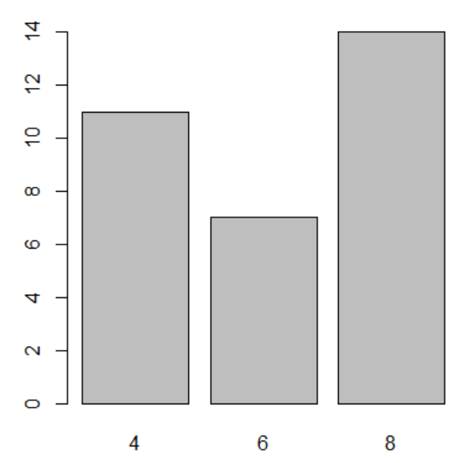
Create a Barplot from mtcars Dataset
mtcars[1:5,]
mpg cyl disp hp drat wt qsec vs am gear carb
Mazda RX4 21.0 6 160 110 3.90 2.620 16.46 0 1 4 4
Mazda RX4 Wag 21.0 6 160 110 3.90 2.875 17.02 0 1 4 4
Datsun 710 22.8 4 108 93 3.85 2.320 18.61 1 1 4 1
Hornet 4 Drive 21.4 6 258 110 3.08 3.215 19.44 1 0 3 1
Hornet Sportabout 18.7 8 360 175 3.15 3.440 17.02 0 0 3 2
# plot observations per cylinder (cyl)
> cyl.freq <- table(mtcars$cyl)
> cyl.freq
4 6 8
11 7 14
> barplot(cyl.freq)

Slide 25
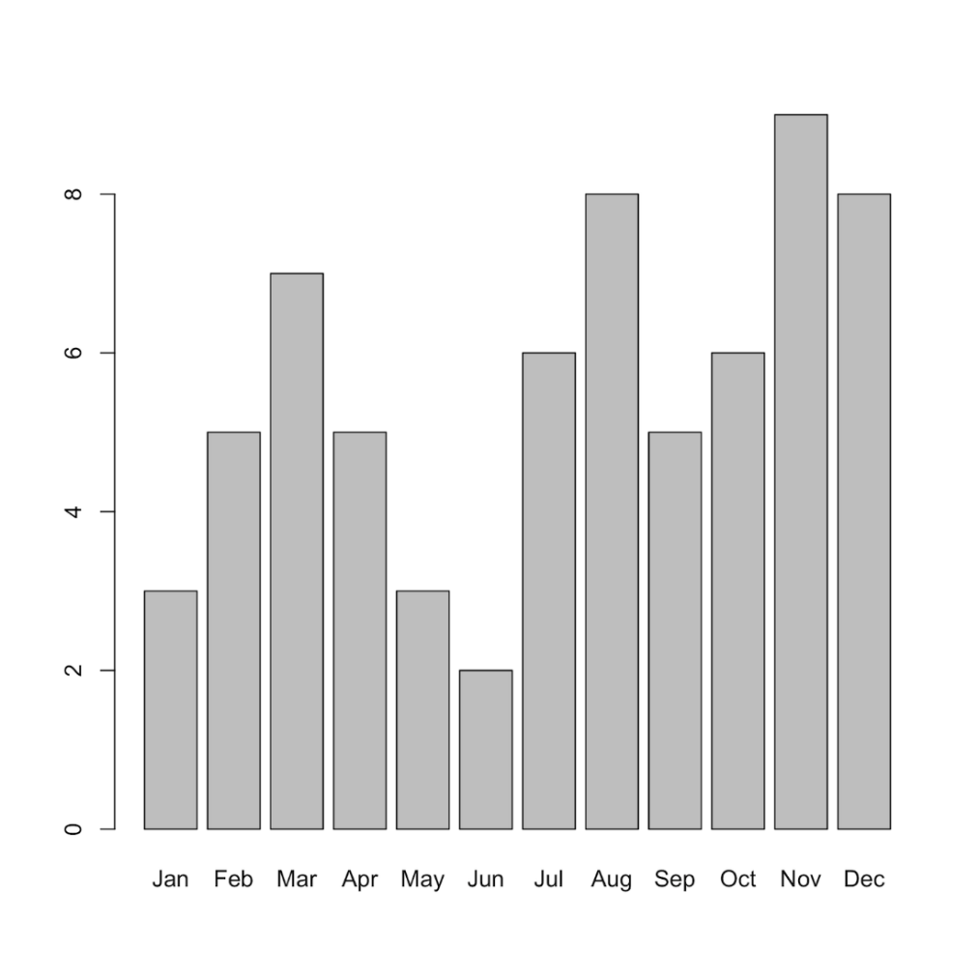
Simple Bar Charts
Simple bar charts require data and names for the categories.
> rain
[1] 3 5 7 5 3 2 6 8 5 6 9 8
> month
[1] "Jan" "Feb" "Mar" "Apr" "May" "Jun" "Jul" "Aug" "Sep" "Oct" "Nov" "Dec"
> barplot(rain, names = month)

Slide 26
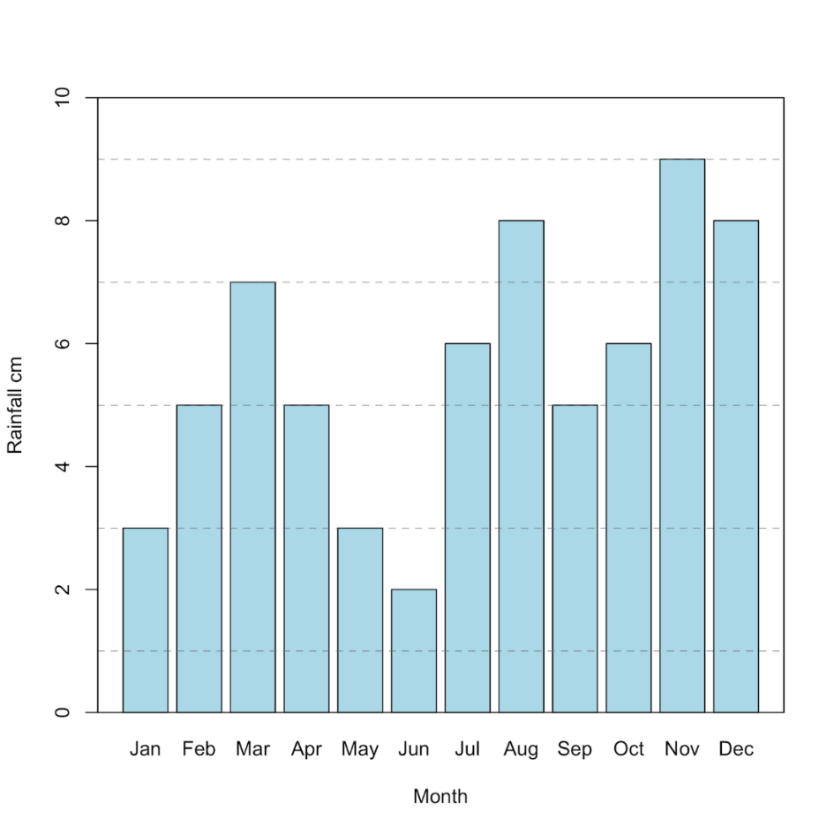
Customizing Bar Charts
Instruction | Result
xlab = “title” | X-axis title
ylab = “title” | Y-axis title
ylim = c(start, end) | Axis limits
col = “color” | Bar color
> barplot(rain, xlab = 'Month', ylab = 'Rainfall cm', ylim = c(0,10), col = 'lightblue')
> abline(h = seq(1,9,2), lty = 2, lwd = 0.5, col = 'gray40')
> box() # draw box around plot

Slide 27
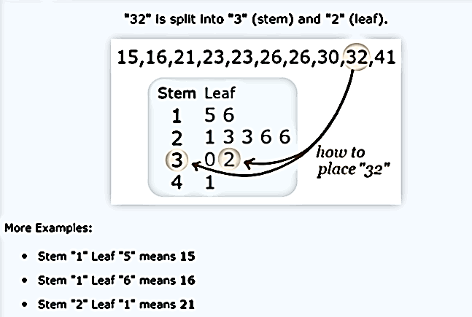
Stem and Leaf Plots
A stem and leaf plot is a special table where each data value is split into a "stem" (the first digit or digits) and a "leaf" (usually the last digit).
https://www.mathsisfun.com/data/stem-leaf-plots.html

Slide 28
Stem and Leaf Plots
A statistician for a basketball team tracked the number of points that each of 12 players on the team had in one game, and then made a stem-and-leaf plot to show the data.
Player 1: 0
Player 2: 0
Player 3: 2
Player 4: 4
Player 5: 7
Player 6: 7
Player 7: 9
Player 8: 11
Player 9: 11
Player 10: 13
Player 11: 18
Player 12: 20
Stem | Leaf
0 | 0 0 2 4 7 7 9
1 | 1 1 3 8
2 | 0
https://www.khanacademy.org/math/ap-statistics/quantitative-data-ap/histograms-stem-leaf/v/u08-l1-t2-we3-stem-and-leaf-plots

Slide 29
Stem and Leaf Plots in R
> data2
[1] 3 5 7 5 3 2 6 8 5 6 9 4 5 7 3 4
> stem(data2)
The decimal point is at the |
2 | 0000 # one 2, three 3s
4 | 000000 # two 4s, four 5s
6 | 0000 # two 6s, two 7s
8 | 00 # one 8, one 9

Slide 30
Increasing the Number of Bins
> data2
[1] 3 5 7 5 3 2 6 8 5 6 9 4 5 7 3 4
> stem(data2, scale=2)
The decimal point is at the |
2 | 0
3 | 000
4 | 00
5 | 0000
6 | 00
7 | 00
8 | 0
9 | 0

Slide 31
Stem and Leaf with Real Numbers
> data4
[1] 23.0 17.0 12.5 11.0 17.0 12.0 14.5
[8] 9.0 11.0 9.0 12.5 14.5 17.0 8.0 21.0
> stem(data4,scale=2)
The decimal point is at the |
8 | 000
10 | 00
12 | 055
14 | 55
16 | 000
18 |
20 | 0
22 | 0

Slide 32
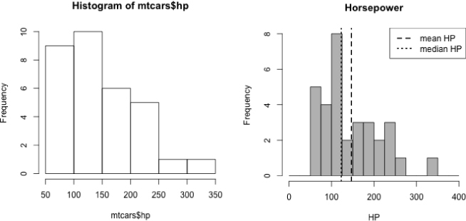
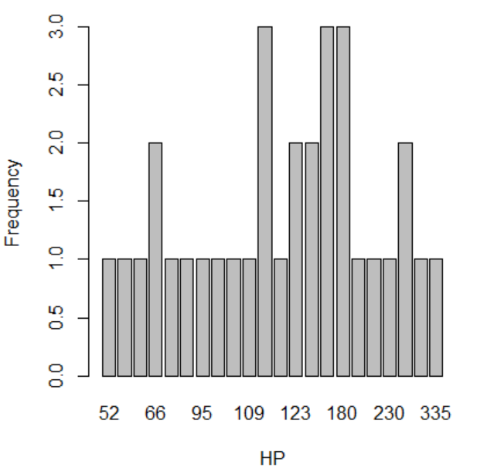
Histograms
The barplot is sensible for counting observations in relation to categorical variables but is of virtually no use if the variable you’re interested in is numeric/continuous
Stem plots show original values and allow samples to be reconstructed, but are unwieldy with larger data sets
Histograms are the "classic" way to view a distribution of continuous measurements
Histograms are sometimes confused with barplots owing to their similar appearance

Slide 33
Histograms
A histogram plots continuous data by binning the number of continuous observations
The size of this interval is known as the binwidth.
Consider the horsepower data of the 32 cars in the mtcars dataset
> hist(mtcars$hp)
The histogram uses binwidths of 50 units spanning the range of the data, centered roughly in the range of 75 to 150, tapering off on the right (this is known as a right or positive skew
The accuracy of a histogram as a representation of the shape of a distribution of measurements depends solely upon the widths of the intervals used to bin the data.

Slide 34
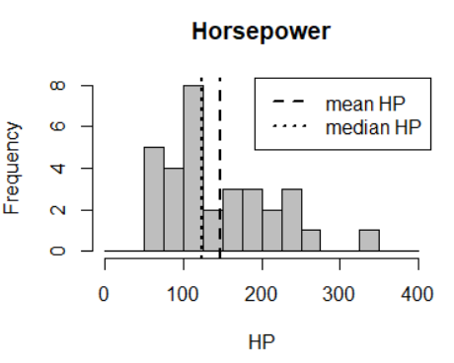
Histograms
Binwidths can be modified by supplying a vector of "breaks" to the hist command
> hist(mtcars$hp,breaks=seq(0,400,25),
col="gray",main="Horsepower",xlab="HP")
> abline(v=c(mean(mtcars$hp),median(mtcars$hp)),
lty=c(2,3),lwd=2)
> legend("topright",
legend=c("mean HP","median HP"), lty=c(2,3),lwd=2)

Slide 35
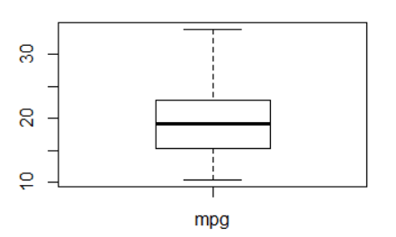
boxplot()
Create box-whisker plots with the boxplot() command
> boxplot(mtcars$mpg,names=c('mpg'))

Slide 36
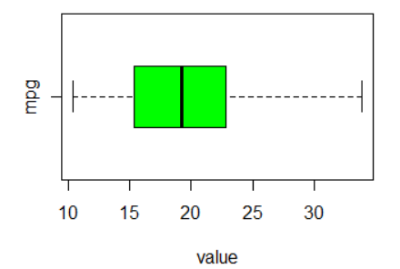
Customizing Boxplots
> boxplot(mtcars$mpg,names=c('mpg'),show.names=TRUE,
horizontal=TRUE,xlab="value",col="green")
Instruction | Result
names = “names” | Sets names for boxes
range = n | Extent of whiskers
xlab = “title” | X-axis title
ylab = “title” | Y-axis title
col = “color” | Color of box fill

Slide 37
Ch. 15 Probability

Slide 38
Probability is Central to Statistics
Even the most complicated statistical techniques and models usually have the ultimate goal of making a probabilistic statement about a phenomenon.
A probability is a number that describes a measure of chance associated with a particular observation or statement.
Probability is always a number between 0 and 1 (inclusive) and is often expressed as a fraction.
The calculation of a probability depends on the definition of an event.

Slide 39
Probability Measurements
In statistics, an event typically refers to a specific outcome that can occur.
To describe the chance of event A actually occurring, you use a probability, denoted by Pr(A)
Pr(A) = 0 suggests A cannot occur
Pr(A) = 1 suggests that A occurs with complete certainty

Slide 40
Classical Probability
Roll a six-sided, fair die. Let A be the event “you roll a 5 or a 6.”
You can assume that each outcome on a standard die has a probability of occurring 1/6 in any given roll. Under these conditions, you have this:
Pr(A) = 1/6 + 1/6 = 1/3
This is what’s known as a frequentist, or classical, probability: the relative frequency with which an event occurs over many identical, objective trials
Contrast this with a Bayesian probability, which uses prior knowledge or subjective belief to inform the calculations

Slide 41
Multiple Events
Calculation of probabilities based on several defined events can usually be broken down into a specific calculation concerning two distinct events
Assume you roll a standard die and define event A to be “you roll a 4 or more” (i.e. 4, 5, or 6) and event B to be “you roll an even number” (i.e. 2, 4, or 6).
You can therefore conclude that
Pr(A) = 1/2 and Pr(B) = 1/2

Slide 42
Conditional Probability
A conditional probability is the probability of one event occurring after taking into account the occurrence of another event.
Pr(A|B) represents “the probability that A occurs, given that B has already occurred,” and vice versa if you write Pr(B|A)
If Pr(A|B) = Pr(A), then the two events are independent
If Pr(A|B) ≠ Pr(A), then the two events are dependent
Generally, you can’t assume that Pr(A|B) is equal to Pr(B|A).
Using the dice example, let Pr(A|B) be the probability of a single even number roll being a 4 or more (i.e. a 4 or a 6) after an even number has been rolled
Since there are three even numbers, 2, 4, and 6, the probability that you roll a 4 or more is 2/3
Since Pr(A|B), which is 2/3, is not equal to Pr(A), which is 1/2, the two events are dependent

Slide 43
Ch. 16 Common Probability Distributions

Slide 44
Standard Distributions and R
Probability distributions describe the probability of an outcome
They come in many shapes, but in only one size: probabilities in a distribution always add up to 1
Their properties are well understood and documented.
Most statistical software packages have corresponding built-in functionality for their evaluation.
The common distributions are broadly categorized as either discrete or continuous
Each distribution has four core R functions tied to it:
a d-function, for specific mass or density function values
a p-function, for cumulative distribution probabilities
a q-function, for quantiles
an r-function, for random variate generation

Slide 45
The Bernoulli distribution
A Bernoulli distribution is a discrete probability distribution with one trial (n = 1) of a variable having two possible outcomes in which "success" (1) occurs with probability p and "failure" (0) occurs with probability q = 1 - p, where 0 < p < 1
This type of variable can be referred to as binary or dichotomous
Flipping a coin: p(heads) = 1 out of 2 = 0.5 (50%)
q = 0.5 # probability of rolling tails
Rolling a die: p(rolling a 1) = 1 out of 6 = 0.16 (16%)
q = 0.84 # probability of rolling NOT(1)
Chance of rain: p(rain) = 0.2 (20%)
q = 0.8 # probability of NOT(rain)

Slide 46
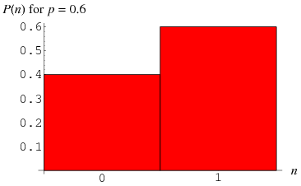
Plotting a Bernoulli Distribution
Barplots are a good choice to display the probability density p(n)

Slide 47
Binomial Distributions
The binomial distribution is the distribution of successes in n number of trials involving binary discrete random variables
The role of the Bernoulli distribution is typically one of a “building block” for more complicated distributions, like the binomial, that give you more interesting results
Binomial distributions are distributions of discrete (vs. continuous) values
if number of trials (n) = 1, it is identical to Bernoulli
binomial distributions are discrete ("stairsteppy")
close to normal distribution if the sample size is large

Slide 48
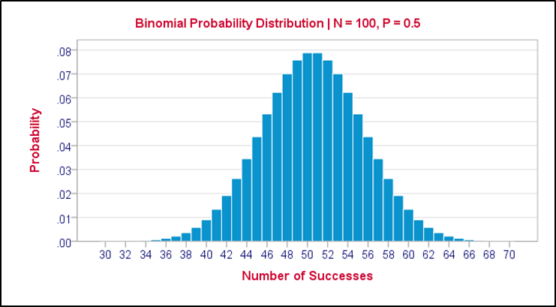
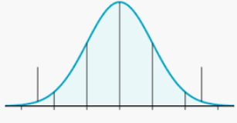
Binomial Distributions
Binomial distributions are discrete ("stairsteppy")
Population density is close to a normal distribution if the sample size is large
Large Sample Binomial Distribution Curve
Normal Distribution Curve

Slide 49

Calculating Binomial Probabilities
Consider rolling a die with success defined as getting a specific value, e.g. a 4
If you roll a die independently size times, what is the probability of observing exactly x successes in total?
Use the d-function (density function) for binomial distributions
dbinom(x, size, prob, log = FALSE)
# Probability of one success with one roll, one die
> dbinom(x=1, size=1, prob=1/6) # Bernoulli
[1] 0.1666667

Slide 50
d-function for Binomial Distributions
More examples:
# Probability of one success with two rolls, one die
> dbinom(x=1,size=2,prob=1/6)
[1] 0.2777778
# Probability of one success with four rolls, one die
> dbinom(x=1,size=4,prob=1/6)
[1] 0.3858025
# Probability of two successes with five rolls, one die
> dbinom(x=2,size=5,prob=1/6)
[1] 0.160751
# Probability of two successes with ten rolls, one die
> dbinom(x=2,size=10,prob=1/6)
[1] 0.29071

Slide 51
d-function for Binomial Distributions
A vector can be supplied for x to calculate a sequence of probabilities
Notice the highest probability as shown in this example is for one success in 10 rolls
> dbinom(x=0:5,size=10,prob=1/6)
[1] 0.16150558 0.32301117 0.29071005 0.15504536
0.05426588 0.01302381

Slide 52
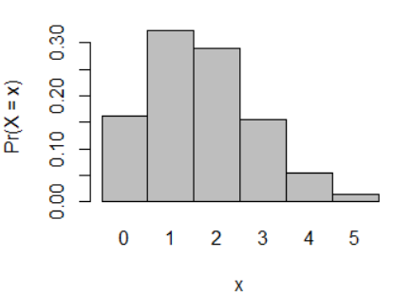
d-function for Binomial Distributions
Plotting the results:
> X.prob <- dbinom(x=0:5,size=10,prob=1/6)
> barplot(X.prob,names.arg=0:5,space=0,xlab="x",ylab="Pr(X = x)")

Slide 53
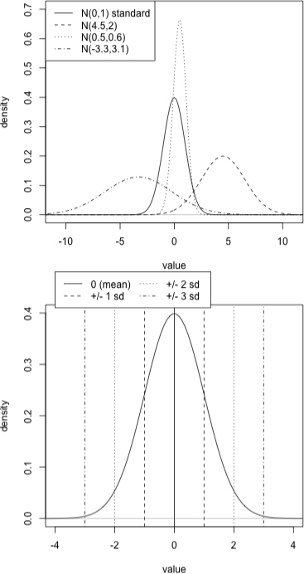
Normal Distributions
The normal distribution is one of the most well-known and commonly applied probability distributions in modeling continuous random variables
Characterized by a distinctive “bell-shaped” curve, it is also referred to as the Gaussian distribution.
4 examples of a normal distribution. The notation
X ∼ N(μ, σ)
where X is a continuous random variable, indicates that “X follows a normal distribution with mean μ and standard deviation σ.”

Slide 54
Normal Distributions
The parameters μ (mu) and σ (sigma) describe the mean and the standard deviation of the distribution, with variance σ².
If you have a random variable X then you can create a Z score by subtracting the mean from X and dividing the result by the standard deviation, or
(X – μ) / σ
This is known as the standardization of X
> x <- c(90, 87, 73, 91, 83, 64, 97)
# calculate Z-scores of all elements
> (x - mean(x)) / sd(x)
[1] 0.5624854 0.2999922
[3] -0.9249759 0.6499831
[5] -0.0499987 -1.7124554
[7] 1.1749694

Slide 55
Calculating Z-Scores with R
Given a vector of values, the scale() function will calculate standardized (Z) scores
> x <- c(90, 87, 73, 91, 83, 64, 97)
> scale(x)
[,1]
[1,] 0.5624854
[2,] 0.2999922
[3,] -0.9249759
[4,] 0.6499831
[5,] -0.0499987
[6,] -1.7124554
[7,] 1.1749694
attr(,"scaled:center")
[1] 83.57143 # mean
attr(,"scaled:scale")
[1] 11.42887 # standard deviation

Slide 56
d-function for Normal Distributions
dnorm calculates probability density, not probabilities
returns points calculated for a normal distribution based on mean and standard deviation
Use seq to create a sequence of values, evaluate the density with dnorm, and then plot the result
> xvals <- seq(-4,4,length=50)
> fx <- dnorm(xvals,mean=0,sd=1)
> fx
[1] 0.0001338302 0.0002537388 0.0004684284 0.0008420216 0.0014737603 0.0025116210
[7] 0.0041677820 0.0067340995 0.0105944324 0.0162292891 0.0242072211 0.0351571786
[13] 0.0497172078 0.0684578227 0.0917831740 0.1198192782 0.1523049307 0.1885058641
[19] 0.2271744074 0.2665738719 0.3045786052 0.3388479358 0.3670573564 0.3871565916
[25] 0.3976152387 0.3976152387 0.3871565916 0.3670573564 0.3388479358 0.3045786052
[31] 0.2665738719 0.2271744074 0.1885058641 0.1523049307 0.1198192782 0.0917831740
[37] 0.0684578227 0.0497172078 0.0351571786 0.0242072211 0.0162292891 0.0105944324
[43] 0.0067340995 0.0041677820 0.0025116210 0.0014737603 0.0008420216 0.0004684284
[49] 0.0002537388 0.0001338302

Slide 57
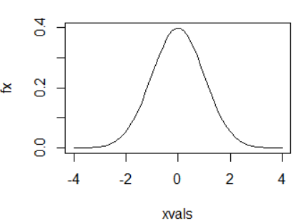
d-function for Normal Distributions
To plot the results:
> xvals <- seq(-4,4,length=50)
> fx <- dnorm(xvals,mean=0,sd=1)
> plot(xvals,fx,type="l")

Slide 58
p-function for Normal Distributions
The pnorm function obtains cumulative probability densities for a normal distribution ("sums up the dnorm values")
pnorm(q, mean = 0, sd = 1, lower.tail = TRUE, log.p = FALSE)
mean=0 and sd=1 are defaults
e.g. show the probability of values of q within 1 standard deviation for μ = 0
Find the difference between P(<=1) and P (<=-1)
pnorm(q=1)
pnorm(q=-1)
> pnorm(1) - pnorm(-1)
[1] 0.6826895

Slide 59
p-function for Normal Distributions
Example: Widget weights produced at Acme Widget Works have weights that are normally distributed with mean 17.46 grams and variance 375.67 grams. What is the probability that a randomly chosen widget weighs more then 19 grams (i.e. what is Pr(X > 19))?
Remember that variance is σ² so we need to use sqrt(σ²) for the standard deviation
Probability of X <= 19:
> pnorm(19, mean=17.46, sd=sqrt(375.67))
[1] 0.5316644
Probability of X > 19 is everything else (subtract from 1)
> 1 - pnorm(19, mean=17.46, sd=sqrt(375.67))
[1] 0.4683356

Slide 60
q-function for Normal Distributions
The qnorm() function finds the boundary value that determines a given area
For example, suppose you want to find the boundary value of the 85th percentile of a normal distribution whose mean is 70 and whose standard deviation is 3.
i.e. 85% of the values in a population that is normally distributed with a mean of 70 and standard deviation of 3 will lie below 73.1093.
> qnorm(0.85,mean=70,sd=3)
[1] 73.1093

