Slide 1
COP2073C
Introduction to Statistical Programming with R
Module 9: Advanced Statistics in R: Regression
Reading (Book of R):
Ch. 20 Simple Linear Regression

Slide 2
Ch. 20 Simple Linear Regression

Slide 3
Linear Regression and Linear Relationships
Linear regression explains the relationship between a dependent variable and one or more independent variables
Other names for the dependent variable: outcome variable, response variable
Other names for the independent variable: predictor variable, explanatory variable
Example using Rbase MASS dataset
> library(MASS)
> ?survey
survey {MASS} R Documentation
Description: This data frame contains the responses of 237 Statistics I students at the University of Adelaide to a number of questions.

Slide 4
MASS survey Data Format
Sex | The sex of the student. (Factor with levels "Male" and "Female".)
Wr.Hnd | span (distance from tip of thumb to tip of little finger of spread hand) of writing hand, in centimetres.
NW.Hnd | span of non-writing hand
W.Hnd | writing hand of student. (Factor, with levels "Left" and "Right".)
Fold | “Fold your arms! Which is on top” (Factor, with levels "R on L", "L on R", "Neither".)
Pulse | pulse rate of student (beats per minute).
Clap | ‘Clap your hands! Which hand is on top?’ (Factor, with levels "Right", "Left", "Neither".)
Exer | how often the student exercises. (Factor, with levels "Freq" (frequently), "Some", "None".)
Smoke | how much the student smokes. (Factor, levels "Heavy", "Regul" (regularly), "Occas" (occasionally), "Never".)
Height | height of the student in centimetres.
M.I | whether the student expressed height in imperial (feet/inches) or metric (centimetres/metres) units. (Factor, levels "Metric", "Imperial".)
Age | age of the student in years.

Slide 5
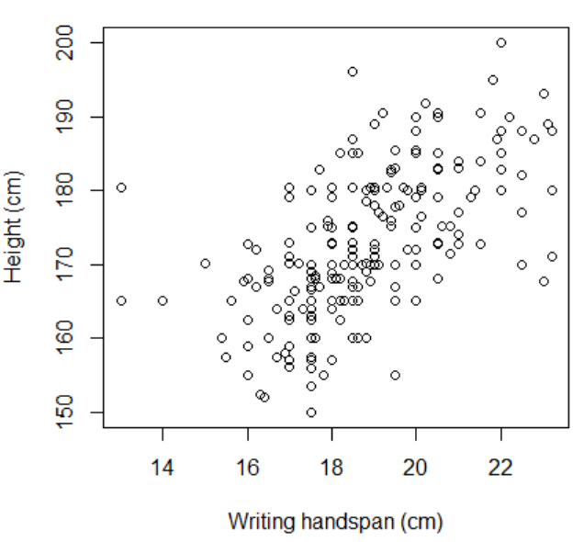
Linear Relationship Example: Plotting
Plot student height vs. writing-hand handspan
Note the use of formula notation ~ "height is a function of handspan"
or
"height on handspan"
Clustering indicates a positive linear relationship
> plot(survey$Height ~ survey$Wr.Hnd, xlab="Writing handspan (cm)",
ylab="Height (cm)")

Slide 6
Linear Relationship Example: Correlation
The dataset contains some missing values, use which(is.na …) to find them
> which(is.na(survey$Height) | is.na(survey$Wr.Hnd))
[1] 3 12 15 25 26 29 31 35 43 58 68 70 81 83 84 90
[17] 92 96 108 121 133 157 173 179 203 213 217 225 226
> incomplete.obs <- which(is.na(survey$Height)|is.na(survey$Wr.Hnd))
> length(incomplete.obs)
[1] 29

Slide 7
Linear Relationship Example: Correlation
Calculate the correlation coefficient using cor( ) function to assess strength of the relationship
Range of coefficient values is -1 to +1, where -1 is a perfect negative correlation and +1 is a perfect positive correlation
"use" parameter indicates method for dealing with missing values; "complete.obs" means missing values are handled by casewise deletion (and if there are no complete cases, that gives an error)
> cor(survey$Wr.Hnd,survey$Height,use="complete.obs")
[1] 0.6009909 # moderately strong positive correlation

Slide 8
Model Definition
The simple linear regression model states that changes in a response (dependent) variable are due to a change in an explanatory (independent) variable plus or minus a residual error value
The goal is to estimate the coefficients of B₀ and B₁ in the following equation:
y = B₀ + B₁x
where B₀ is the y-intercept and B₁ is the slope of the fitted line (notice the similarity between this equation and the more familiar one for a straight line y = mx + b)
In R, the lm function performs the estimation for you.

Slide 9
The lm( ) Function
lm {stats} R Documentation
Fitting Linear Models
Description
lm is used to fit linear models. It can be used to carry out regression, single stratum analysis of variance and analysis of covariance (although aov may provide a more convenient interface for these).
Usage
lm(formula, data, subset, weights, na.action,
method = "qr", model = TRUE, x = FALSE, y = FALSE, qr = TRUE,
singular.ok = TRUE, contrasts = NULL, offset, ...)

Slide 10
Example: Using lm( ) to Fit a Model
Use lm to fit a linear model of the mean student height by handspan, store it as survfit
Height is the response, Wr.Hnd is the predictor
~ is "formula notation" for data (see ?lm)
> survfit <- lm(Height ~ Wr.Hnd,data=survey)
> survfit
Call:
lm(formula = Height ~ Wr.Hnd, data = survey)
Coefficients:
(Intercept) Wr.Hnd
113.954 3.117
So here is our model:
y = 113.954 + 3.117x

Slide 11
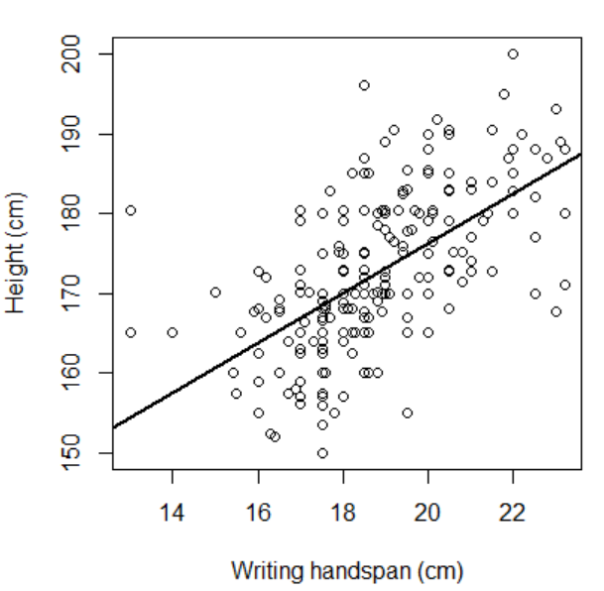
Example: Using lm( ) to Fit a Model
Run the plot again, but this time add the fitted regression line:
> survfit <- lm(Height~Wr.Hnd,data=survey)
> plot(survey$Height ~ survey$Wr.Hnd,
xlab="Writing handspan (cm)", ylab="Height (cm)")
> abline(survfit,lwd=2)

Slide 12
Showing Residuals
The fitted line is referred to as a least-squares regression because it minimizes the average squared difference between the observed data and itself
To calculate distances – known as "residuals" -- between selected observed points and the fitted line, choose two observed values from the dataset, refer to them as obsA and obsB
> obsA <- c(survey$Wr.Hnd[197],survey$Height[197])
> obsB <- c(survey$Wr.Hnd[154],survey$Height[154])
> obsA
[1] 15.00 170.18
> obsB
[1] 21.50 172.72

Slide 13
Showing Residuals
Call the coef() function to use the coefficients from the regression model to calculate the distances between the points and the fitted line, and plot the results as segments
> mycoefs <- coef(survfit)
> mycoefs
(Intercept) Wr.Hnd
113.953623 3.116617
> b0 <- mycoefs[1]
> b1 <- mycoefs[2]
> plot(survey$Height ~ survey$Wr.Hnd, xlab="Writing handspan (cm)", ylab="Height (cm)")
> abline(survfit,lwd=2)
> segments(x0=c(obsA[1],obsB[1]),y0=b0+b1*c(obsA[1],obsB[1]),
x1=c(obsA[1],obsB[1]),y1=c(obsA[2],obsB[2]),lwd=3,lty=2)

Slide 14
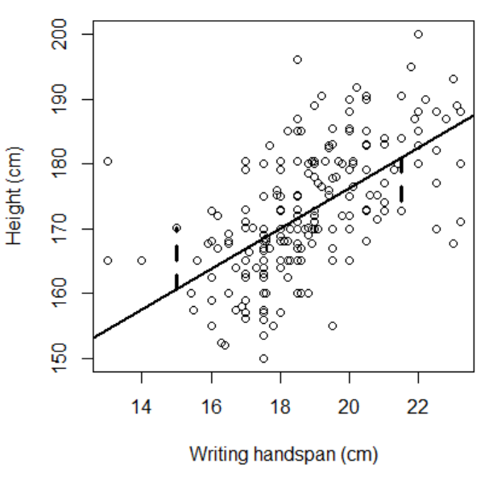
Showing Residuals

Slide 15
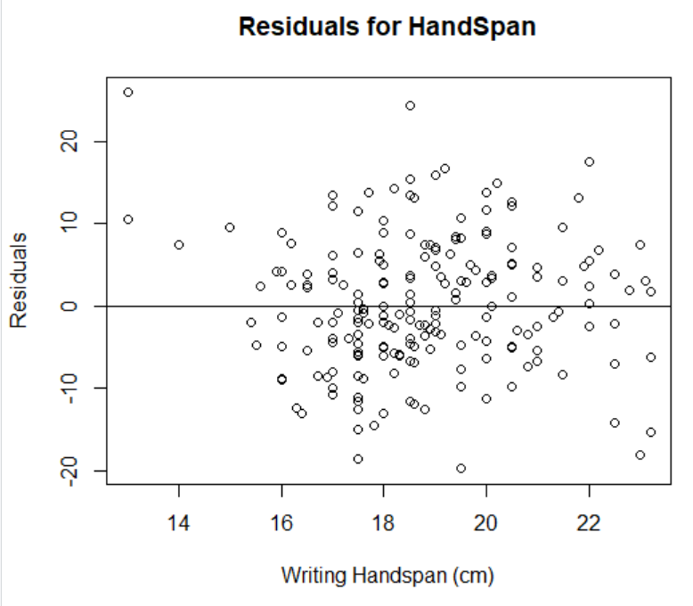
Evaluating the Model
To determine if the linear model is appropriate for this data, look for a lack of a pattern in a plot of the residuals
Residual points should appear random
> survfit.resid <- resid(survfit)
> complete.obs <- which(
!is.na(survey$Height) &
!is.na(survey$Wr.Hnd))
> plot(survey$Wr.Hnd[complete.obs],
survfit.resid,
ylab="Residuals",
xlab="Writing Handspan (cm)",
main="Residuals for HandSpan")
> abline(0,0)

Slide 16
Statistical Inference
Is there statistical evidence to support a relationship between the predictor and the response?
Model-based inference is carried out by R when lm objects are processed.
Use the summary function on the model created by lm to determine:
the significance associated with the regression coefficients
the interpretation of the coefficient of determination
(labeled R-squared in the output)
A small p-value is strong evidence against the claim that the predictor has no effect on the response
Significance codes, e.g. ***, indicate level of statistical significance

Slide 17
Statistical Inference
> summary(survfit)
Call:
lm(formula = Height ~ Wr.Hnd, data = survey)
Residuals:
Min 1Q Median 3Q Max
-19.7276 -5.0706 -0.8269 4.9473 25.8704
Coefficients:
Estimate Std. Error t value Pr(>|t|)
(Intercept) 113.9536 5.4416 20.94 <2e-16 ***
Wr.Hnd 3.1166 0.2888 10.79 <2e-16 *** ← predictor
---
Signif. codes: 0 ‘***’ 0.001 ‘**’ 0.01 ‘*’ 0.05 ‘.’ 0.1 ‘ ’ 1
Residual standard error: 7.909 on 206 degrees of freedom
(29 observations deleted due to missingness)
Multiple R-squared: 0.3612, Adjusted R-squared: 0.3581
F-statistic: 116.5 on 1 and 206 DF, p-value: < 2.2e-16

Slide 18
Coefficient of Determination
summary( ) provides the values of Multiple R-squared and Adjusted R-squared
Both of these are referred to as the coefficient of determination; they describe the proportion of the variation in the response that can be attributed to the predictor.
Multiple R-squared:0.3612, Adjusted R-squared: 0.3581

Slide 19
Coefficient of Determination
For simple linear regression, the first (unadjusted) measure is simply the square of the estimated correlation coefficient
> cor(survey$Wr.Hnd,survey$Height,use="complete.obs") ^ 2
[1] 0.3611901
→ 36.1 percent of the variation in the student heights can be attributed to handspan
The adjusted measure is an alternative quality metric covered in Ch. 22 of the text, not in the scope of this course

Slide 20
Prediction
Fitting a statistical model allows predictions of values
One prediction type involves calculating a point estimate of the mean response value based on the value of the explanatory variable
Example: determine the mean height for students with a handspan of 14.5 cm and for students with a handspan of 24 cm
Use the regression formula provided earlier, y = B₀ + B₁x
> as.numeric(b0 + b1 * 14.5)
[1] 159.1446
> as.numeric(b0 + b1 * 24)
[1] 188.7524
According to the model, mean heights are around 159.14 and 188.75cm, respectively
as.numeric( ) removes the "(Intercept)" annotation from the result

Slide 21
Confidence Intervals: Mean Values
The predict( ) function can calculate confidence intervals for the mean values of the heights
x-values must be stored as a column in a data frame
The name of the column must match the predictor used in the original call to create the fitted model object
> xvals <- data.frame(Wr.Hnd=c(14.5,24))
> xvals
Wr.Hnd
1 14.5
2 24.0

Slide 22
Confidence Intervals: predict( )
The first argument to predict( ) must be the fitted model.
The "newdata" argument passes the data frame containing the specified predictor values.
The "interval" argument specifies confidence as a character string value.
The confidence level, e.g. 95%, is passed via the level argument
> mypred <- predict(survfit,newdata=xvals,interval="confidence",level=0.95)
> mypred
fit lwr upr
1 159.1446 156.4956 161.7936
2 188.7524 185.5726 191.9323

Slide 23
Confidence Intervals: predict( ) Results
> mypred <- predict(survfit,newdata=xvals,interval="confidence",level=0.95)
> mypred
fit lwr upr
1 159.1446 156.4956 161.7936
2 188.7524 185.5726 191.9323
The first column, with a heading of fit, is the point estimate on the regression line (calculated earlier)
lwr and upr provide the lower and upper CI limits, respectively.
The result is interpreted as a 95% confidence that the mean height of a student with a handspan of 14.5cm lies somewhere between 156.5cm and 161.8cm, and between 185.6cm and 191.9cm for a handspan of 24cm.

Slide 24
Confidence Intervals: Individual Observations
To find the prediction interval for individual observations with a certain probability, change the interval argument to prediction.
> mypred.ind <- predict(survfit,newdata=xvals,interval="prediction",level=0.95)
> mypred.ind
fit lwr upr
1 159.1446 143.3286 174.9605
2 188.7524 172.8390 204.6659
The intervals here are significantly larger because raw observations at a specific x value will be more variable than their mean.
The results are interpreted as 95% confidence intervals for raw student heights values.

Slide 25
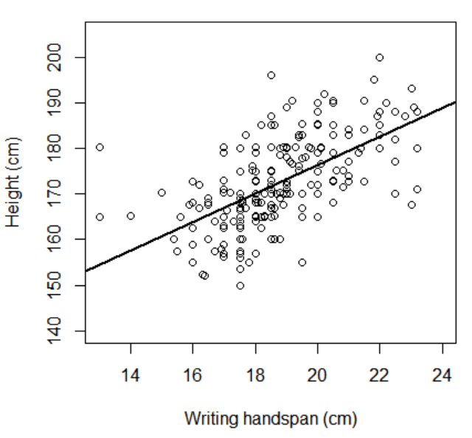
Plotting Intervals
Intervals are well suited to visualization for simple linear regression models.
Start by plotting the data and estimated regression line, using xlim and ylim to widen the x- and y-limits in order to accommodate the full length and breadth of the confidence and prediction intervals.
> plot(survey$Height~survey$Wr.Hnd,
xlim=c(13,24),ylim=c(140,205),
xlab="Writing handspan (cm)",
ylab="Height (cm)")
> abline(survfit,lwd=2)

Slide 26
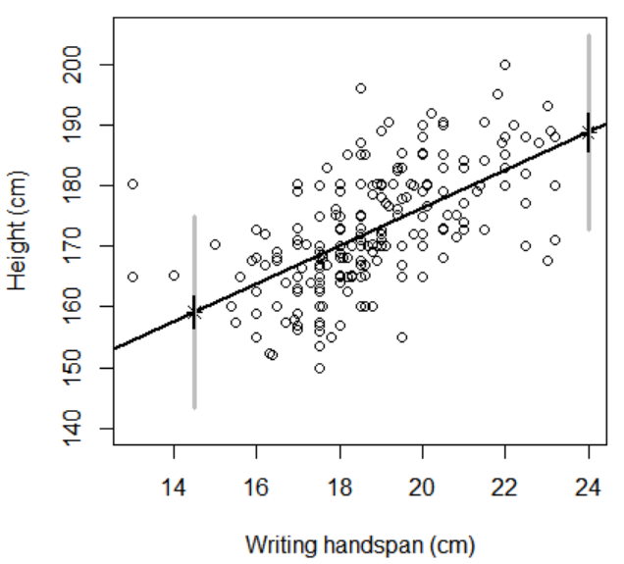
Plotting Intervals
Add the locations of the fitted values for x = 14.5 and x = 24 and two sets of vertical lines showing the confidence and prediction intervals
> points(xvals[,1],mypred[,1],pch=8)
> segments(x0=c(14.5,24), # P.I.
y0=c(mypred.ind[1,2],mypred.ind[2,2]),
x1=c(14.5,24),
y1=c(mypred.ind[1,3],mypred.ind[2,3]),
col="gray",lwd=3)
> segments(x0=c(14.5,24), # C.I.
y0=c(mypred[1,2],mypred[2,2]),
x1=c(14.5,24),
y1=c(mypred[1,3],mypred[2,3]),
lwd=2)

Slide 27
Interpolation vs. Extrapolation
Interpolation and extrapolation describe the nature of a given prediction.
A prediction is referred to as interpolation if the x value you specify falls within the range of your observed data.
Extrapolation is when the x value of interest lies outside of the range of observed data.
Using the previous point-predictions, the location x = 14.5 is an example of interpolation and x = 24 is an example of extrapolation.
Interpolation is preferable to extrapolation—it makes more sense to use a fitted model for prediction in the vicinity of data that have already been observed.
Extrapolation that isn’t too far out of that vicinity may still be considered reliable.

Slide 28
Categorical Predictors
Discrete or categorical explanatory variables, made up of k distinct groups or levels, can be used to model a mean response.
As with models based on continuous variables, observations must all be independent of one another and residuals must be normally distributed with an equal variance.
The simplest case is k = 2 (a binary-valued predictor), which forms the basis of more complicated situations in which the categorical predictor has more than two levels (a multilevel predictor: k > 2).
A binary predictor variable with two levels has observations coded either 0 or 1.
The simple linear regression model equation still holds, but the interpretation of the model parameters, B₀ and B₁, isn’t really one of an intercept and a slope anymore, but instead something like two intercepts, where B₀ provides the baseline or reference value of the response when X = 0 and B₁ represents the additive effect on the mean response if X = 1.

Slide 29
Binary Variables (k = 2)
The MASS survey data contains a Sex variable where students categorized their gender as Male or Female.
> class(survey$Sex) [1] "factor" > table(survey$Sex) Female Male 118 118
Use this data to determine whether there is statistical evidence that the height of a student is affected by sex.

Slide 30
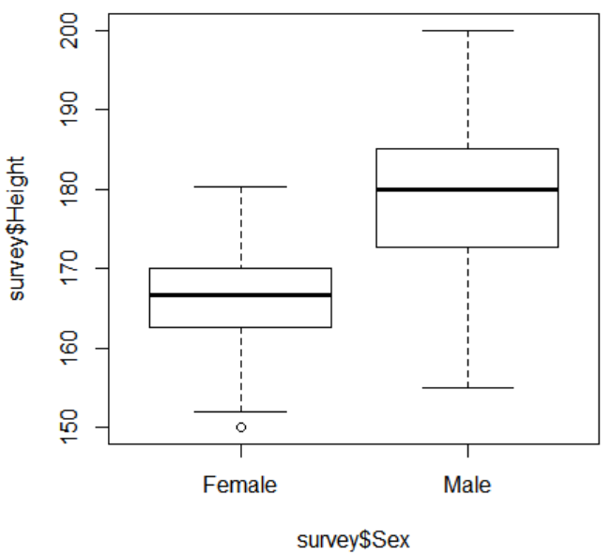
Plotting Categorical Data
Because the response variable specified to the left of the ~ is numeric and the explanatory variable to the right is a factor, the default behavior of R in that situation is to produce side-by-side boxplots.
> plot(survey$Height~survey$Sex)

Slide 31
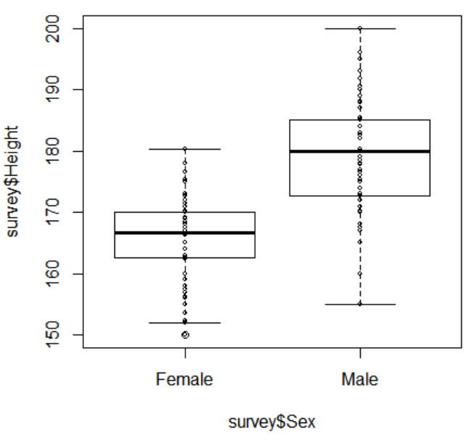
Plotting Categorical Data
Superimpose the raw height and sex observations on top of the boxplots by converting the factor vector to numeric with a call to as.numeric( )
> points(survey$Height~as.numeric(survey$Sex),cex=0.5)

Slide 32
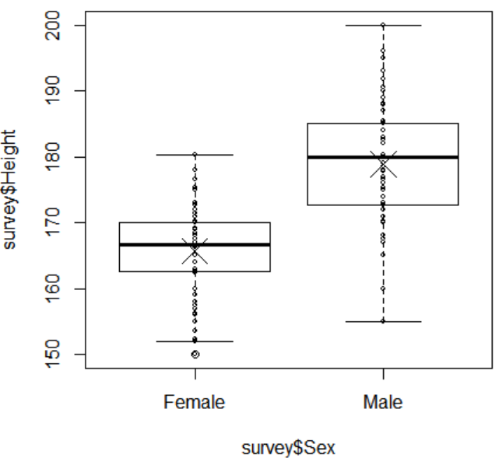
Plotting Categorical Data
Display the mean heights according to sex
> means.sex <- tapply(survey$Height,INDEX=survey$Sex,FUN=mean,na.rm=TRUE)
> means.sex
Female Male
165.6867 178.8260
> points(1:2,means.sex,pch=4,cex=3)
In this call, the argument na.rm=TRUE is matched to the ellipsis in the definition of tapply and is passed to mean to ensure the missing values present in the data do not end up producing NAs as the results.
A further call to points adds those coordinates (as × symbols) to the image

Slide 33
Linear Regression of Binary Variables
The plot indicates that males tend to be taller than females—but is there statistical evidence of a difference to back this up?
Use lm to produce a least-squares estimates
> survfit2 <- lm(Height~Sex,data=survey)
> summary(survfit2)
Call:
lm(formula = Height ~ Sex, data = survey)
Residuals:
Min 1Q Median 3Q Max
-23.886 -5.667 1.174 4.358 21.174
Coefficients:
Estimate Std. Error t value Pr(>|t|)
(Intercept) 165.687 0.730 226.98 <2e-16 ***
SexMale 13.139 1.022 12.85 <2e-16 ***
---
Signif. codes: 0 ‘***’ 0.001 ‘**’ 0.01 ‘*’ 0.05 ‘.’ 0.1 ‘ ’ 1
Residual standard error: 7.372 on 206 degrees of freedom
(29 observations deleted due to missingness)
Multiple R-squared: 0.4449, Adjusted R-squared: 0.4422
F-statistic: 165.1 on 1 and 206 DF, p-value: < 2.2e-16

Slide 34
Linear Regression of Binary Variables
Because the predictor is a factor vector instead of numeric, the reporting of the coefficients is slightly different
The estimate of B₀ is again reported as (Intercept); this is the estimate of the mean height if a student is female. The estimate of B₁ is reported as SexMale.
The corresponding regression coefficient of 13.139 is the estimated difference for the mean height of a male student
The test for B₁ (p-value <2e-16)is generally of the most interest since this value indicates whether there is statistical evidence that the mean response variable is affected by the explanatory variable

