Slide 1
COP2073C
Introduction to Statistical Programming with R
Module 11: Modeling Data with the Tidyverse
Reading (R for Data Science):
Ch. 18 Model Basics with modelr

Slide 2
Ch. 18 (R for Data Science) Model Basics with modelr

Slide 3
Introduction to Models
Models provide simple summaries of datasets
Models can be used to partition data into patterns and residuals (differences between observed and predicted values of data)
There are two types of models:
A generic model which expresses a pattern, e.g.
y = a * x + b or y = a * x ^ b
x and y are known variables from your data
a and b are parameters, or coefficients, that can vary to capture different patterns
A fitted model using a specific form of the generic model, e.g.
y = 3 * x + 7 or y = 9 * x²
a fitted model is just the closest, "best" model from a family of generic models

Slide 4
Approximation is Useful
Models look like noisy clouds of points
Having the “best” model doesn’t imply that you have a good model
All models are wrong, but some are useful. -George Box
The goal of a model is not to determine absolute truth, but to discover a simple approximation that is still useful
There are many different ways to model data, each with its own theoretical backing

Slide 5
The Modelr Toolkit
modelr wraps around base R’s modeling functions to make them work naturally in a pipe
sim1 is a simple dataset (30 x 2) in the modelr toolkit for learning modeling concepts
library(tidyverse)
library(modelr)
options(na.action = na.warn) # handle missing values with a warning
> sim1
# A tibble: 30 x 2
x y
<int> <dbl>
1 1 4.20
2 1 7.51
3 1 2.13
4 2 8.99
5 2 10.2
# ... with 25 more rows

Slide 6
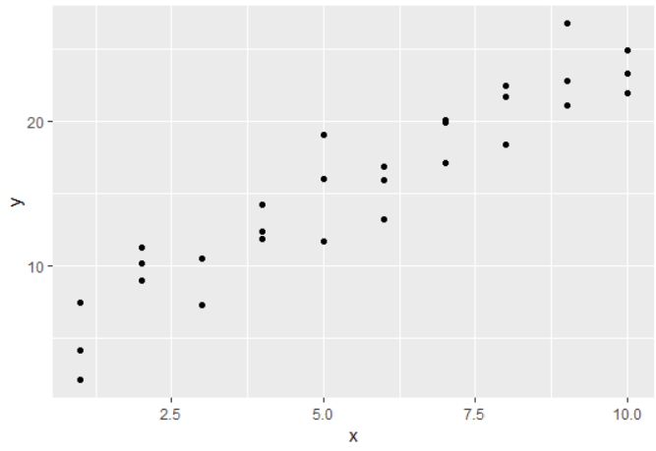
Plotting the sim1 Dataset
> ggplot(sim1, aes(x, y)) + geom_point()

Slide 7
Determining a Basic Model
The pattern in the sim1 plot is readily apparent as an upward sloping line (bottom left to upper right)
The formula for the line is
y = mx + b
where m is the slope and b is the y-intercept
How can we model this?

Slide 8
The runif() Function
The runif() (Random Uniform) function generates a random distribution of values between a lower and upper bound
useful when simulating data for probability problems
as more samples are generated, the data will take the form of a normal distribution (bell curve)
To generate n values between lower and upper
runif(n, lower, upper)
> runif(10, 1, 5) # 10 values between 1 and 5
[1] 2.220979 4.483633 4.481119 2.624884 3.916466
[6] 1.493478 4.098819 4.990049 4.142196 2.348586

Slide 9
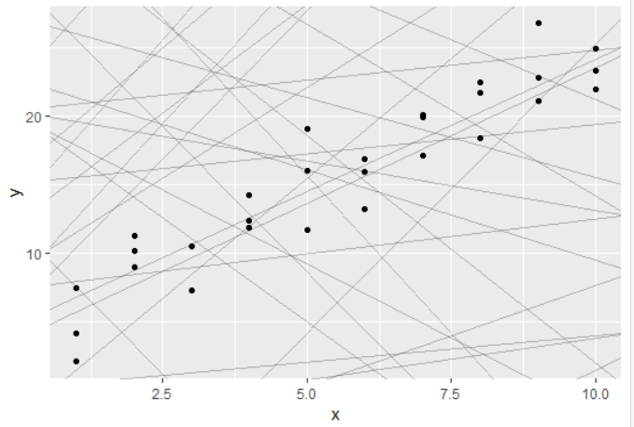
sim1 Plot vs. Random Line Data
compare 50 random lines layered on the sim1 plot; are any of these a good fit?
> models <- tibble(y = runif(50, -20, 40), m = runif(50, -5, 5))
> ggplot(sim1, aes(x, y)) + geom_abline(aes(intercept = y, slope = m),
alpha = 1/4, data = models) + geom_point()

Slide 10
Formulating a Model
Some of the lines in the random mapping may be a good fit, but we need a precise method to determine the best fit
Linear regression models the relationship between predictor and response variables.
The lm() (linear model) function in R performs linear regression to model linear relationships (fit linear models)
lm(formula, data)
formula is of the form y ~ x
y is the dependent variable
x is (one or more) independent variables
"y is a function of x"

Slide 11
Applying the lm() Function
y ~ x as an argument to lm() will translate to the function
y = mx + b (the slope and intercept are implicit)
lm() actually finds the closest model in a single step using a sophisticated algorithm
The coef() function extracts the coefficients of the model as a numeric vector
> sim1_mod <- lm(y ~ x, data = sim1)
> coef(sim1_mod)
(Intercept) x
4.220822 2.051533
> ggplot(sim1, aes(x, y)) +
geom_abline(aes(intercept = coefs[1], slope = coefs[2])) +
geom_point()

Slide 12
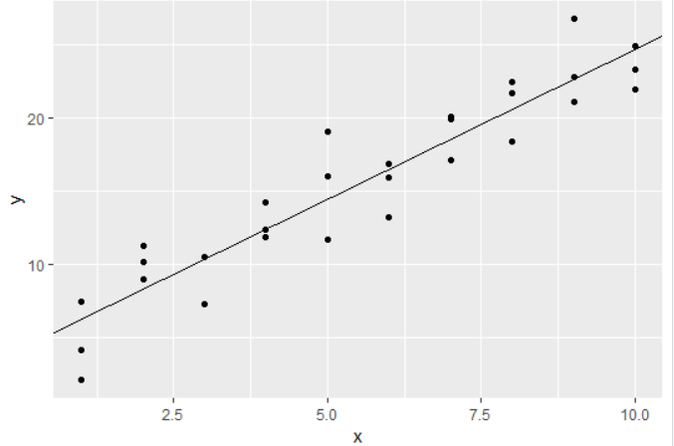
Best Fit Using lm()
> ggplot(sim1, aes(x, y)) +
geom_abline(aes(intercept = coefs[1], slope = coefs[2])) +
geom_point()

Slide 13
Validating and Visualizing Models
One approach used to validate a model is to visualize predicted values (expected results)
The modelr package provides several useful functions to do this
Start by generating a sequence of values to use for predictions that covers the region where the data lies using the modelr::data_grid() function
Argument is a data frame or tibble
Increments between values will not necessarily be consistent
> grid <- sim1 %>% data_grid(x)
> grid
# A tibble: 10 x 1
x
<int>
1 1
2 2
3 3
4 4
5 5
6 6
7 7
8 8
9 9
10 10

Slide 14
modelr::add_predictions()
add_predictions() uses a model to make predictions from a dataset
> sim1_mod <- lm(y ~ x, data = sim1)
> grid_p <- grid %>% add_predictions(sim1_mod)
> grid_p
# A tibble: 10 x 2
x pred
<int> <dbl>
1 1 6.27
2 2 8.32
3 3 10.4
4 4 12.4
5 5 14.5
6 6 16.5
7 7 18.6
8 8 20.6
9 9 22.7
10 10 24.7

Slide 15
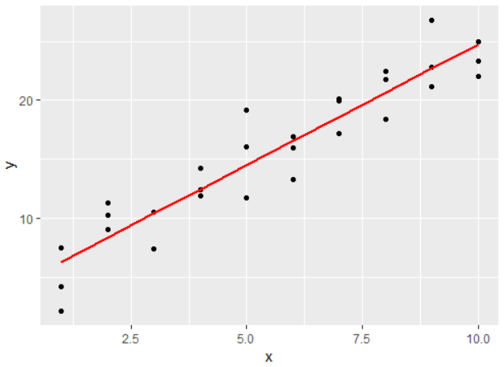
Plot the Predictions
pred is a new column added by the add_predictions function
> ggplot(sim1, aes(x)) +
geom_point(aes(y = y)) +
geom_line(aes(y = pred),
data = grid_p,
colour = "red",
linewidth = 1)

Slide 16
Residuals
Predictions tell you the pattern that the model represents, residuals tell you what the model has missed
Residuals are just the distances between the observed and predicted values
modelr::add_residuals() works in a similar fashion as add_predictions(), but we use original data instead of a fabricated grid
sim1.R <- sim1 %>%
add_residuals(sim1_mod)

Slide 17
Residuals (cont)
> sim1.R <- sim1 %>%
add_residuals(sim1_mod)
> sim1.R
# A tibble: 30 x 3
x y resid
<int> <dbl> <dbl>
1 1 4.20 -2.07
2 1 7.51 1.24
3 1 2.13 -4.15
4 2 8.99 0.665
5 2 10.2 1.92
# ... with 25 more rows

Slide 18
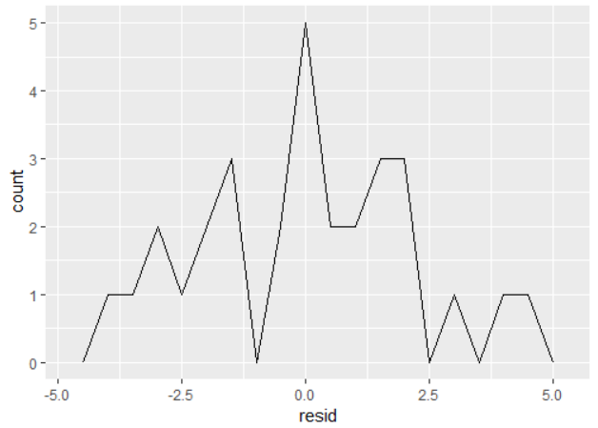
Residuals (cont)
A frequency polygon can show the accuracy of the predictions (distance between predicted and actual values)
ggplot(sim1.R, aes(resid)) +
geom_freqpoly(binwidth = 0.5)
there are 3 actual values that are (approx.) 2 units away from the predicted value
There are 5 actual values that are 0 units away from the predicted value

Slide 19
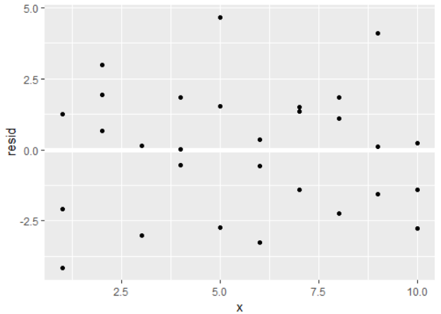
Plotting the Residuals
> ggplot(sim1.R, aes(x, resid)) +
geom_ref_line(h = 0) +
geom_point()
Note the randomness of the plotted points

Slide 20
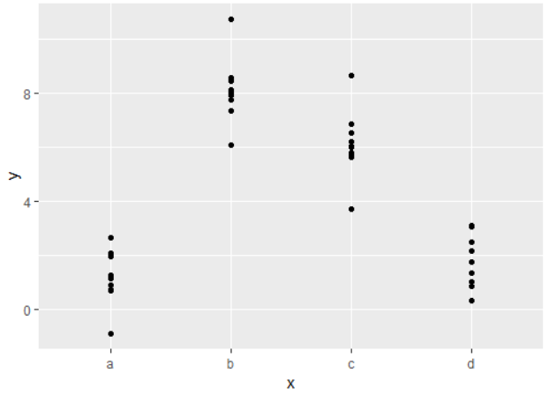
Categorical Variables
sim2 is a modelr dataset containing categorical variables a, b, c, and d
Plot it with
ggplot(sim2) +
geom_point(aes(x, y))

Slide 21
Categorical Variables (cont)
Use lm to fit a model to a dataset with categorical variables, and add_predictions to generate predictions
> mod2 <- lm(y ~ x, data = sim2)
> grid <- sim2 %>%
data_grid(x) %>%
add_predictions(mod2)
> grid
# A tibble: 4 x 2
x pred
<chr> <dbl>
1 a 1.15
2 b 8.12
3 c 6.13
4 d 1.91

Slide 22
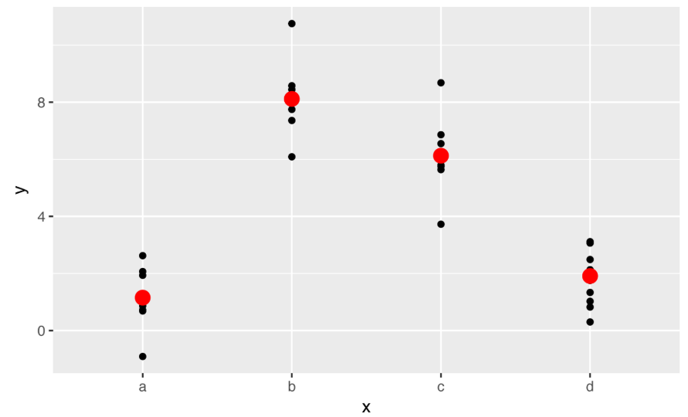
Categorical Variables (cont)
In general terms, a model with a categorical x will predict the mean value for each category
This can be seen by plotting the predictions over the original data points
> ggplot(sim2, aes(x)) +
geom_point(aes(y = y)) +
geom_point(
data = grid,
aes(y = pred),
color = "red",
size = 4)

Slide 23
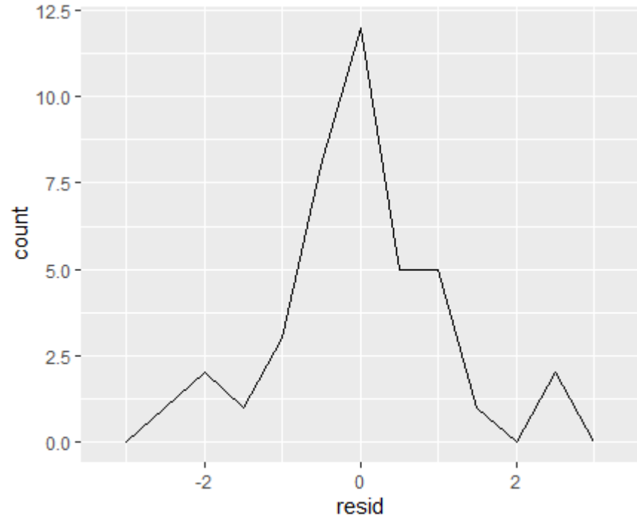
Residuals for Categorical Variables
Calculate the residuals for our categorical data using add_residuals
> sim2.R <- sim2 %>% add_residuals(mod2)
> ggplot(sim2.R, aes(resid)) +
geom_freqpoly(binwidth = .5)

