Slide 1



GitHub Classroom in the Classroom
David Singletary David.Singletary@fscj.edu
William Money s2735014@students.fscj.edu

Slide 2
GitHub Classroom
The following slides provide information for using GitHub Classroom, which allows the creation of individual classrooms
Why GitHub Classroom?
Students can be assigned to a specific course's classroom
Repositories created by the instructor can be cloned by students and maintained within the classroom
By default, student repositories are private

Slide 3
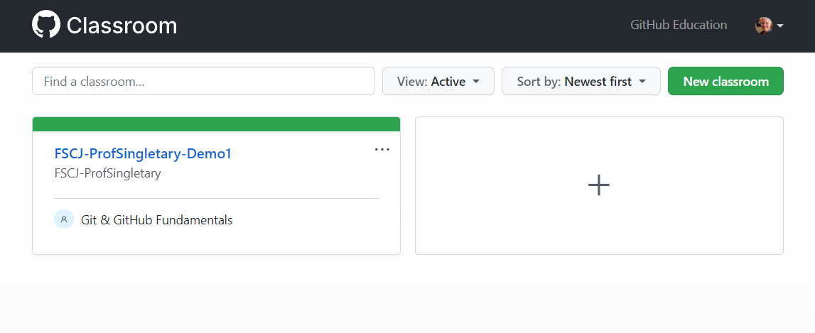
GitHub Classroom (Instructor Notes)
Apply for GitHub Education, after account is verified create an organization. I used FSCJ-ProfSingletary (FSCJ-<my GitHub ID>)
Log in to GitHub Classroom (classroom.github.com) and create a new classroom

Slide 4
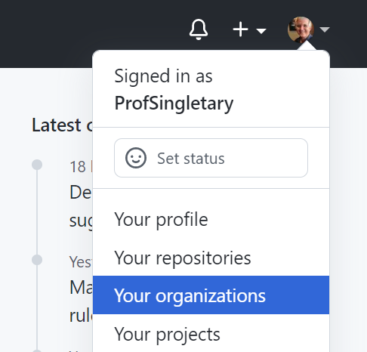
Creating an Organization
Organizations can be used to organize your courses (e.g. Programming, Analytics, Networking, etc.
Select "Your organizations" from your profile menu in GitHub

Slide 5
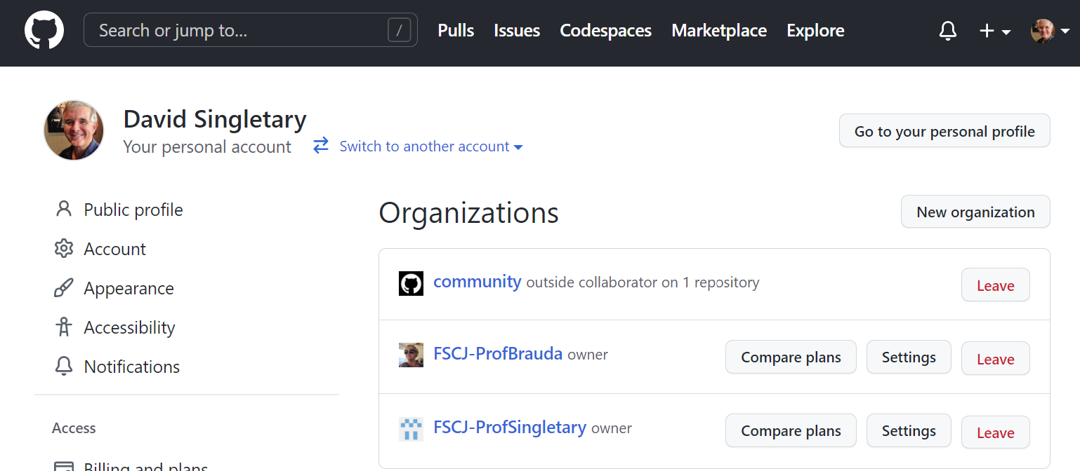
Creating an Organization
Select "New organization" from the page

Slide 6
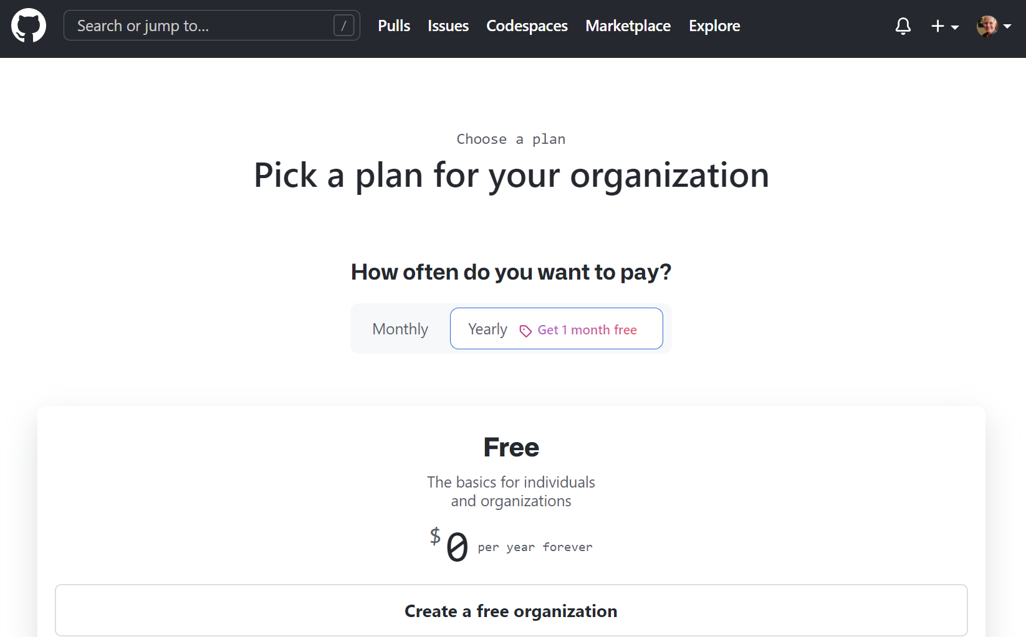
Creating an Organization
Choose "Create a free organization"

Slide 7
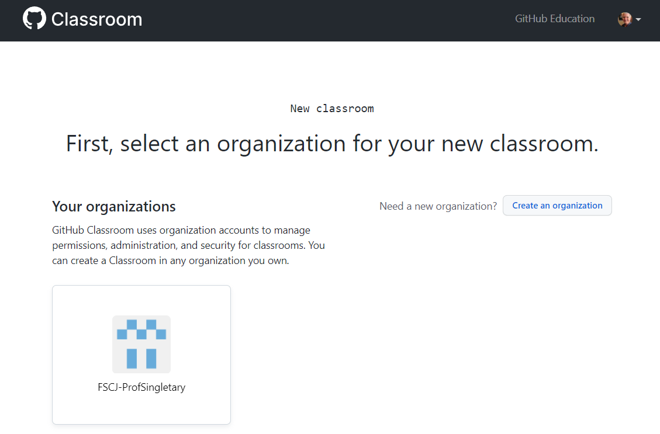
GitHub Classroom (Instructor Notes)
After creating your organization, select it to create a classroom

Slide 8
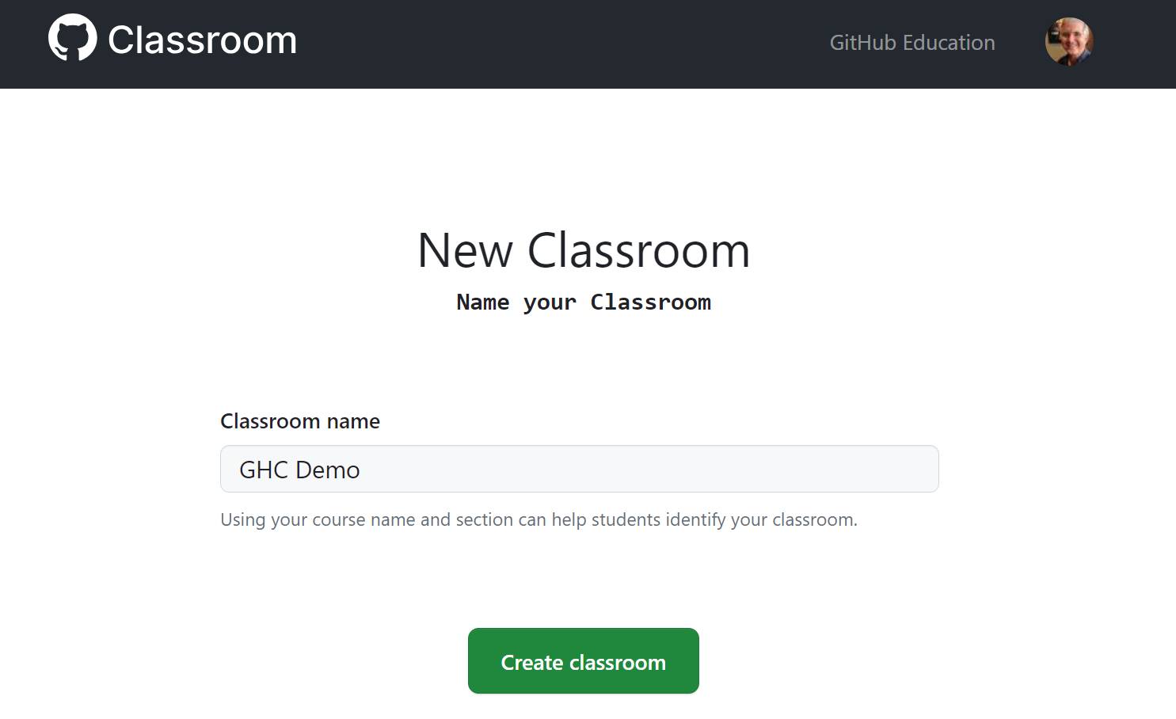
GitHub Classroom (Instructor Notes)
Name your classroom

Slide 9
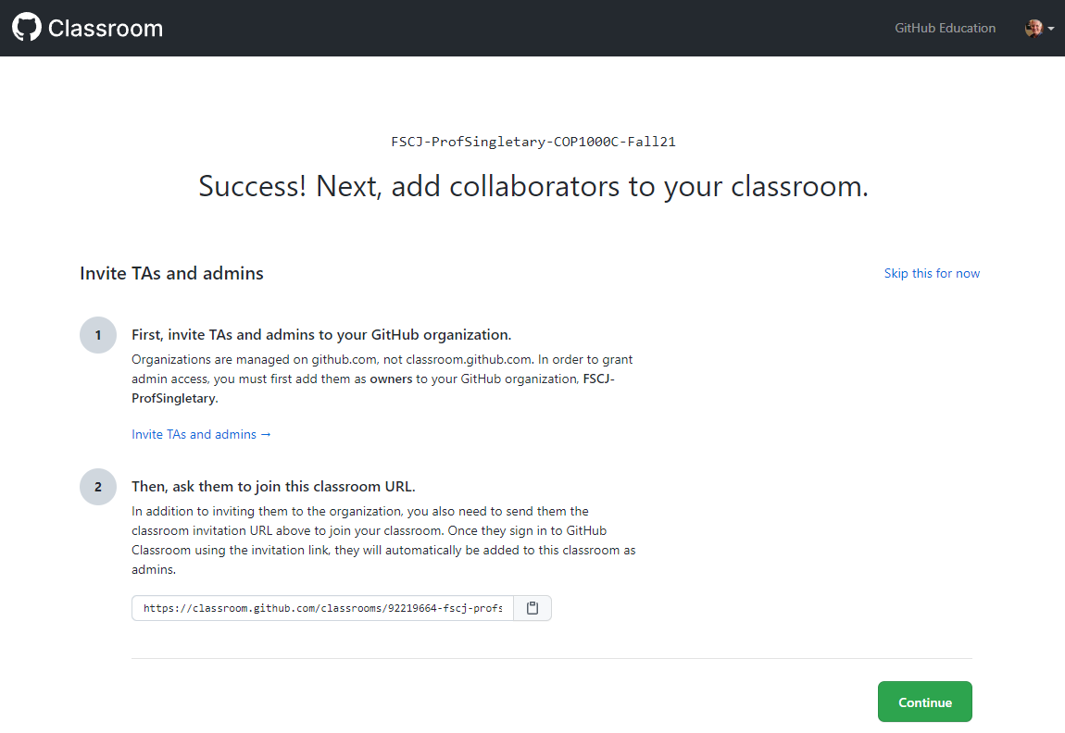
Creating a Classroom
TAs or Admins?

Slide 10
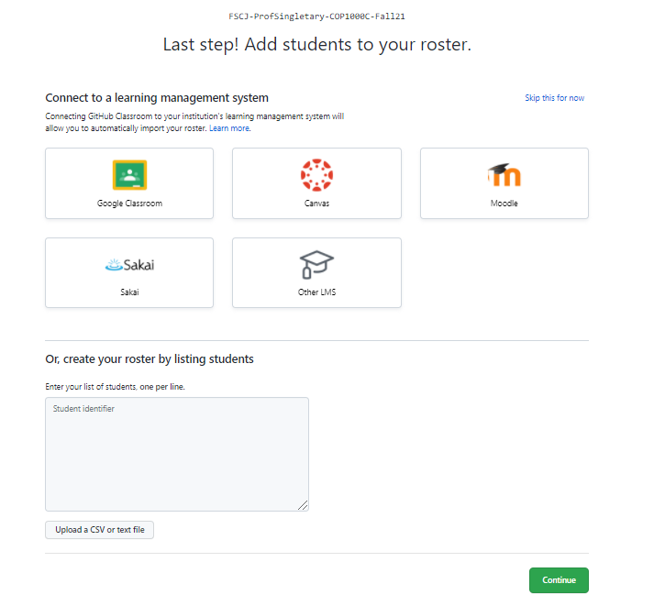
Creating a Classroom
Add Students
Note: this is not required; an alternative approach is to let your students add themselves by accepting your assignment invitations

Slide 11

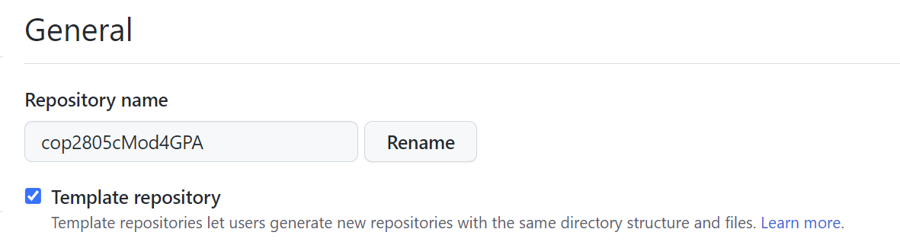
Creating Assignments
To create an assignment, start by creating a repo for your assignment in your normal GitHub account
This repo must be a public template
In the repo Settings page:

Slide 12
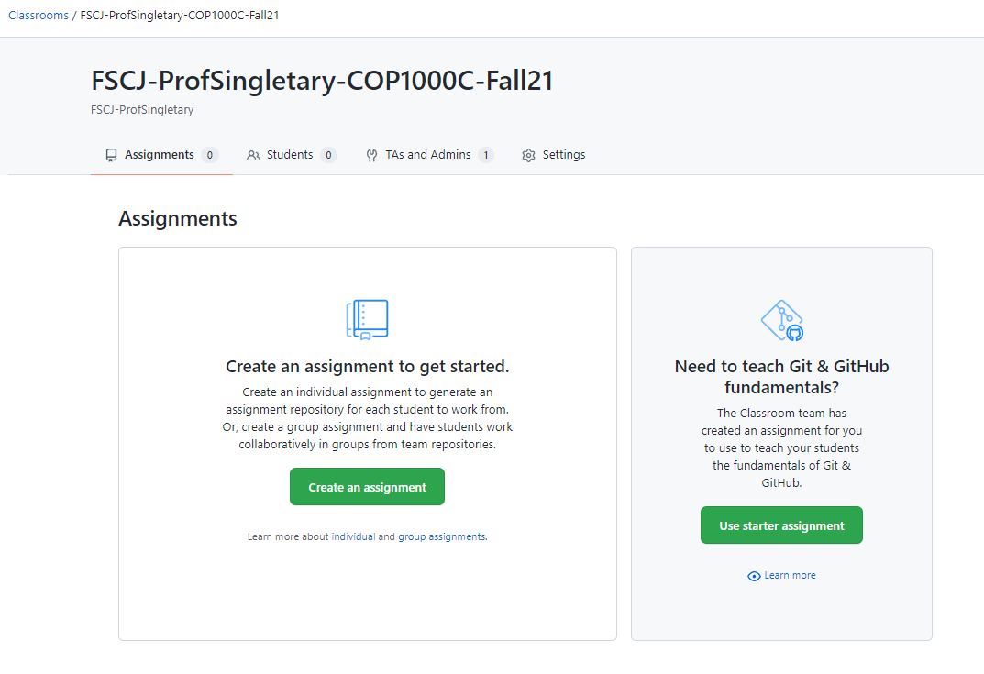
Creating Assignments
In your GitHub Classroom course, create an assignment

Slide 13
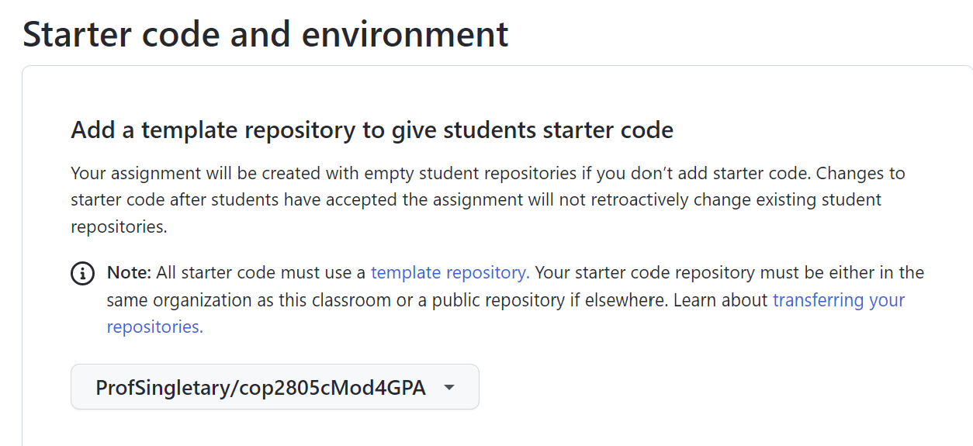
Creating Assignments
Use your template for the assignment starter code:

Slide 14
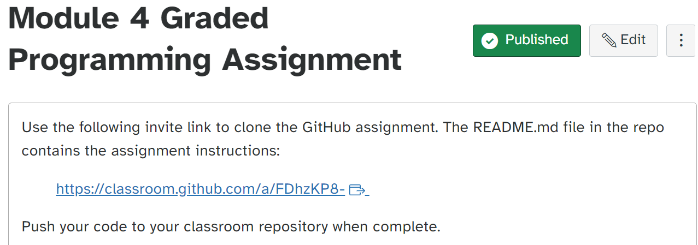
Creating Assignments
Provide the assignment invitation link to your students, e.g. in Canvas:

Slide 15
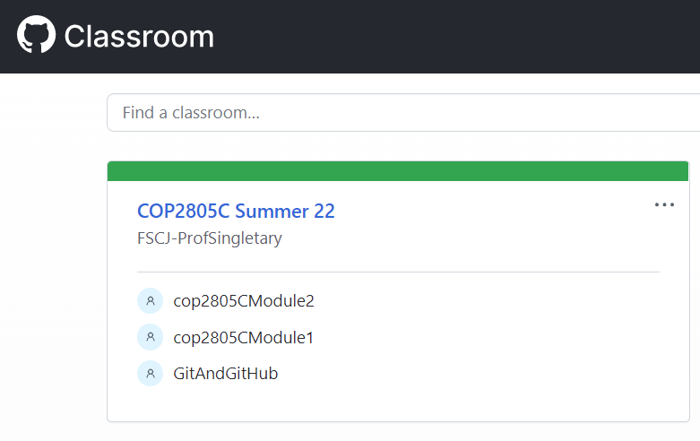
Grading Assignments
Log in to GitHub Classroom and Select Your Course Assignment
https://classroom.github.com/classrooms

Slide 16
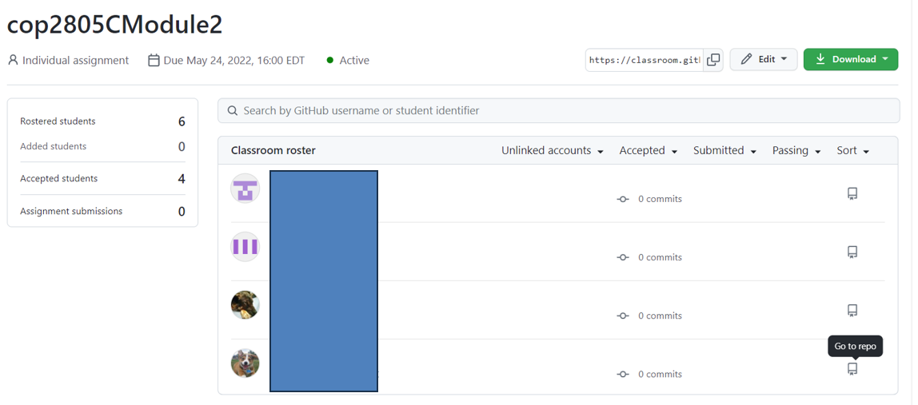
Select the "Go to repo" Icon
Grading Assignments

Slide 17
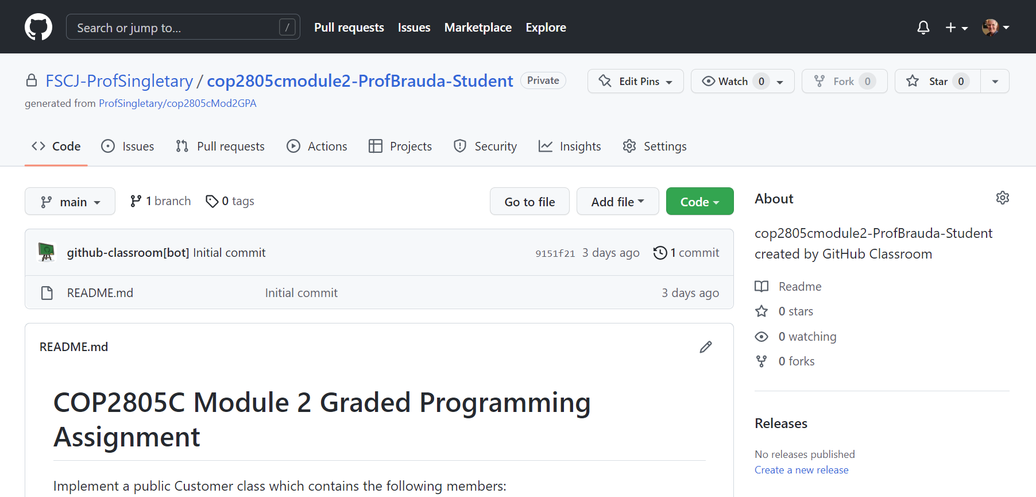
Grading Assignments
Select "Code" For Download/Access Options

Slide 18
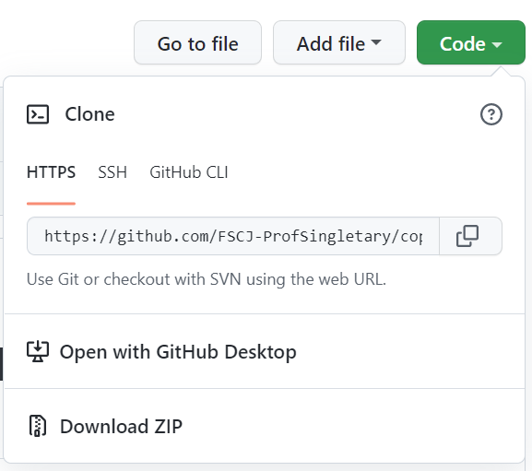
Grading Assignments
Choose Your Preferred Option
Clone the student repo
Open with GH Desktop
Download Zip

Slide 19
Or Use "Go to file" to Go Directly to Desired File
Grading Assignments

Slide 20
GitHub Workflows
A GitHub workflow is a configurable automated process that will run one or more jobs.
Workflows are defined by a YAML file checked in to your repository and will run when triggered by an event in your repository, or they can be triggered manually, or at a defined schedule.
Workflows are defined in the .github/workflows directory in a repository, and a repository can have multiple workflows, each of which can perform a different set of tasks.
You can have one workflow to build and test pull requests, another workflow to deploy your application every time a release is created, and still another workflow that adds a label every time someone opens a new issue https://docs.github.com/en/actions/using-workflows/about-workflows

Slide 21
Automated Grading using Actions and Workflows
You can use autograding to automatically check a student's work for an assignment on GitHub Classroom.
You configure tests for an assignment, and the tests run immediately every time a student pushes to an assignment repository on GitHub.com.
The student can view the test results, make changes, and push to see new results.
After a student accepts an assignment, on every push to the assignment repository, GitHub Actions runs the commands for your autograding test in a Linux environment containing the student's newest code.
GitHub Classroom creates the necessary workflows for GitHub Actions.
You can add, edit, or delete autograding tests for an existing assignment.
(All changes made via the Classroom UI will be pushed to existing student repositories, so use caution when editing tests)
https://docs.github.com/en/education/manage-coursework-with-github-classroom/teach-with-github-classroom/use-autograding

Slide 22
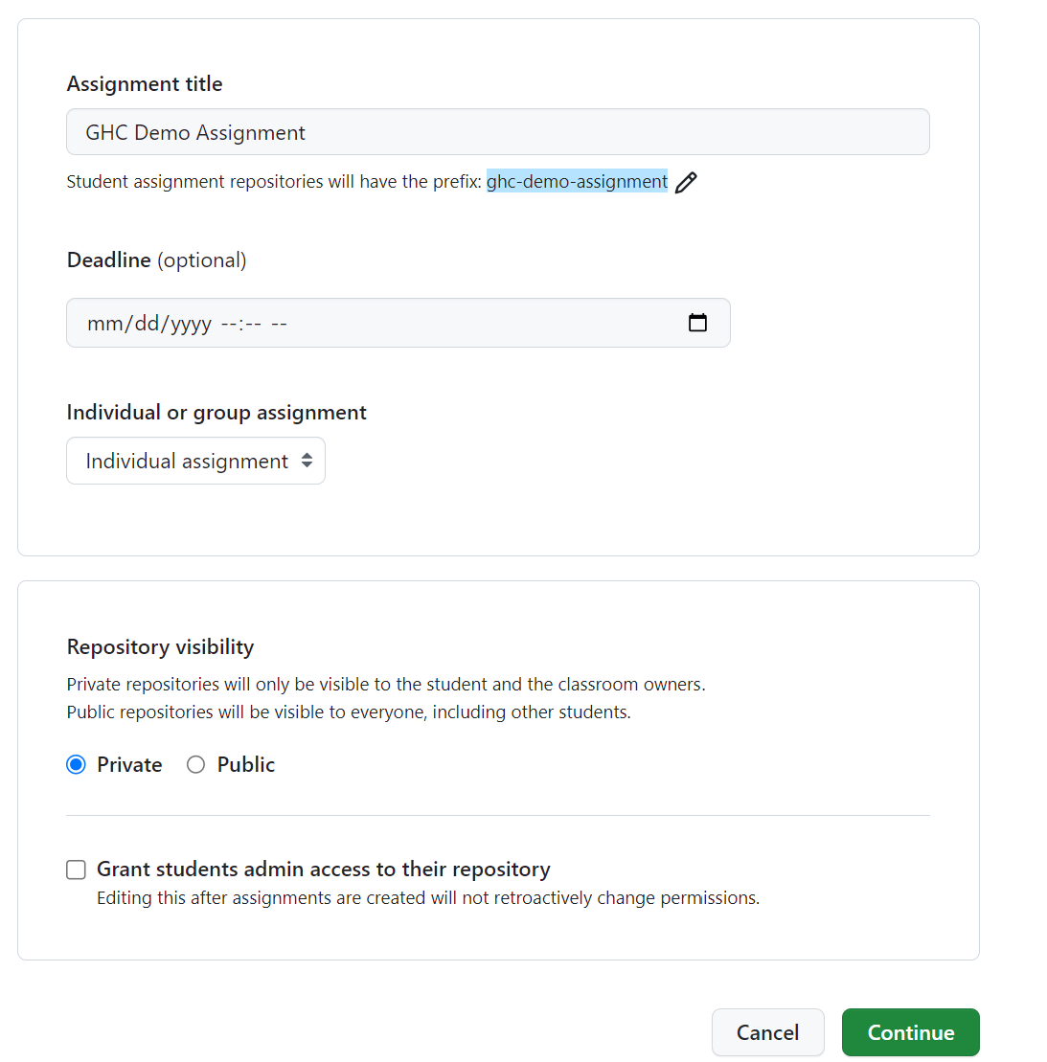
Set up the assignment as shown earlier
Automated Grading

Slide 23
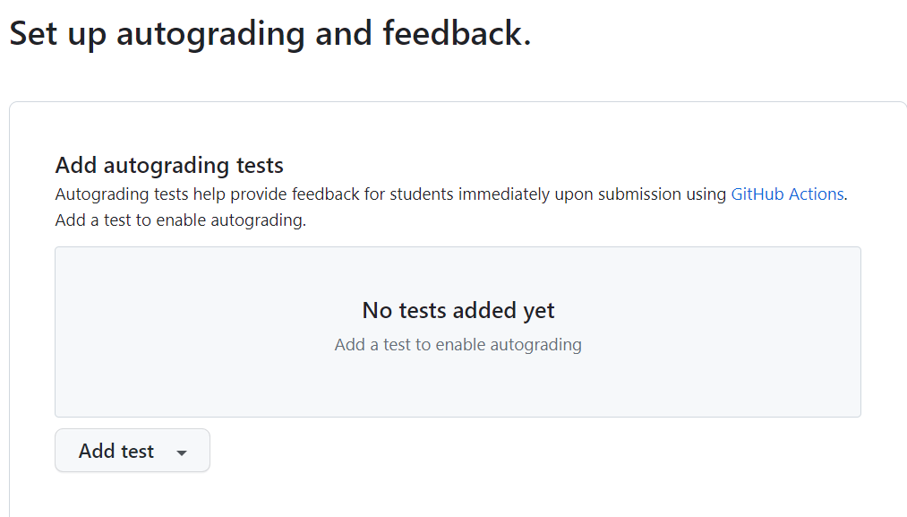
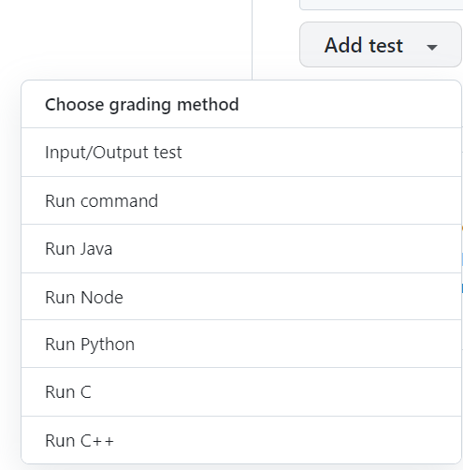
Add a test in the "Set up autograding and feedback" section, choose "Input/Output test"
Automated Grading

Slide 24
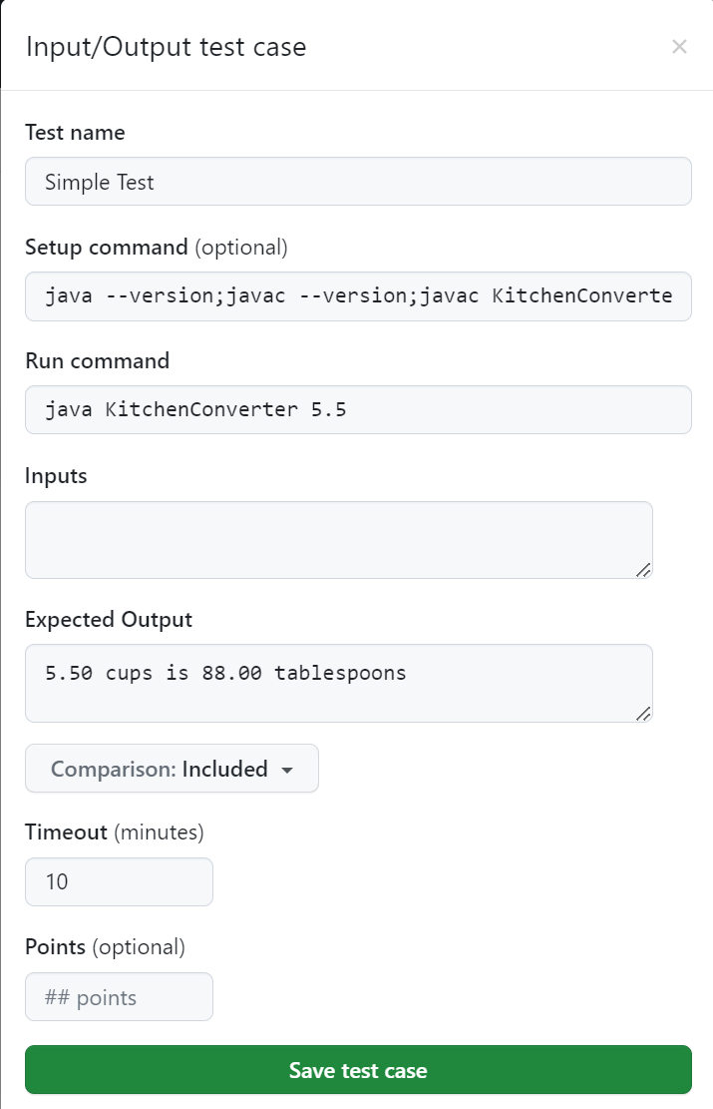
Automated Grading
I used the following parameters:
Test name: Simple Test
Setup command: javac KitchenConverter.java
(builds the students application)
Run command:
java KitchenConverter 5.5 (application requires command line input)
Expected output: 5.50 cups is 88.00 tablespoons
Timeout: 10 minutes (default)
Points (optional): not specified

Slide 25
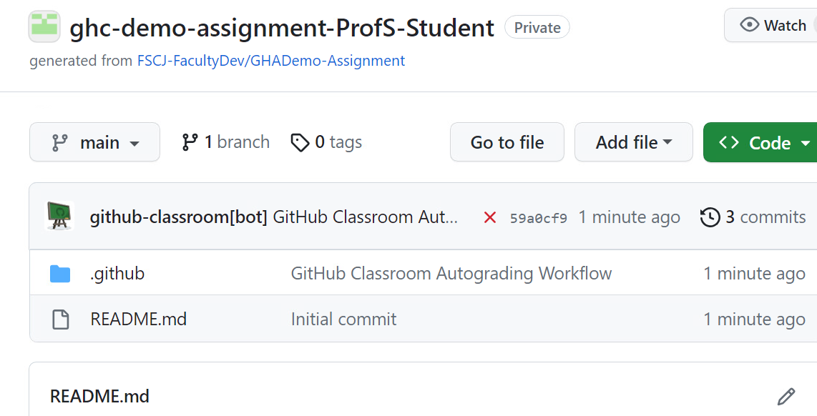
The assignment repo is created with two folders: .github/classroom and .github/workflows
Automated Grading

Slide 26
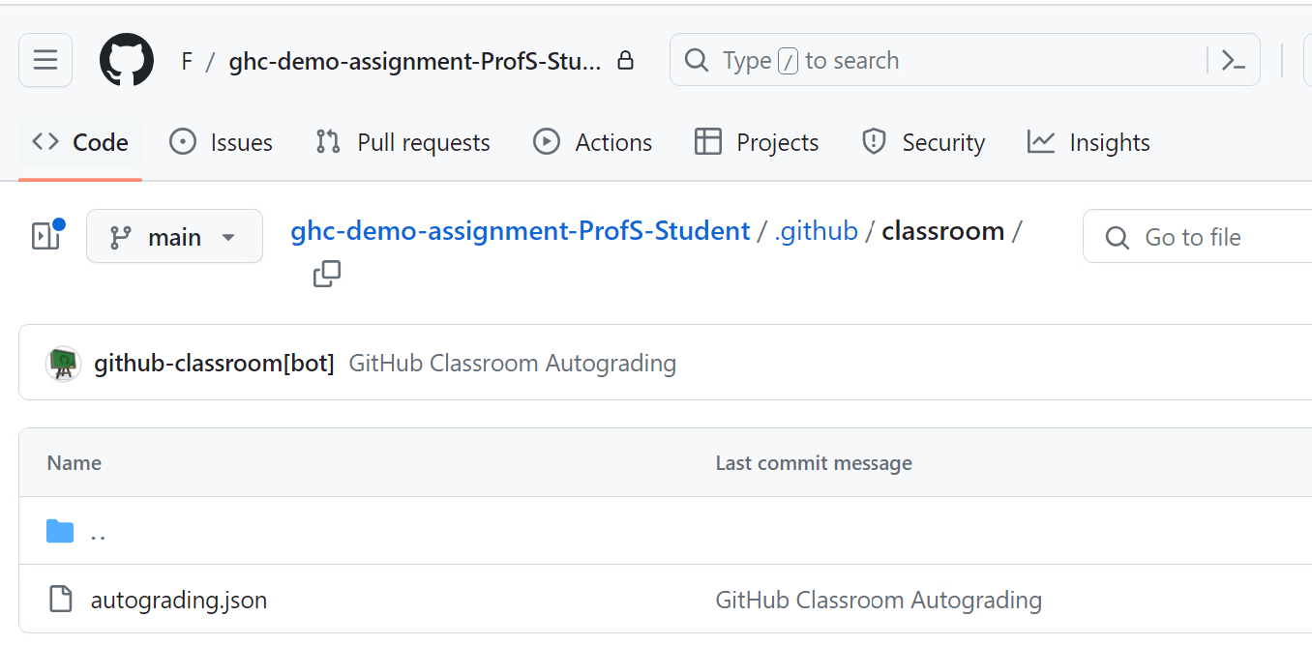
The classroom folder contains a JSON input file
Automated Grading using Workflows

Slide 27
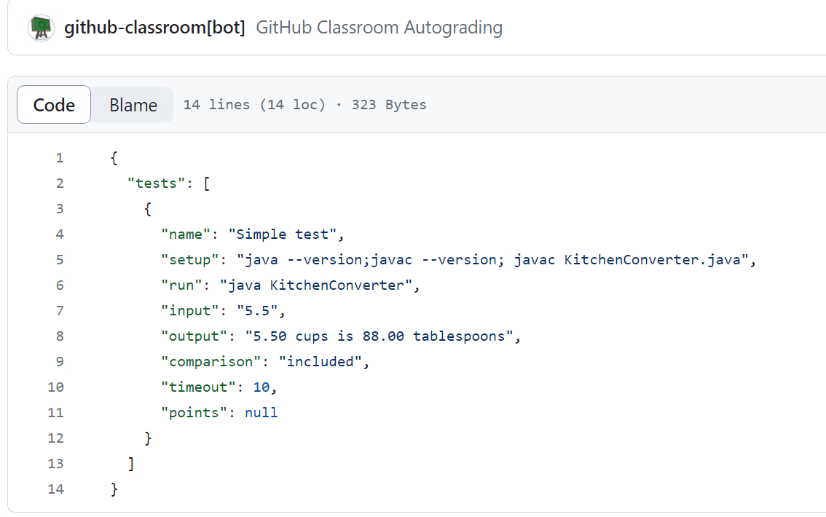
Automated Grading
JSON input file

Slide 28
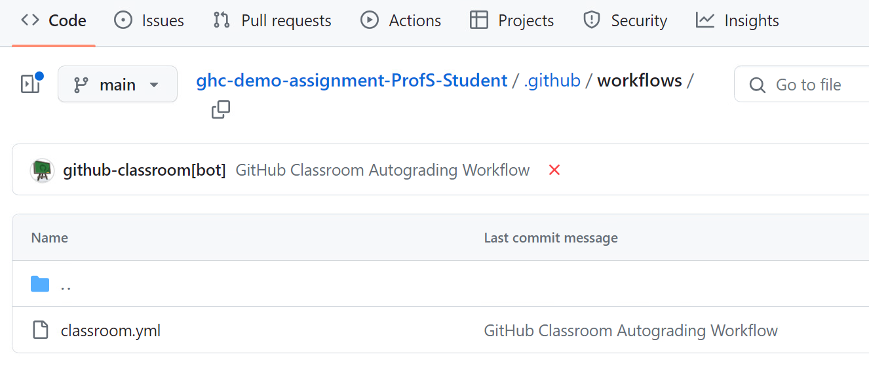
The workflows folder contains a YAML workflow file
Automated Grading

Slide 29
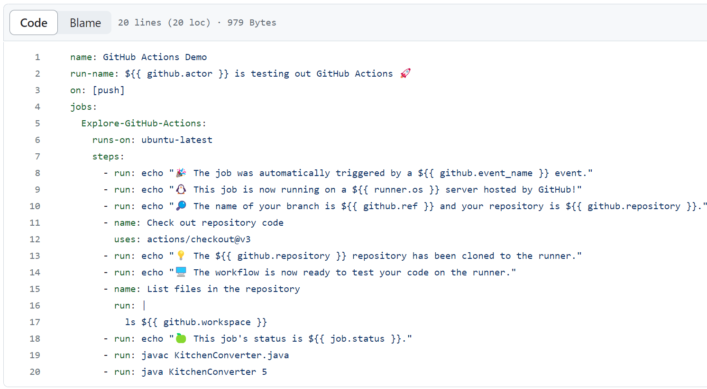
Automated Grading

Slide 30
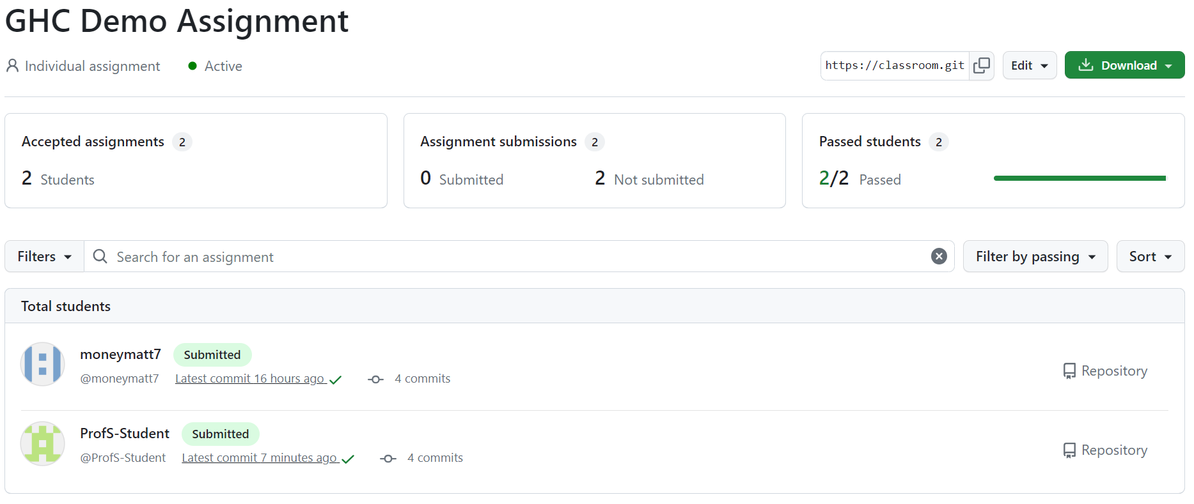
Automated Grading

Slide 31

To see test details, click on the icon.
Automated Grading

Slide 32
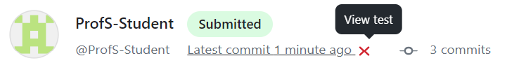
Failed tests are marked with an X, which you can click on
Automated Grading

Slide 33
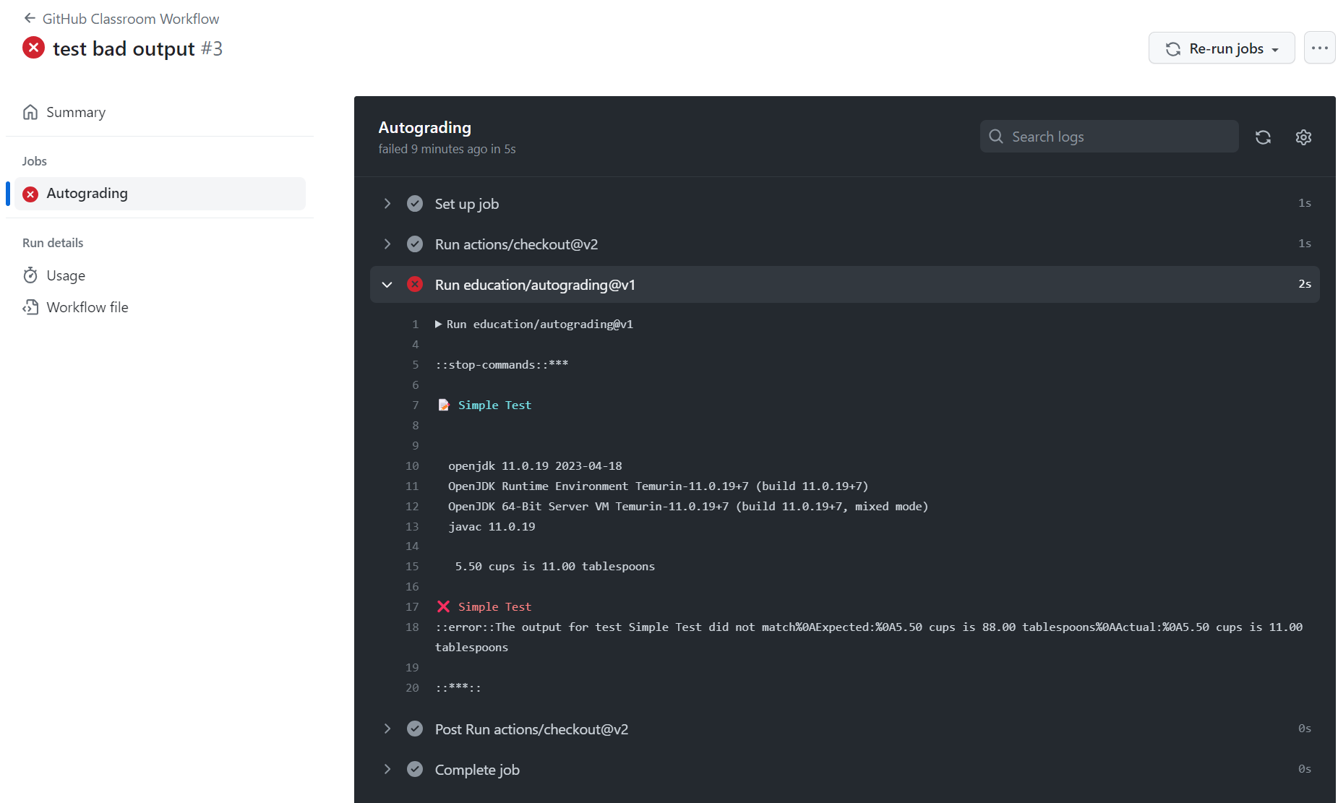
Automated Grading

Slide 34
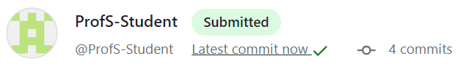
Successful tests are marked with a green checkmark, which you can also click on
Automated Grading

Slide 35
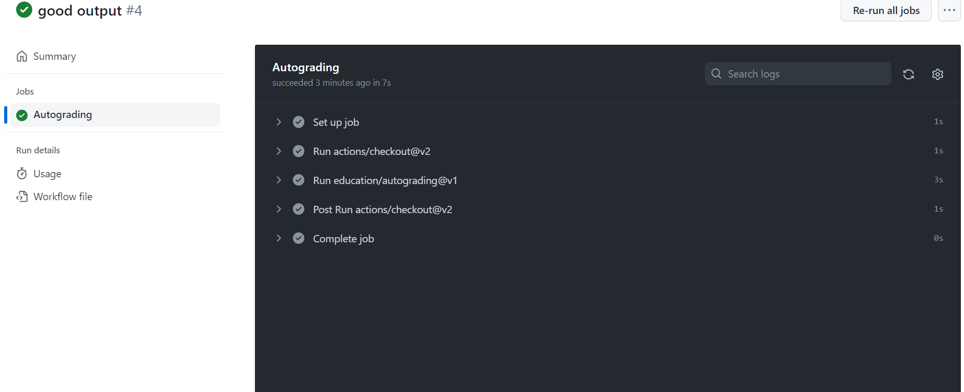
Automated Grading

Slide 36
