Slide 1



GitHub Classroom in the Classroom
David Singletary David.Singletary@fscj.edu
William Money s2735014@students.fscj.edu

Slide 2
GitHub Classroom
The following slides provide information for using GitHub Classroom, which allows the creation of individual classrooms
Why GitHub Classroom?
Students can be assigned to a specific course's classroom
Repositories created by the instructor can be cloned by students and maintained within the classroom
By default, student repositories are private

Slide 3
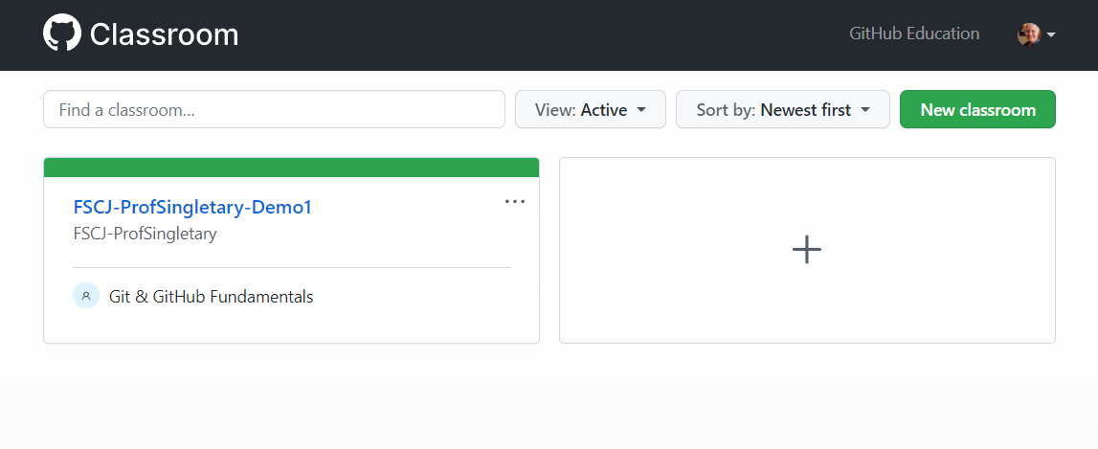
GitHub Classroom (Instructor Notes)
Apply for GitHub Education, after account is verified create an organization. I used FSCJ-ProfSingletary (FSCJ-<my GitHub ID>)
Log in to GitHub Classroom (classroom.github.com) and create a new classroom

Slide 4
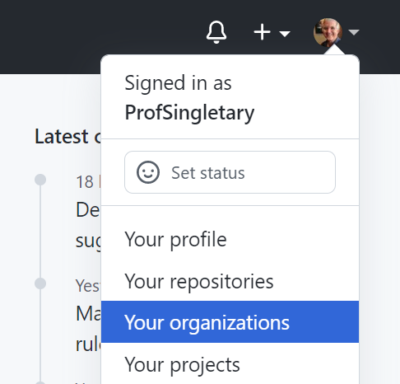
Creating an Organization
Organizations can be used to organize your courses (e.g. Programming, Analytics, Networking, etc.
Select "Your organizations" from your profile menu in GitHub

Slide 5
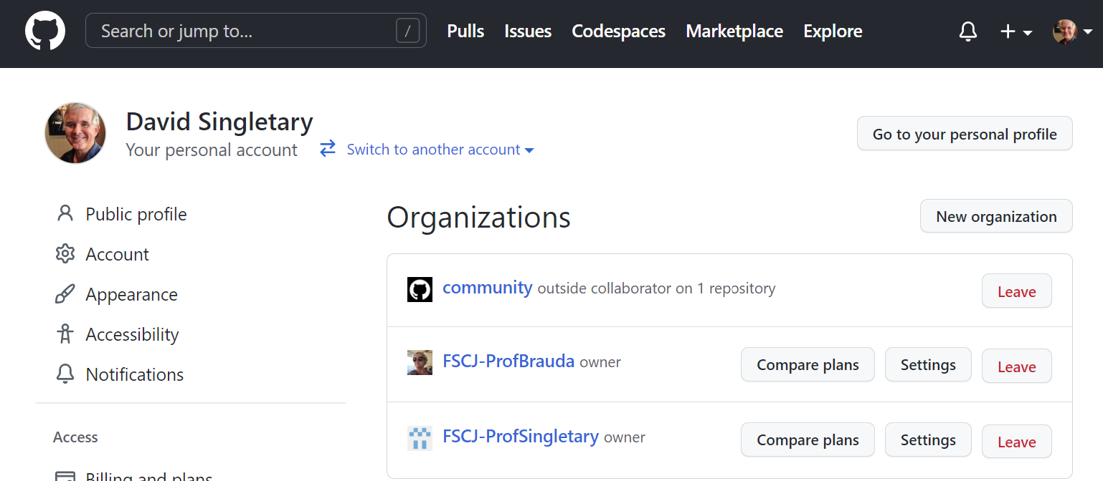
Creating an Organization
Select "New organization" from the page

Slide 6
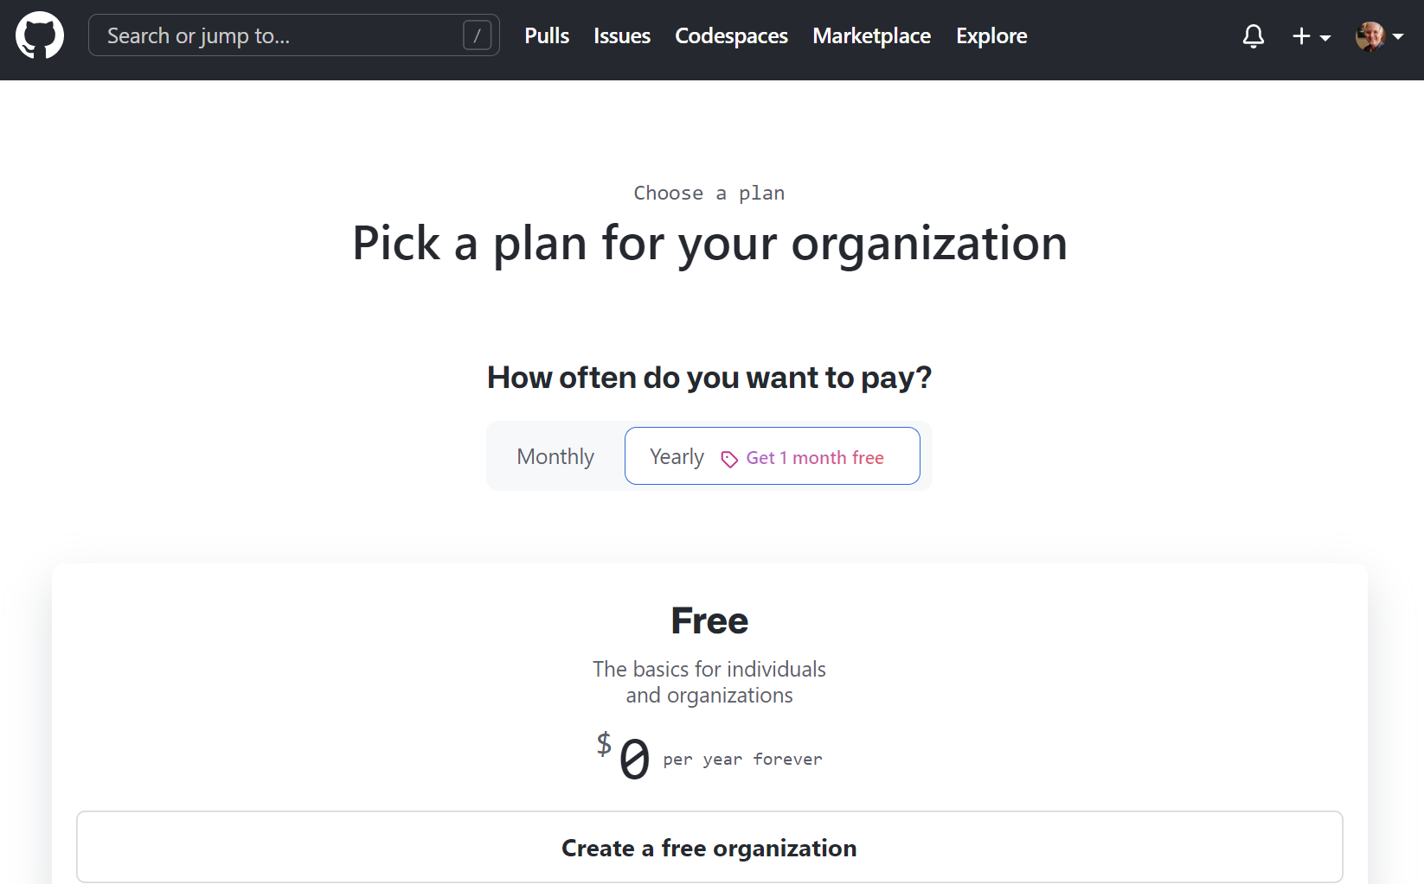
Creating an Organization
Choose "Create a free organization"

Slide 7
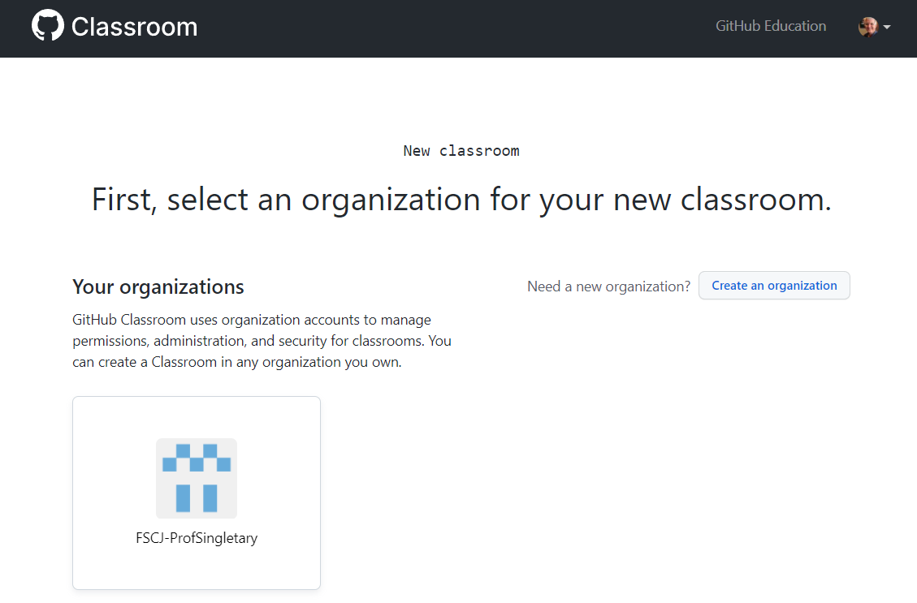
GitHub Classroom (Instructor Notes)
After creating your organization, select it to create a classroom

Slide 8
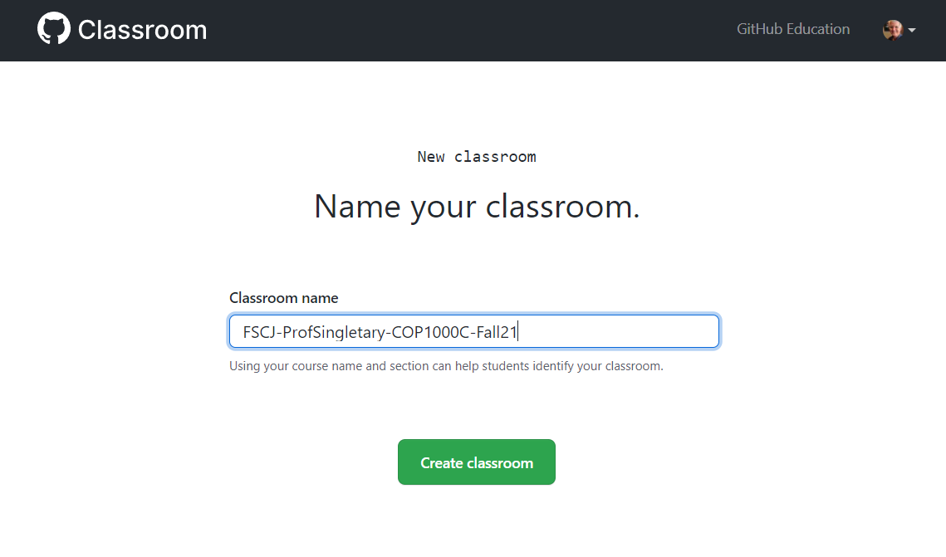
GitHub Classroom (Instructor Notes)
Name your classroom

Slide 9
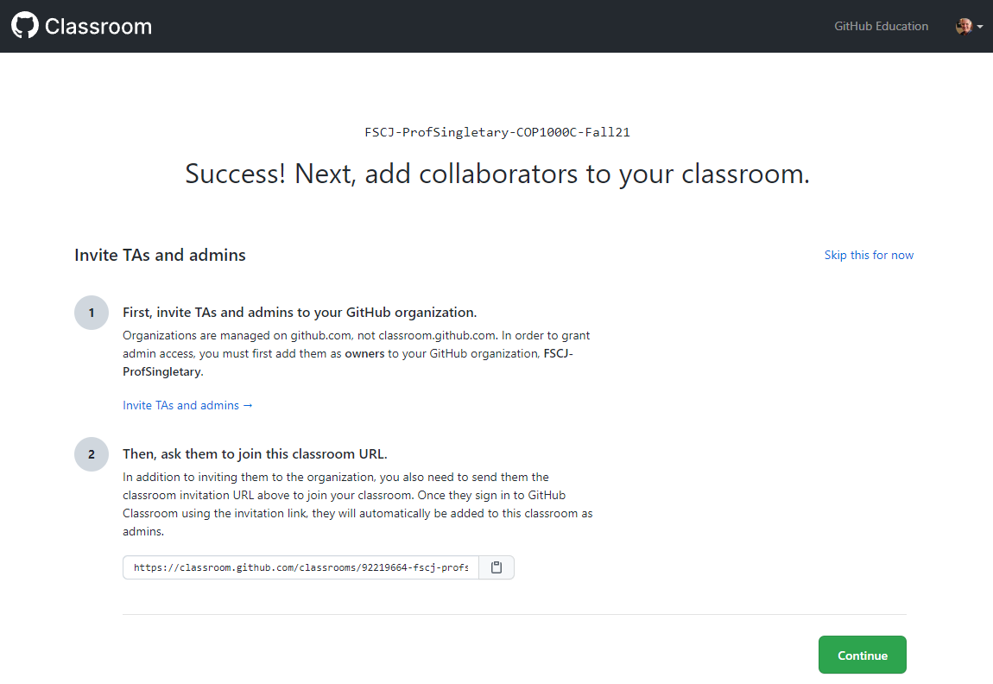
Creating a Classroom
TAs or Admins?

Slide 10
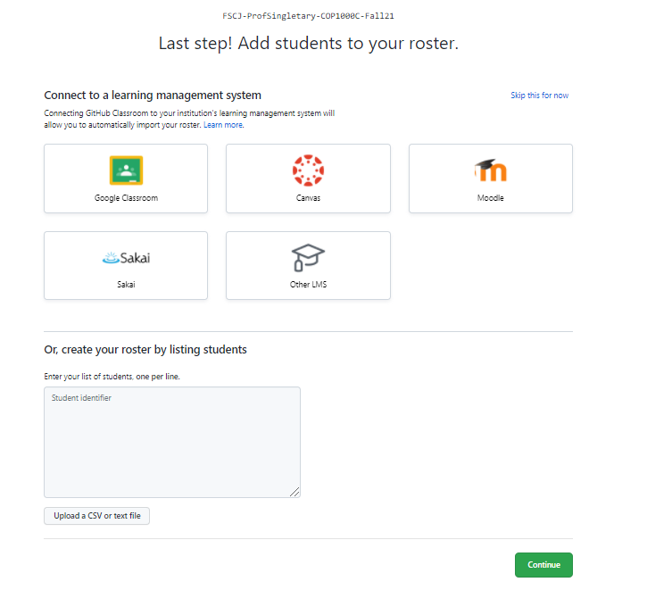
Creating a Classroom
Add Students
Note: this is not required; an alternative approach is to let your students add themselves by accepting your assignment invitations

Slide 11

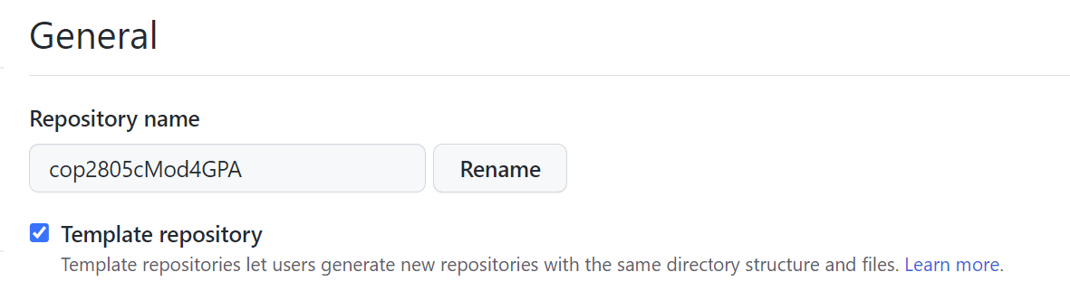
Creating Assignments
To create an assignment, start by creating a repo for your assignment in your normal GitHub account
This repo must be a public template
In the repo Settings page:

Slide 12
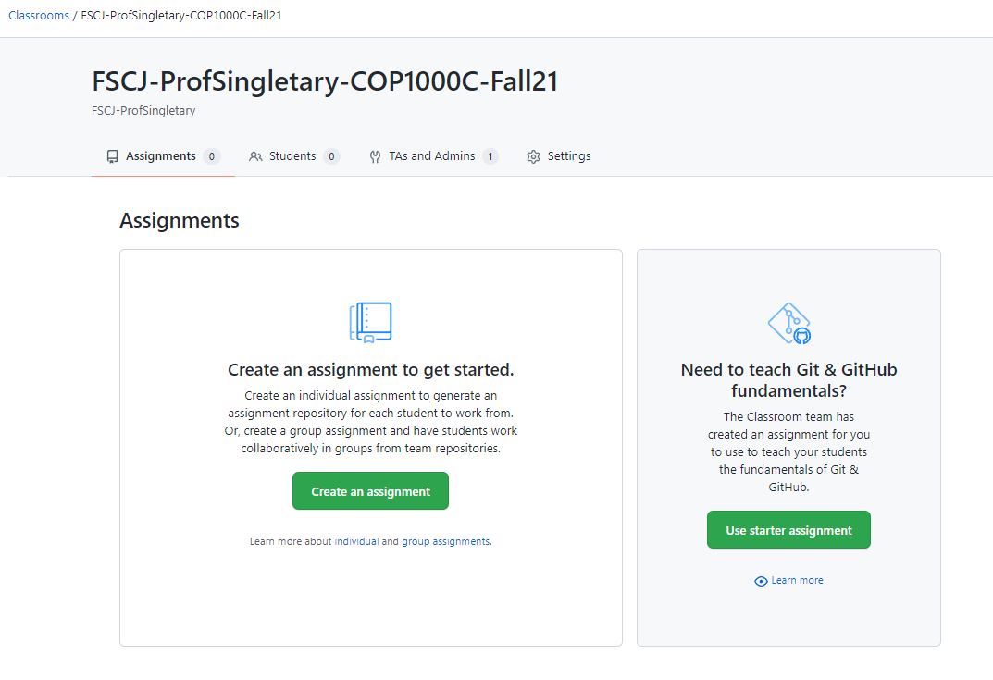
Creating Assignments
In your GitHub Classroom course, create an assignment

Slide 13
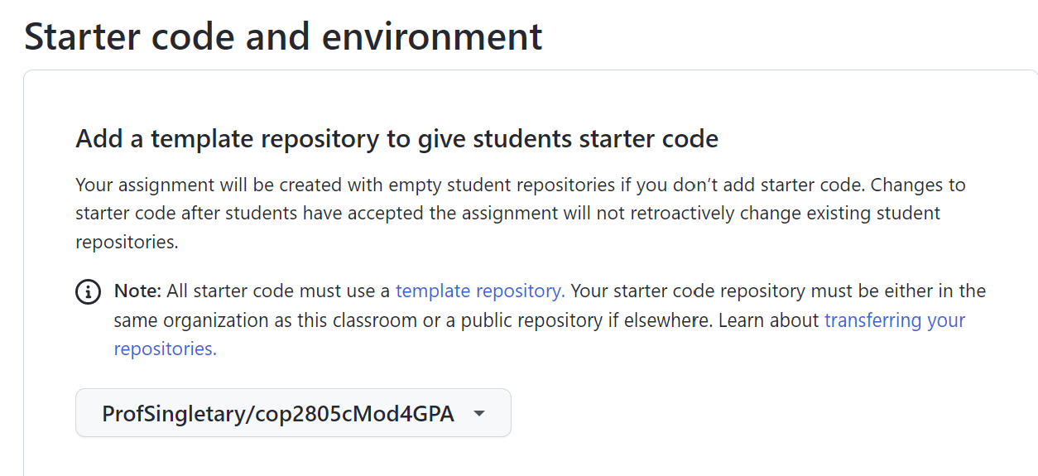
Creating Assignments
Use your template for the assignment starter code:

Slide 14
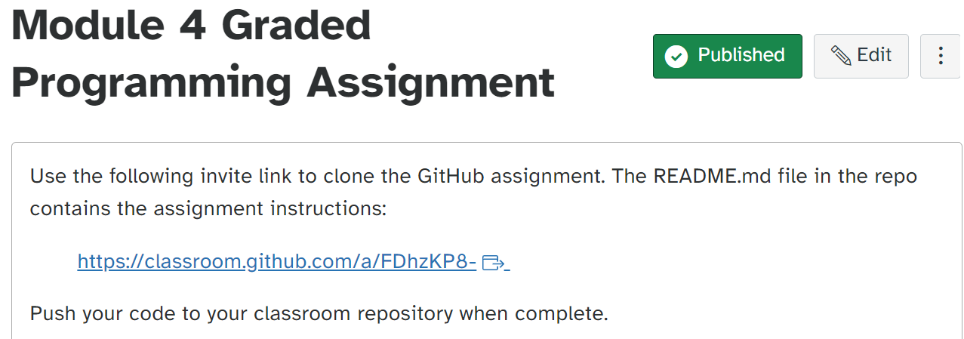
Creating Assignments
Provide the assignment invitation link to your students, e.g. in Canvas:

Slide 15
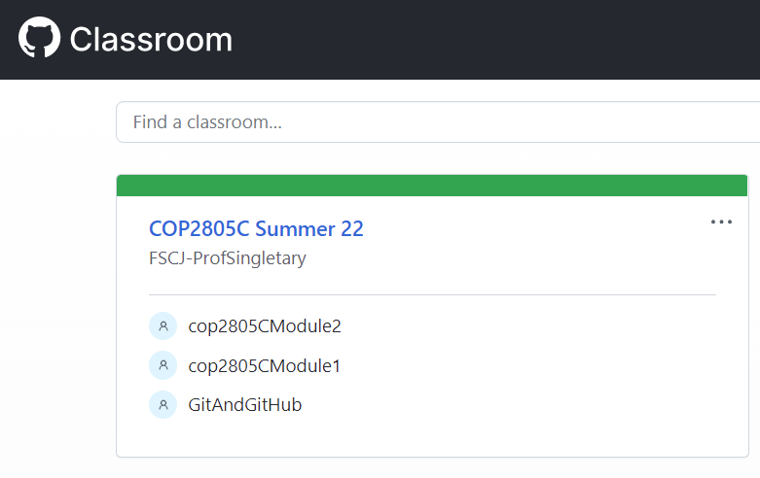
Grading Assignments
Log in to GitHub Classroom and Select Your Course Assignment
https://classroom.github.com/classrooms

Slide 16
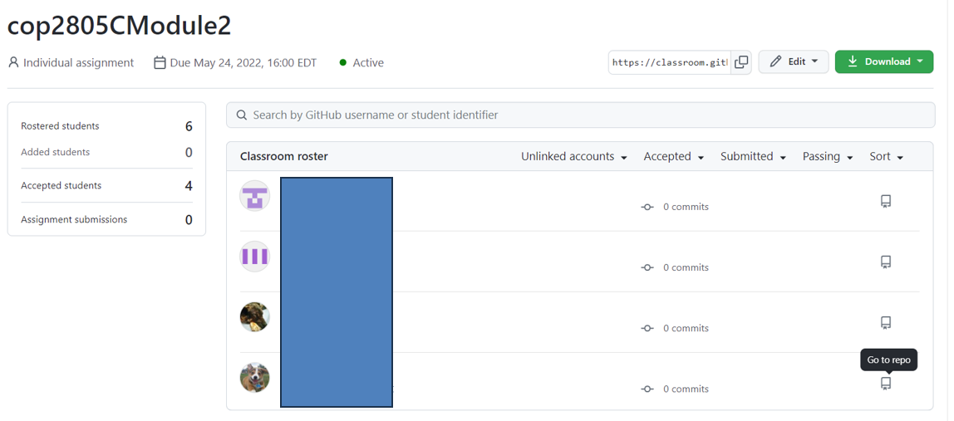
Select the "Go to repo" Icon
Grading Assignments

Slide 17
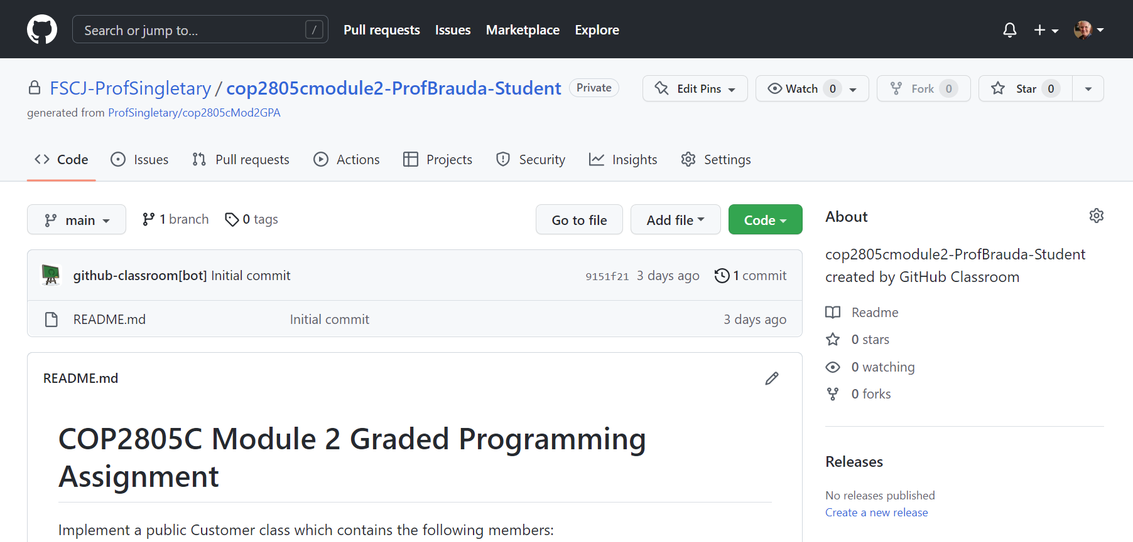
Grading Assignments
Select "Code" For Download/Access Options

Slide 18
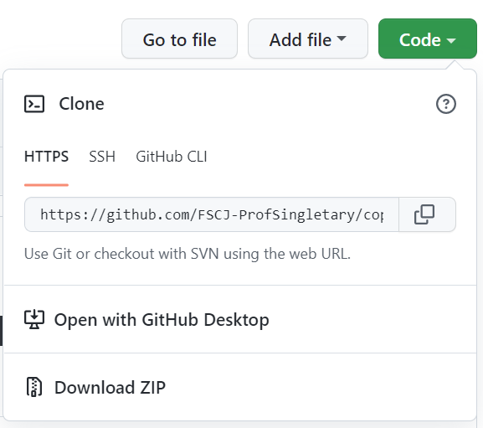
Grading Assignments
Choose Your Preferred Option

Slide 19
Or Use "Go to file" to Go Directly to Desired File
Grading Assignments

Slide 20
