Slide 1


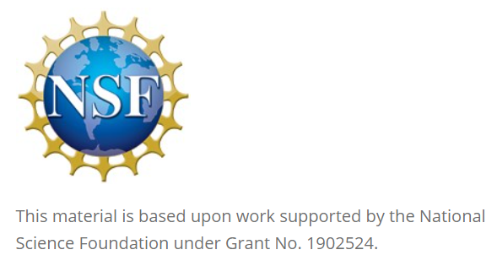
GitHub Classroom in the Classroom
David Singletary David.Singletary@fscj.edu
William Money s2735014@students.fscj.edu

Slide 2



GitHub Classroom, a Student’s Perspective.
William Money
Wrapping up the AS in Computer Information Technology program this fall, and starting the BAS program in Application Development in the Spring of 2024
FSCJ STARS Computing Corps Mission - to broaden participation in computing among women and underrepresented minorities.
FSCJ Summer Internship – Designing and building a Gaddis Pseudocode linter, Psucculint.

Slide 3
GitHub Classroom
Why GitHub Classroom benefits students.
Students are introduced to real world concepts and aspects of computer programming.
GitHub offers a unique system that allows students to easily go from working alone, to working together as a group using branches and version control.
Assignments on GitHub may later be used by students as pieces for their e-portfolio.
GitHub offers loads of free goodies for students.

Slide 4
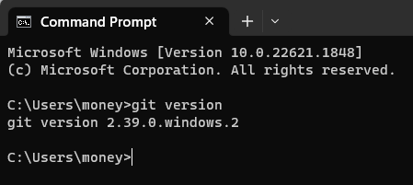

GitHub Classroom
Before using GitHub, students should install Git
Git comes installed by default on most Mac and Linux machines
For instructions and download links go to:
https://github.com/git-guides/install-git
Easy options for several operating systems and methods of installation.

Slide 5
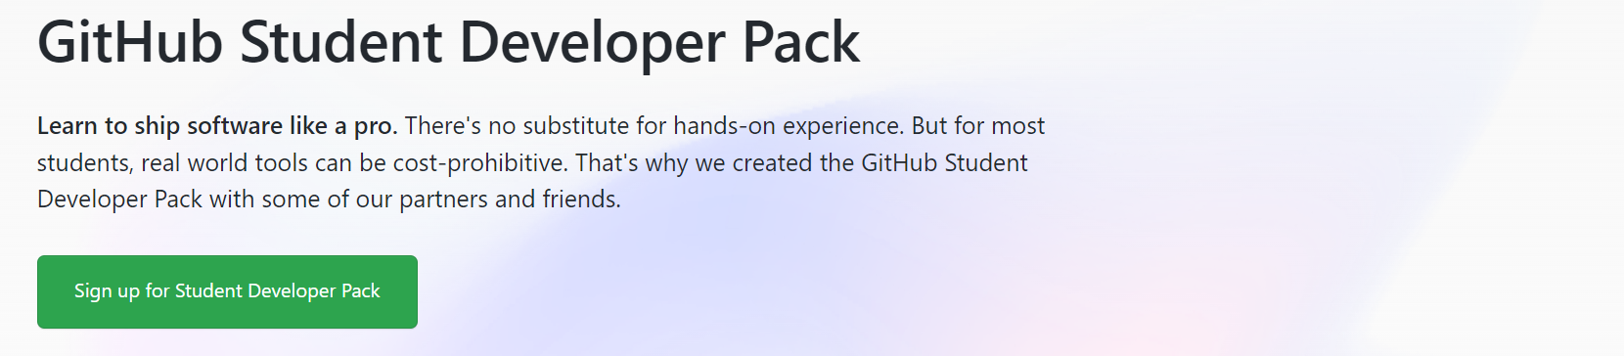
GitHub Student Developer Pack
Great free resources for students!
Sign up at: https://education.github.com/pack
GitHub Pro accounts are FREE for students!

Slide 6
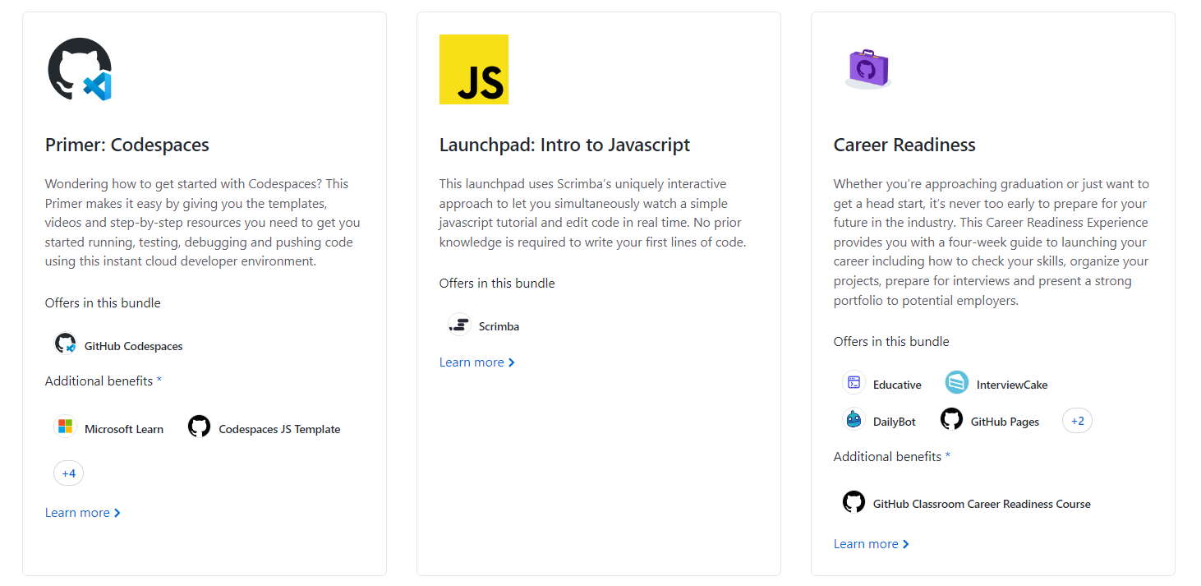
GitHub Student Developer Pack
Several offers from GitHub and their partners

Slide 7
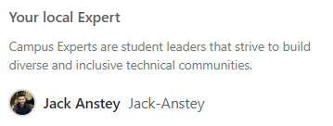
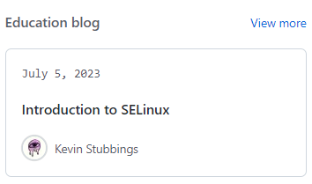

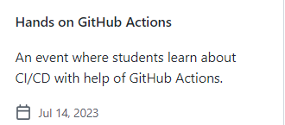
GitHub Global Campus - Students
The https://education.github.com/globalcampus/student page is the dashboard for classrooms, networking and educational resources.
Shows upcoming assignments
A GitHub Community Expert will be assigned to each student.
Educational resources like tutorial blogs, student repositories to learn from or participate in, upcoming student and industry events, and more!

Slide 8
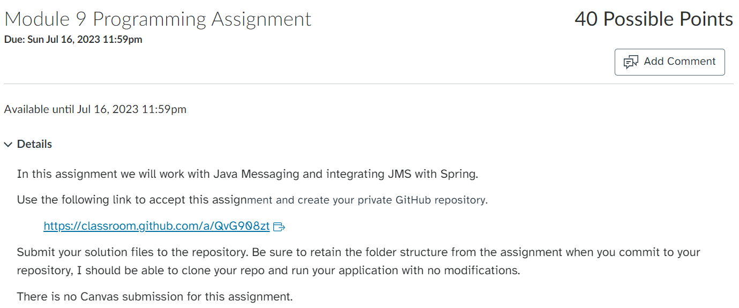
My Experience with GitHub Classroom
Introduced in COP2805C Advanced Java
Assignments received through Canvas

Slide 9
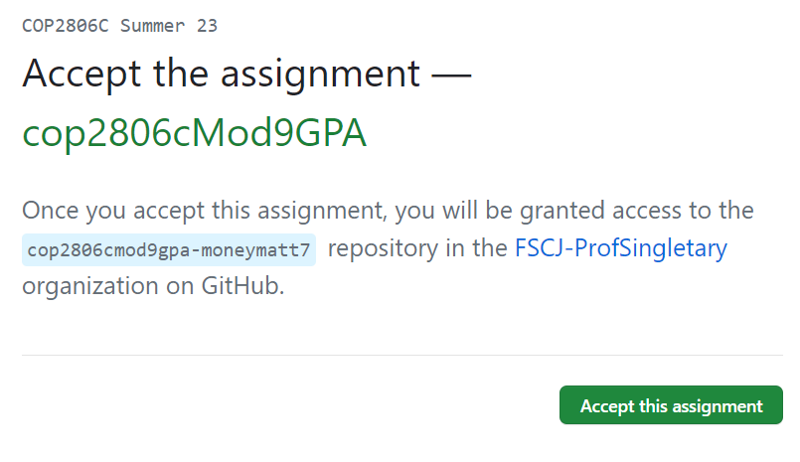
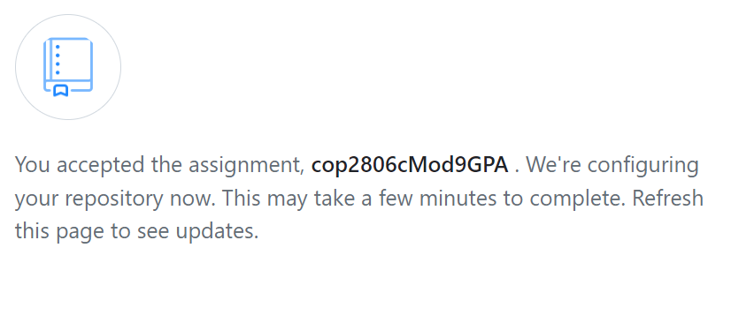
My Experience with GitHub Classroom
Simply accept the assignment and GitHub will configure your individual classroom repository.

Slide 10
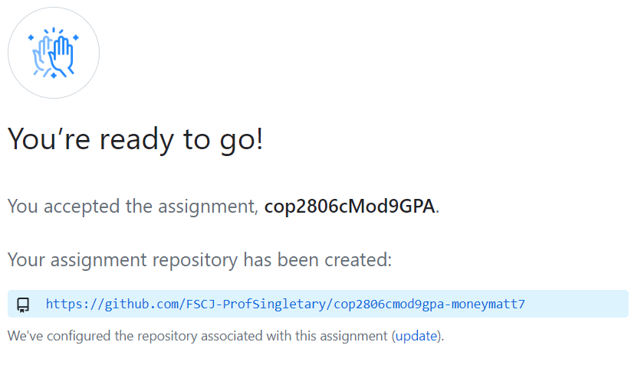
My Experience with GitHub Classroom
Once it’s ready, you are good to go! (This usually only takes a few seconds)

Slide 11
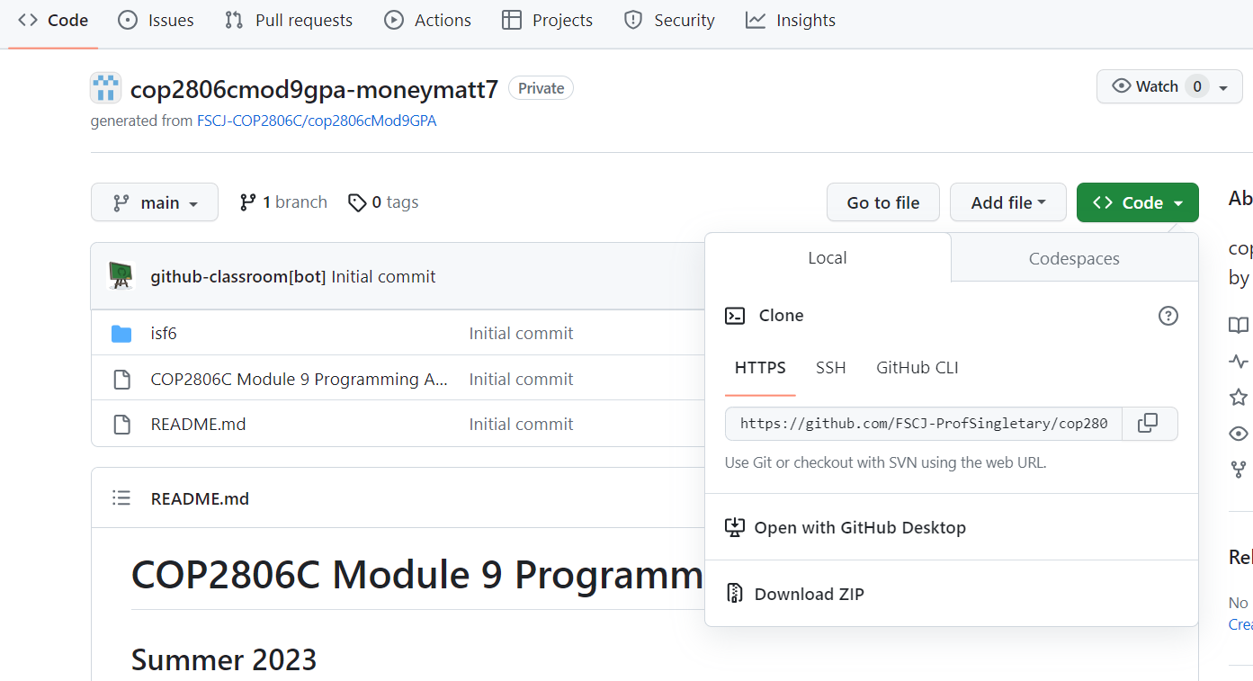
My Experience with GitHub Classroom
Students can upload their work directly to the repository through the web browser.
Students can also work with terminal, command prompt or Git bash to clone the repository to their local device, work on their assignments, and then push them back to the repository.
GitHub also offers a desktop
application that provides a GUI
for performing actions on a
repository.

Slide 12



Moving to General Use – Psucculint
Within the internship at FSCJ, the other student-interns and myself have transitioned from using GitHub Classroom to using GitHub in a real-world application.
Additionally, we are using Miro to chart and track planning, and Slack to facilitate communication within the internship.

Slide 13
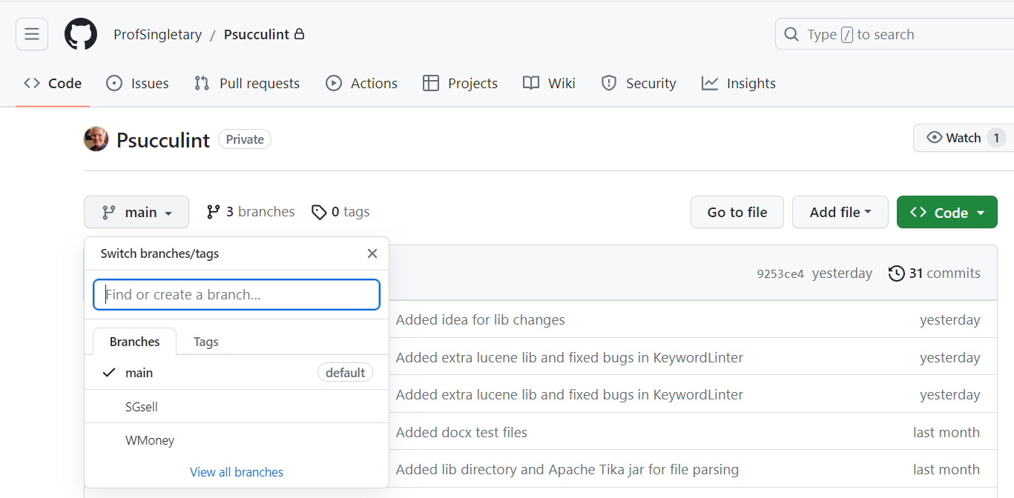
Moving to General Use - Psucculint
By using the features GitHub offers for version control like branches and merging, we are learning what it is like to collaborate on a project in the real world while also building a piece for our portfolios.

Slide 14
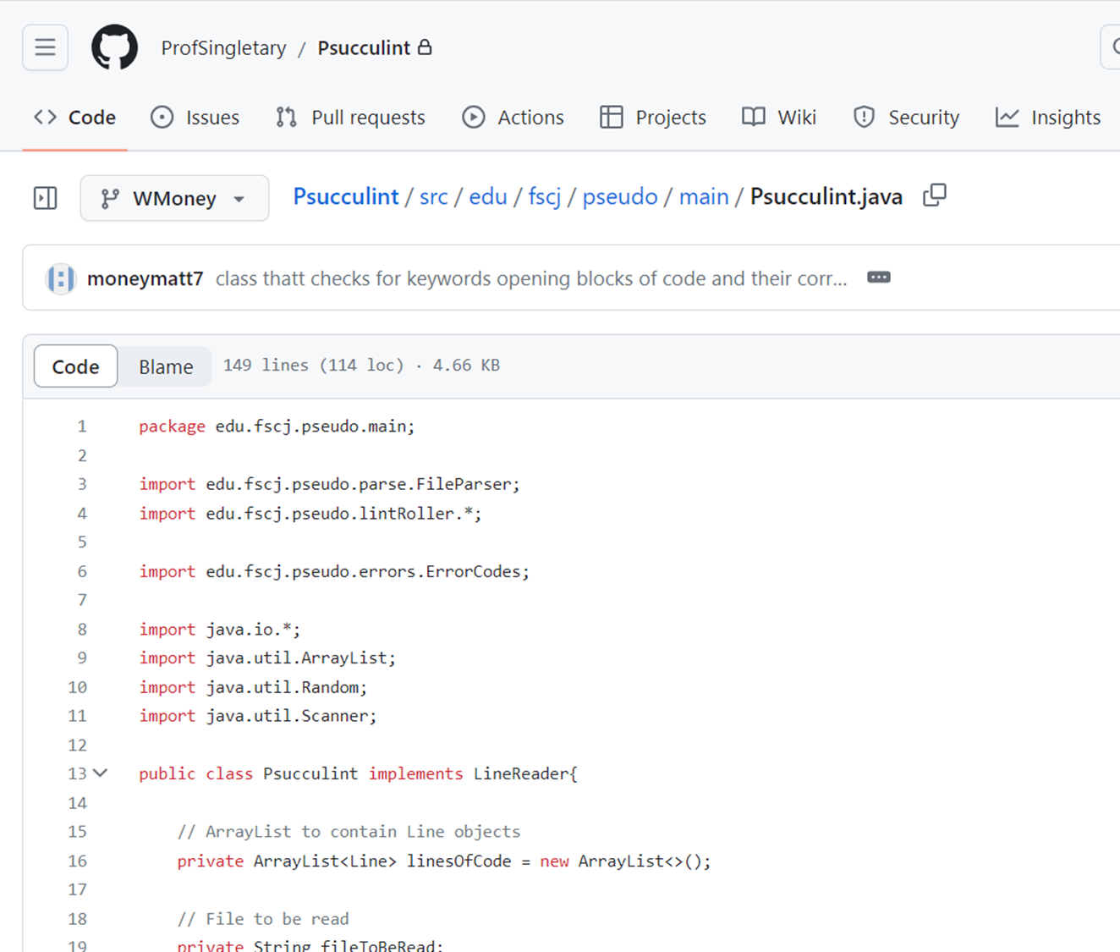
Conclusion – Why I believe using GitHub Classroom is ideal for computer programming students.
Real world work experience
GitHub Classroom teaches many more useful skills than other online learning platforms for computer programming students
Provides tangible pieces towards a resume or e-portfolio
The free software and services provided to students is unmatched

Slide 15
