Slide 1


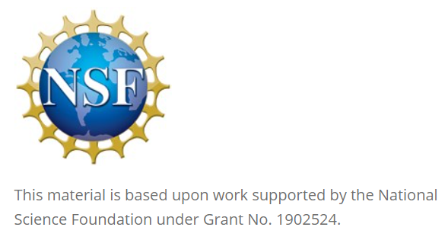
GitHub Classroom in the Classroom
David Singletary David.Singletary@fscj.edu
William Money s2735014@students.fscj.edu

Slide 2
GitHub Classroom
The presentation provides information for using GitHub Classroom, which allows the creation of individual classrooms and assignments in the context of GitHub
Why GitHub?
GitHub (and Git) are critical components in maintaining versioned repositories of work in data science, software development, and other areas
Using these tools is an important job skill that students should be familiar with
Why GitHub Classroom?
GitHub Classroom enables instructors to assign and assess individual work while simultaneously providing students with hands-on experience with GitHub
Assignment repositories created by the instructor can be cloned by students and maintained within the classroom
Cloned student repositories actually belong to the instructor and are private by default

Slide 3
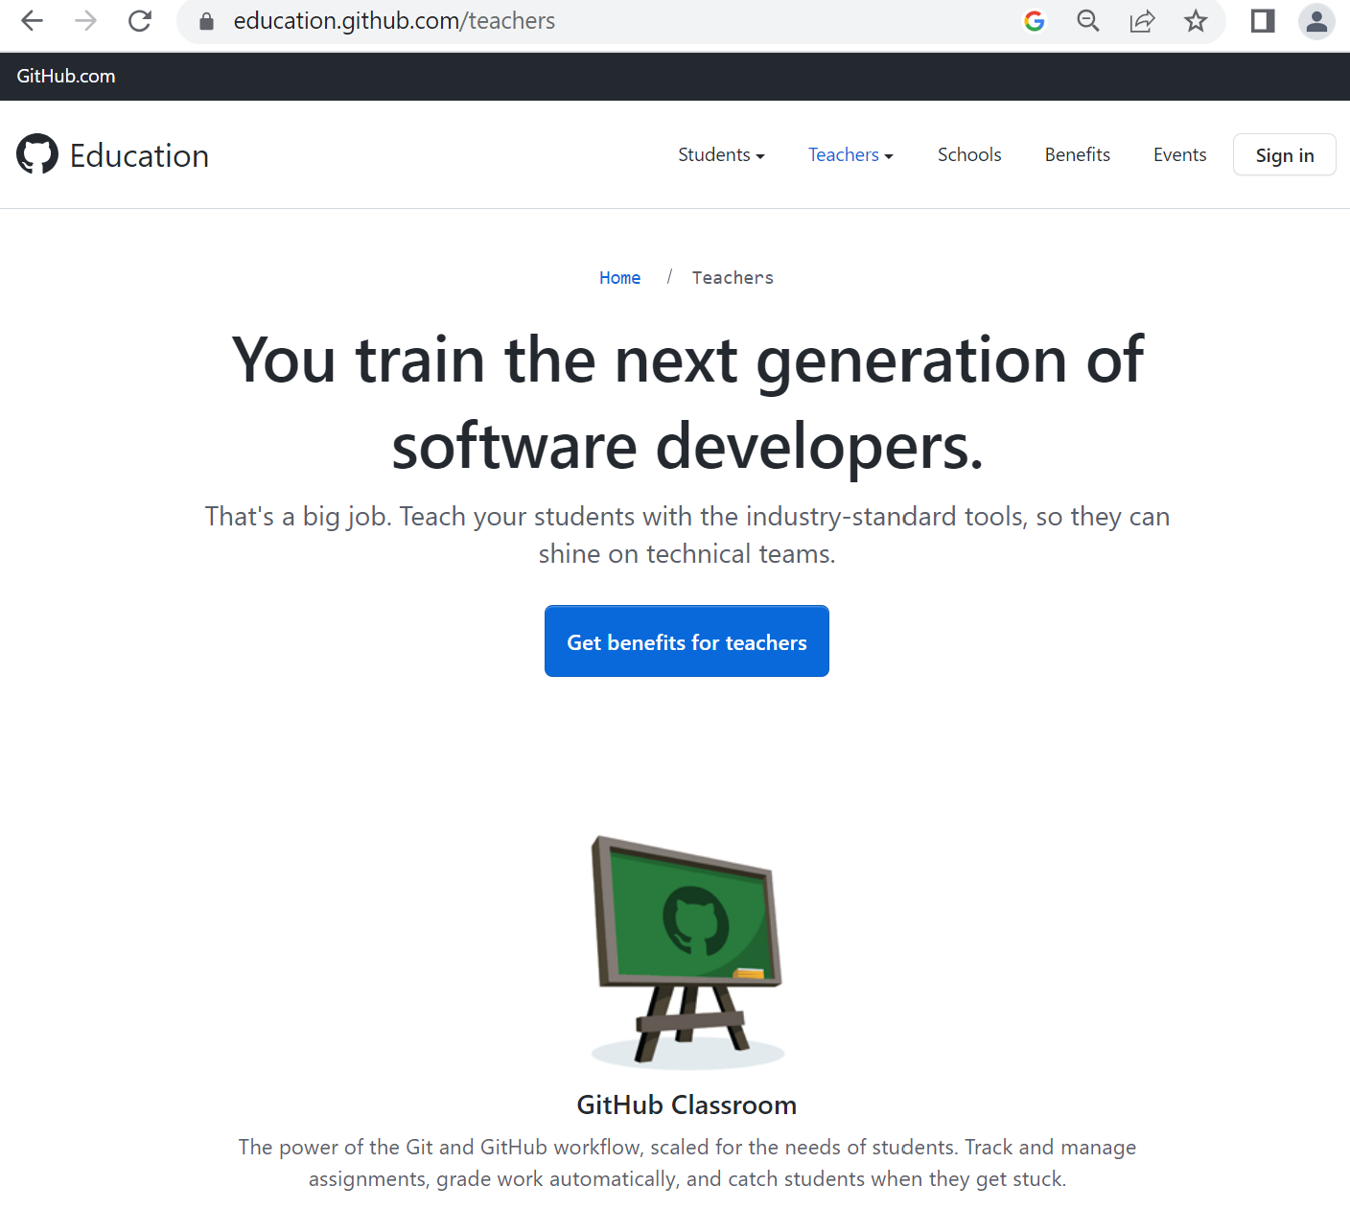
Start with an Instructor Account on GitHub Education
Apply for an instructor account on GitHub Education
(https://education.github.com/teachers)
account verification may take a day or two

Slide 4
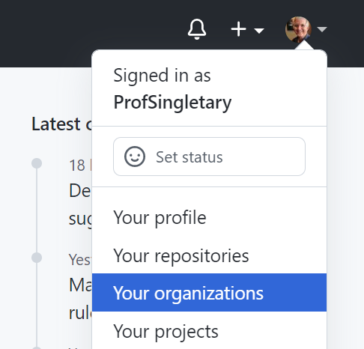
Create an Organization in GitHub
Organizations can be used to organize your courses (e.g. Programming, Analytics, Networking, etc.
Select "Your organizations" from your profile menu in GitHub

Slide 5
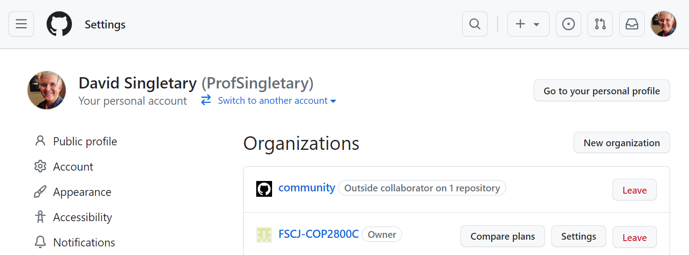
Creating an Organization
Select "New organization" from the page

Slide 6
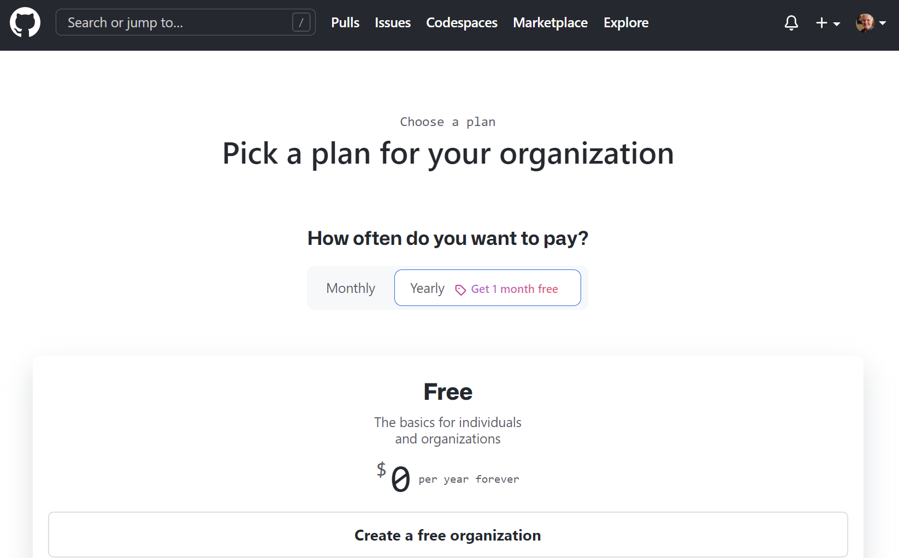
Creating an Organization
Choose "Create a free organization"

Slide 7
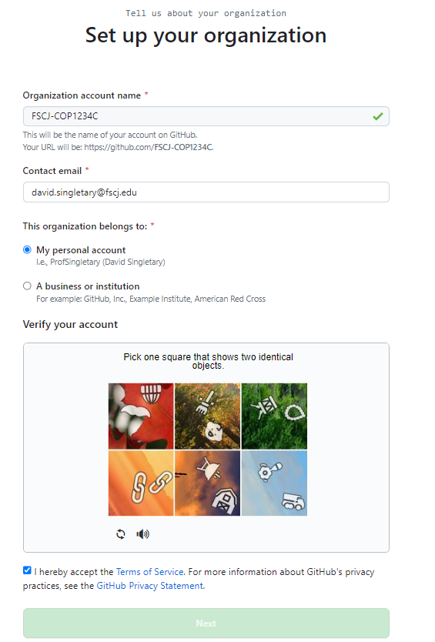
Creating an Organization

Slide 8
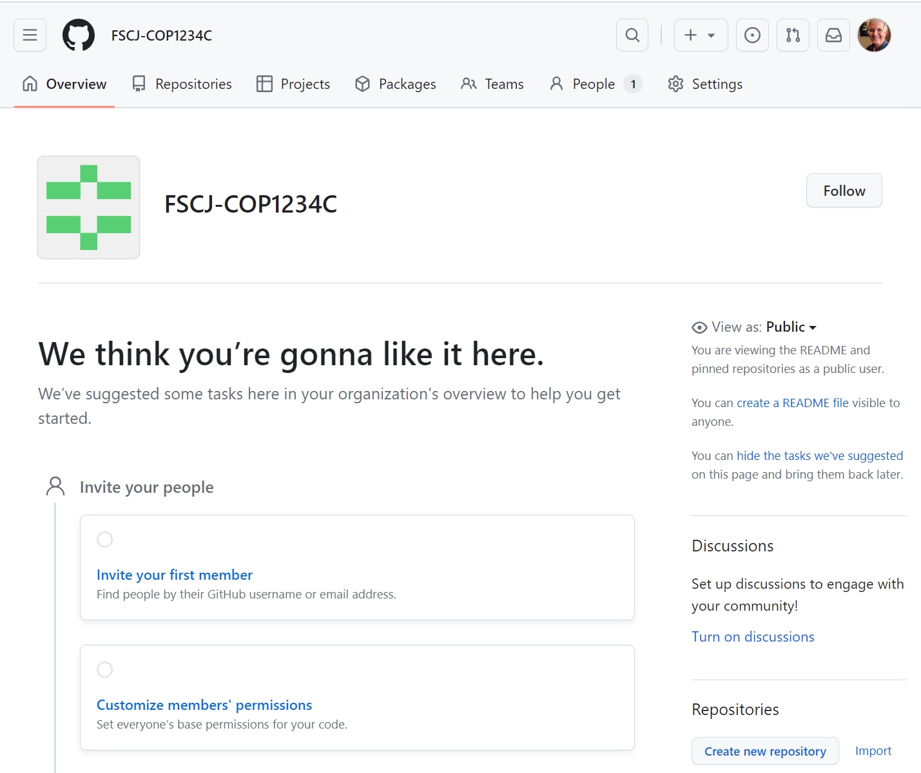
Creating an Organization

Slide 9
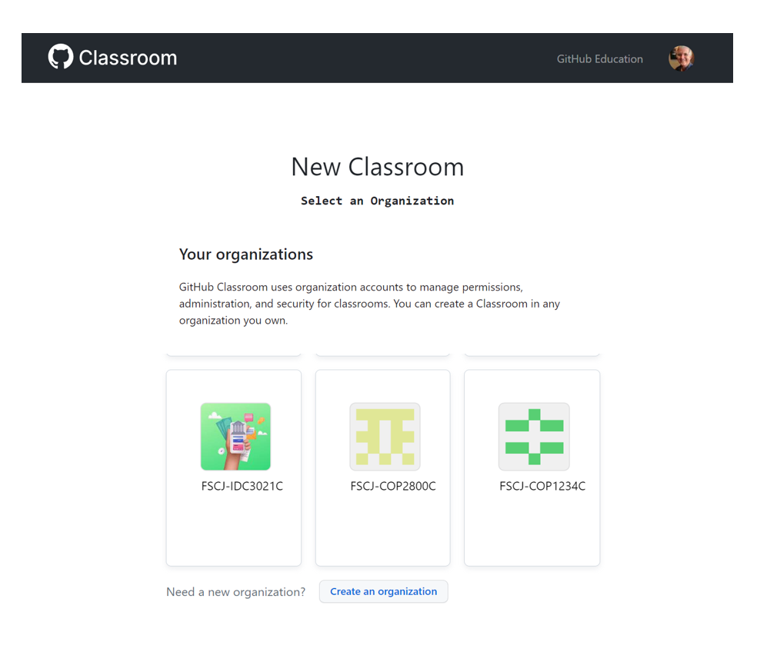
Creating a Classroom
In GitHub Classroom (https://classroom.github.com), select the desired organization for your classroom

Slide 10
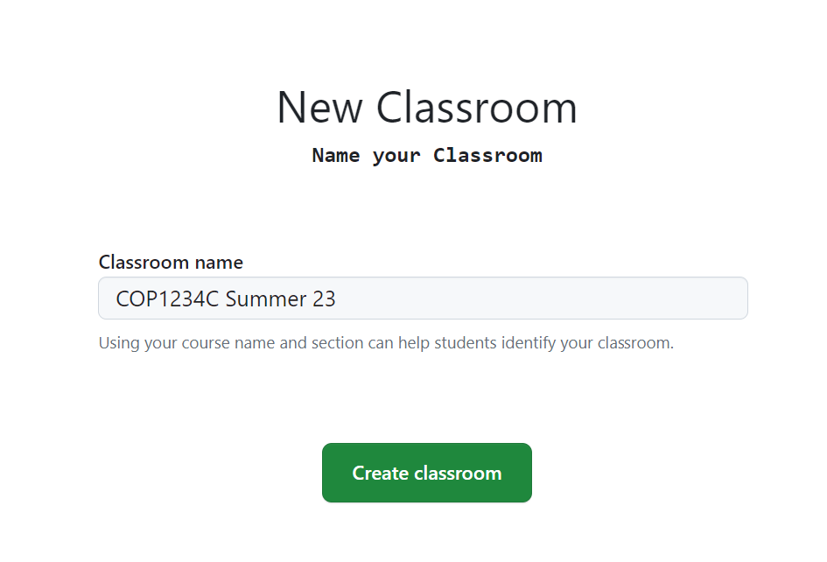
Creating a Classroom
Name your classroom

Slide 11
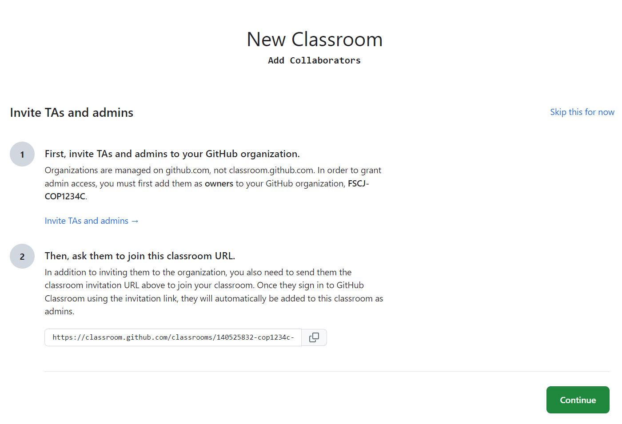
Creating a Classroom
TAs or Admins?

Slide 12
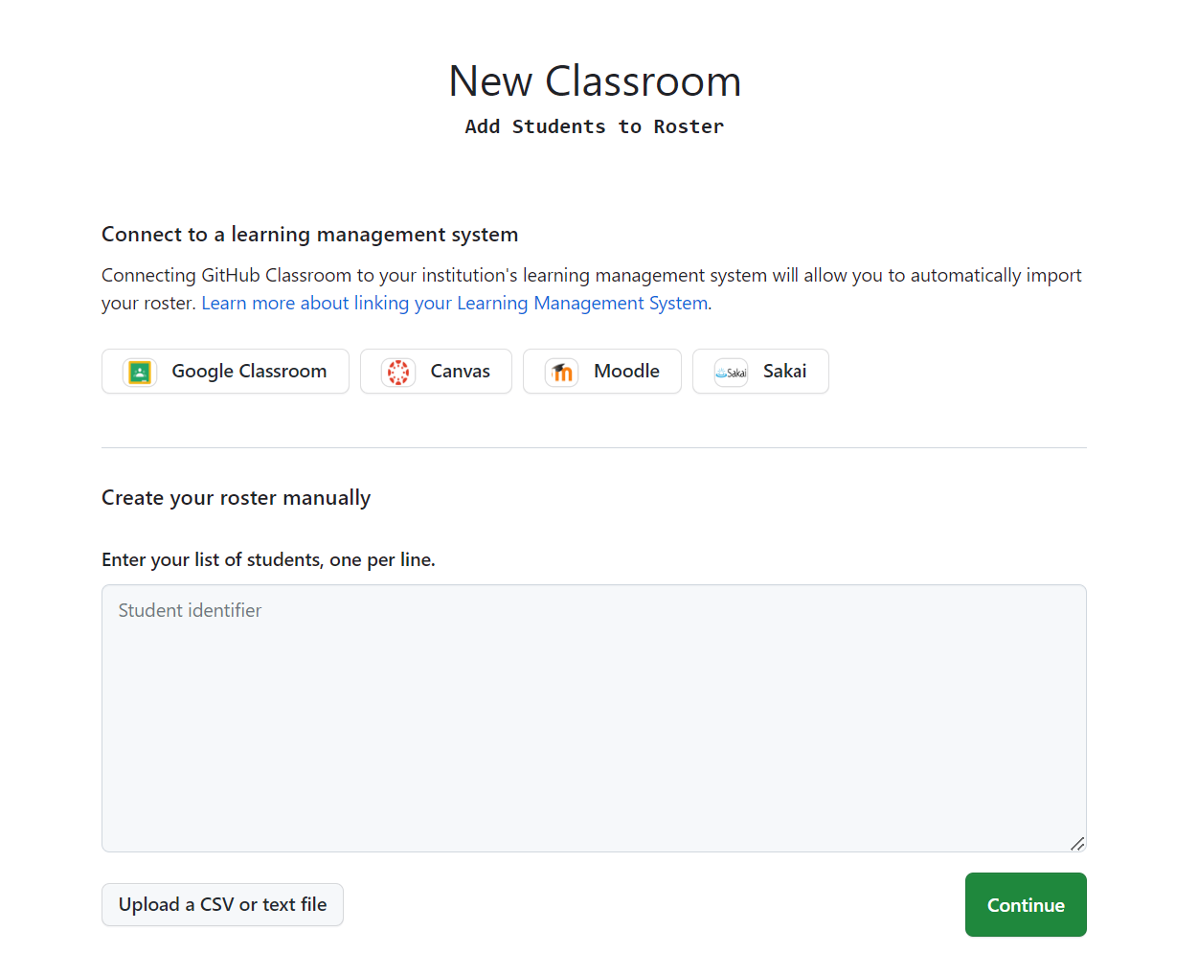
Creating a Classroom
Add Students
Note: this step is not required; an alternative approach is to let your students add themselves by accepting your assignment invitations

Slide 13
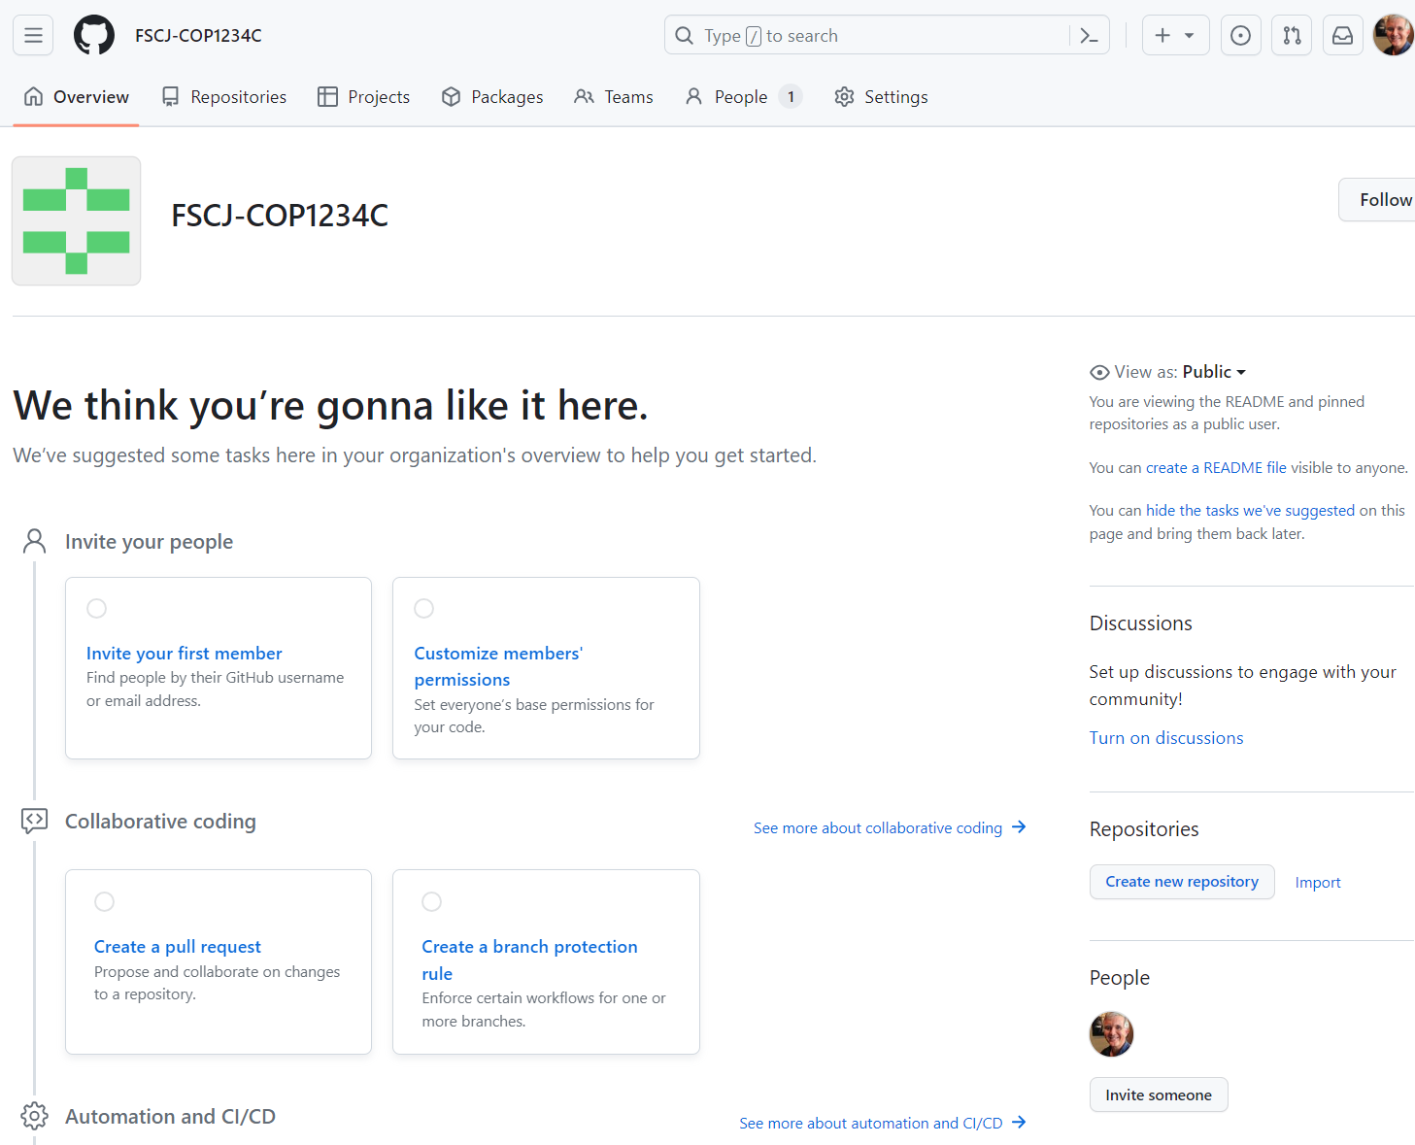
Back in GitHub: Create an Assignment Template
Working in your organization, create a new repository

Slide 14
Back in GitHub: Create an Assignment Template
Working in your organization, create a new repository

Slide 15
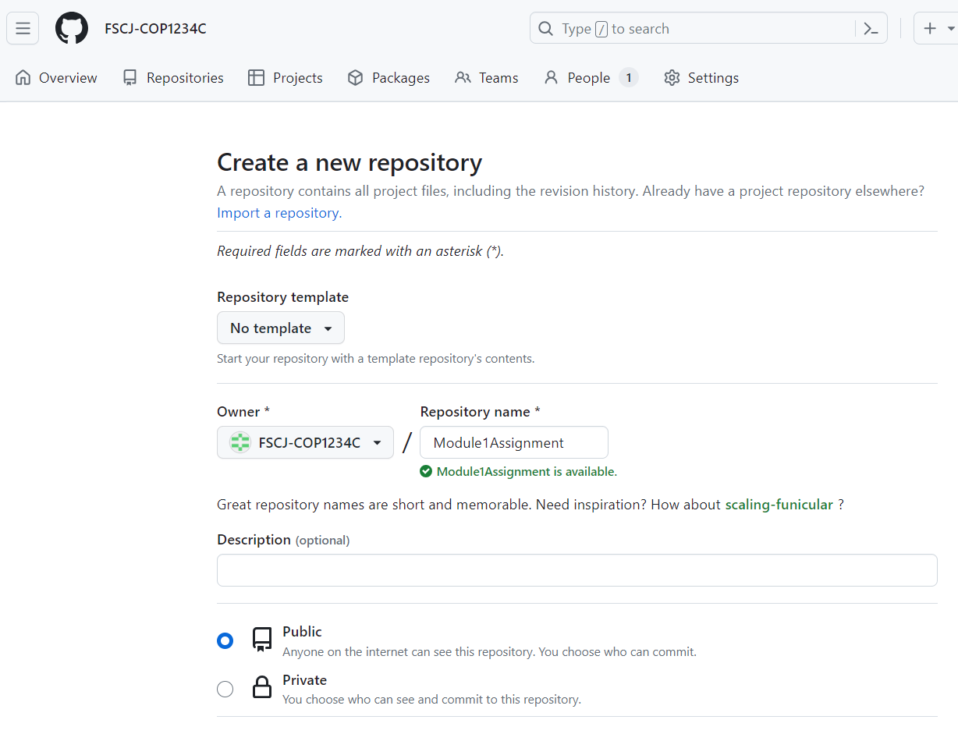
Creating Assignments
Name the repo and set it to Public

Slide 16
Creating Assignments
The repo needs to be a template:
Select the Settings tab

Slide 17
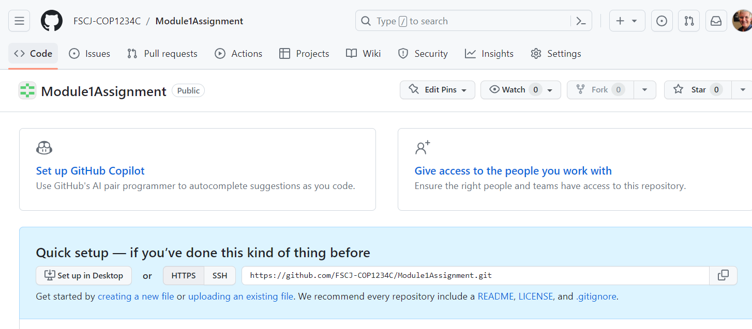
Creating Assignments
The repo needs to be a template
After creating the repo, select the Settings tab

Slide 18
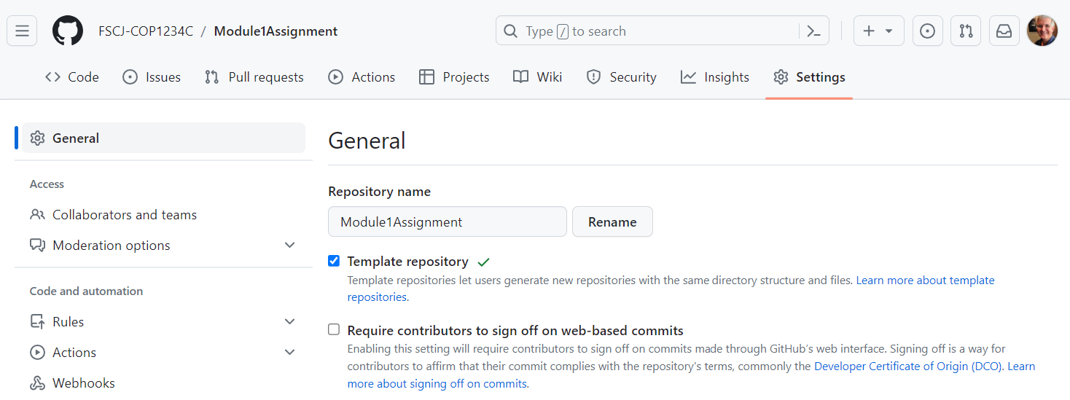
Creating Assignments
On the Settings page, check the Template repository box

Slide 19
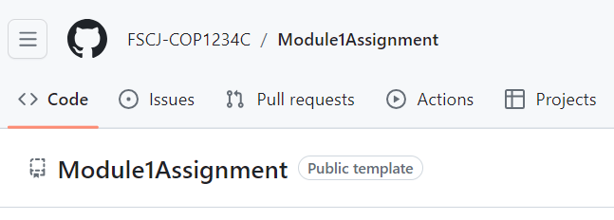
Creating Assignments
Note: there is no "OK", "Submit", or "Commit" button – just checking the Template repository box commits the setting
Return to the repo home page and refresh the browser to verify the repo is a "Public template"

Slide 20
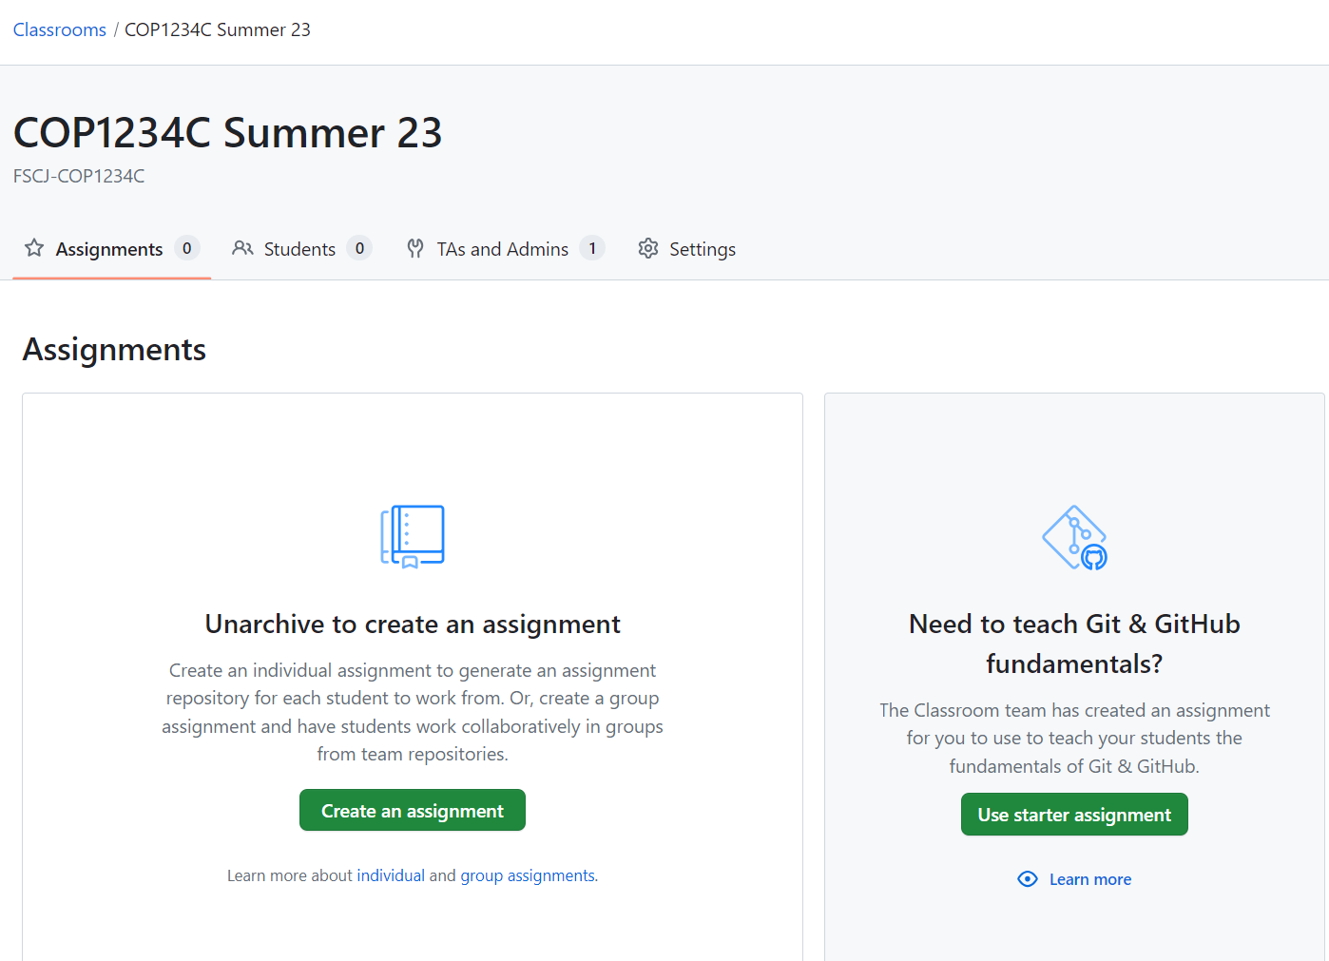
Creating Assignments
Back in GitHub Classroom, select your course and create an assignment

Slide 21
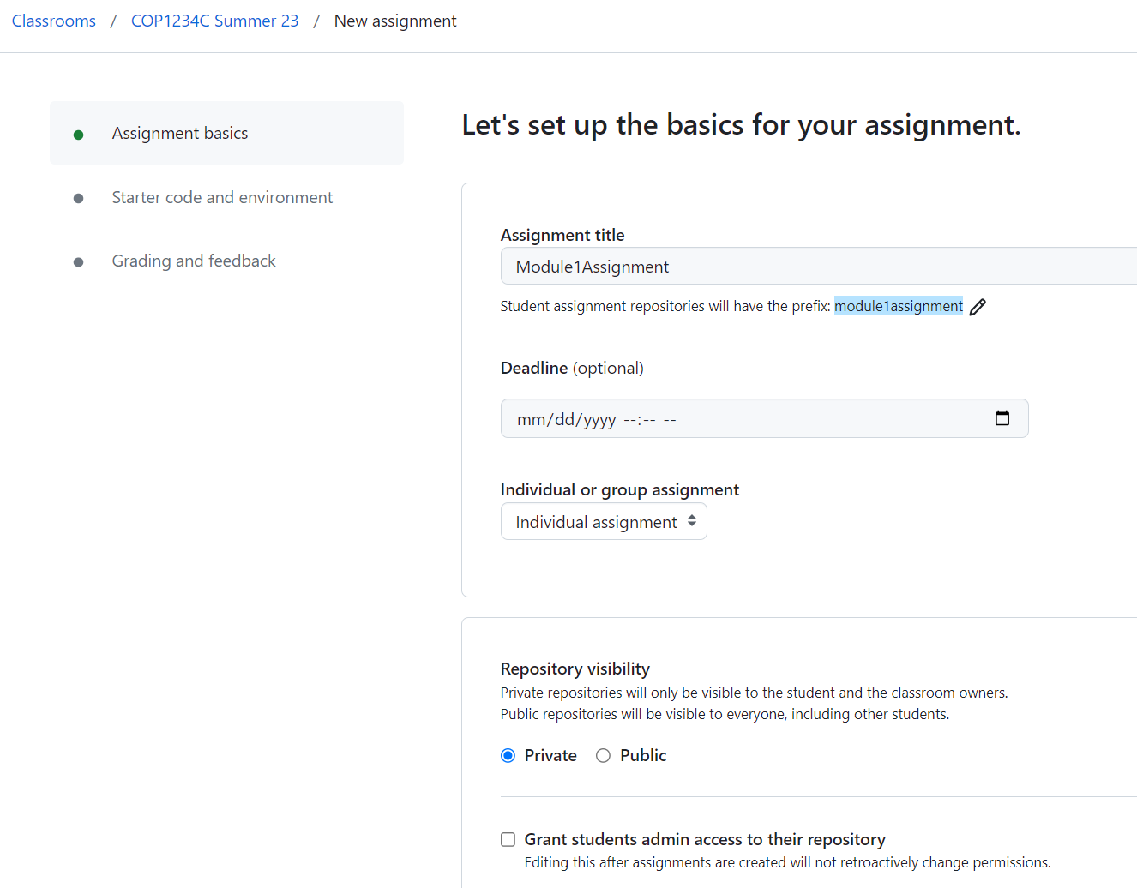
Creating Assignments
Back in GitHub Classroom, select your course and create an assignment
Can use same name as template, or not
Private visibility for repo is a good thing

Slide 22
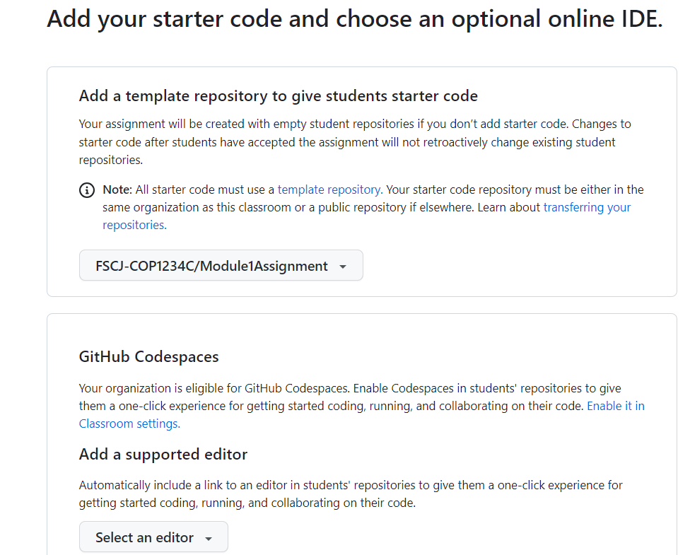
Creating Assignments
Select your GitHub template repo for the assignment starter code:

Slide 23
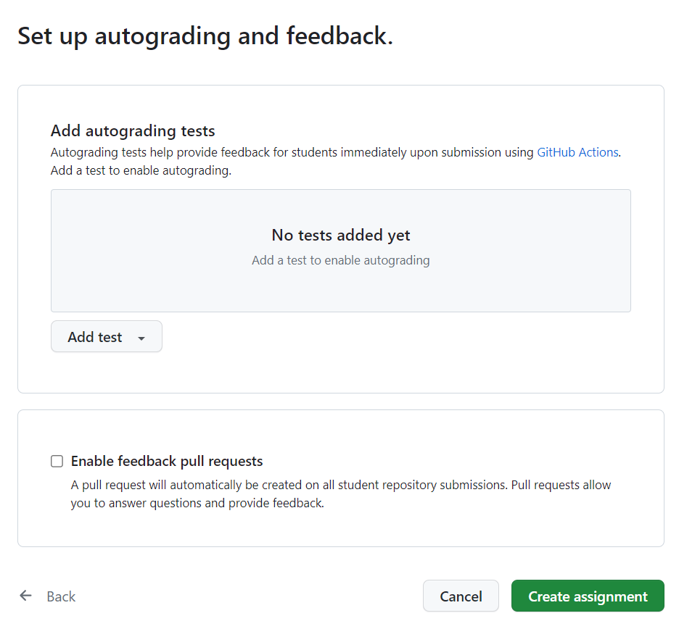
Creating Assignments
Set up a test for autograding if desired, then "Create assignment"

Slide 24
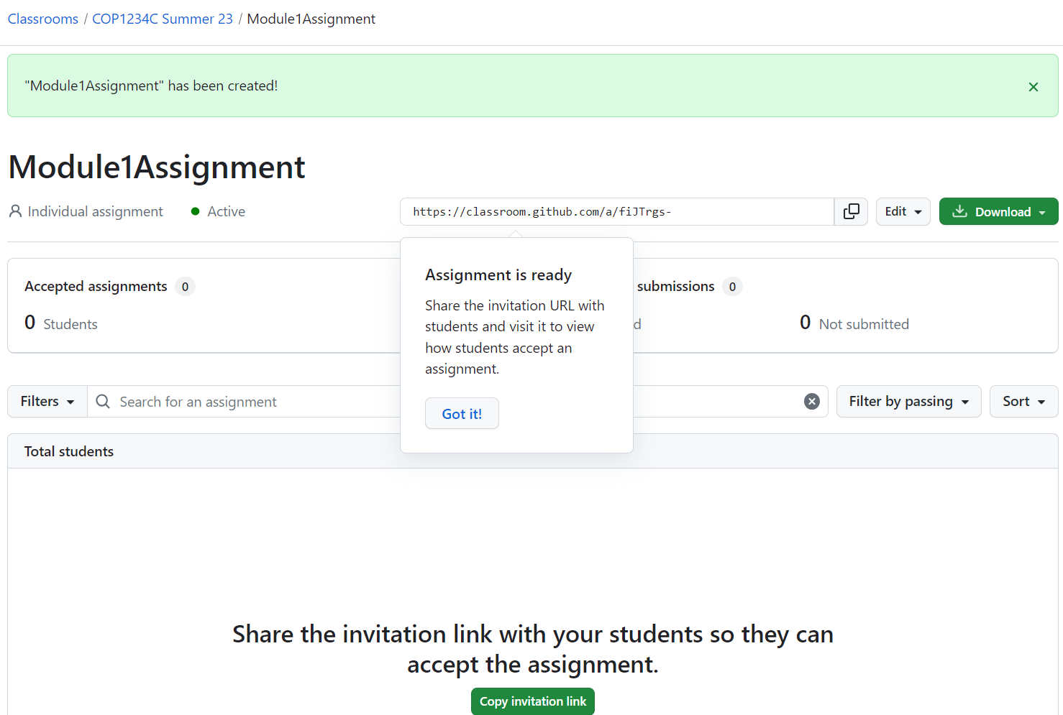
Creating Assignments
Provide the assignment invitation link to your students

Slide 25
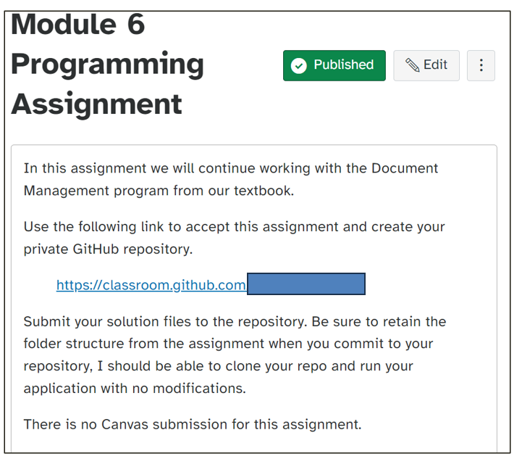
Creating Assignments
Sample assignment in Canvas:

Slide 26
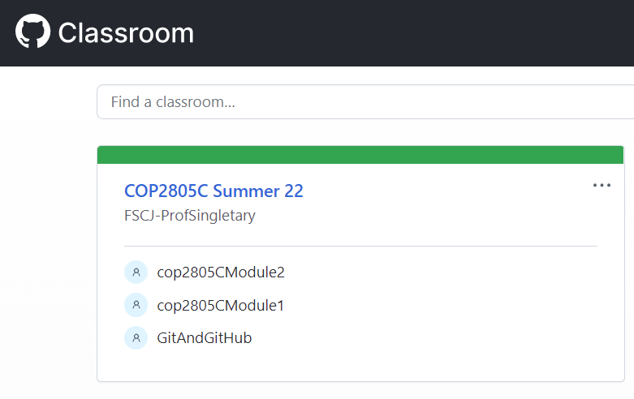
Grading Assignments
Log in to GitHub Classroom and Select the Course Assignment
https://classroom.github.com/classrooms

Slide 27
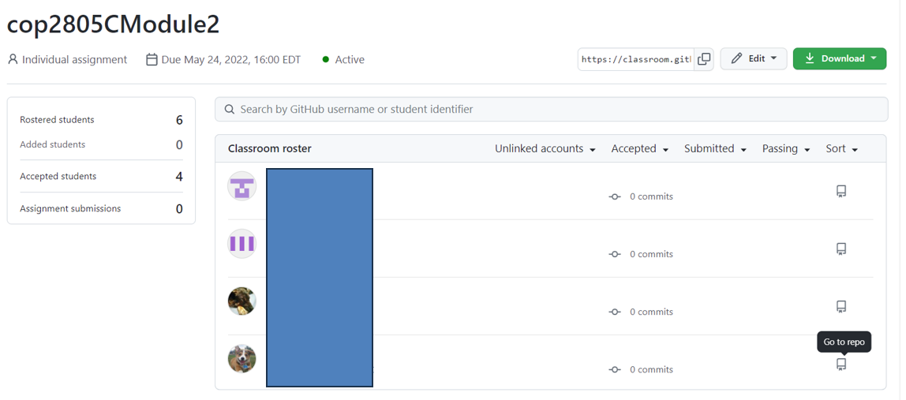
Select the "Go to repo" Icon
Grading Assignments

Slide 28
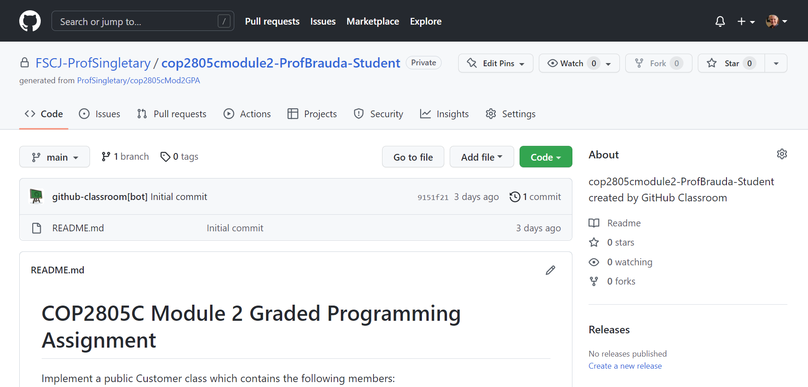
Grading Assignments
Select "Code" For Download/Access Options

Slide 29
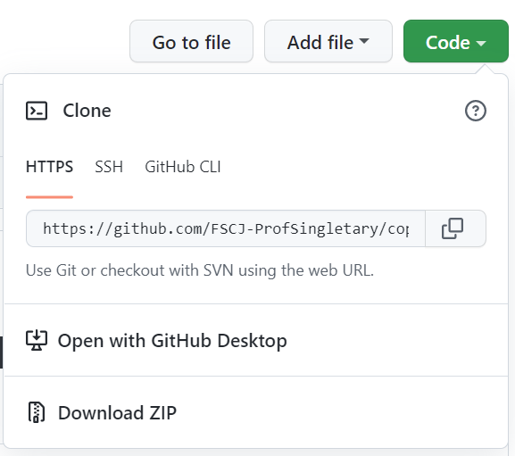
Grading Assignments
Choose Your Preferred Option
Clone the student repo
Open with GH Desktop
Download Zip

Slide 30
Or Use "Go to file" to Go Directly to Desired File
Grading Assignments

Slide 31
GitHub Workflows
A GitHub workflow is a configurable automated process that will run one or more jobs.
Workflows are defined by a YAML file checked in to your repository and will run when triggered by an event in your repository, or they can be triggered manually, or at a defined schedule.
Workflows are defined in the .github/workflows directory in a repository, and a repository can have multiple workflows, each of which can perform a different set of tasks.
You can have one workflow to build and test pull requests, another workflow to deploy your application every time a release is created, and still another workflow that adds a label every time someone opens a new issue https://docs.github.com/en/actions/using-workflows/about-workflows

Slide 32
Automated Grading using Actions and Workflows
You can use autograding to automatically check a student's work for an assignment on GitHub Classroom.
You configure tests for an assignment, and the tests run immediately every time a student pushes to an assignment repository on GitHub.com.
The student can view the test results, make changes, and push to see new results.
After a student accepts an assignment, on every push to the assignment repository, GitHub Actions runs the commands for your autograding test in a Linux environment containing the student's newest code.
GitHub Classroom creates the necessary workflows for GitHub Actions.
You can add, edit, or delete autograding tests for an existing assignment.
(All changes made via the Classroom UI will be pushed to existing student repositories, so use caution when editing tests)
https://docs.github.com/en/education/manage-coursework-with-github-classroom/teach-with-github-classroom/use-autograding

Slide 33
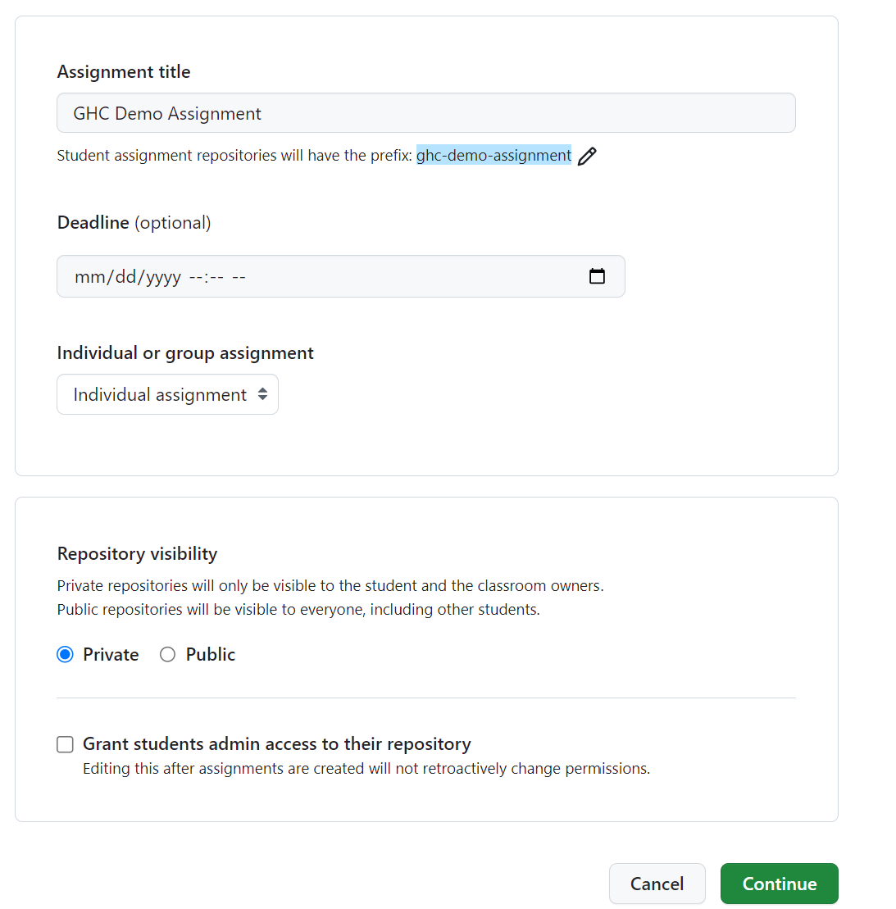
Set up the assignment as shown earlier
Automated Grading

Slide 34
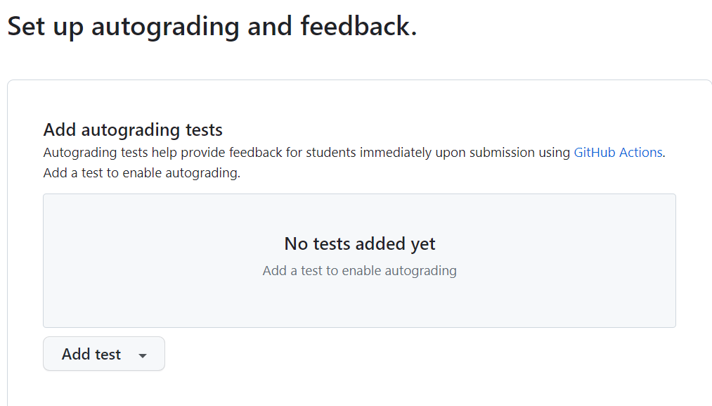
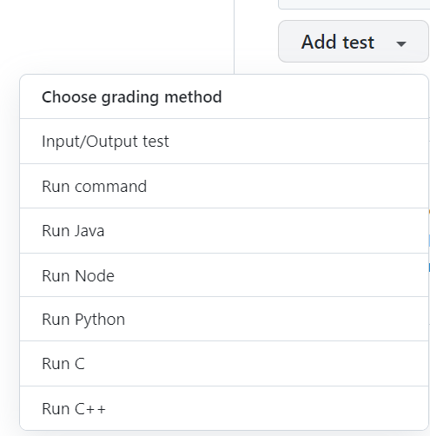
Add a test in the "Set up autograding and feedback" section, choose "Input/Output test"
Automated Grading

Slide 35
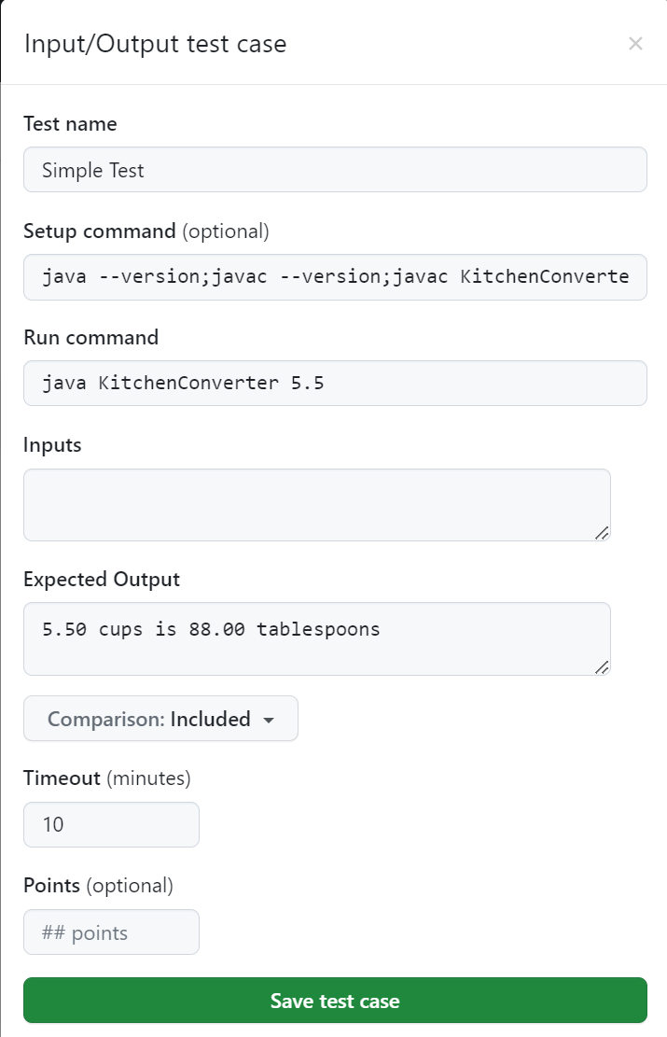
Automated Grading
I used the following parameters:
Test name: Simple Test
Setup command: javac KitchenConverter.java
(builds the students application)
Run command:
java KitchenConverter 5.5 (application requires command line input)
Expected output: 5.50 cups is 88.00 tablespoons
Timeout: 10 minutes (default)
Points (optional): not specified

Slide 36
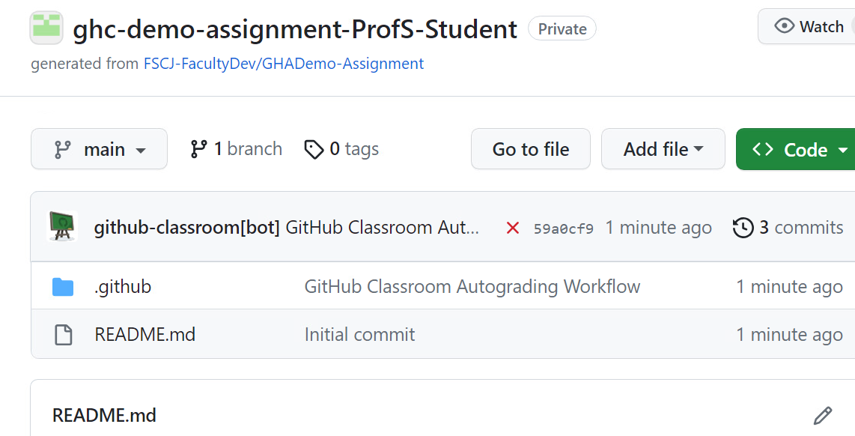
The assignment repo is created with two folders: .github/classroom and .github/workflows
Automated Grading

Slide 37
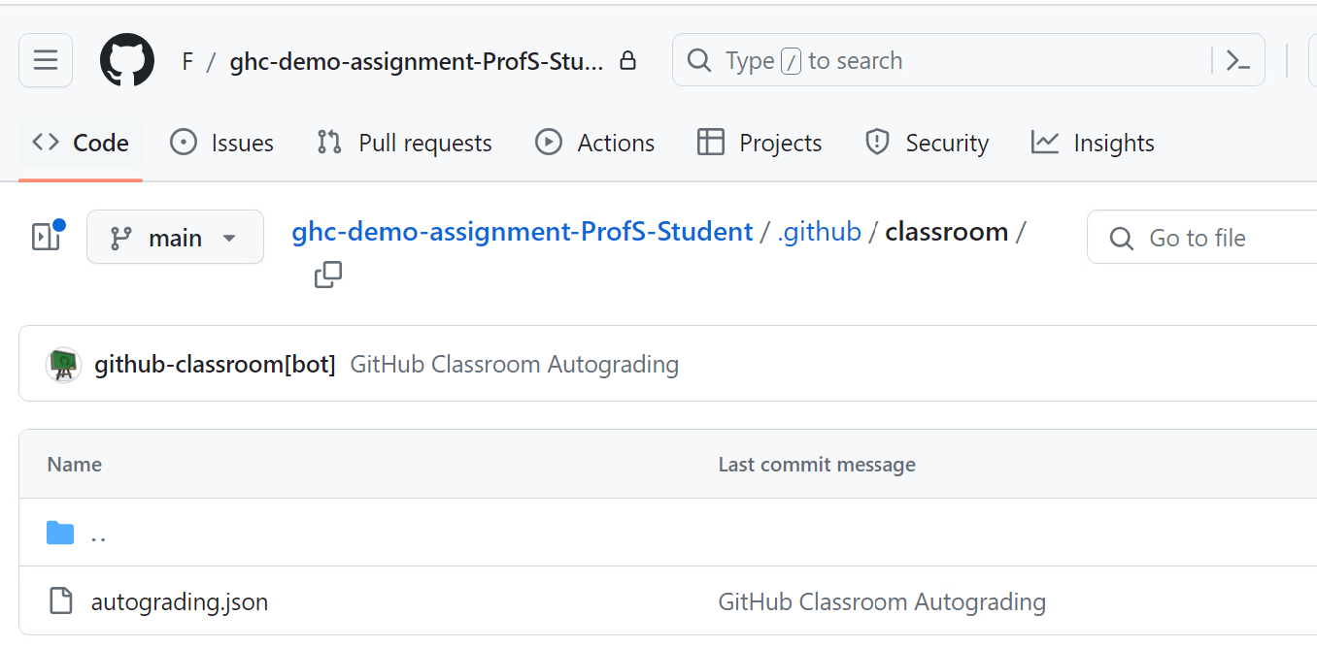
The classroom folder contains a JSON input file
Automated Grading using Workflows

Slide 38
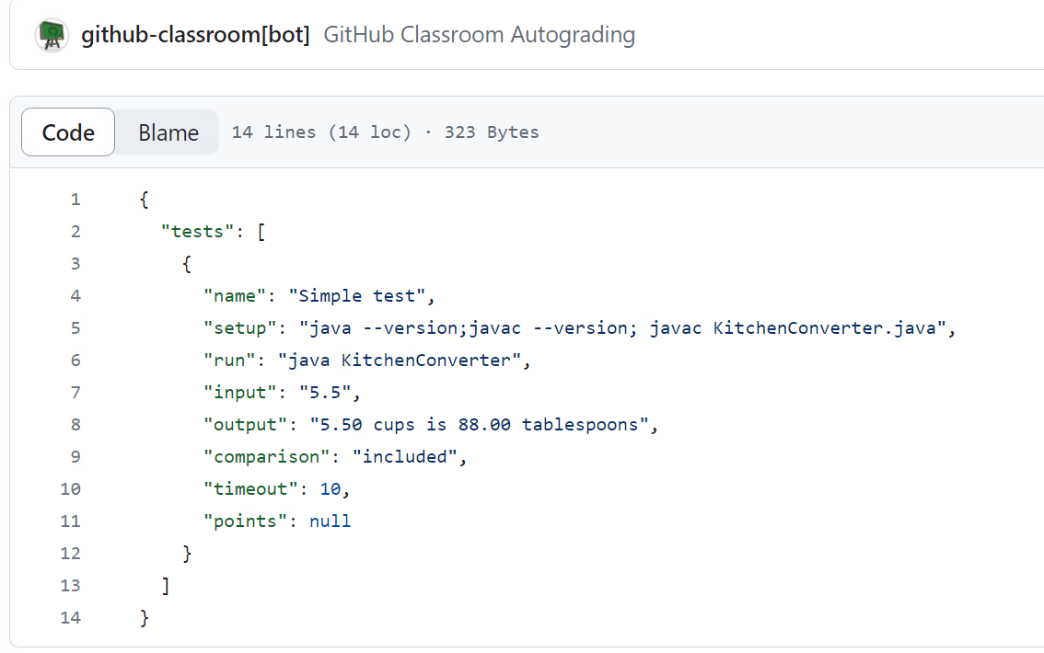
Automated Grading
JSON input file

Slide 39
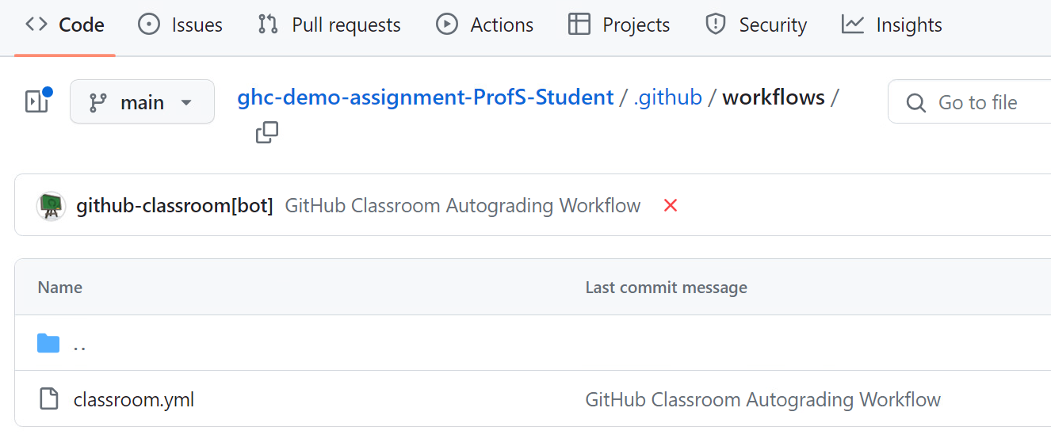
The workflows folder contains a YAML workflow file
Automated Grading

Slide 40
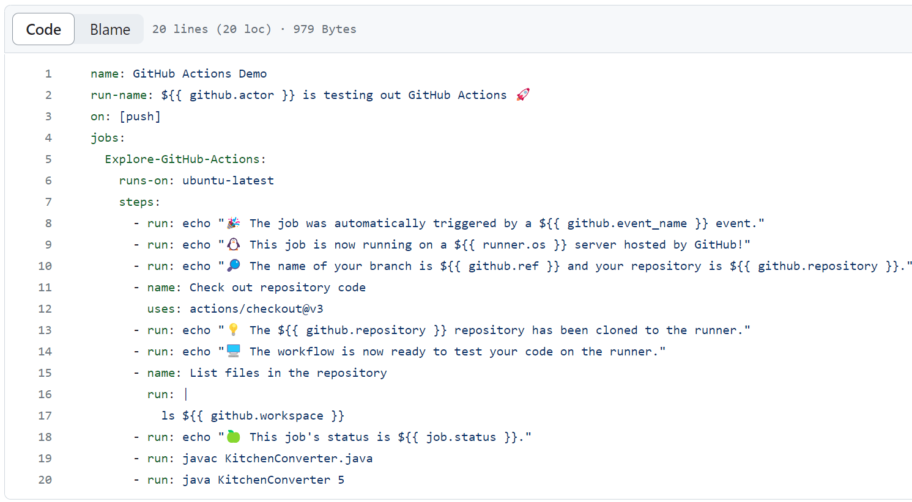
Automated Grading

Slide 41
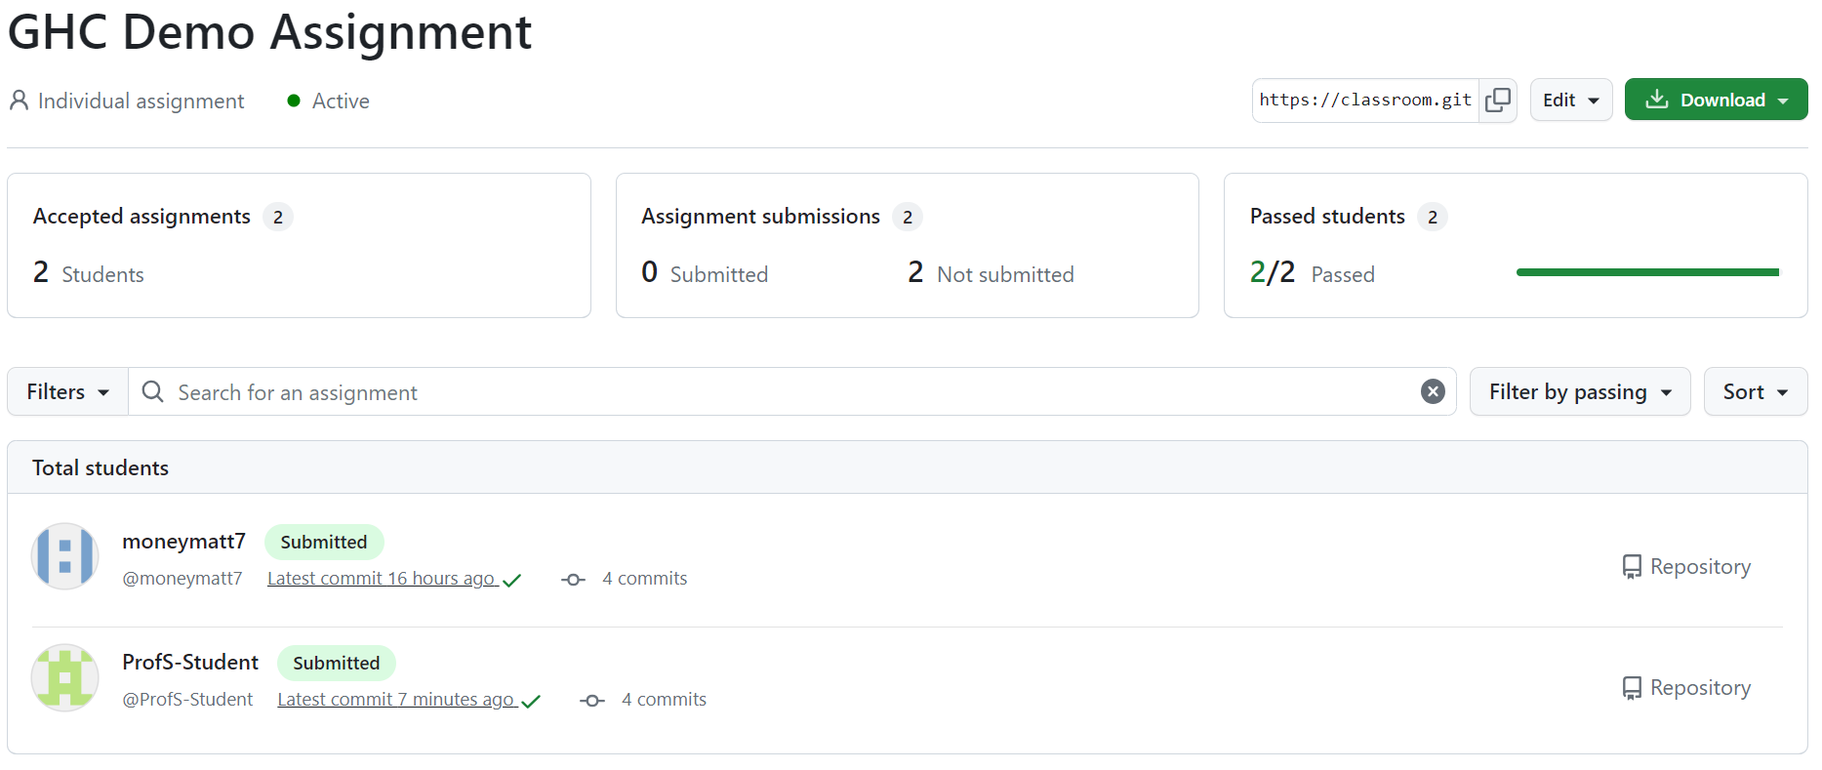
Automated Grading

Slide 42

To see test details, click on the icon.
Automated Grading

Slide 43
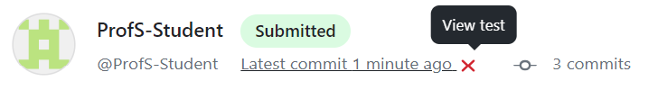
Failed tests are marked with an X, which you can click on
Automated Grading

Slide 44
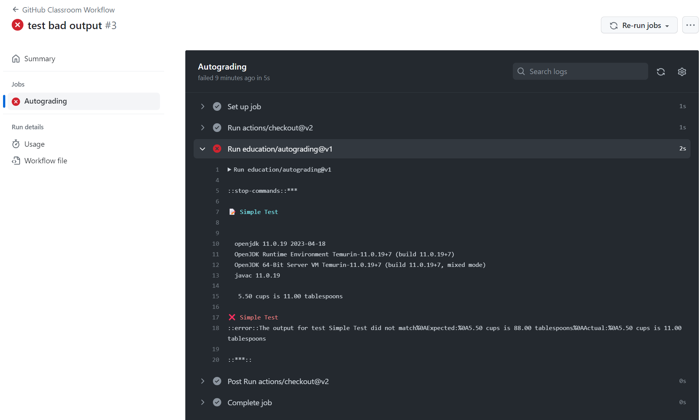
Automated Grading

Slide 45
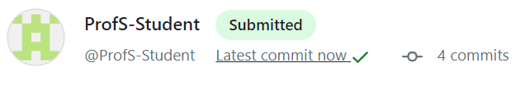
Successful tests are marked with a green checkmark, which you can also click on
Automated Grading

Slide 46
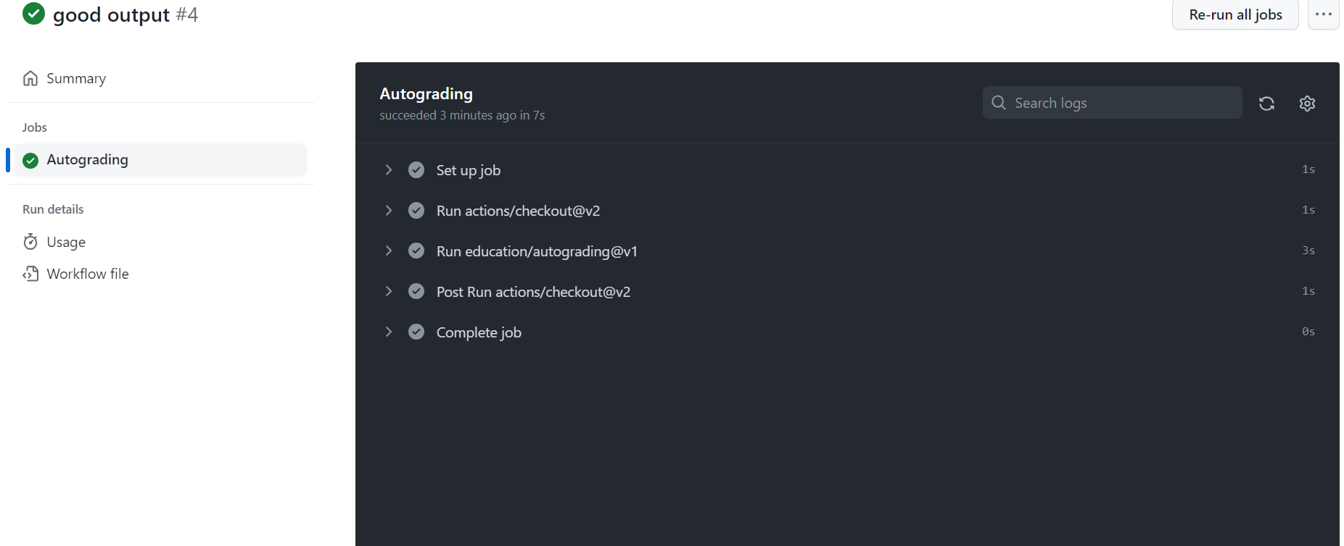
Automated Grading

Slide 47
