Slide 1
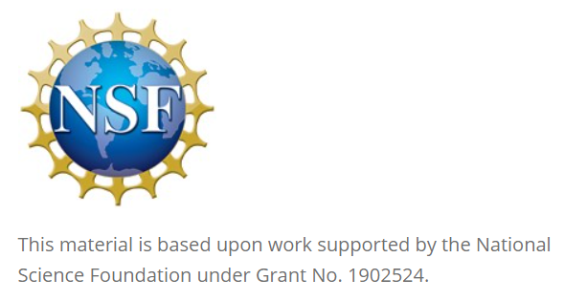
Leveraging Slack for Student Collaboration
David Singletary David.Singletary@fscj.edu
Pamela Brauda Pamela.Brauda@fscj.edu
Kathryn Arraya
Steven Gsell

Slide 2
Overview
Slack (https://slack.com/) is a widely adopted cloud-based team communication platform in industry. This session will present a case study showcasing the successful use of Slack for fostering collaboration among undergraduate students across various technology courses. It will provide insights into how Slack was integrated into course curriculum to enhance communication, project management, and teamwork among students. Attendees will learn about the setup of Slack workspaces, the creation of course-specific channels, the integration of tools, and the adoption of digital communication best practices in order to enrich the educational experience and prepare students for the collaborative demands of the tech industry.

Slide 3
