Slide 1
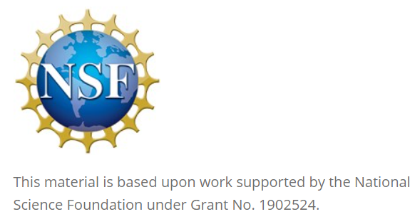
Leveraging Slack for Student Collaboration
David Singletary David.Singletary@fscj.edu
Pamela Brauda Pamela.Brauda@fscj.edu
Kathryn Arraya
Steven Gsell

Slide 2
Overview
Slack (https://slack.com/) is a widely adopted cloud-based team communication platform in industry. This session presents a case study showcasing the successful use of Slack for fostering collaboration among undergraduate students across various technology courses. It will provide insights into how Slack was integrated into course curriculum to enhance communication, project management, and teamwork among students. Attendees will learn about the setup of Slack workspaces, the creation of course-specific channels, the integration of tools, and the adoption of digital communication best practices in order to enrich the educational experience and prepare students for the collaborative demands of the tech industry.

Slide 3
Why Slack
Gartner: "Social Software in the Workplace" https://www.gartner.com/reviews/market/workplace-social-software
Positives: "Slack - Superior Messaging Platform"
Negatives: "A mix between efficient communication and interface overload"
Top Slack Alternatives
Office 365 (including SharePoint Online)
Adobe Acrobat (Document Cloud)
Google Workspace
"Non-business" alternatives
Discord
Reddit

Slide 4
Anecdotal Evidence for Popularity in Tech
Many popular developer communities, including open-source projects and tech-focused groups, use Slack for communication.
Numerous tech companies, both startups and established enterprises, adopt Slack as their primary communication tool.
Tech conferences and meetups often use Slack to facilitate communication among attendees.
Developers appreciate Slack's ability to enhance productivity through integrations, bots, and automation.
With the rise of remote work, developers frequently share positive experiences using Slack to maintain team communication and collaboration.
Platforms like Reddit, Stack Overflow, and Twitter have numerous threads and discussions where developers share their positive experiences with Slack.

Slide 5
Slack for Software Development
Integrations with development tools like GitHub, Jira, and CI/CD pipelines.
Slack's integrations streamline workflows, reducing context switching and improving efficiency.
Features like channel organization, search functionality, and customizability

Slide 6
Shared Undergraduate Workspace Advantages
Centralized Communication: consolidates communication channels for all courses, making it easier for students to stay informed about announcements, assignments, and deadlines.
Collaboration Opportunities: collaboration across courses on interdisciplinary projects, share resources, and coursework.
Networking: allows students to network with peers from various courses, potentially leading to new friendships, study groups, and professional connections.
Resource Sharing: sharing of relevant resources such as articles, tutorials, and tools across multiple courses, enriching the learning material available to everyone.
Real-Time Support: real-time support from instructors and peers, which can be particularly beneficial for addressing questions and issues promptly.
Community Building: helps build a sense of community among students and instructors, encouraging engagement and participation beyond the confines of individual courses.

Slide 7
Shared Undergraduate Workspace Advantages
Cross-Course Announcements: announcements reach all students across different courses simultaneously, ensuring important information is disseminated quickly and efficiently.
Facilitating Mentorship: senior students or those who have taken certain courses can mentor juniors, providing guidance and sharing their experiences, which can be very beneficial for newcomers.
Integrated Tools and Apps: integrations with various tools (e.g., GitHub, Trello, Google Drive) can streamline project management and collaborative tasks across courses, enhancing productivity and learning.
Enhanced Learning Experience: informal communication style can make students feel more comfortable asking questions and participating in discussions, leading to a more engaging and interactive learning experience.
Feedback and Improvement: Instructors gather feedback from students about the courses in real-time, allowing for continuous improvement based on student input.
Event Coordination: Organizing events, such as hackathons, guest lectures, or study sessions, becomes easier.

Slide 8
