Slide 1

Leveraging Slack for Student Collaboration
David Singletary David.Singletary@fscj.edu
Pamela Brauda Pamela.Brauda@fscj.edu
Student Presenters:
Kathryn Araya (A.S. Data Science Technology)
Steven Gsell (B.A.S. Information Systems Technology, Application Development Concentration)

Slide 2
Overview
Slack (https://slack.com/) is a widely adopted cloud-based team communication platform in industry. This session presents a case study showcasing the successful use of Slack for fostering collaboration among undergraduate students across various technology courses. It will provide insights into how Slack was integrated into course curriculum to enhance communication, project management, and teamwork among students. Attendees will learn about the setup of Slack workspaces, the creation of course-specific channels, the integration of tools, and the adoption of digital communication best practices in order to enrich the educational experience and prepare students for the collaborative demands of the tech industry.

Slide 3
Why Slack
Gartner: "Social Software in the Workplace" https://www.gartner.com/reviews/market/workplace-social-software
Positives: "Slack - Superior Messaging Platform"
Negatives: "A mix between efficient communication and interface overload"
Top Slack Alternatives
Office 365 (Microsoft Teams, SharePoint)
Adobe Acrobat (Document Cloud)
Google Workspace
WebEx
"Non-business" alternatives
Discord
Reddit

Slide 4
Anecdotal Evidence for Popularity in Tech
Many popular developer communities, including open-source projects and tech-focused groups, use Slack for communication.
Numerous tech companies, both startups and established enterprises, adopt Slack as their primary communication tool.
Tech conferences and meetups often use Slack to facilitate communication among attendees.
Developers appreciate Slack's ability to enhance productivity through integrations, bots, and automation.
With the rise of remote work, developers frequently share positive experiences using Slack to maintain team communication and collaboration.
Platforms like Reddit, Stack Overflow, and Twitter have numerous threads and discussions where developers share their positive experiences with Slack.

Slide 5
Slack for Software Development
Integrations with development tools like GitHub, Jira, and CI/CD pipelines.
Slack's integrations streamline workflows, reducing context switching and improving efficiency.
Features like channel organization, search functionality, and customizability
Real-time collaboration (huddles)

Slide 6
Shared Undergraduate Workspace
Centralized communication: consolidates communication channels for all courses, making it easier for students to stay informed about announcements, assignments, and deadlines.
Collaboration opportunities: collaboration across courses on interdisciplinary projects, share resources, and coursework.
Networking: allows students to network with peers from various courses, potentially leading to new friendships, study groups, and professional connections.
Resource sharing: sharing of relevant resources such as articles, tutorials, and tools across multiple courses, enriching the learning material available to everyone.
Real-Time support: real-time support from instructors and peers, which can be particularly beneficial for addressing questions and issues promptly.
Community building: helps build a sense of community among students and instructors, encouraging engagement and participation beyond the confines of individual courses.

Slide 7
Shared Undergraduate Workspace
Cross-course announcements: announcements reach all students across different courses simultaneously, ensuring important information is disseminated quickly and efficiently.
Facilitating mentorship: senior students or those who have taken certain courses can mentor juniors, providing guidance and sharing their experiences, which can be very beneficial for newcomers.
Integrated tools and apps: integrations (e.g., GitHub, Trello, Google Drive) can streamline project management and collaborative tasks across courses, enhancing productivity and learning.
Enhanced learning experience: informal communication style can make students feel more comfortable asking questions and participating in discussions, leading to a more engaging and interactive learning experience.
Feedback and improvement: feedback from students about the courses in real-time, allowing for continuous improvement based on student input.
Event coordination: organize events, such as hackathons, guest lectures, or study sessions, becomes easier.

Slide 8
Organizing the Workspace
Dedicated workspaces for individual courses ("v1")
Shared workspace per semester ("v2"), one channel per course e.g.,
Summer 2024
# general - all students are members; shared general content
# random - all students are members; "fun" content (memes)
# COP2800C - course-specific channel, restricted membership
# CEN3330C - course-specific channel, restricted membership
# CEN4025C - course-specific channel, restricted membership
...
NOTE: some lower-level courses are excluded from shared workspaces to avoid distractions for first-time college students

Slide 9
Administering the Workspace
Instructors are workspace creators w/full admin rights
Can delete posts if necessary
Syllabus (Technology Requirements):
Slack
We will collaborate using Slack, an industry-standard collaboration tool. Slack is free (disregard their prompting to upgrade to the paid version, we do not use it). Instructions for joining the Slack workspace and course channel will be provided in Canvas. Slack runs on Windows and Mac (https://slack.com/downloads)

Slide 10
Administering the Workspace
Canvas Announcement
Slack Workspace Invitation
Here is the invite link for our Slack workspace:
https://join.slack.com/t/summer24-workspace/shared_invite/...
You can download Slack for Windows here: https://slack.com/downloads/windows You can download Slack for Mac here: https://slack.com/downloads/mac There is also a Slack app for iOS and Android devices.
If you haven't used Slack before, each workspace contains channels for discussion topics.
The workspace has a dedicated channel for this course: #cop3330c
We also have a #general channel for general IT questions and discussions. This channel is shared among many other courses that are running this semester.
The #random channel is for fun stuff: technology memes, personal/job announcements, etc. that you would like to share with the class.
All Slack posts must remain family-friendly. Be respectful. Do not DM without consent from the recipient. Do not share code solutions for course assignments before the due date, but feel free to share ideas, hints, and algorithms.

Slide 11
Student Experience (Kate Araya)
Survey Questions
We conducted a survey with a total of eight questions to understand students’ experiences with Slack. The primary focus was on identifying the specific benefits students feel Slack provides. Here are two key questions from the survey:
How has your educational experience benefitted from using Slack?
Do you feel Slack could continue to be beneficial to you after graduation, perhaps in a professional setting?

Slide 13
More than half of the respondents found Slack beneficial across various value data points.
Notably, the lowest added benefit identified was “Assistance with Assignments,” is subjective and could be interesting to explore further through a query comparing “Ask” versus “Response.” Regarding Collaboration, it might be valuable to conduct a more focused query to assess a student’s Slack presence, comfort in asking for help, and comfort in responding.

Slide 14
Focusing on soft skills, our survey revealed that three out of ten students did not perceive soft skills as an added benefit of using Slack.
This is an intriguing response, as many students without professional work experience may not fully understand the term “soft skills” or recognize their importance for career growth.
By adhering to social and school constructs and codes of conduct, students are practicing these skills daily.
As we progress in our careers, often without direct communication, hiring managers are increasingly focusing on the soft skills of potential candidates, which could significantly impact their employability.

Slide 15
This brings us to why Slack can be essential for students.
Team-building and collaboration, practicing professionalism, properly asking technical questions, or overcoming obstacles and seeking guidance are all skills that will be valuable in our careers post-graduation.
While we and many professionals in our field may be geographically dispersed, gaining a sense of community through collaboration on various projects helps mitigate the sense of isolation often experienced by technology professionals.
With a tool like Slack in education, we can develop more experienced students with better communication and productivity skills, leading to improved data and technology outcomes.

Slide 16
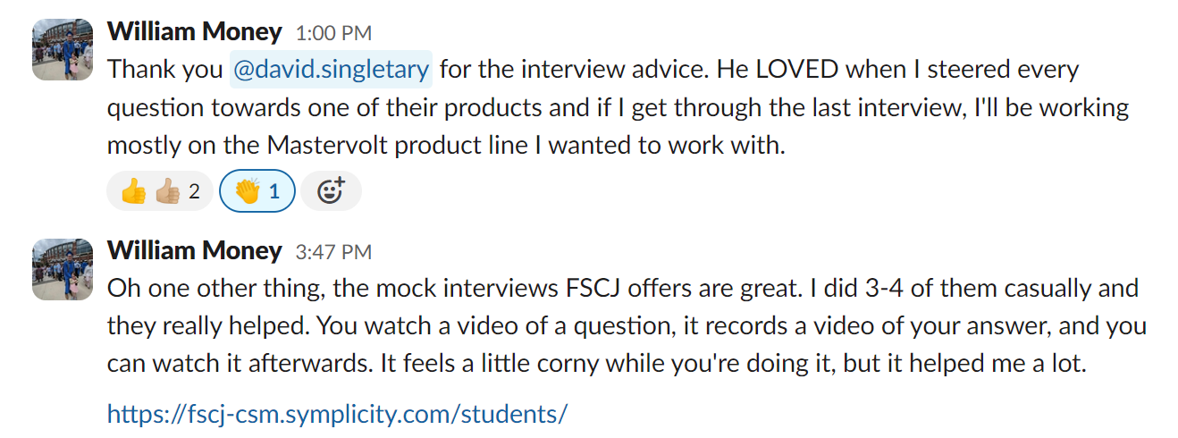
Instructor Perspective
Students get to share great advice and endorsements across classes

Slide 17
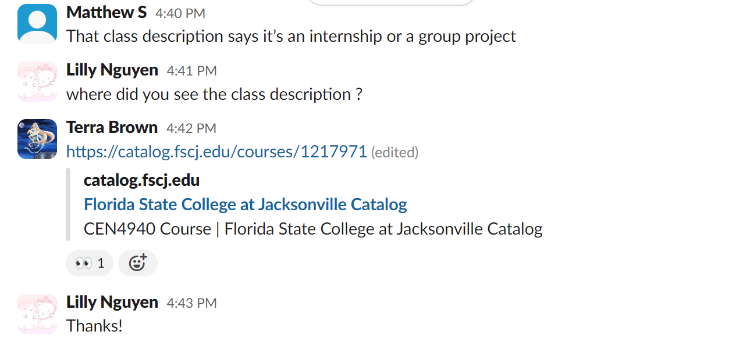
Instructor Perspective
Students give and get information about school from each other

Slide 18
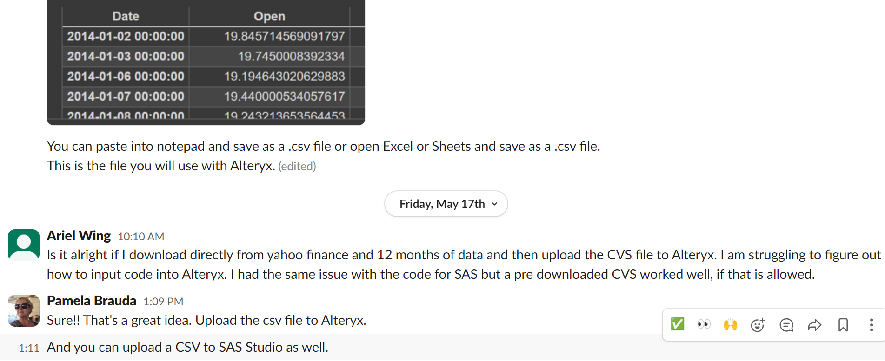
Instructor Perspective
Students who join a class channel can see feedback and assistance for other student's questions – screenshots are easy to paste.

Slide 19
Instructor Perspective
Slack is easier to use on a mobile phone or tablet
Lower authentication thresholds
Easier to add attachments, photos, screenshots
Lightweight feeling compared with traditional email, less formal
Students see how professionals communicate in a work setting
It feels good to get feedback from others, even if it's just a ☺ or 

Slide 20
Instructor Perspective
Students encourage and support each other during difficult times

Slide 21
Student Experience (Steven Gsell)
Yes, it sounds just like the animal!
Current FSCJ student pursuing B.A.S in Computer Information Systems
Focus on software development
Been using Slack in multiple classes throughout education at FSCJ
Observed how Slack can add cohesion of communication in groups

Slide 22
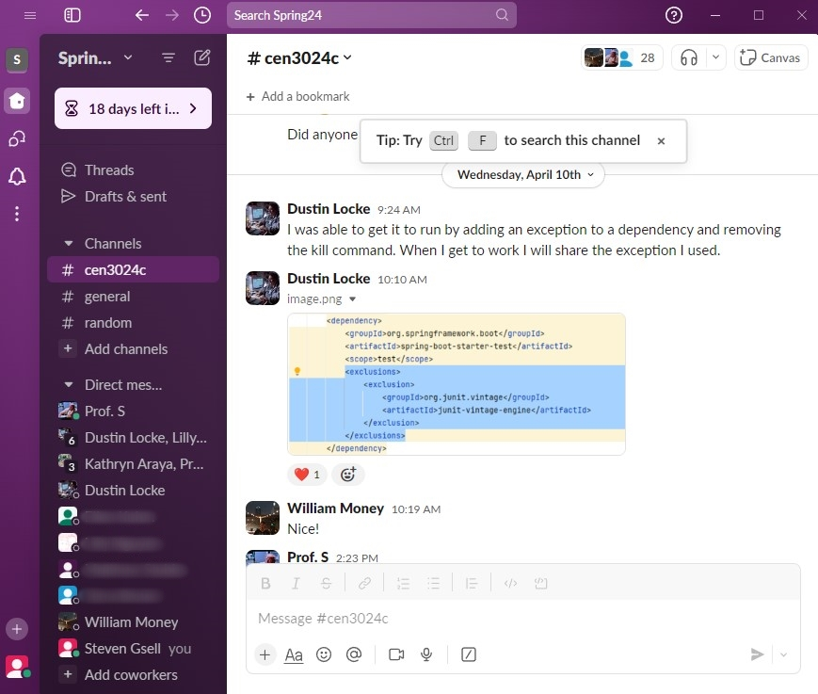
Allows for Group Problem Solving
Software projects in a class setting can be chaotic without clear communication
We are all learning and perhaps working with several new technologies for the first time. We are also learning HOW to learn in a fast-paced tech environment.
When our groups run into problems, Slack allows us to pinpoint the problem as a group and see the clear solution when someone finds it!
Notes:
Software projects in a class setting can be chaotic without clear communication
We are all learning and perhaps working with several new technologies for the first time. We are also learning HOW to learn in a fast-paced tech environment.
When our groups run into problems, Slack allows us to pinpoint the problem as a group and see the clear solution when someone finds it!
(Dustin was able to pinpoint a problem with our Spring-Boot API and share what he found with our group. It was part of a dependency that we could manually exclude.)

Slide 23
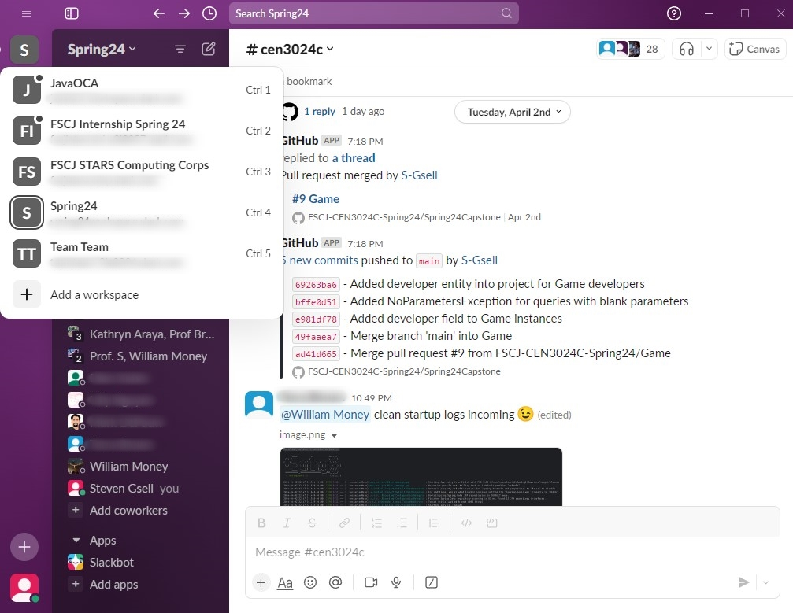
Allows Organized Group Separation
Juggling different groups can quickly become a chore without the proper tools.
Slack allows you to have multiple workspaces at once, with a user-friendly UI to jump between all your groups.
Having clearly defined workspaces allows for easy transitioning from one group to another.
Notes:
Juggling different groups can quickly become a chore without the proper tools.
Slack allows you to have multiple workspaces at once, with a user-friendly UI to jump between all your groups.
Having clearly defined workspaces allows for easy transitioning from one group to another.
(At FSCJ it can get to be a little much if you are taking multiple IT classes at the same time. Slack allows a handy workspace system to jump between your groups of peers.)

Slide 24
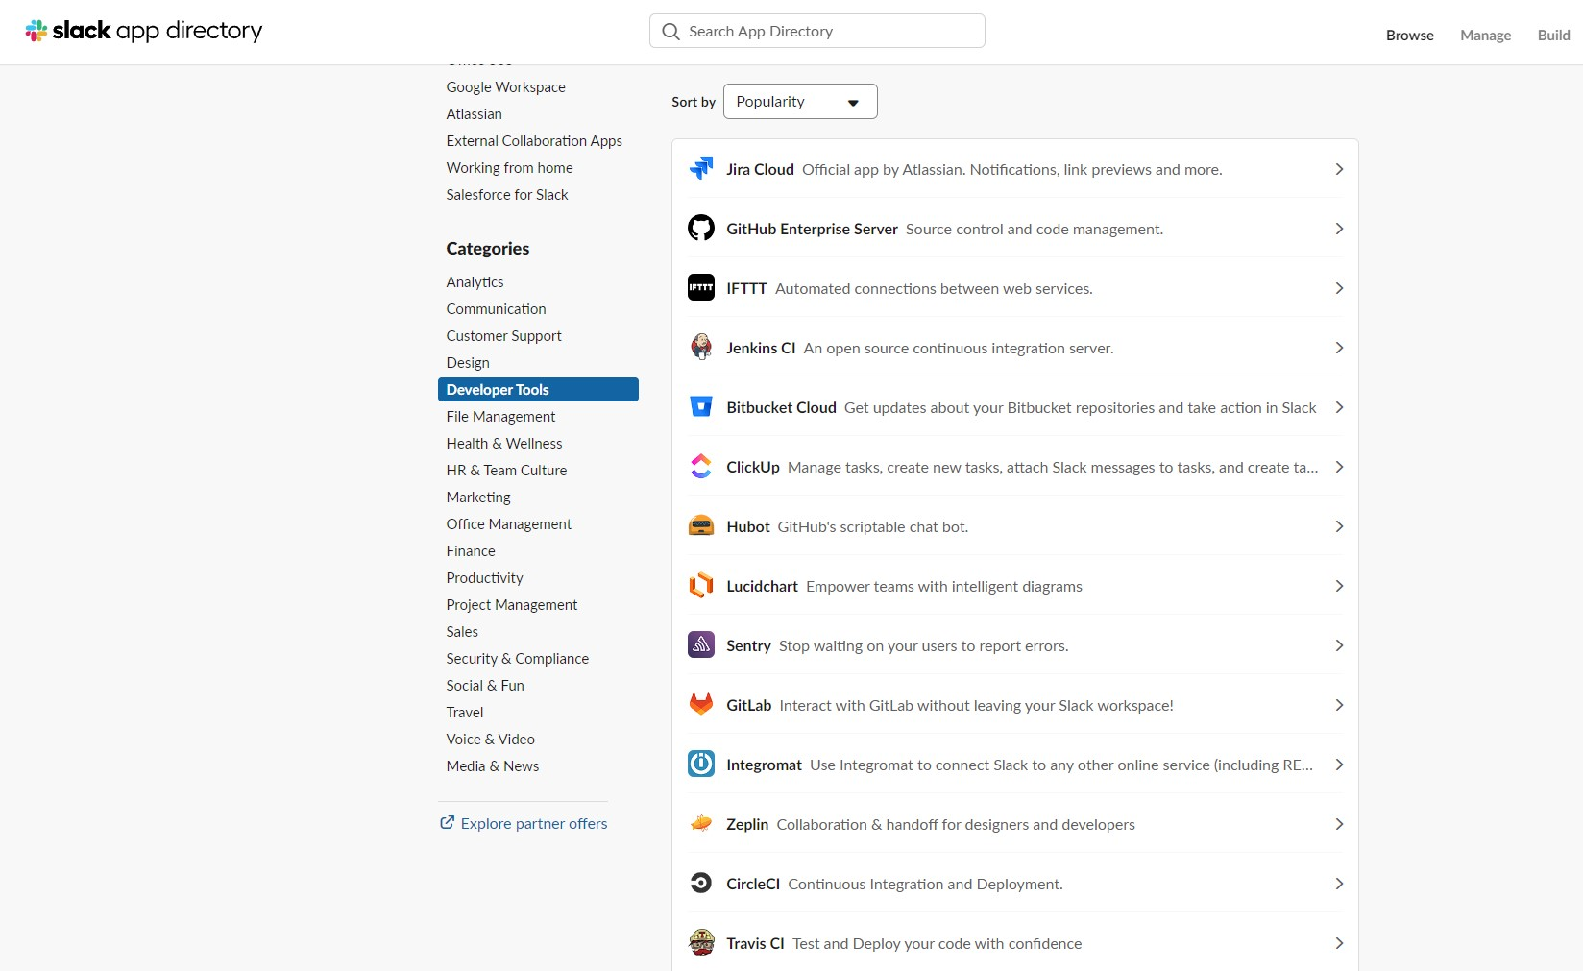
Allows Communication Customization
One of the most noticeable things about Slack is the customization that is possible through their add-on apps!
There are thousands of useful apps that can be added to a Slack workspace that supports the task your group is trying to accomplish.
This customization allows for adaptation to different technologies and for an ever-changing Agile environment.
https://slack.com/apps
Notes:
One of the most noticeable things about Slack is the customization that is possible through their add-on apps!
There are thousands of useful apps that can be added to a Slack workspace that supports the task your group is trying to accomplish.
This customization allows for adaptation to different technologies and for an ever-changing Agile environment.

Slide 25
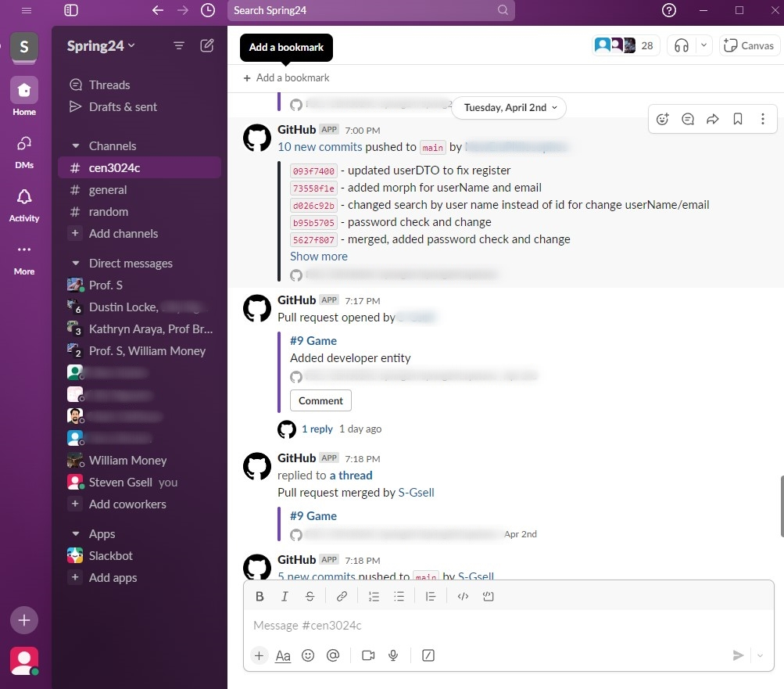
Allows Repository Transparency
Some of our groups have utilized the GitHub plugin for Slack. This allows the group to be up to date with every update and change happening.
This allows cohesion of progress updates when the group reconvenes to discuss the next steps!
No matter what you are teaching, there will almost certainly be an add-on that can help your group setting.
Notes:
How often have you gone to push your code only to see that you need to pull the new updated first?
Some of our groups have utilized the GitHub plugin for Slack. This allows the group to be up to date with every update and change happening.
This allows cohesion of progress updates when the group reconvenes to discuss the next steps!

Slide 26
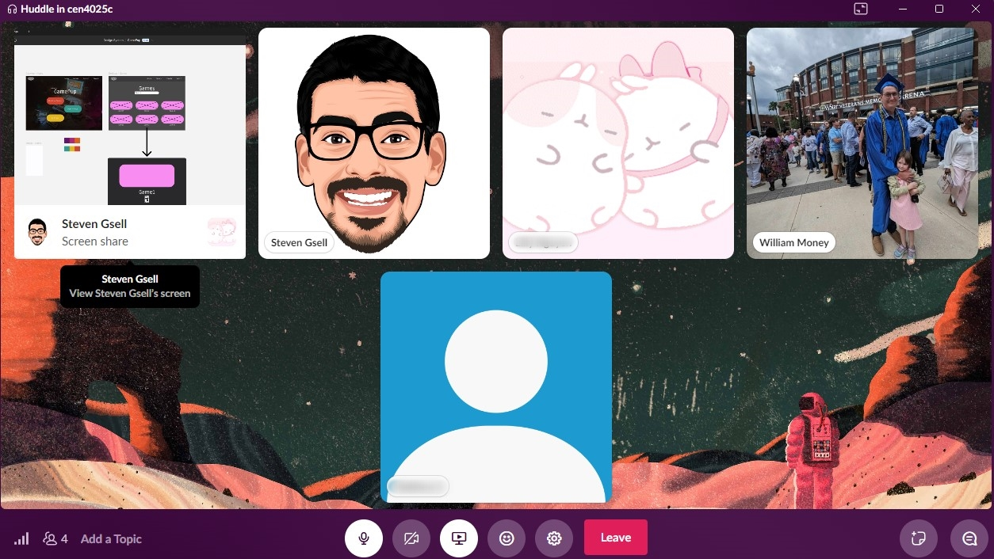
Enhances Cohesive File & Screen Sharing
By utilizing the Slack Huddle feature our groups are able to have a live collaboration on demand.
If there is any confusion to the project at hand there can be clarification in the matter of seconds!
The cliché goes that a picture speaks a thousands words. So 30fps screen sharing should speak about 30,000 words per second. (pause for cheesy joke laughter)
Notes:
By utilizing the Slack Huddle feature our groups are able to have a live collaboration on demand.
If there is any confusion to the project at hand there can be clarification in the matter of seconds!
The cliché goes that a picture speaks a thousands words. So 30fps screen sharing should speak about 30,000 words per second. (pause for laughter)

Slide 27
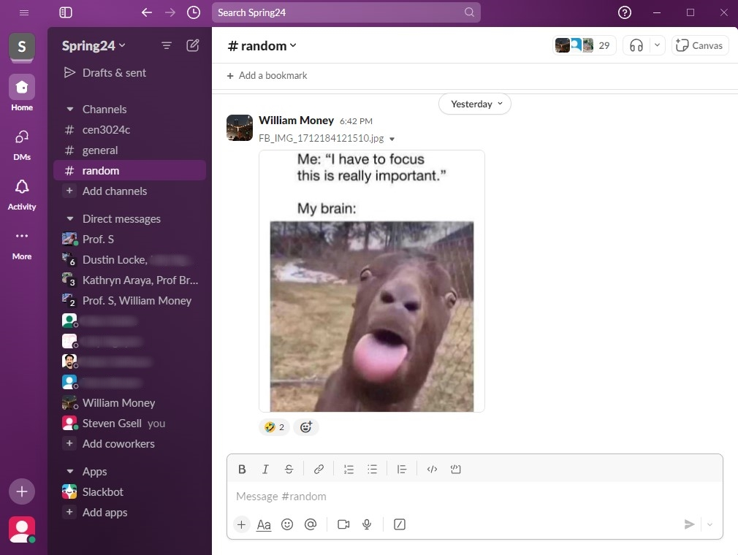
Supports community and friendship
Sometimes our computer notifications can cause a bit of a stressful spike in our bodies when we hear that jingle or notification noise.
In a healthy group setting, those notifications can perk you up and bring motivation to your work-flow!
Efficiency is always important, especially in the tech world. However, we find our group is most efficient when we are all laughing with each other.
Notes:
Sometimes our computer notifications can cause a bit of a stressful spike in our bodies when we hear that jingle or notification noise. (pop pop pop brush brush brush)
In a healthy group setting, those notifications can perk you up and bring motivation to your work-flow!
Efficiency is always important, especially in the tech world. However, we find our group is most efficient when we are all laughing with each other.

Slide 28


