Slide 1

Excel
Course Overview
FinTech

Slide 2
CGS2512C Spreadsheet Concepts
This course is designed for individuals who wish to master and use spreadsheet software. The course is directed toward novices, first-time owners of personal or business computers, and individuals who would like to learn more about spreadsheet software and operations. Covered in the course are the history and terminology of spreadsheet software, spreadsheet design and construction, and uses of spreadsheet to solve financial problems. Also covered are spreadsheet graphics, spreadsheet database, and spreadsheet automation with macros. The course requires use of computers.

Slide 3
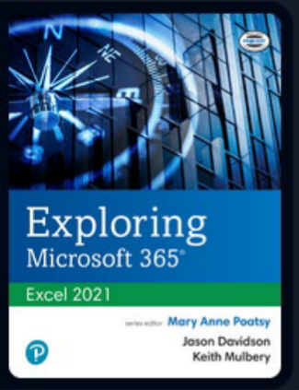
CGS2512C – Spreadsheet Concepts Textbook

Slide 4
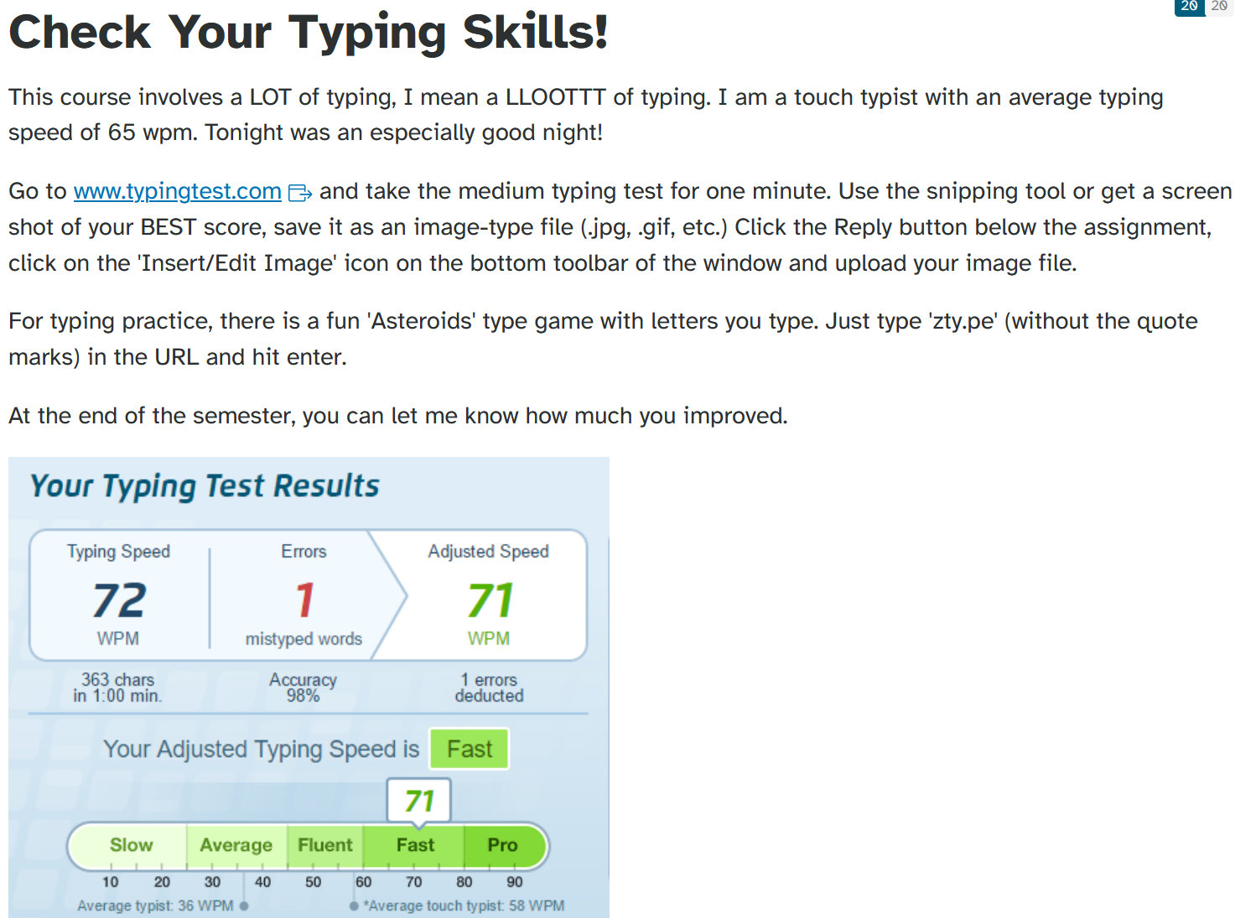
Typing Test
www.typingtest.com

Slide 5
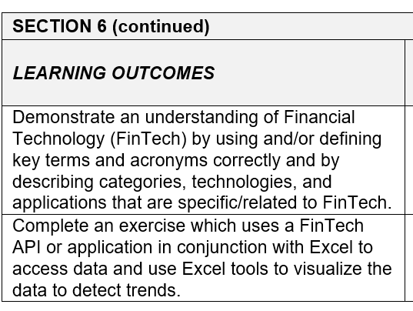
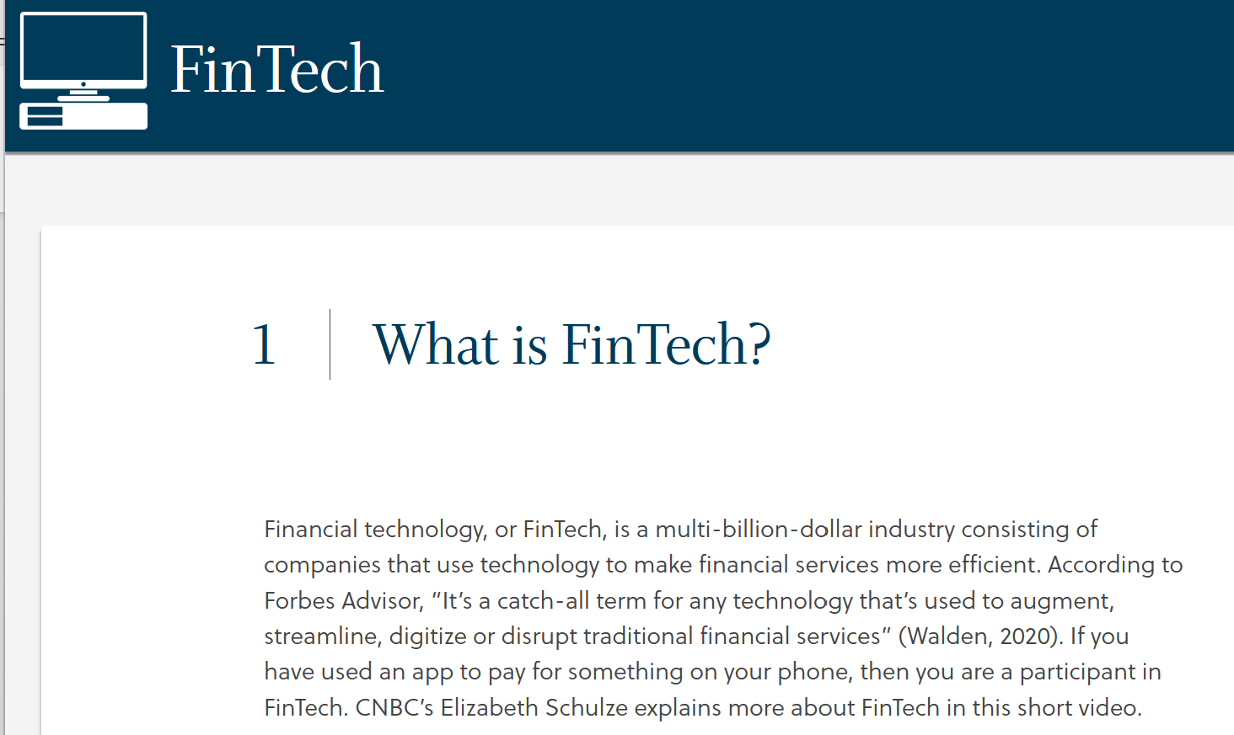
FinTech
Learning outcomes added for FinTech grant
FinTech Learning Unit created by FSCJ Center for Elearning
https://cel.fscj.edu/LOR/cgs/1100c/1/

Slide 6
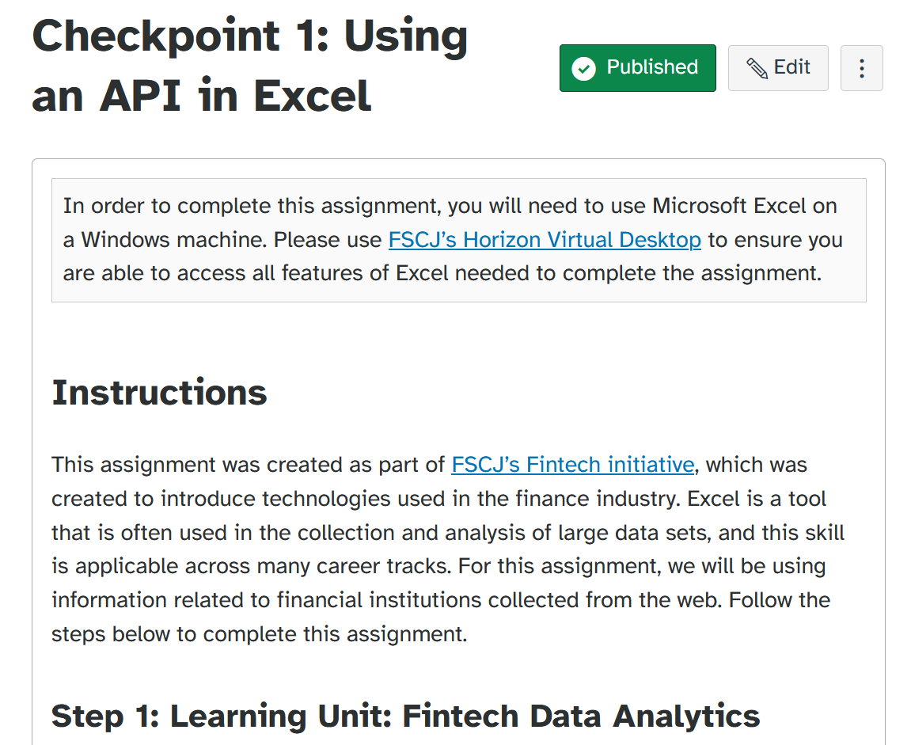
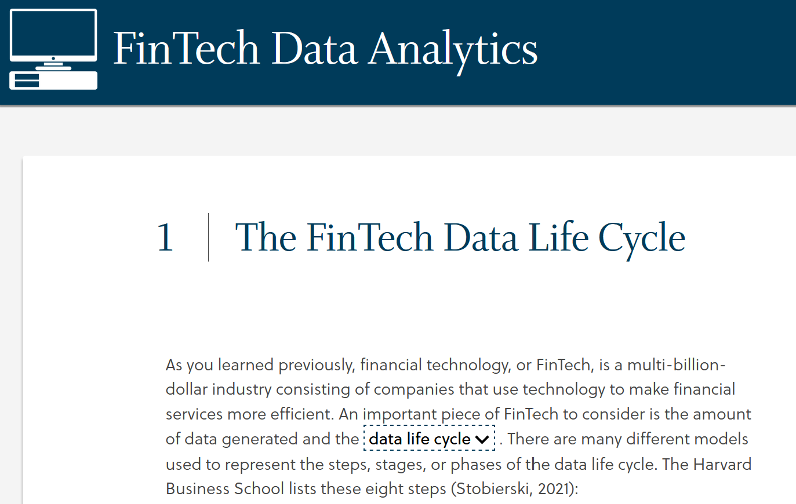
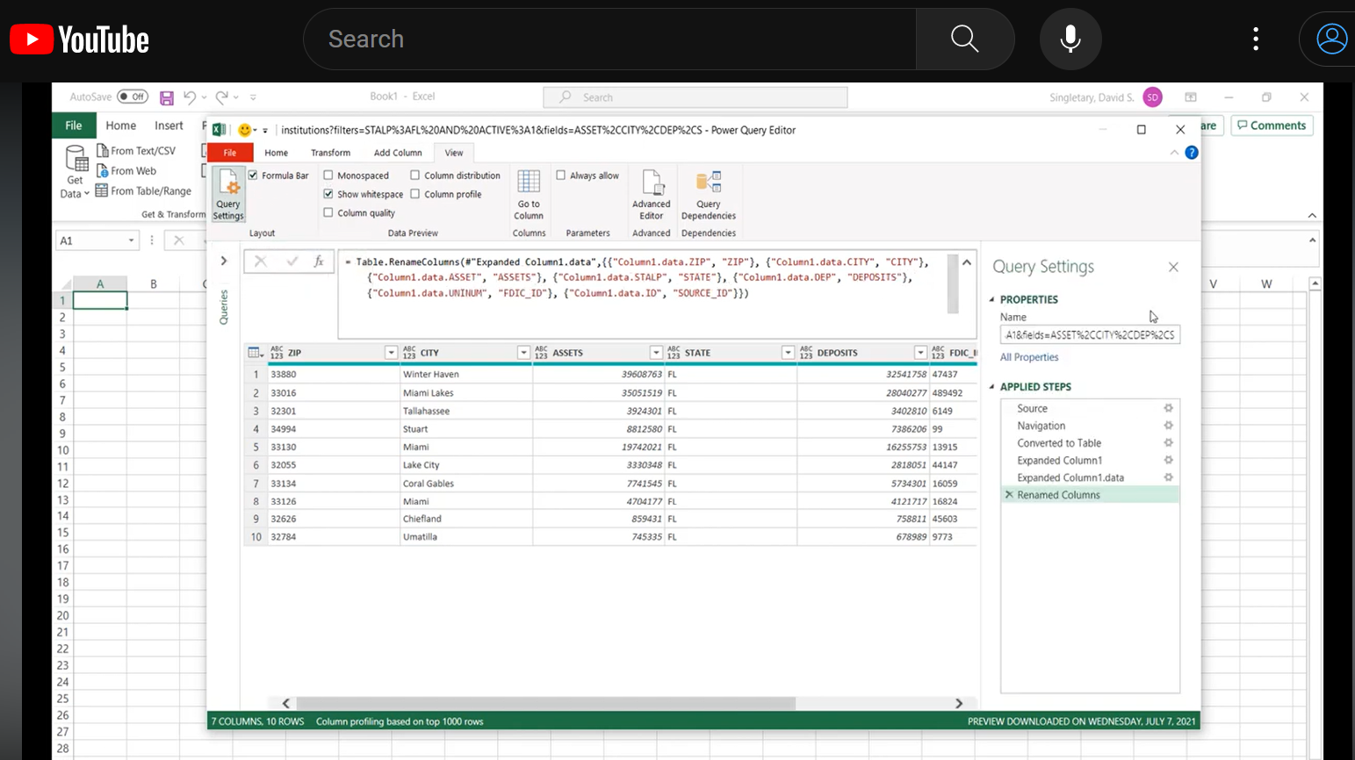
FinTech: Use an API
Access an API using Excel
Learning Unit + Recorded Walkthrough
https://cel.fscj.edu/LOR/cgs/2512/1/

