Slide 1
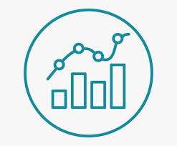
Data Visualization
Course Overview
FinTech

Slide 2
CAP2741C Data Visualization
This course teaches students how to build visual data models for analysis using commonly available tools including Microsoft Excel, Microsoft Power BI, Tableau and JavaScript libraries. Topics include charts, tables, graphs, maps, infographics and dashboards. The concepts are utilized in hands-on labs.
Content includes
Tableau (+ Tableau Desktop Specialist certification prep)
Power BI
Python (Plotly/Dash)
JavaScript: D3, Bokeh
Final Project (create dashboard using student's tool choice)

Slide 3
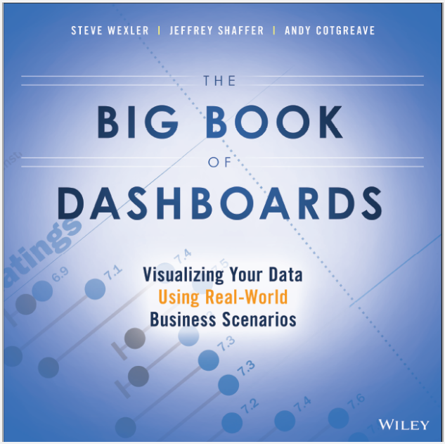
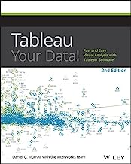

CAP2741C – Data Visualization Textbooks

Slide 4
FinTech
PowerBI content used for IDC4251C (Data Mining for FinTech)

