Slide 1


Equitable Data Visualization with Python
David Singletary David.Singletary@fscj.edu
Pamela Brauda Pamela.Brauda@fscj.edu
Gina Baker

Slide 2

Gina M. Baker
Background in secondary education and arts management
Interests:
Programming
Cleaning data (really!)
Meaningful, beautiful visualizations
Lifelong learning
Finding the perfect grilled chicken marinade

Slide 3
Equitable Data Viz… what’s the deal?
“…dealing fairly and equally with all concerned.”
-(Merriam-Webster)
“Fair and impartial.”
-(Oxford)

Slide 4
Two Considerations
Inclusive
Chart formatting should reflect accuracy
Symbols, icons, images, data representations
Culturally sensitive
Accurate
Devoid of stereotypes
Accessible
Consider this about your users:
Backgrounds
Skills
Differing abilities
Experiences
Technical expertise

Slide 5

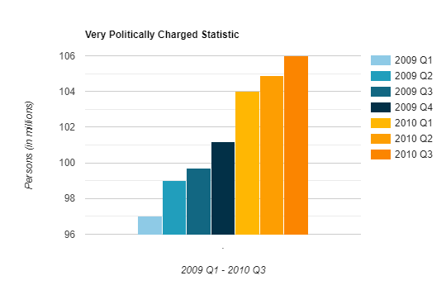

Example:
Look at that crazy growth in less than two years time! I’m experiencing a moderate level of concern, approaching panic.

Slide 6
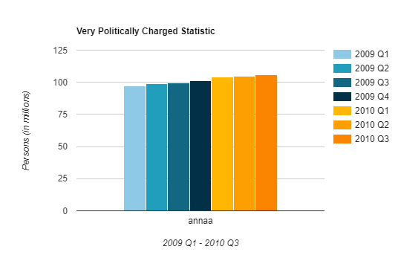
Example:
vs.

Slide 7
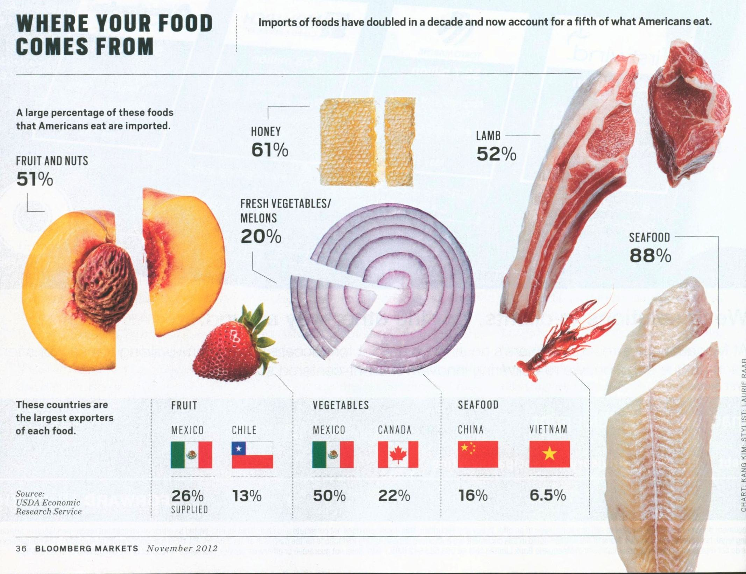
Example:

Slide 8
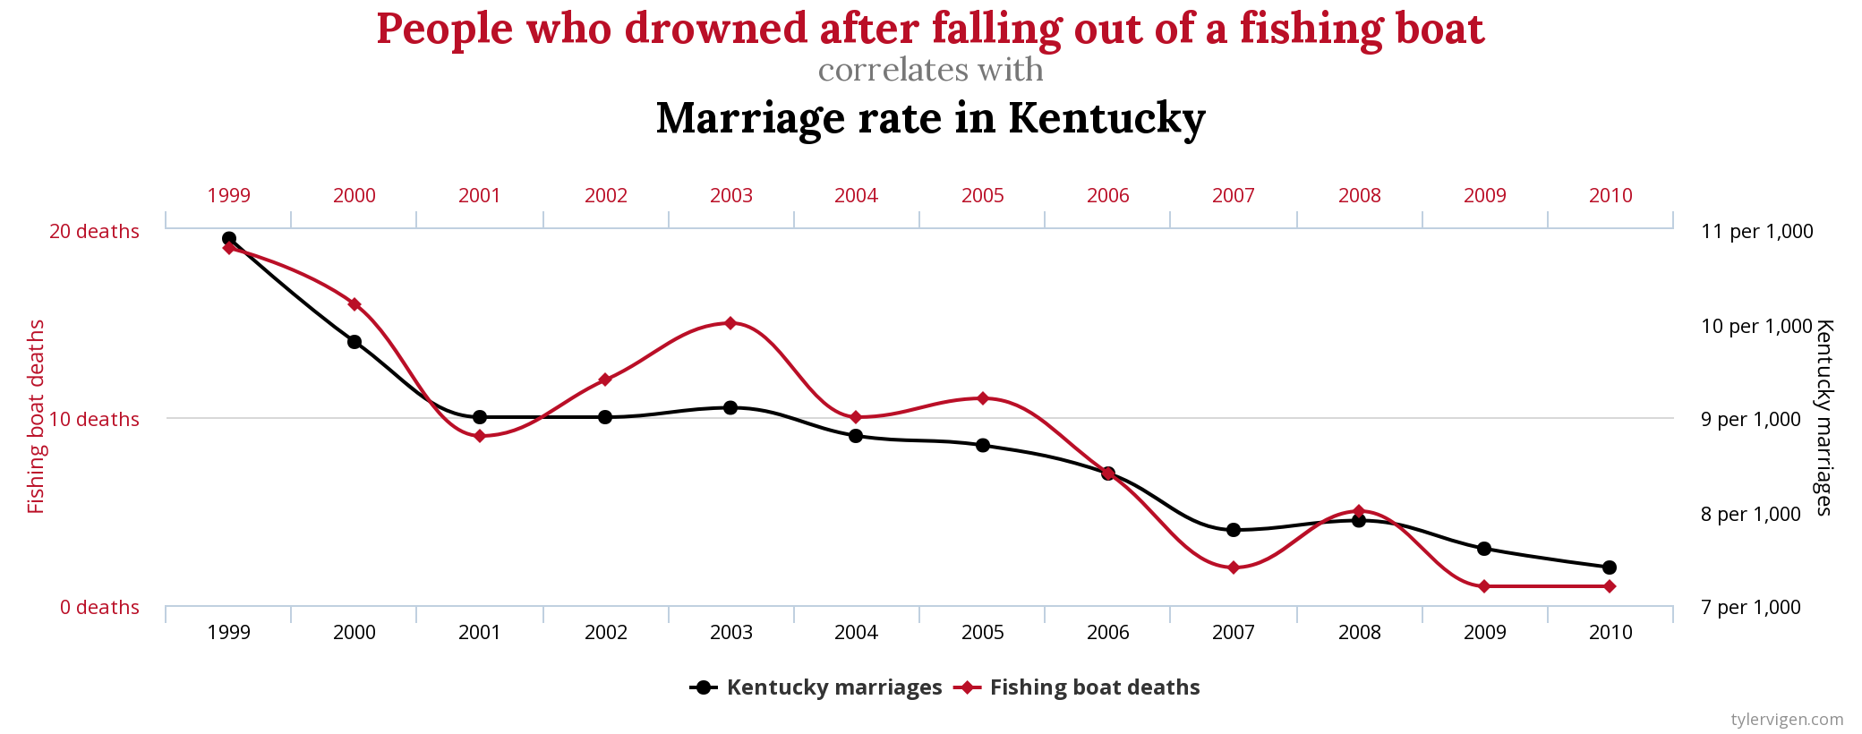
Example:
Tyler Vigen, https://tylervigen.com/spurious-correlations

Slide 9
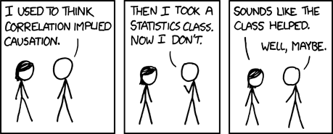
Conclusions:
Randall Munroe, https://m.xkcd.com/552/

Slide 10
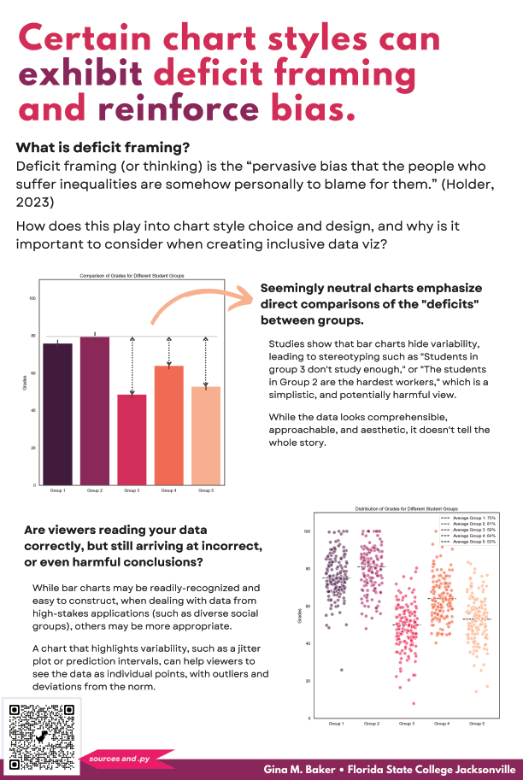
Project
Created for HI-TECH Poster Session
Focuses on “deficit framing” in data visualization
Shows two example charts
Data and charts created entirely in Python
Libraries used:
Seaborn
Matplotlib
Pandas
Numpy

Slide 11
Project
Uses “dummy” data that was generated within the program (NumPy)
Data contained individual grades for groups of 100-125 students, starting with five randomly-selected average scores
np.random.normal was used to generate scores in a normal distribution
Resulting data was loaded into a Pandas DataFrame

Slide 12
Fighting deficit framing
Highlighting the negative aspects or shortcomings of a particular issue, situation, or group
Can lead to overarching stereotypes or victim blaming
Often a consideration when speaking about:
Social issues
Poverty
Education disparities
Environmental issues

Slide 13
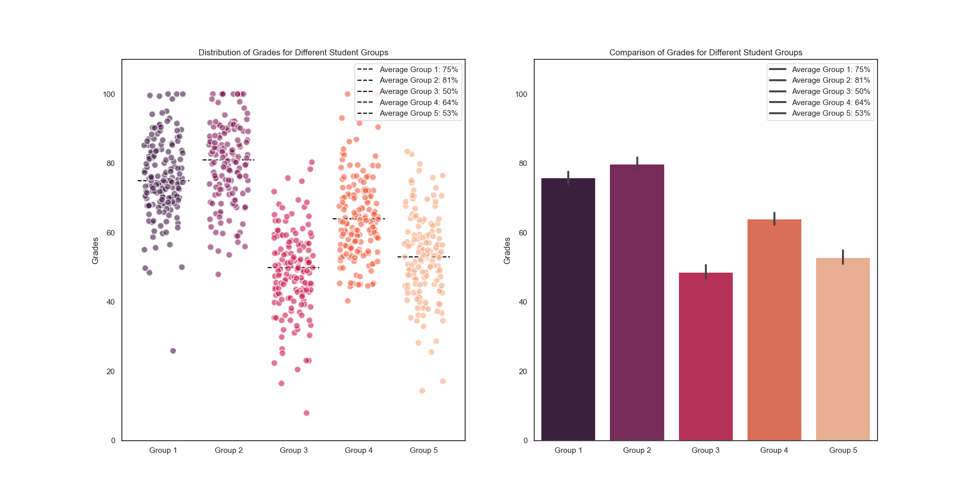
Traditional Bar Graph
Shows scores as a single data point: the average score of the group as a whole
Exaggerates group homogeneity
Shows no indication of outcome variation within groups
Shows instead outcome differences between groups
This can lead to harmful stereotypes

Slide 14
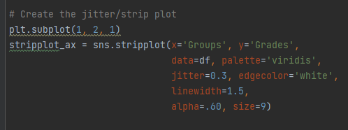
Strip/Jitter Plot
Supports individual heterogeneity
Works well when dealing with data from high-stakes applications
Created with matplotlib to set up a subplot (from matplotlib.pyplot) and Seaborn

Slide 15
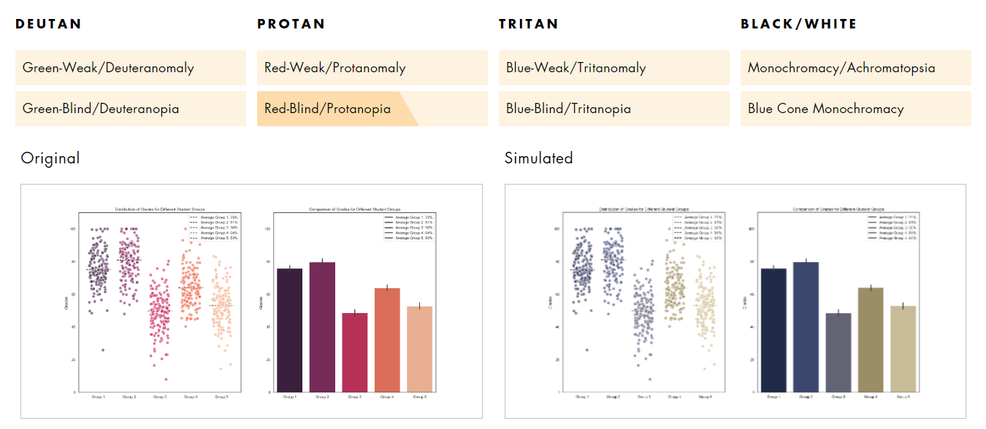
Colorblind accessibility:

Slide 16
Key Takeaways
Responsible data viz is something to strive for
Inclusivity
Accessibility
Consider highlighting variation in groups instead of stark differences
Rely on the available tools
Python
Libraries used:
Pandas
Matplotlib
Seaborn
NumPy

Slide 17


