Slide 1

GitHub Classroom in the Classroom Instructor Notes

Slide 2
GitHub Classroom
The following slides provide information for using GitHub Classroom, which allows the creation of individual classrooms
Why GitHub Classroom?
Students can be assigned to a specific course's classroom
Repositories created by the instructor can be cloned by students and maintained within the classroom
By default, student repositories are private

Slide 3
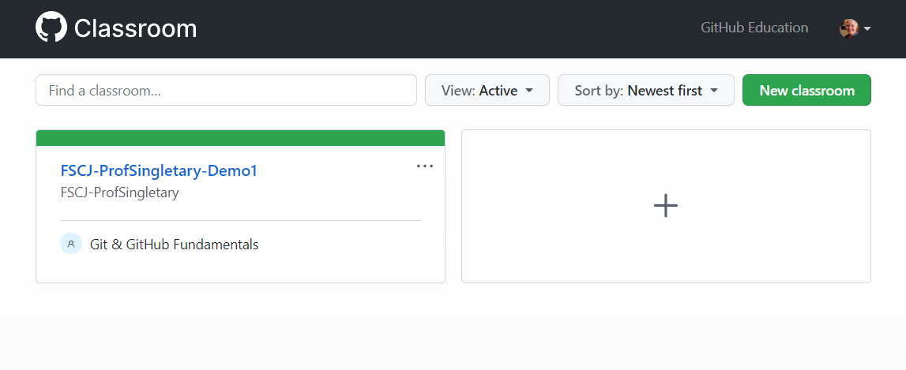
GitHub Classroom (Instructor Notes)
Apply for GitHub Education, after account is verified create an organization. I used FSCJ-ProfSingletary (FSCJ-<my GitHub ID>)
Log in to GitHub Classroom (classroom.github.com) and create a new classroom

Slide 4
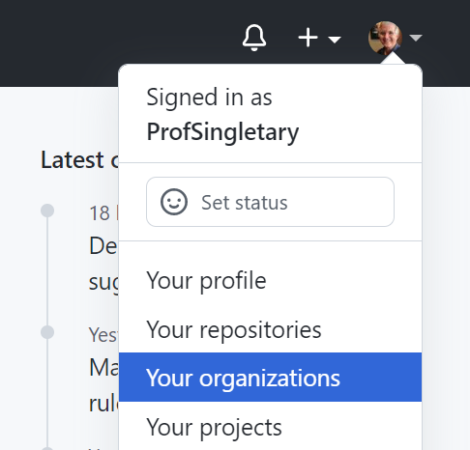
Creating an Organization
Organizations can be used to organize your courses (e.g. Programming, Analytics, Networking, etc.
Select "Your organizations" from your profile menu in GitHub

Slide 5
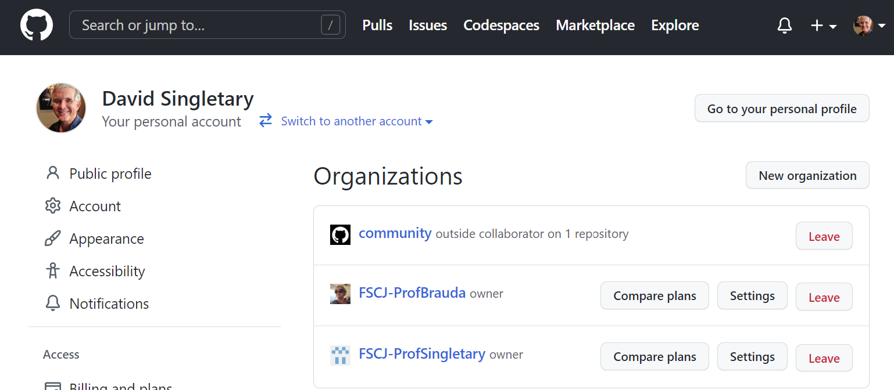
Creating an Organization
Select "New organization" from the page

Slide 6
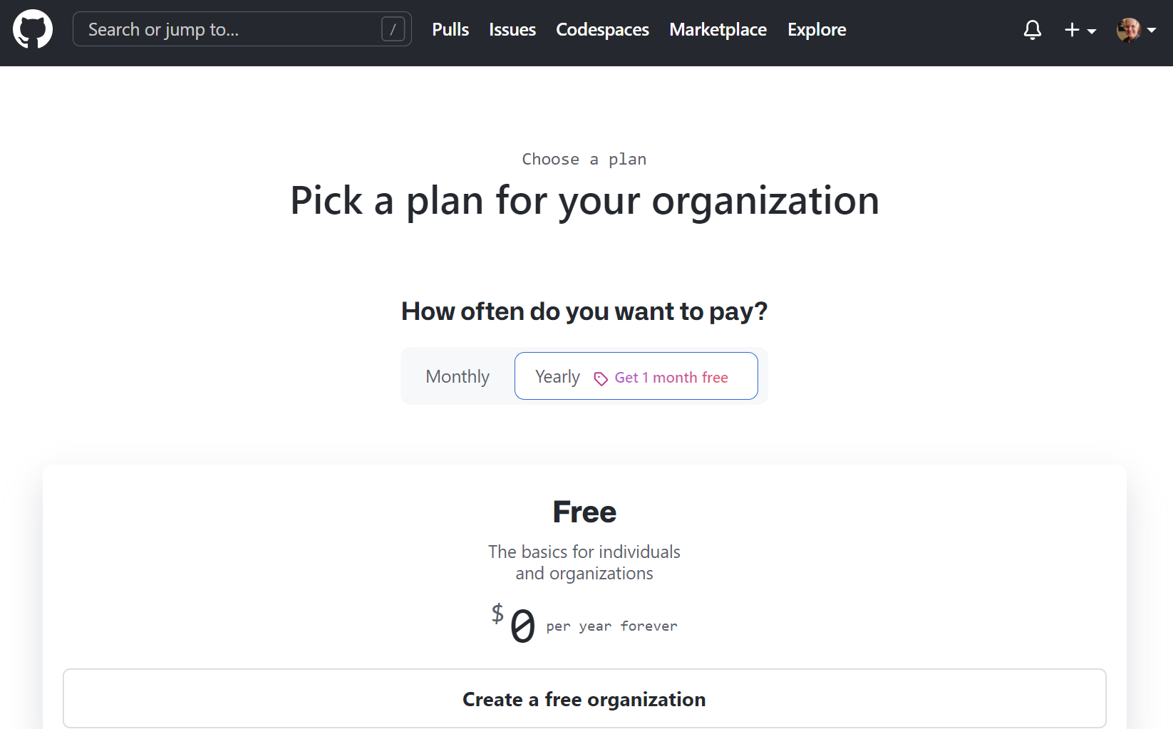
Creating an Organization
Choose "Create a free organization"

Slide 7
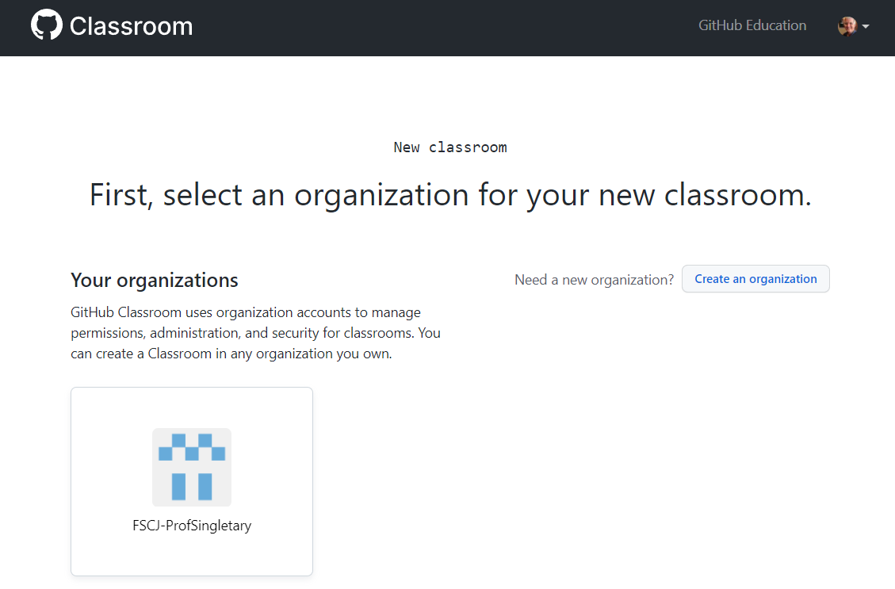
GitHub Classroom (Instructor Notes)
After creating your organization, select it to create a classroom

Slide 8
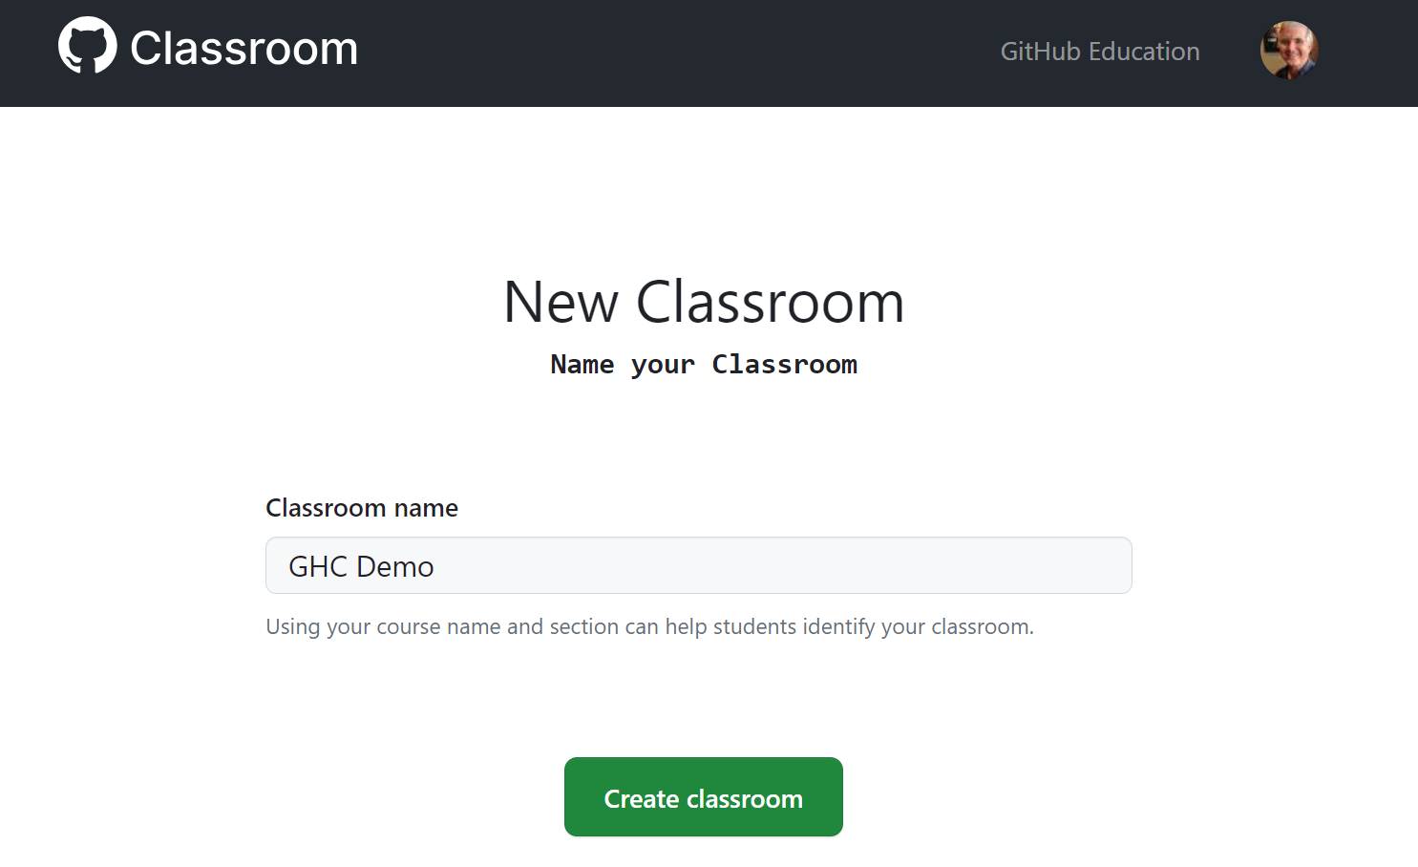
GitHub Classroom (Instructor Notes)
Name your classroom

Slide 9
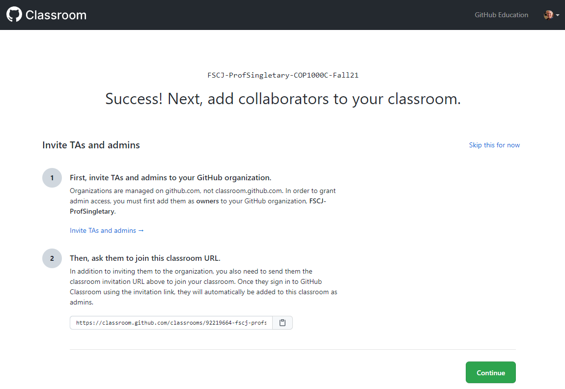
Creating a Classroom
TAs or Admins?

Slide 10
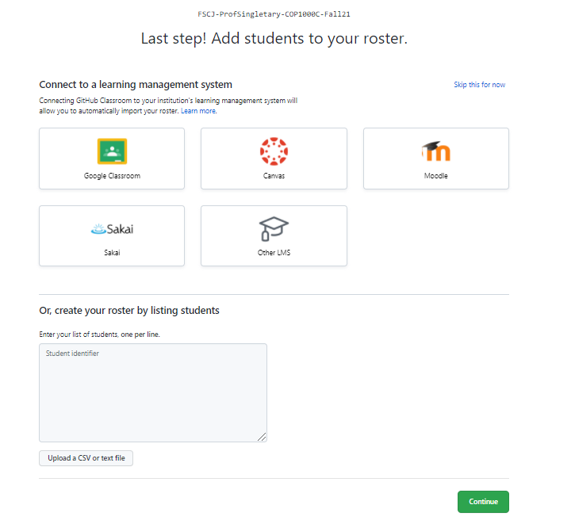
Creating a Classroom
Add Students
Note: this is not required; an alternative approach is to let your students add themselves by accepting your assignment invitations

Slide 11

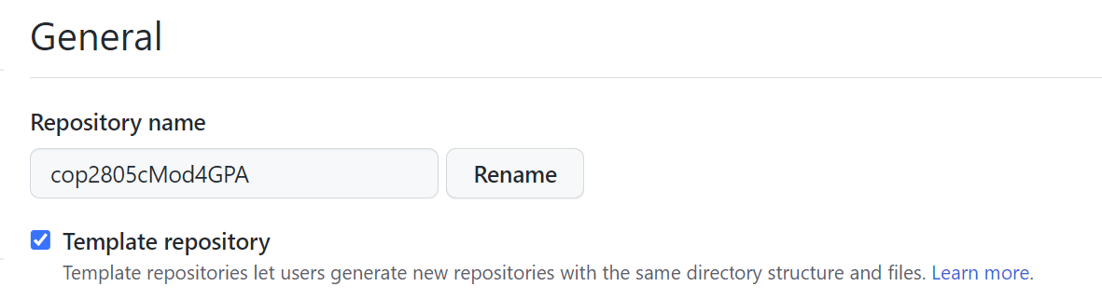
Creating Assignments
To create an assignment, start by creating a repo for your assignment in your normal GitHub account
This repo must be a public template
In the repo Settings page:

Slide 12
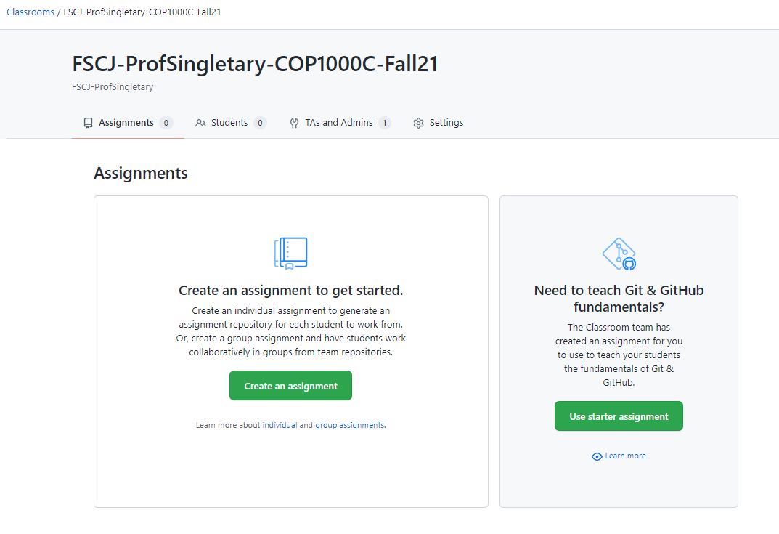
Creating Assignments
In your GitHub Classroom course, create an assignment

Slide 13
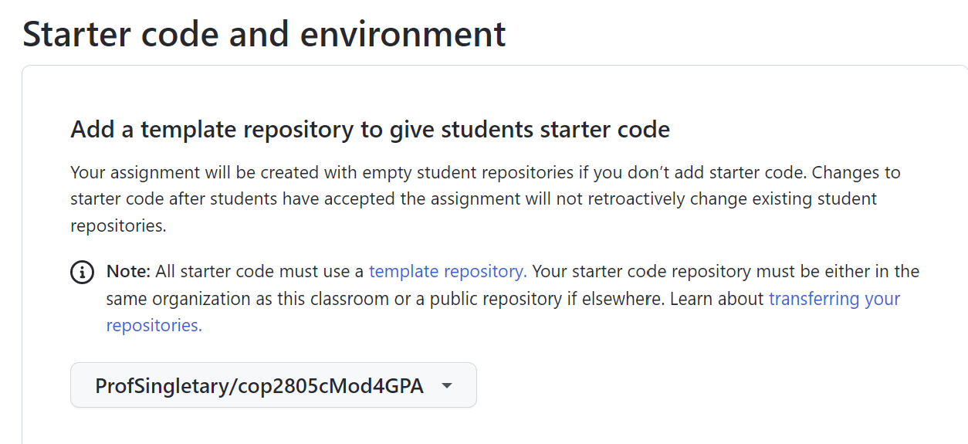
Creating Assignments
Use your template for the assignment starter code:

Slide 14
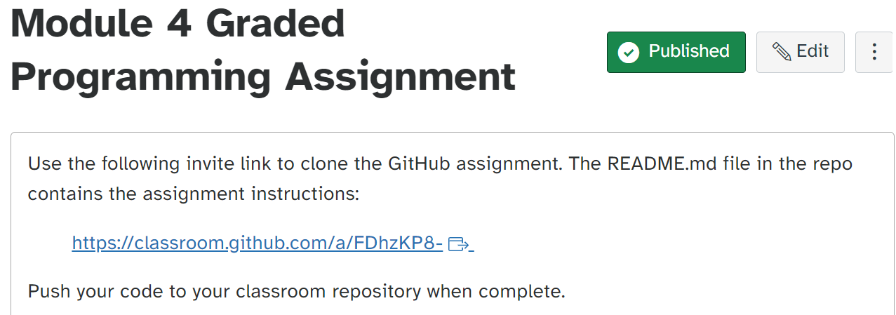
Creating Assignments
Provide the assignment invitation link to your students, e.g. in Canvas:

Slide 15
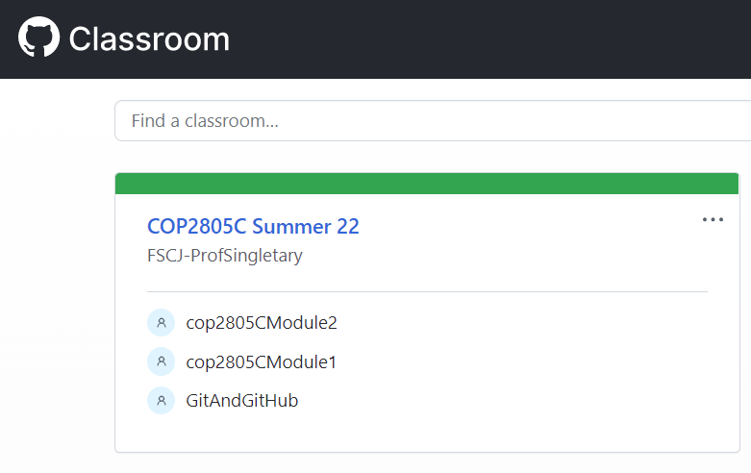
Grading Assignments
Log in to GitHub Classroom and Select Your Course Assignment
https://classroom.github.com/classrooms

Slide 16
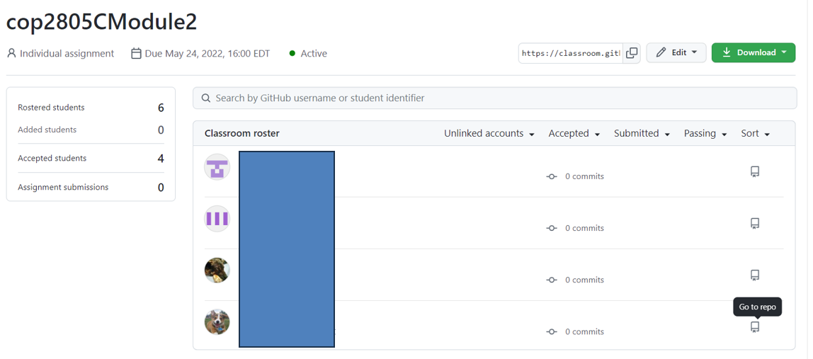
Select the "Go to repo" Icon
Grading Assignments

Slide 17
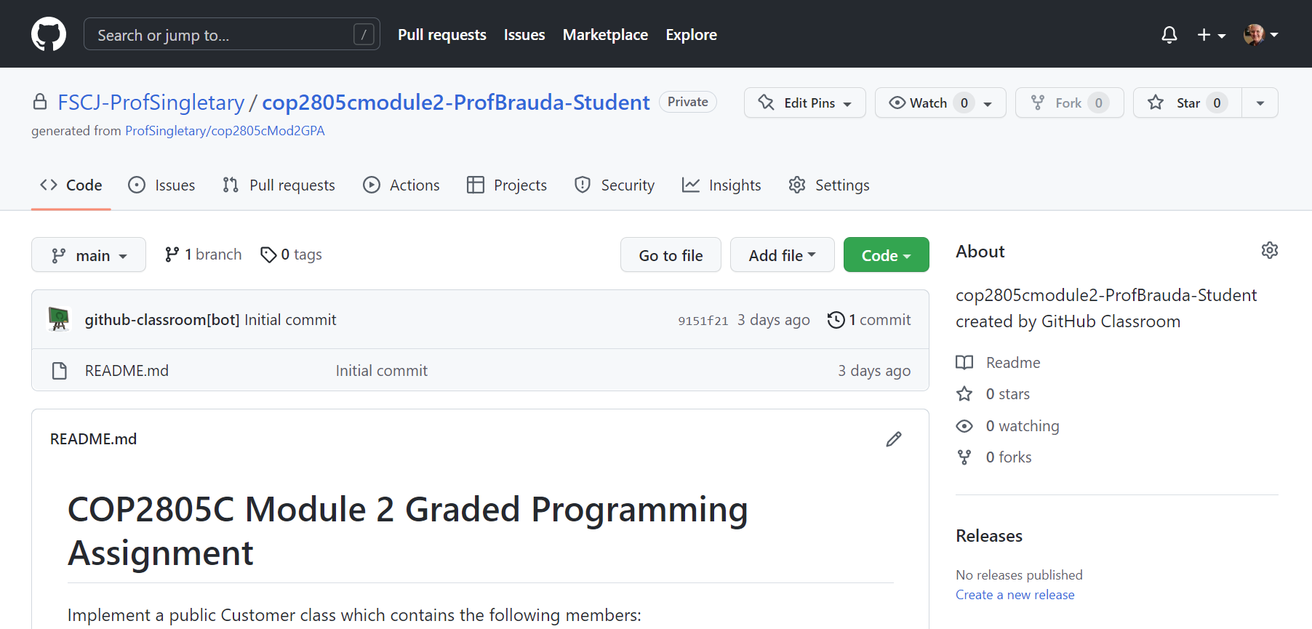
Grading Assignments
Select "Code" For Download/Access Options

Slide 18
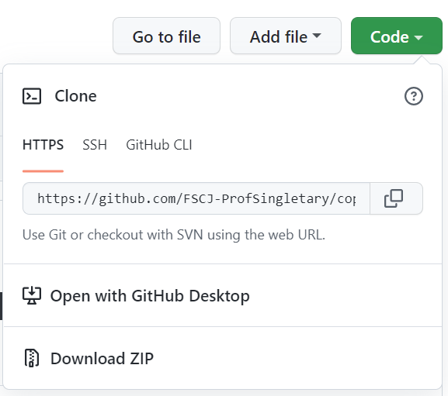
Grading Assignments
Choose Your Preferred Option
Clone the student repo
Open with GH Desktop
Download Zip

Slide 19
Or Use "Go to file" to Go Directly to Desired File
Grading Assignments

