Slide 1
The Data Science House We BILT Summer Working Connections South 2023
Prof. Pamela Brauda
Prof. David Singletary

Slide 2
Day 2 Summary
Day 2 Tuesday July 18
Morning
Lessons learned (R)
(Create an account at https://posit.co/products/cloud/cloud/ )
Posit
Foundational Statistics
Afternoon
Lessons learned (SAS)
(Create an account at https://welcome.oda.sas.com/ )
Leveraging curriculum (SAS for FinTech)
Guest Speaker: DataTEC Administrative Perspective (Dr. Sherri Litt, FSCJ Associate Provost, Baccalaureate, Career and Technical Education)

Slide 3
Intro to SAS Programming – CTS2456C
Course Outline
Prerequisites and co-requisites
Updates planned
Course Shell
Course Software – FREE
Microsoft Office (PPT for submitting screenshots)
Textbooks – on O'Reilly for FREE!

Slide 4
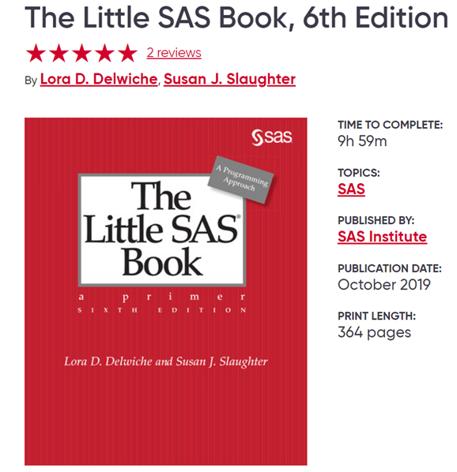
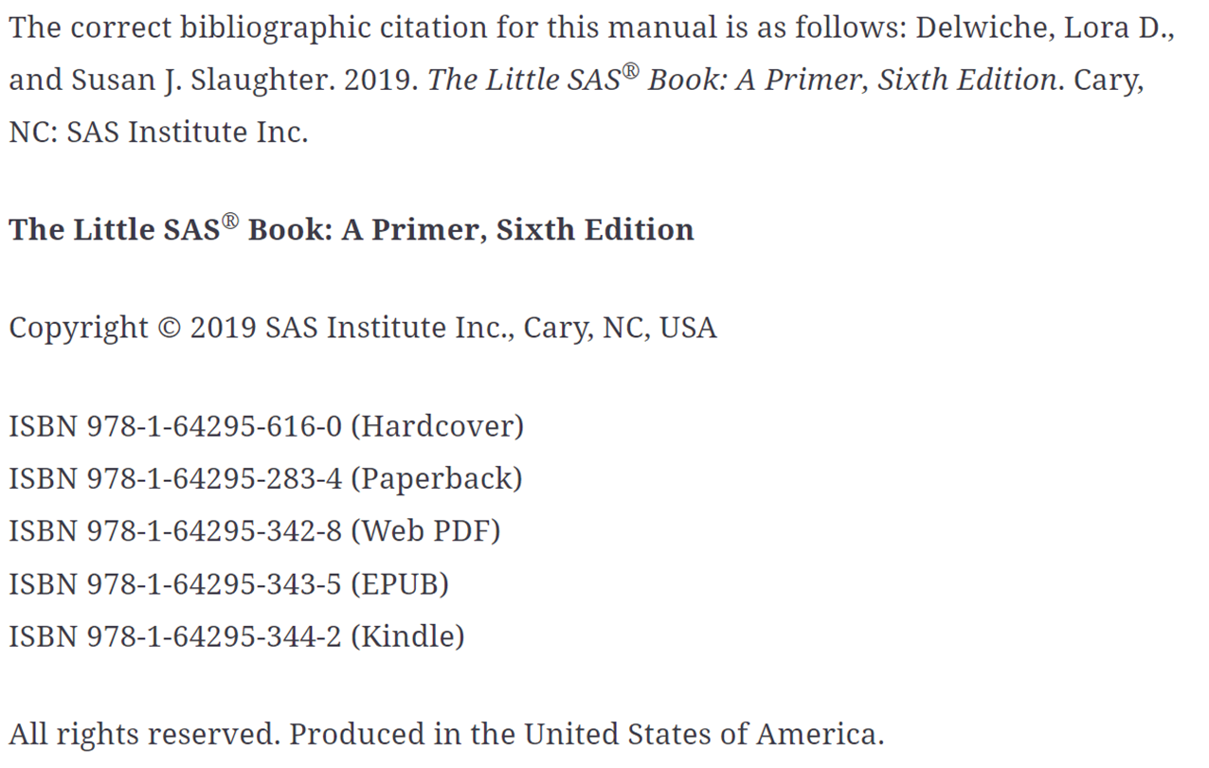

Slide 5
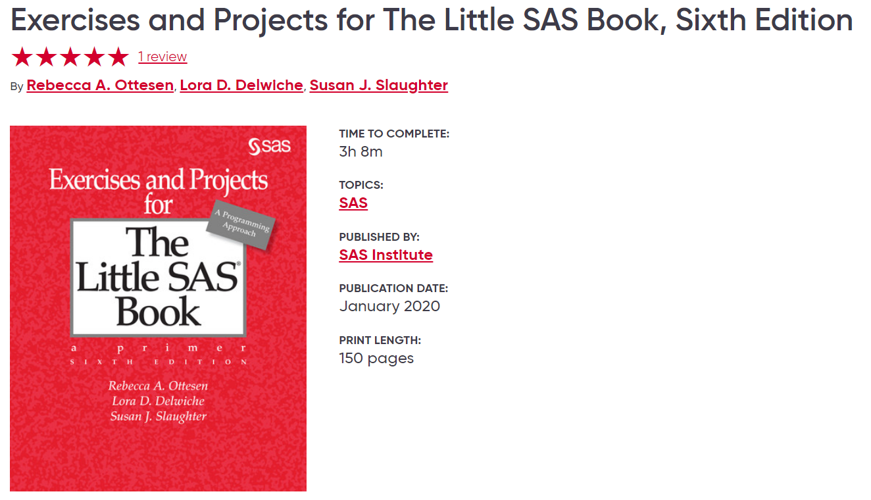
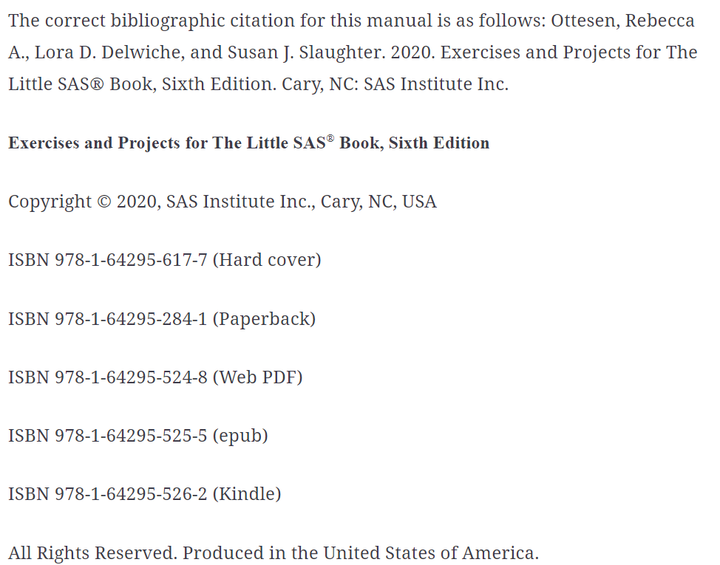

Slide 6
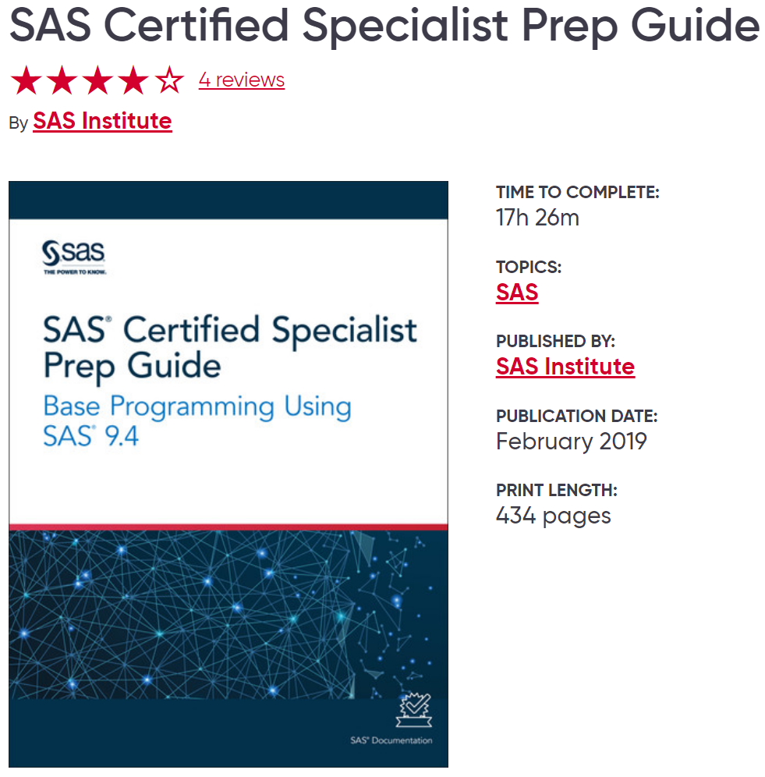
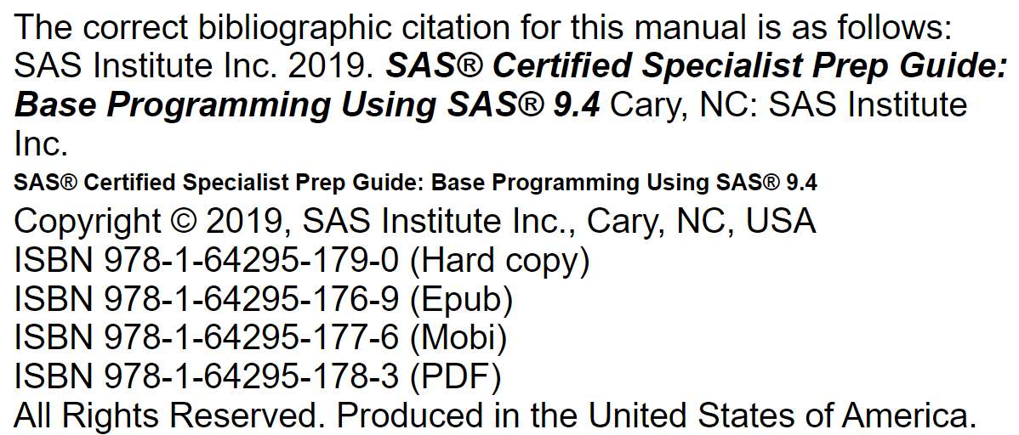

Slide 7
SAS OnDemand
https://welcome.oda.sas.com/
https://support.sas.com/en/software/ondemand-for-academics-support.html#m-246788010732195741774
https://support.sas.com/en/software/ondemand-for-academics-support.html#students
https://video.sas.com/detail/videos/how-to-tutorials
Registration Code to access my course
c737eefe-d194-4a9e-9606-daef242360d9

Slide 8
Getting Started
Get the data files for the textbook and exercises books
73044-example – data for code examples in the textbook
73046-example – data for exercises
Upload data files to shared folder for student use

Slide 9
Video Demos
Use the code examples from the textbook
Make the code examples available to the students on SAS Studio so they can play with the code

Slide 10
Assignments
1st assignment (GPA1-A) – show me you created your account
2nd assignment (GPA1-B) – follow the steps in the PDF (in the SAS folder)
3rd assignment (GPA2-A) – upload the data files
4th assignment (Lab 2 – ungraded) – use the examples data files
5th assignment (GPA2-B) – use the exercises data files
Remaining assignments are all exercises from the Exercises book

Slide 11
Statistics with SAS
Chapter 4 – Sorting, Printing, and Summarizing Your Data
PROC MEANS
PROC FREQ
Chapter 8 – Visualizing Your Data
PROC SGPLOT – bar charts, histograms, density curves, box plots, scatter plots, series plots, fitted curves
Chapter 9 – Using Basic Statistical Procedures
PROC UNIVARIATE
PROC TTEST
PROC CORR
PROC REG
PROC ANOVA

Slide 12
