Slide 1
The Data Science House We BILT Summer Working Connections South 2023
Prof. Pamela Brauda
Prof. David Singletary

Slide 2
Day 1 Summary
Day 1 Monday July 17
Morning
A.S. in Data Science Technology - History and Update
Embedded Certifications
Data Science Technician
FinTech Technician
Industry Certifications
Reimbursement
Implementation in curriculum
KSA Process
Learning from Attending Conference Workshops and Sessions
Making professional connections
Splunk
Alteryx
Machine Learning/AI
Learning from Disseminating at Conference Workshops and Sessions
Building a foundation for a B.A.S.
Afternoon
Lessons learned (Git, GitHub, and GitHub Classroom) (Create an account at https://github.com and https://classroom.github.com )
Student presentation (William Money)
Guest Speaker: BILT at FSCJ (Dr. Annette Barrineau, Dean of Business)

Slide 3
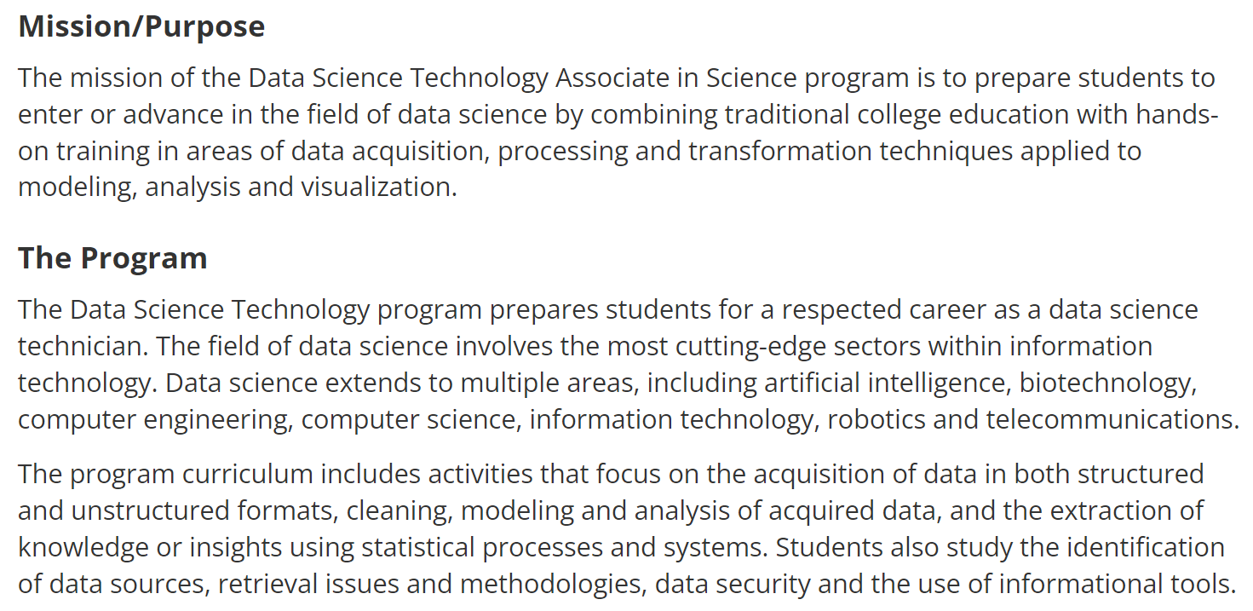
A.S in Data Science Technology (2019)
https://catalog.fscj.edu/preview_program.php?catoid=45&poid=8178&hl=2157

Slide 4
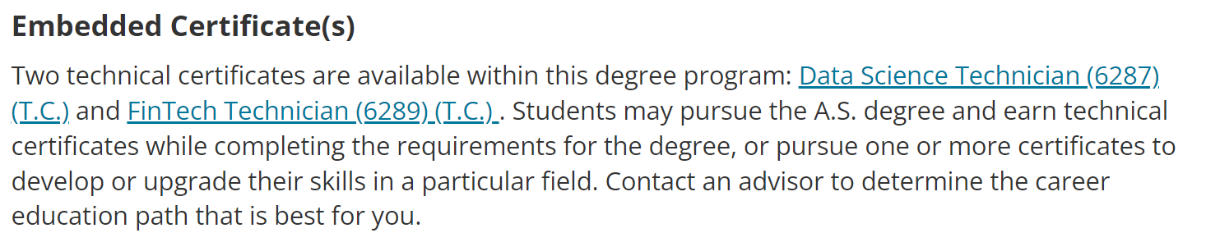
Embedded Certificates
https://catalog.fscj.edu/preview_program.php?catoid=45&poid=8180
https://catalog.fscj.edu/preview_program.php?catoid=45&poid=8275

Slide 5
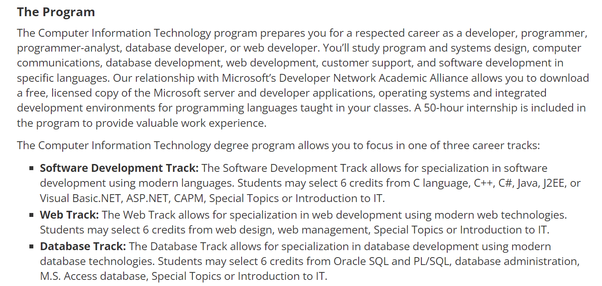
How Did We Get Here?
Start with the A.S. in Computer Information Technology (2018)
"Lay of the land" – the A.S. in Computer Information Technology program as we started designing the new program:

Slide 6
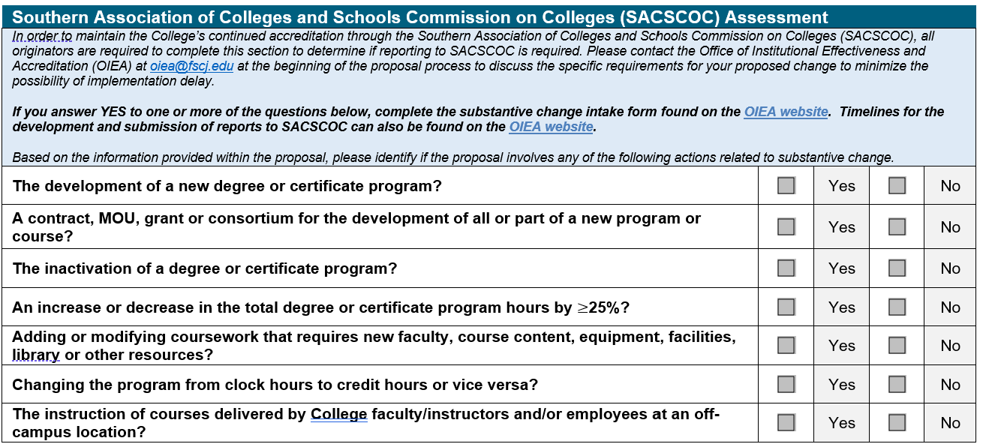
Substantive Changes
Substantive changes in Florida can result in extended time periods for approval of a new program

Slide 7
Substantive Changes
To avoid the "substantive change" categorization for our new program, we examined the department's curriculum landscape to see where we could lay the groundwork for a "non-substantive" design by integrating data science outcomes into existing courses and including them in a temporary track in an existing program.
New learning outcomes were added to the following courses:
Introduction to Information Technology
Programming in Python
Computer Networks and Telecommunications

Slide 8
A.S. Computer Information Technology 2018
Additional Learning Outcomes:
Introduction to Information Technology
"Use data science terminology to describe concepts, programming languages, and tools used for data acquisition and data analysis."
Programming in Python
"Describe the Data Life Cycle and how it is implemented in Python"
"Write Python applications which use Numpy and Pandas to manipulate and analyze data"
"Write Python applications which use Matplotlib to visualize data"
Computer Networks and Telecommunications
"Describe the concepts of network virtualization and cloud computing"

Slide 9
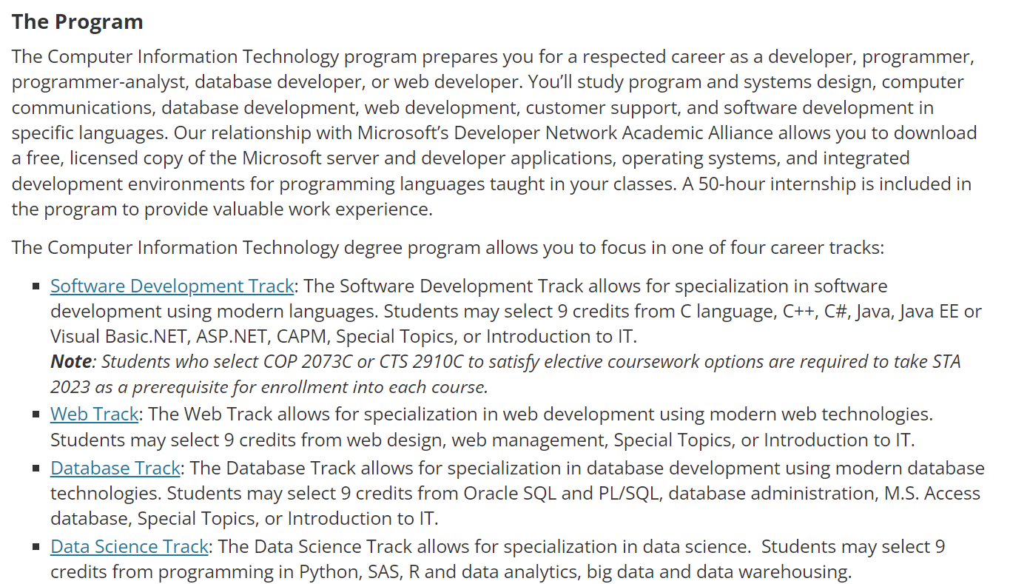
A.S. Computer Information Technology 2019/2020
In 2019 the Data Science track was added to the CIT program to help the modified courses and impending program to get some traction

Slide 10
Data Science Track
Added to the CIT program in 2018
9 Credit Hours, 3 Courses Minimum (prerequisites not listed)
CIS 2349C - Introduction to Big Data Using Hadoop (New)
COP 2034C - Programming in Python
COP 2551C - Introduction to Object-Oriented Programming with Java
COP 2073C - Introduction to Statistical Programming with R (New)
Note: Students must complete STA 2023 prior to enrollment in this course.
CAP 2787C - Data Warehousing (derived from 4000-level BI course)
CTS 2456C - Introduction to SAS Programming (New)
In 2021 the track was removed since the A.S. in Data Science Technology program implementation was complete

Slide 11
NSF/ATE Grant
DataTEC (Data Science Technician Education & Careers) "Meeting Industry Needs Through a Two-Year Data Science Technician Education Program" NSF grant #1902524

Slide 12
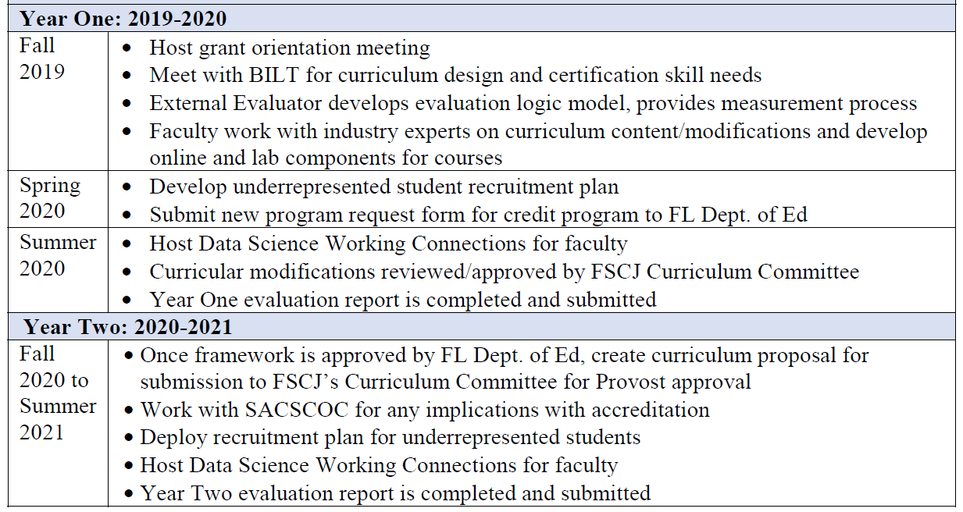
DataTEC Grant Timeline – Years 1 & 2

Slide 13
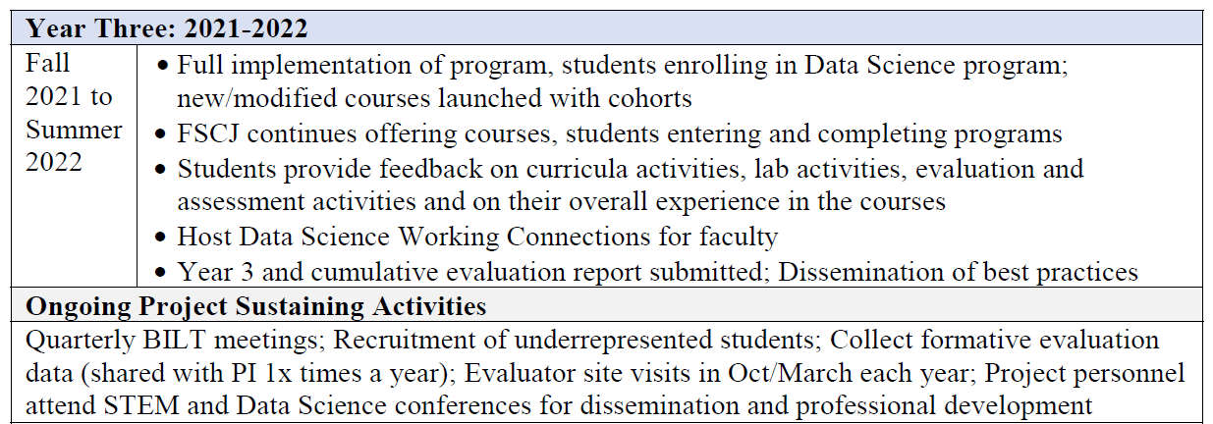
DataTEC Grant Timeline – Year 3 & Ongoing
Year 4 Extension Approved Spring 2022
Investigating Year 5 NCE

Slide 14
A.S. Data Science Technology Curriculum
(GenEd – 15 hours)
CAP 2741C - Data Visualization
CAP 2787C - Data Warehousing
CGS 1060C - Introduction to Information Technology
CGS 2512C - Spreadsheet Concepts and Practices
CIS 2349C - Introduction to Big Data Using Hadoop
CNT 1015 - Operating Systems Foundations
CNT 2001C - Computer Networks and Telecommunications
COP 1000C - Introduction to Computer Programming
COP 2034C - Programming in Python
COP 2073C - Introduction to Statistical Programming with R
COP 2800C - Java 1
COP 2822C - Web Technologies
CTS 1120C - Fundamentals of Information Security
CTS 2437C - SQL Server I - Fundamentals
CTS 2456C - Introduction to SAS Programming

Slide 15
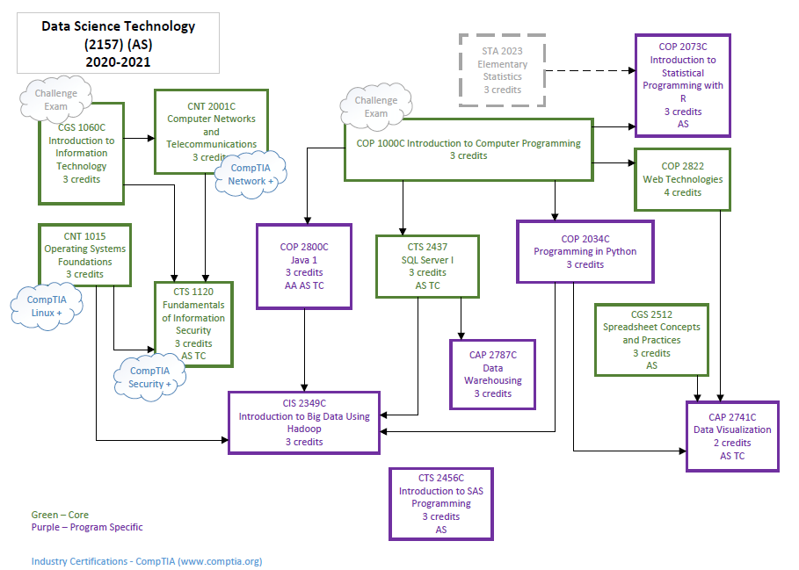
Course Sequence Flowchart

Slide 16
Recommended Course Sequence
Term I | ENC 1101 English Composition MAC 1105 College Algebra (or MGF1106 or MGF1107) CGS 1060C Introduction to Information Technology CNT 1015 Operating Systems Foundations
Term II | Humanities (Refer to General Education Requirements) COP 1000C Introduction to Computer Programming CNT 2001C Computer Networks and Telecommunications STA 2023 Elementary Statistics
Term III | CTS 1120C Fundamentals of Information Security CTS 2437C Introduction to SQL CGS 2512 Spreadsheet Concepts and Practices COP2800C Java 1
Term IV | Social Science (Refer to General Education Requirements) COP2034C Programming in Python COP2822C Web Technologies CAP2787C Data Warehousing
Term V | COP2073C Introduction to Statistical Programming with R CIS2349C Big Data with Hadoop CTS2456C Introduction to SAS CAP2741C Data Visualization

Slide 17
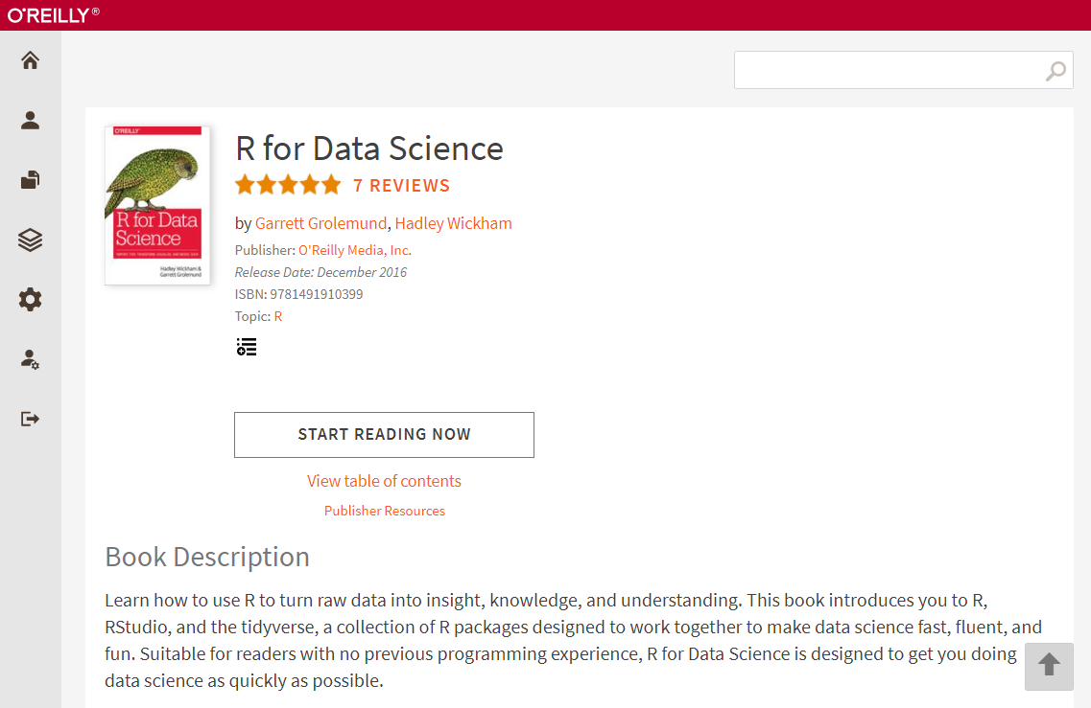
Free Textbooks for Most Courses

Slide 18
Industry Certification Exam Preparation
Students will be prepared through their coursework to take exams which provide the following certifications:
CompTIA Network+ (CNT2001C)
CompTIA Security+ (CTS1120C)
Oracle Java OCA SE8 (COP2800C)
SAS Base Programming (CTS2450C)
Certified Associate in Python Programming (PCAP) (COP2034C)
Microsoft Office Specialist / Excel (CGS2512)
Tableau Desktop Specialist (CAP2741C)
Grant Funds Available for Exam Vouchers

Slide 19
Useful Links
Associate's Degree State Framework (Approved by Florida State DOE)
http://www.fldoe.org/core/fileparse.php/18703/urlt/1511010100-1920.rtf
Florida State College at Jacksonville (FSCJ) Program Page
https://www.fscj.edu/academics/areas-of-study/stem/2157
Grant Summary page
https://www.fscj.edu/academics/workforce-education/grant-programs/datatec

Slide 20
