Slide 1
CIS 2349C
Introduction To Big Data Using Hadoop
Module 1: Introduction to Big Data, Analytics, and Hadoop
Textbook (Bahga) Ch. 1 Introduction to Big Data
Ch. 2 Setting Up the Big Data Stack
(White) Ch. 1 Meet Hadoop
App. A Installing Apache Hadoop

Slide 2
COURSE DESCRIPTION
This course will provide students with an understanding of designing, building, and maintaining Hadoop applications. Particular attention will be paid to the Hadoop architecture and the Hadoop ecosystem of tools. Students will learn to apply Hadoop and related Big Data technologies such as MapReduce, Hive, Impala, and Pig in developing analytics and solving the type of problems faced by enterprises today.

Slide 3
Definitions: Data Analytics and Big Data
Data Analytics
processes, technologies, frameworks, and algorithms used to extract meaningful insights from data
Big Data
datasets whose volume, velocity, or variety is too large to store, manage, process, and analyze using traditional tools

Slide 4
Categories of Data Analytics: Descriptive
Descriptive analytics
Analyzing past data to summarize: “what happened?”
Summary statistics
visualizations

Slide 5
Categories of Data Analytics: Diagnostic
Diagnostic analytics
Also past data, but: “why did it happen”
Sometimes known as root cause analysis
“Drill down and drill through”
Drill down takes the user from a more general view of the data to a more specific one
Drill through allows the user to pass from one report to another while still analyzing the same set of data.

Slide 6
Categories of Data Analytics: Predictive
Predictive analytics
Predicts events, outcomes, future values
“what is likely to happen?”
Predictive models trained by existing data

Slide 7
Categories of Data Analytics: Prescriptive
Prescriptive analytics
Predict outcomes and best course of action to achieve them
“What can we do to make it happen?”

Slide 8
Characteristics of Big Data
Volume: too large to fit on a single machine
Velocity: large amount of data generated in a short time period, with possible time constraints (e.g. fraud detection, denial of service attack)
Variety: structured, unstructured, semi-structured. Text, images, audio, video, sensors
Veracity: accuracy. Data usually requires cleaning

Slide 9
Examples of Big Data
Web: user analytics, performance monitoring
Finance: credit risk modeling, fraud detection
Healthcare: epidemiological surveillance, fraudulent claim detection
IoT (Internet of Things): cellular data, resource usage

Slide 10
Analysis Types
Analyses of big data can be categorized as one of several types
basic statistics
common algorithms include counts, max/min/mean, correlations
regression
linear, stochastic (random), others
classification
K-Nearest Neighbor (KNN), Decision Trees, others
clustering
K-Means, others

Slide 11
Analysis Modes
Batch mode
Data is collected over time and then sent for processing by analytics tools
Realtime (Stream)
Data is fed continuously to analytics tools
Can be broken up into “micro-batches”
What does “realtime” mean?
Every millisecond? Every 5 minutes? Every hour?
Interactive
Query data on demand
Choice depends on business objective
Combinations of all three are sometimes used

Slide 12
Big Data Analytics Work Flow
collect data
prepare data
determine analysis types
determine analysis mode
choose visualization tools

Slide 13
The Big Data Stack
What is a stack?
“The term Software Stack refers to the set of components that work together to support the execution of the application. Some software components power back-end processes, some are used to perform calculations and some are used in the presentation layer to enable user interface. In any case, the components of a software stack work in tandem to efficiently deliver application services to the end-user.”
https://www.sumologic.com/glossary/software-stack/
“Big Data Stack” refers to software components that work together to manage big data

Slide 14
The Big Data Stack
Alternatives are available for each component, determined by analysis type
Web and Visualization
Analysis, Storage, and Queries
Data Access Connectors
Raw Data

Slide 15
Raw Data
Logs (e.g. web applications)
Transactional Data (e.g. eCommerce, banking, financial)
Social Media
Sensors
Healthcare applications
Network Devices

Slide 16




Data Access Connectors
Publish-Subscribe Messaging (e.g. Apache Kafka, AWS Kinesis)
https://kafka.apache.org/
https://aws.amazon.com/kinesis/
Source-Sink (e.g. Apache Flume)
https://flume.apache.org/
Database (e.g. Apache Sqoop)
https://sqoop.apache.org/
Messaging Queues (e.g. RabbitMQ, AWS SQS)
https://www.rabbitmq.com/
Custom Connectors

Slide 17
Analysis, Storage, and Queries: Data Storage
How do we store data collected from data access connectors?
Distributed filesystems (e.g. HDFS)
Relational databases (e.g. MySQL)
Non-relational (NoSQL) databases (e.g. Hbase, MongoDB)
Notes:
Hadoop Distributed File System

Slide 18
Analysis, Storage, and Queries: Batch Analytics
Analyze data in batches (non real-time)
Hadoop/MapReduce: distributed processing framework
Pig: scripting for MapReduce
Oozie: manage MapReduce jobs
Apache Spark: supports batch analysis and other modes

Slide 19
Analysis, Storage, and Queries: Real-time Analytics
Analyze streaming data
Storm: consumes data from various frameworks and connectors
Spark Streaming: component of Spark which allows analysis of streaming data

Slide 20
Analysis, Storage, and Queries: Interactive Queries
Query data using SQL and "SQL-like" statements
Spark SQL
Hive: "Hive Query Language", query HDFS data
Amazon Redshift: query petabyte+ warehouses, parallelizes queries across clusters
Google BigQuery

Slide 21
Web and Visualization Connectors
Django: Python-based web application framework
Matplotlib: most utilized visualization library, "free MATLAB"
Seaborn: resides on top of matploblib, additional themes
Plotly/Dash

Slide 22
Big Data Analytics Patterns
1. Large dataset → distributed filesystem → batch mode analysis → storage
(textbook: “Alpha” pattern)
2. Streaming data → realtime analysis
(textbook: “Beta” pattern)
3. Streaming data → batch and realtime analysis
(textbook: “Gamma” pattern)
4. Interactive queries
(textbook: “Delta” pattern)
These patterns can be mapped to specific frameworks and vendors

Slide 23

Introduction to Hadoop
What is Hadoop?
“The Apache™ Hadoop® project develops open-source software for reliable, scalable, distributed computing.”
Hadoop is a software framework that allows for cost-effective distributed processing of large data sets across clusters of "commodity" hardware (hardware based on open standards)
Hadoop is designed to scale up from single servers to thousands of machines
The software is designed to detect and handle failures at the application layer, instead of relying on expensive fault-tolerant hardware
https://hadoop.apache.org/

Slide 24
Commodity Hardware Does Not Mean "Low-End"
For the sake of illustration, a Hadoop data node in 2014 would have had the following specifications:
Two hex/octo-core 3 GHz CPUs
64−512 GB ECC RAM[68]
12−24 × 1−4 TB SATA disks
Gigabit Ethernet with link aggregation

Slide 25
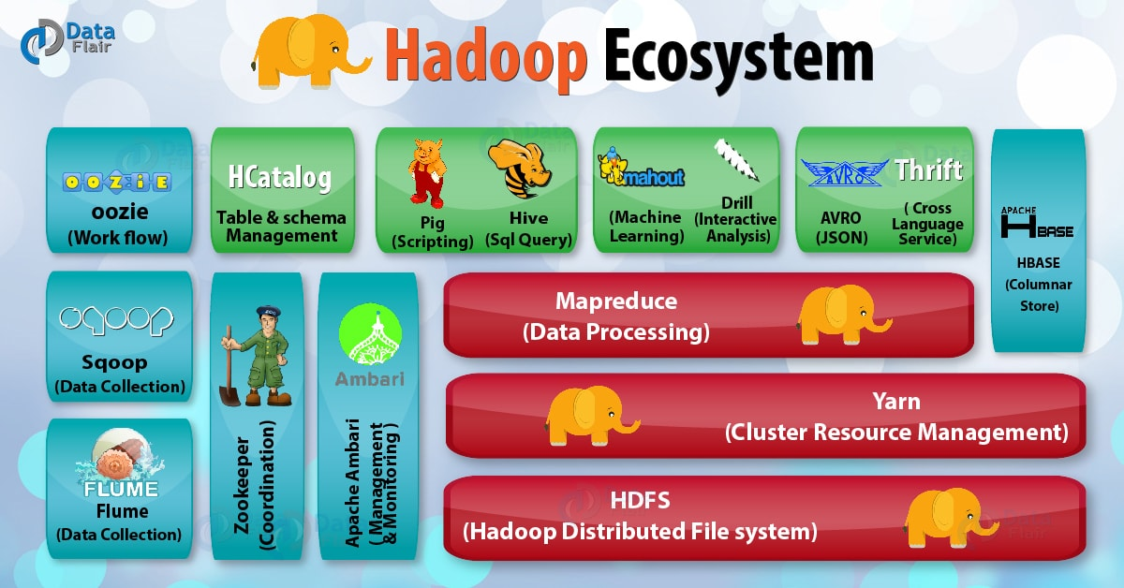
The Hadoop Ecosystem
https://data-flair.training/blogs/hadoop-ecosystem-components/

Slide 26
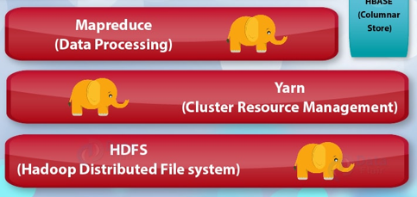
The Hadoop Ecosystem: Core Components
Core components:
HDFS (Hadoop Distributed FileSystem)
Distributes big data across multiple nodes
Retains redundant copies in case of hardware failure with automatic recovery
Yarn: “Yet Another Resource Negotiator”
Cluster resource management – which tasks run when, which nodes are available
MapReduce
Distributed processing programming model
“Mappers” and “Reducers”
Mappers transform data across distributed nodes
Reducers aggregate data

Slide 27
RAID and HDFS
HDFS clusters do not benefit from using RAID ("redundant array of inexpensive disks") for data node storage
The redundancy that RAID 1 (mirroring) provides is not needed, since HDFS handles it by replication between nodes.
RAID 0, which "stripes" data across multiple disks, is commonly used to increase performance, but turns out to be slower than the JBOD ("just a bunch of disks") strategy used by HDFS, which spreads data blocks evenly across available disks and nodes
If a disk fails in a JBOD configuration, HDFS can continue to operate without the failed disk, whereas with RAID 0, failure of a single disk causes the whole array to become unavailable.

Slide 28
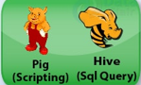
The Hadoop Ecosystem: Scripting and Querying with Pig and Hive
Pig is a high-level data processing language which simplifies and enhances the development of MapReduce programs.
The language used to express data flows is known as "Pig Latin"
Hive is a framework for data warehousing which is layered on top of Hadoop.
HiveQL (dialect of SQL) is used to query data in Hive.

Slide 29

The Hadoop Ecosystem: Managing with Ambari
Ambari is a provisioning, managing, and monitoring tool for Hadoop clusters
dashboard for monitoring health and status of the Hadoop cluster.
provides central management for starting, stopping, and reconfiguring Hadoop services across the entire cluster.

Slide 30

The Hadoop Ecosystem: Storing with HBase
HBase is an open-source, non-relational (NoSQL) columnar distributed database modeled after Google's Bigtable and written in Java.
NoSQL ("not only SQL") databases are non tabular, and store data differently than relational tables
a columnar database is optimized for fast retrieval of columns of data
HBase runs on top of HDFS.

Slide 31



The Hadoop Ecosystem: Hbase Alternatives
MySQL (and other products) provide storage using a relational data model
Many organizations are using NoSQL database alternatives to Hbase, particularly for real-time applications.
MongoDB and Cassandra are two popular alternatives which provide similar capabilities and a rich set of features

Slide 32
Installing Hadoop
Hadoop can run in 3 modes:
Standalone
Pseudo-distributed
Distributed
IMPORTANT: Apache Hadoop is not currently supported on IPv6 networks
Determine which host will serve as the name node and which host(s) will server as the data nodes.
A data node can reside on the name node.

Slide 33
Installing Hadoop (already done on lab systems)
The basic steps for installing Hadoop are as follows:
INSTALL JAVA
Hadoop requires Java to be installed.
CREATE UNIX USER ACCOUNTS
It’s good practice to create dedicated Unix user accounts to separate the Hadoop processes from each other, and from other services running on the same machine. The HDFS, MapReduce, and YARN services are usually run as separate users, named hdfs, mapred, and yarn, respectively. They all belong to the same hadoop group.
INSTALL HADOOP ON ALL NODES
Download Hadoop from the Apache Hadoop releases page, and unpack the contents of the distribution in a sensible location, such as /usr/local (/opt is another standard choice; note that Hadoop should not be installed in a user’s home directory, as that may be an NFS-mounted directory)
CONFIGURE SSH
Systems must be able to communicate with each other without passwords

Slide 34
Disabling IPv6 (already done on lab systems)
IPv6 must be disabled on the cluster for Hadoop to work properly
To verify IPv6 is disabled, enter the following command in a terminal:
cat /sys/module/ipv6/parameters/disable
If the value displayed is 1, IPv6 is disabled, otherwise follow these steps to disable it on all cluster nodes (as the Hadoop user):
sudo vi /etc/default/grub
find the lines beginning with the variable names GRUB_CMDLINE_LINUX_DEFAULT and GRUB_CMDLINE_LINUX
set both of these variables to "ipv6.disable=1" (see next slide)
save the file, then run sudo update-grub
restart the system and check the /sys/module/ipv6/parameters/disable file again
If the system is updated these steps may need to be repeated

Slide 35
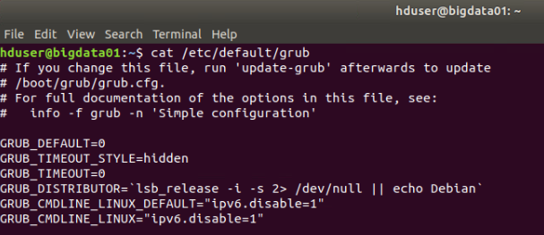
Disabling IPv6

Slide 36
Configuring Hadoop (already done on lab systems)
Once Hadoop is installed and the cluster is configured for no-password SSH access for the various users between the nodes, the cluster can be configured
Set JAVA_HOME in /usr/local/hadoop/etc/hadoop/hadoop-env.sh
export JAVA_HOME=/usr/lib/jvm/java-8-openjdk-amd64
Set the hostname and port number for HDFS in /usr/local/hadoop/etc/hadoop/core-site.xml
<configuration>
<property>
<name>fs.defaultFS</name>
<value>hdfs://bigdata01:9000</value>
</property>
</configuration>

Slide 37

Configuring Hadoop (already done on lab systems)
Create a file named /usr/local/hadoop/etc/hadoop/datanodes and add the names of the data nodes in the cluster
Configure DFS replication and DFS hosts in /usr/local/hadoop/etc/hadoop/hdfs-site.xml
<configuration>
<property>
<name>dfs.replication</name>
<value>1</value>
</property>
<property>
<name>dfs.hosts</name>
<value>datanodes</value>
</property>
</configuration>

Slide 38
Starting Hadoop
Before starting the cluster, format the HDFS file system on the name node:
hdfs namenode -format -force
After Hadoop is configured, start HDFS using the start-dfs.sh script (this will start HDFS across the entire cluster)
start-dfs.sh
When finished with your lab session, stop HDFS
stop-dfs.sh
This is not normally necessary on a production cluster, but since we are using VMs that are not permanently configured, we need to do this step

Slide 39
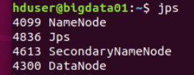
Useful Commands
To determine the version of Hadoop that is running:
hadoop version
To verify the HDFS processes are running, run the jps command
When HDFS is running, folders and files can be added to the HDFS file system
hdfs dfs -mkdir /data
hadoop fs -ls /

Slide 40
Useful Commands
Show the active name nodes
hdfs getconf -namenodes
Show the data node configuration
hdfs dfsadmin -report
The configured HDFS capacity for the cluster is displayed in the report
The configured capacity for each data node is also displayed, which will be approximately half of the capacity (or for more nodes, cluster capacity / number of nodes).
The value is approximate due to overhead associated with the HDFS file system.

Slide 41
Web Interfaces
Ambari is a full featured web interface for the Hadoop tool suite
Installation / configuration is not in the scope of this course
Hadoop provides a basic status dashboard for HDFS at (default) port 9870 (see next slide)

Slide 42
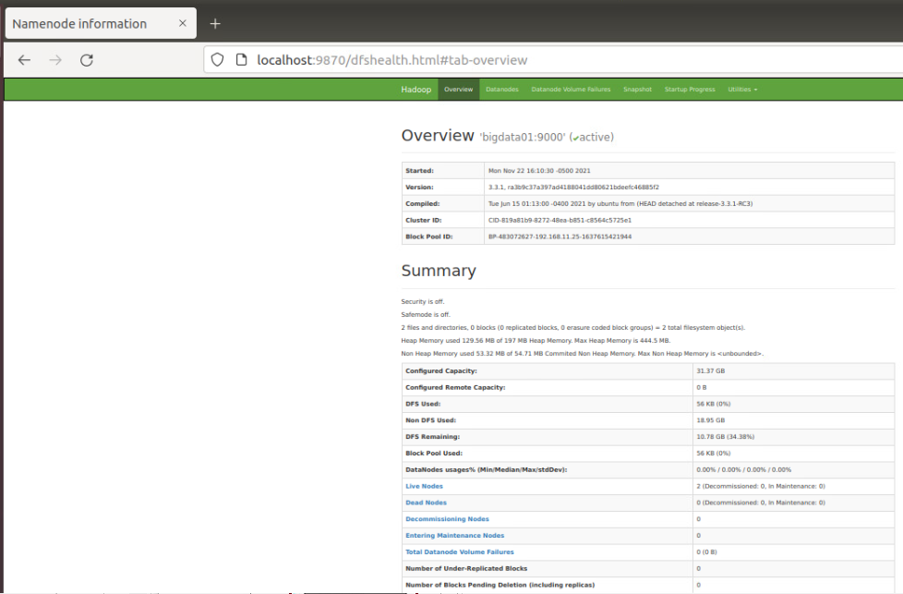
HDFS Status Dashboard (localhost:9870)

