Slide 1
CIS 2349C
Introduction To Big Data Using Hadoop
Module 2: Implementing Big Data Analytics
Textbook (Bahga) Ch. 6 HDFS
(White) Ch. 3 The Hadoop Distributed Filesystem Ch. 10 Installing a Hadoop Cluster

Slide 2
What is HDFS?
HDFS is a filesystem designed to handle large files – log files, sensor data, retail transactions, etc.
The filesystem is distributed across a cluster of nodes – hundreds or even thousands
Scales to large files, e.g. GB to TB in size
Processing can be performed in parallel
Nodes have close proximity to data
Failure-resistant – multiple block copies (distributed, replicated)
“Commodity Computing” -- special purpose computers not required
HDFS is designed more for batch processing rather than interactive use by users.
The emphasis is on high throughput of data access rather than low latency of data access.

Slide 3
What Doesn't Work Well with HDFS
Low-latency data access -- applications that require low-latency access to data, in the tens of milliseconds range, will not work well with HDFS.
HDFS is optimized for delivering high throughput of data, at the expense of latency.
Lots of small files -- because the namenode holds filesystem metadata in memory, the limit to the number of files in a filesystem is governed by the amount of memory on the namenode.
Multiple writers, arbitrary file modifications
Files in HDFS may be written to by a single writer.
Writes are always made at the end of the file, in append-only fashion (a recent feature)
There is no support for multiple writers or for modifications at arbitrary offsets in the file.

Slide 4
HDFS Architecture
Namenodes store locations of file blocks
“edit log” tracks new files, modified files, deleted files
manage data nodes
Datanodes – manage data blocks
Send periodic heartbeats and block reports to name node
Replicated data blocks are "rack-aware" so an entire rack can be lost without impacting data integrity
HDFS Architecture
Namenode
Datanode
Datanode
Datanode

Slide 5
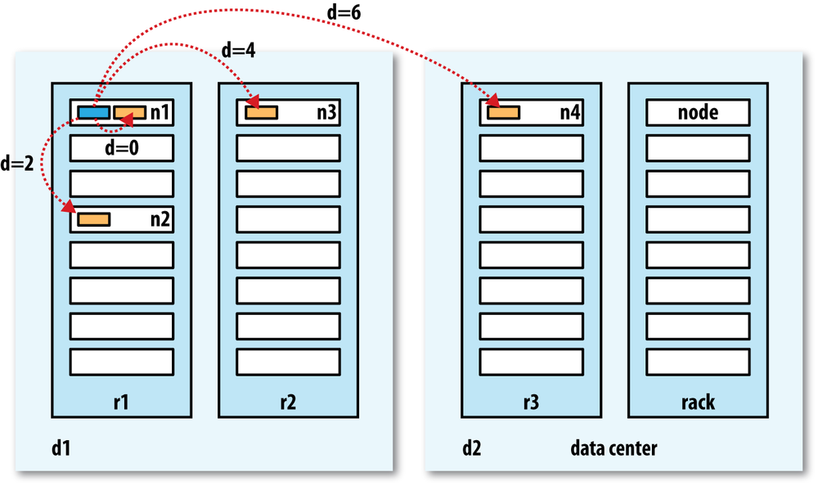
HDFS Architecture
HDFS attempts to localize distributed file block access as much as possible based on the network topology of the cluster and calculated distances between datanodes
An example of this localization might use the following (from more local to more distant)
Processes on the same node
Different nodes on the same rack
Nodes on different racks in the same data center
Nodes in different data centers
The topology is specified using configurable properties
4.
3.
2.
1.

Slide 6
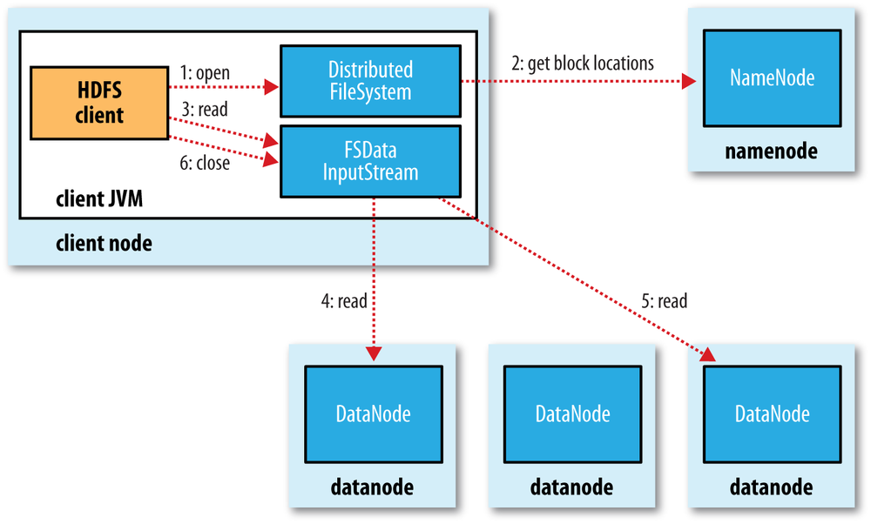
Reading a File
The client opens the file by calling open() on the FileSystem object, which for HDFS is an instance of DistributedFileSystem.
DistributedFileSystem calls the namenode to determine the locations of the first few blocks in the file. For each block, the namenode returns the addresses of the datanodes that have a copy of that block. The DistributedFileSystem returns an FSDataInputStream to the client for it to read data from. FSDataInputStream manages the datanode and namenode I/O.
The client then calls read() on the stream. FSDataInputStream, which has stored the datanode addresses for the first few blocks in the file, then connects to the first (closest) datanode for the first block in the file.
Data is streamed from the datanode back to the client, which calls read() repeatedly on the stream.
When the end of the block is reached, FSDataInputStream closes the connection to the datanode, then finds the best datanode for the next block. From the client's point of view, it is just reading a continuous stream. Blocks are read in order, with the FSDataInputStream opening new connections to datanodes as the client reads through the stream. It will also call the namenode to retrieve the datanode locations for the next batch of blocks as needed.
When the client has finished reading, it calls close() on the FSDataInputStream.

Slide 7
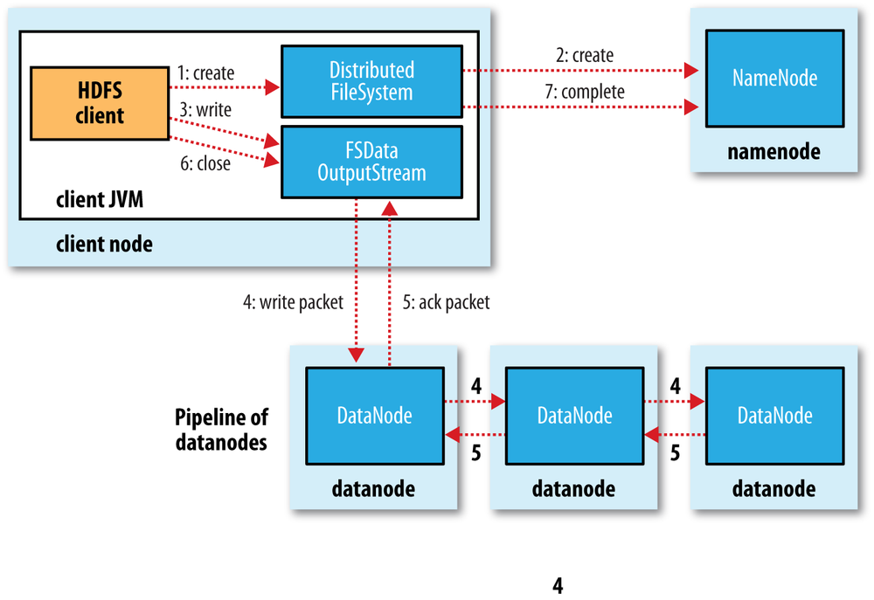
Writing a File
The client creates the file by calling create().
DistributedFileSystem creates a new file. The namenode checks that the file doesn’t already exist and that the client has permissions to create the file. The namenode makes a record of the new file. The DistributedFileSystem returns an FSDataOutputStream for the client to start writing data to.
As the client writes data, the FSDataOutputStream splits it into packets which it writes to an internal data queue. The data queue is consumed by a DataStreamer, which asks the namenode to allocate new blocks by picking a list of suitable datanodes to store the replicas. The list of datanodes forms a pipeline. The DataStreamer streams the packets to the first datanode in the pipeline, which stores each packet and forwards it to the second datanode in the pipeline.
The second datanode stores and forwards the packet to the next datanode in the pipeline.
The FSDataOutputStream maintains an "ack queue" of packets waiting to be acknowledged by datanodes. A packet is removed from the ack queue when it has been acknowledged by all the datanodes in the pipeline. If any datanode fails while data is being written to it, the pipeline is closed and FSDataOutputStream rearranges the queue to continue replicating on non-failing nodes.
When the client has finished writing data, it calls close() on the stream.
Closing the stream flushes all the remaining packets to the datanode pipeline; the client then waits for acknowledgments before contacting the namenode to signal that the operation is complete.

Slide 8


Node Redundancy – Single Point of Failure?
Only one namenode is active at a particular time, but HDFS provides redundancy using various strategies
Metadata backup to network drive
Secondary namenode
HDFS Federation partitioning with separate namenodes for each volume
HDFS High Availability: hot standby namenode w/shared edit log. "Zookeeper" tool tracks active name node. “Extreme measures” taken to ensure only one namenode active at a time (e.g. power shutdown for a misbehaving namenode)

Slide 9
Using HDFS
Ways to Use HDFS
UI (Ambari)
CLI
HTTP
Java (and other language) interfaces
NFS Gateway
HDFS appears as a single image
Most of the Hadoop framework is written in Java, but other languages can access it

Slide 10
HDFS Shell Commands
The File System (FS) shell includes various shell-like commands that directly interact with the Hadoop Distributed File System (HDFS) as well as other file systems that Hadoop supports
bin/hadoop fs <args>
If HDFS is being used, hdfs dfs is a synonym (used in this course)
Most of the commands behave like corresponding Unix commands.
Error information is sent to stderr and the output is sent to stdout
https://hadoop.apache.org/docs/current/hadoop-project-dist/hadoop-common/FileSystemShell.html

Slide 11
HDFS PUT and GET
PUT
Copies files to HDFS
Usage: hdfs dfs –put <local source> <destination on HDFS>
Example:
hdfs dfs -put localfile /user/hadoop/filecopy
GET
Copies files from HDFS
Usage: hdfs dfs –get <source on HDFS> <local destination>
Example:
hdfs dfs -get /user/hadoop/hdfsfile localfile

Slide 12
HDFS LS and CAT
LS
Lists files on HDFS
Usage: hdfs dfs –ls <args>
Example:
hdfs dfs –ls /user/hadoop
CAT
Shows contents of files on HDFS
Usage: hdfs dfs –cat <HDFS file path>
Example:
hdfs dfs -cat /user/hadoop/filename

Slide 13
HDFS RM and MKDIR
REMOVE
Removes an HDFS file
Usage: hdfs dfs –rm <HDFS file path>
Example:
hdfs dfs –rm /user/Hadoop/hdfsfile
CREATE
Creates an HDFS directory
Usage: hdfs dfs –mkdir <HDFS path>
Example:
hdfs dfs –mkdir /user/hadoop/newdir

Slide 14
HDFS RMDIR AND RM -R
RMDIR
Removes an HDFS folder
Usage: hdfs dfs –rmdir <HDFS folder path>
Example:
hdfs dfs –rmdir /user/Hadoop
Note: this command will fail if the folder is not empty
RM -R
Removes an HDFS folder recursively (included folder contents)
Usage: hdfs dfs –rm -r <HDFS folder path>
Example:
hdfs dfs –rm -r /user/Hadoop
Note: use with caution!

Slide 15
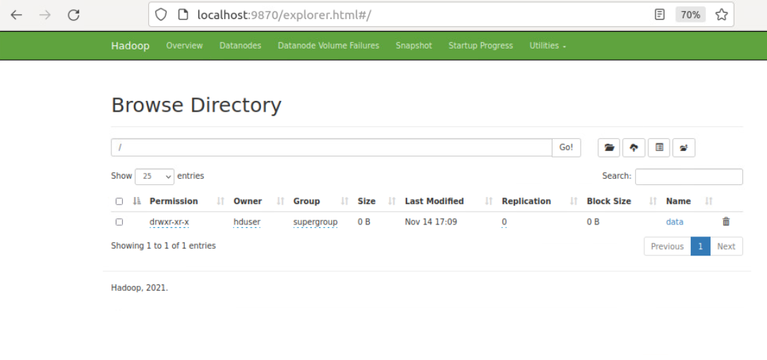
Web Interfaces and APIs
Use the "Utilities" tab on the Hadoop Web Admininistration page (port 9870) to work with the HDFS filesystem, "Browse Directory" tool

Slide 16
Web Interfaces and APIs for HDFS
Various frameworks and APIs (including open source) are available, including libraries designed for Java and Python access
The Snakebite package described in the Bahga textbook is obsolete
mrjob lets you write MapReduce jobs in Python and run them on several platforms.
Pydoop is a Python interface to Hadoop that allows you to access HDFS and write MapReduce applications in pure Python Pydoop's
HDFS API uses a C-language based API which is in turn a JNI (Java Native Interface) library that interacts with the JVM.
Hadoop provides a web-server implementation which allows access using a browser and REST APIs.

Slide 17
Using Java to Access HDFS
A dependency management tool such as Maven, Gradle, or Ant is highly recommended to build Java applications using Hadoop
The simplest method to access HDFS using Java is via an InputStream (see next slide)
Hadoop-specific imports required:
org.apache.hadoop.fs.FsUrlStreamHandlerFactory;
(factory implementation for HDFS-specific URLs)

Slide 18
Using Java to Access HDFS
public class JavaReadHDFSURL {
public static final String HOST = "hdfs://<hostname:port>/path";
try {
URL.setURLStreamHandlerFactor(new FsUrlStreamHandlerFactory());
InputStream is = new URL(HOST).openStream();
InputStreamReader isr = new InputStreamReader(is);
Buffered Reader br = new BufferedReader(isr);
String line = br.readLine();
while (line != null) {
System.out.println(line);
line = br.readLine();
}
} catch (IOException e) {
System.out.println("Local exception: " + e);
}
}

Slide 19
Using Python (Pydoop) to Access HDFS
To use Pydoop to access HDFS, Python 3 and pip3 are required
(This has been completed on the lab system)
On Ubuntu:
sudo apt-get update
sudo apt-get install python3
sudo apt-get -y install python3-pip
Installing pydoop (assuming environment variable values shown below):
sudo sh -c "export PATH=/usr/lib/jvm/java-8-openjdk-amd64:$PATH; export HADOOP_HOME=/usr/local/hadoop; export JAVA_HOME=/usr/lib/jvm/java-8-openjdk-amd64; pip3 install pydoop"

Slide 20
Using Pydoop to Access HDFS
To run Pydoop applications on Ubuntu, the LD_LIBRARY_PATH environment variable must be added to .bashrc so Pydoop can access Hadoop's native shared libraries:
export LD_LIBRARY_PATH=${HADOOP_HOME}/lib/native
The applications must access the namenode

Slide 21
Using Pydoop to Access HDFS
# testpydoop.py
# tests various Pydoop API calls
# HDFS must be up and running
import pydoop.hdfs as hdfs
# make a test folder
hdfs.mkdir('/test')
# write text to a file in the test folder
hdfs.dump('hello, world', '/test/hello.txt')

Slide 22
Using Pydoop to Access HDFS
# testpydoop.py (cont)
# read the file ('rt' mode is 'read text')
hdfs.load('/test/hello.txt', mode='rt')
# check file stats (size)
hdfs.stat('/test/hello.txt').st_size
# copy to a new file
hdfs.cp('/test/hello.txt', '/test/hello2.txt')

Slide 23
Using Pydoop to Access HDFS
# testpydoop.py (cont)
# read a big file (assumes u.data is present)
with hdfs.open('/data/u.data', mode='rt') as fi:
line = fi.readline()
while line:
print(line, end="")
line = fi.readline()

