Slide 1
CIS 2349C
Introduction To Big Data Using Hadoop
Module 3: Yarn and Hadoop I/O
Textbook (Bahga) Ch. 7.1 pp. 222-228
(White) Ch. 4 YARN Ch. 5 Hadoop I/O
(Murthy) Ch. 11 Apache Hadoo YARN
https://learning.oreilly.com/library/view/apache-hadoop-yarn/9780133441925/ch11.html#ch11lev1sec1

Slide 2
Ch. 4 YARN: What is YARN?
Yet Another Resource Negotiator
YARN is Hadoop’s cluster resource management system, introduced in Hadoop 2.
YARN enables multiple applications to run simultaneously on the same shared cluster and allows applications to negotiate resources based on need.
YARN provides APIs for requesting and working with cluster resources, but these are not typically used directly by user code.
Instead, users write to higher-level APIs which themselves are built on YARN and hide the resource management details from the user.

Slide 3
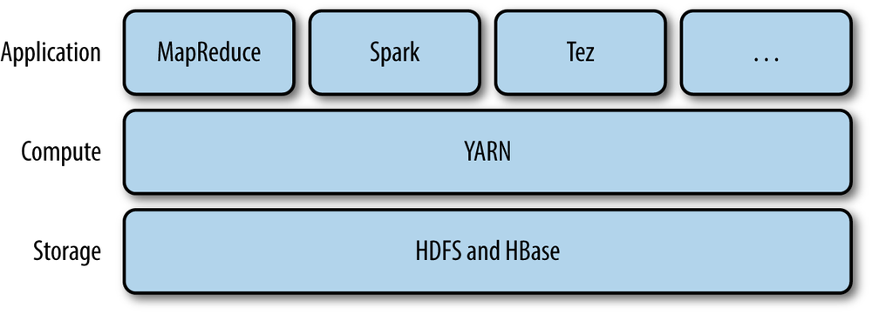
What is YARN?
MapReduce, Spark, and other applications use YARN as a cluster compute layer and the cluster storage layer (HDFS and HBase).

Slide 4
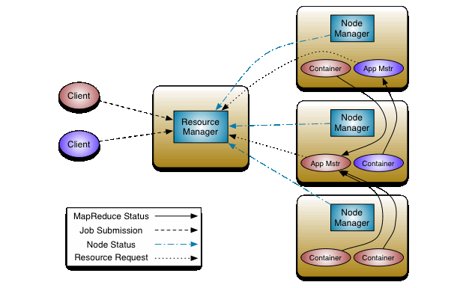
YARN Core Services
YARN provides two primary daemons:
a resource manager (one per cluster) to manage the use of resources across the cluster.
node managers running on all the nodes in the cluster to launch and monitor containers.
A timeline server has been added as a new feature (next slide)

Slide 5
YARN TimeLine Server
The YARN TimeLine Server provides storage and retrieval of an application’s current and historic information by
Persisting Application Specific Information
The collection and retrieval of information specific to an application or framework.
This information is then queryable via REST APIs for rendering by application/framework specific UIs.
Persisting Generic Information about Completed Applications
Generic information includes application level data such as
queue-name
user information
a list of attempts that ran for an application
information about each attempt
the list of containers run under each attempt
information about each container.

Slide 6
YARN Configuration
Configuration for YARN is contained in the $HADOOP_HOME/etc/hadoop/yarn-site.xml file
Setting the YARN resource manager:
<configuration>
<!-- Site specific YARN configuration properties -->
<property>
<name>yarn.resourcemanager.address</name>
<value>hostname:8032</value>
</property>
</configuration>

Slide 7
Starting the YARN daemons
Start the HDFS daemons first, then start the YARN daemons
The yarn command uses a --daemon option and start keyword to start its daemons by name
To stop use the stop keyword, stopping the daemons in reverse order
A simple script to start the YARN daemons:
echo "clearing cache"
$HADOOP_HOME/bin/yarn resourcemanager -format-state-store
echo "starting resource manager"
$HADOOP_HOME/bin/yarn --daemon start resource manager
sleep 1
# start timeline server if configured (optional)
#echo "starting timeline server"
#$HADOOP_HOME/bin/yarn --daemon start timelineserver
#sleep 1
echo "starting nodemanager"
$HADOOP_HOME/bin/yarn --daemon start nodemanager

Slide 8
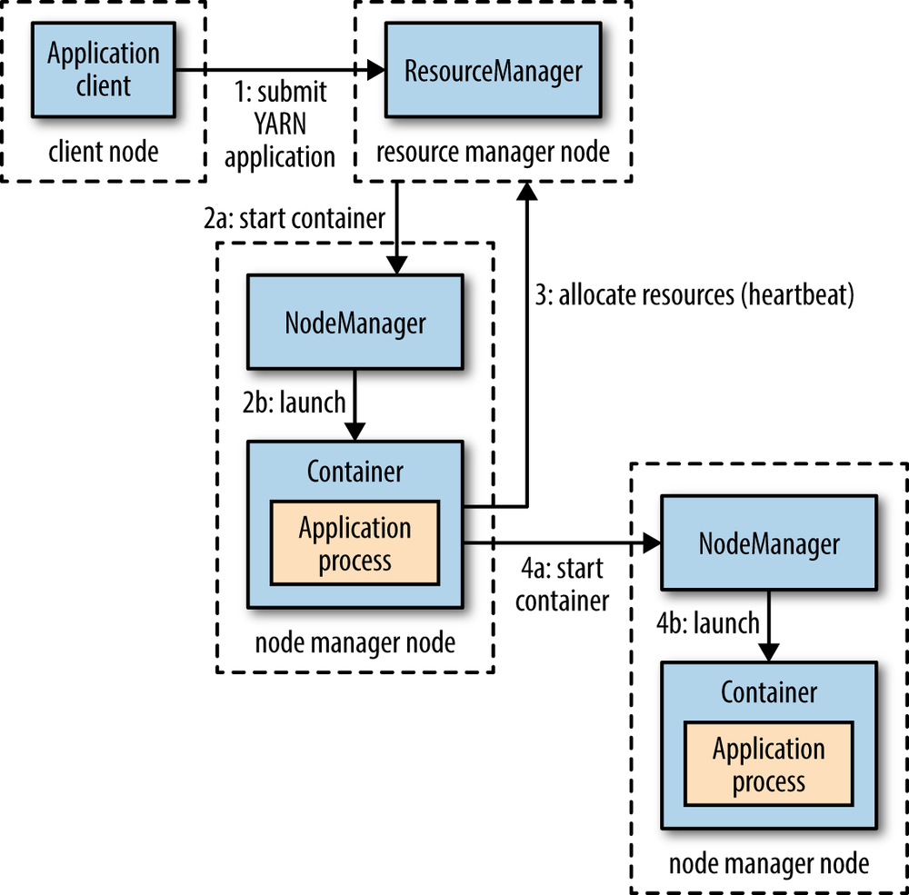
YARN Application Process
client contacts the resource manager and asks to run an application master process
(a) The resource manager instructs a node manager to start a new container.
(b) The node manager launches the container containing the application master on that node.
If necessary, the application master requests more containers from the resource manager and repeats steps 2a and 2b (steps 4a and 4b)

Slide 9
Resource Requests
A ResourceRequest represents a request made by an application to the ResourceManager to obtain various container allocations
A YARN resource request for a set of containers can specify the amount of computer resources required for each container (memory and CPU), as well as locality constraints for the containers in that request
Locality is critical in ensuring that distributed data processing algorithms use the cluster efficiently, so YARN allows an application to specify locality constraints for the containers it is requesting
Locality constraints can be used to request a container on a specific node or rack, or anywhere on the cluster (off-rack)

Slide 10
Resource Requests
If a locality constraint cannot be met, either no allocation is made or, optionally, the constraint can be loosened.
For example, if a specific node was requested but it is not possible to start a container on it (because other containers are running on it), YARN will try to start a container on a node in the same rack, or, if that’s not possible, on another node in the cluster.

Slide 11
Resource Requests
A YARN application can make resource requests at any time while it is running.
For example, an application can make all of its requests up front, or it can request more resources dynamically to meet the changing needs of the application.
Spark (covered in a subsequent module) takes the first approach, starting a fixed number of executors on the cluster.
MapReduce (also covered in a subsequent module) has two phases: the map task containers are requested up front, but the reduce task containers are not started until later.
If a MapReduce task fails, additional containers will be requested so the failed tasks can be rerun.

Slide 12
Application Lifespan
The lifespan of a YARN application can vary from a short-lived application of a few seconds to a long-running application that runs for days or even months.
Rather than look at how long an application runs, it’s useful to categorize applications in terms of how they map to the jobs that users run.
The simplest case is one application per user job, which is the approach that MapReduce takes.

Slide 13
Application Lifespan
The second model is to run one application per workflow or user session of (possibly unrelated) jobs.
This can be more efficient than one application per user, since containers can be reused between jobs, and there is also the potential to cache intermediate data between jobs.
Spark is an example that uses this model.

Slide 14
Application Lifespan
The third model is a long-running application that is shared by different users.
Apache Slider was an example of a long-running application master for launching other applications on the cluster
Slider has been integrated into the Hadoop core YARN services.
Apache Impala (a SQL-on-Hadoop alternative) is another example
Impala provides a proxy application for its daemons to request cluster resources.
The “always on” application master provides low-latency responses to queries since the overhead of starting a new application master is avoided

Slide 15
Building YARN Applications
Writing a YARN application is usually not necessary since there are many applications which are already written to use it
Spark and Tez are frequently used for batch processing with YARN
These applications execute DAGs: directed acyclic graph applications (see next slide)
Spark, Samza, and Storm are tools commonly used for stream processing with YARN
Hadoop provides a Distributed-Shell application, an example of a non-MapReduce application built on top of YARN.
Distributed-Shell is a simple mechanism for running shell commands and scripts in containers on multiple nodes in a Hadoop cluster.

Slide 16
DAGs (Directed Acyclic Graphs)
A directed graph is a collection of points (nodes, or vertices) and unidirectional connections (edges)
A directed acyclic graph (DAG) is a directed graph with no cycles (loops)
Node
Edge (note directional arrow)
B
E
A
D
C
F

Slide 17
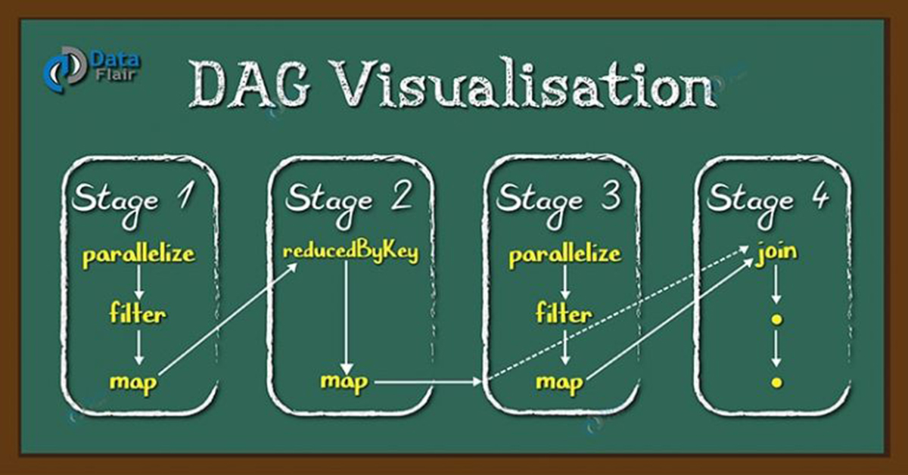
DAGs (Directed Acyclic Graphs)
A YARN application is either a single job or a DAG of jobs
For example, a DAG in Apache Spark is a set of nodes and edges, where
nodes represent a resilient distributed dataset (RDD), a Spark data structure on which operations are applied
edges represent the operation to be applied on the RDD.
every edge directs from earlier to later in the sequence
https://data-flair.training/blogs/dag-in-apache-spark/

Slide 18
Scheduling in YARN
The YARN scheduler allocates resources to applications according to a defined policy.
There is no one “best” policy, which is why YARN supports multiple schedulers and configurable policies.
Three schedulers are available in YARN:
First-In, First-Out (FIFO) Scheduler (default)
Capacity Scheduler
Fair Scheduler

Slide 19
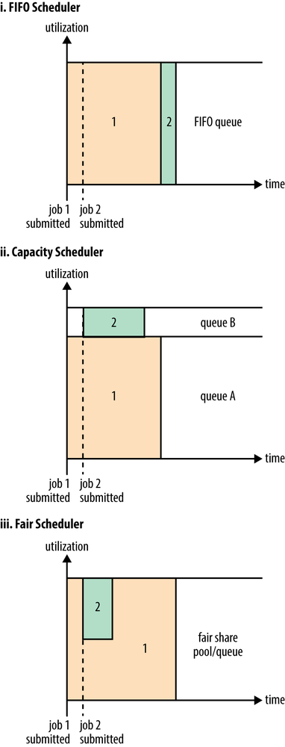
Scheduling in YARN
The FIFO Scheduler places applications in a queue and runs them in the order of submission (first in, first out).

Slide 20
Scheduling in YARN
The Capacity Scheduler (created by Yahoo) uses a separate dedicated queue with reserved resources which allows small jobs to start as soon as they are submitted.
Larger jobs may take longer if they have to wait for available resources

Slide 21
Scheduling in YARN
The Fair Scheduler (created by Facebook) dynamically balances resources between all running jobs.
A single large job will get all the resources in the cluster.
When a second job starts, it is allocated its fair share of resources.

Slide 22
Scheduling in YARN
FIFO is used by default
To specify a capacity or fair scheduler, the ${HADOOP_HOME}/etc/hadoop/yarn-site.xml file is used
<property> <name>yarn.resourcemanager.scheduler.class</name> <value> org.apache.hadoop.yarn.server.resourcemanager.scheduler.fair.FairScheduler </value> </property>
or
<property> <name>yarn.resourcemanager.scheduler.class</name> <value>yarn.resourcemanager.scheduler.class org.apache.hadoop.yarn.server.resourcemanager.scheduler.capacity.CapacityScheduler </value> </property>

Slide 23
Ch. 5 Hadoop I/O
Hadoop includes primitives and tools to enhance the processing of large data sets
Some of these are techniques that are more general than Hadoop, such as data integrity and compression, but deserve special consideration when dealing with multiterabyte datasets.
Others are Hadoop tools or APIs that form the building blocks for developing distributed systems, such as serialization frameworks and on-disk data structures.

Slide 24
Data Integrity
Hadoop and HDFS use checksums to verify data integrity
A checksum is computed for the data when it first enters the system, and again whenever it is transmitted across a channel that may be unreliable.
The data is corrupt if the new checksum doesn’t exactly match the original.
This technique doesn’t offer any way to fix the data—it is merely error detection
A CRC-32 ("32-bit cyclic redundancy check") checksum is used by Hadoop and a more efficient variant named CRC-32C is used by HDFS.
HDFS checksums all data written to it and (by default) verifies checksums when reading data.
When clients read data from datanodes, they verify checksums as well, comparing them with those stored on the datanodes.

Slide 25
Data Integrity
Because HDFS stores replicas of blocks, it can “heal” corrupted blocks by copying a replica to produce a new, uncorrupted copy.
If a client detects an error when reading a block, it reports the bad block and the datanode it was trying to read from to the namenode and then throws a ChecksumException.
The namenode marks the block replica as corrupt so it doesn’t direct any more clients to it or try to copy it to another datanode.
The namenode then schedules a copy of the block to be replicated on another datanode, so its replication factor is back at the expected level.
Once this has happened, the corrupt replica is deleted.

Slide 26
Data Integrity
It is possible to disable verification of checksums before using the open() method to read a file.
This is done from the shell by using the -ignoreCrc option with the -get or the equivalent -copyToLocal command.
This feature is useful if you have a corrupt file that you want to inspect so you can decide what to do with it.
You can find a file’s checksum with
hadoop fs -checksum
e.g.
hadoop fs -checksum hdfs://nn1.example.com/file1
hadoop fs -checksum file:///etc/hosts
This is useful to check whether two files in HDFS have the same contents

Slide 27
Compression
File compression:
reduces the space needed to store files
speeds up data transfer across the network or to and from a disk
For large datasets, the impact of compression can be significant
There are many different compression formats, tools, and algorithms, each with different characteristics.
Unlike some algorithms used for visual media, data processing algorithms need to be lossless so compressed data can be extracted with no loss of content
gzip (GNU zip, where GNU = "GNU's not Unix", a recursive acronym which represents the Free Software Foundation's Unix-like operating system and tools) is one of the most commonly used compression formats on Unix systems

Slide 28
Compression
gzip offers command line options to tailor the compression operations for either faster operation or better compression
e.g. gzip -1 filename
As described in the gzip man page:
-# --fast --best
Regulate the speed of compression using the specified digit #, where -1 or --fast
indicates the fastest compression method (less compression) and -9 or --best
indicates the slowest compression method (best compression). The default
compression level is -6 (that is, biased towards high compression at expense of
speed).
Other compression tools include bzip2, which is slower than gzip but supports splitting (random access within the compressed data) which can be a useful feature in Hadoop

Slide 29
Compression
For large files, use a compression format that supports splitting on the whole file, otherwise MapReduce applications can become very inefficient.
A codec (coder/decoder) is the implementation of a compression-decompression algorithm
Hadoop makes use of codecs to manipulate compressed data.
A Hadoop codec is represented by an implementation of the Java CompressionCodec interface.
The GzipCodec encapsulates the compression and decompression algorithm for gzip.
The BZip2Codec encapsulates the algorithm for bzip2.
Compressed input files are decompressed automatically as they are read by MapReduce, which uses the filename extension (e.g. gz for gzip or .bz2 for bzip2) to determine which codec to use.

Slide 30
Compression
The following snippet demonstrates the use of compression in a MapReduce application (MapReduce is covered in an upcoming module):
public static void main(String[] args) throws Exception {
Job job = new Job();
job.setJarByClass(MaxTemperature.class);
FileInputFormat.addInputPath(job, new Path(args[0]));
FileOutputFormat.setOutputPath(job, new Path(args[1]));
job.setOutputKeyClass(Text.class);
job.setOutputValueClass(IntWritable.class);
FileOutputFormat.setCompressOutput(job, true);
FileOutputFormat.setOutputCompressorClass(job, GzipCodec.class);

Slide 31
Serialization
Serialization is the process of turning structured objects into a byte stream for transmission over a network or for writing to persistent storage (e.g. binary files)
Marshalling is another term sometimes used to represent serialization
Deserialization (unmarshalling) is the reverse process of turning a byte stream back into a series of structured objects.
In Hadoop, communication between nodes in the system is implemented using remote procedure calls (RPCs).
The RPC protocol uses serialization to render messages (data) into a binary stream to be sent over the network to the remote node, which then deserializes the binary stream into the original message.

Slide 32
Serialization
Whether data is serialized over a network connection or to persistent storage, the process must be
compact (to make efficient use of network bandwidth and storage space)
fast (overhead when reading/writing terabytes of data must be minimal)
extensible (protocol changes may be needed)
interoperable (support multiple programming languages)
The Java language provides serialization, but it does not meet the above criteria
The org.apache.hadoop.io.serializer package provides a mechanism for using different serialization frameworks in Hadoop
Hadoop uses its own serialization format called Writables (no 'e'!)
Most MapReduce programs use Writables for their key and value types

Slide 33
Serialization
Writables are implemented using the Hadoop Writable interface
package org.apache.hadoop.io;
import java.io.DataOutput;
import java.io.DataInput;
import java.io.IOException;
public interface Writable {
void write(DataOutput out) throws IOException;
void readFields(DataInput in) throws IOException;
}

Slide 34
Serialization
Hadoop provides Writable wrapper classes for primitive types (similar to the Java language's wrapper classes for primitives)
The wrapper classes also include two variable sized types (VIntWritable and VLongWritable) for more efficient use of storage
Java primitive | Writable implementation | Serialized size (bytes)
boolean | BooleanWritable | 1
byte | ByteWritable | 1
short | ShortWritable | 2
int | IntWritable | 4
 | VIntWritable | 1–5
float | FloatWritable | 4
long | LongWritable | 8
 | VLongWritable | 1–9
double | DoubleWritable | 8

Slide 35
Serialization
Serializing an object (convert from object to stream)
IntWritable writable = new IntWritable(163);
// serialize the object into a byte array
byte[] bytes = serialize(writable);
// bytes can now be written to the net or to a file
public static byte[] serialize(Writable writable) throws IOException {
ByteArrayOutputStream out = new ByteArrayOutputStream();
// wrap ByteArrayOutputStream into DataOutputStream
DataOutputStream dataOut = new DataOutputStream(out);
writable.write(dataOut);
dataOut.close();
return out.toByteArray();
}

Slide 36
Serialization
Deserializing an object (convert from stream to object)
IntWritable newWritable = new IntWritable();
// assume bytes array has been read from net or file
deserialize(newWritable, bytes);
public static byte[] deserialize(Writable writable, byte[] bytes)
throws IOException {
ByteArrayInputStream in = new ByteArrayInputStream(bytes);
DataInputStream dataIn = new DataInputStream(in);
writable.readFields(dataIn);
dataIn.close();
return bytes;
}

Slide 37
Comparison
Hadoop provides two interfaces which support object comparison:
WritableComparable (extends java.lang.Comparable)
RawComparator (extends java.util.Comparator)
Comparison of data is crucial for MapReduce, which includes a sorting phase where keys are compared
Writable objects which implement RawComparator provide an optimization which allows comparison of records read from a stream without deserializing them into objects, avoiding object creation overhead.

Slide 38
The Hadoop Text Class
Text (org.apache.hadoop.io.Text) is a Writable class for UTF-8 sequences.
Text is the Writable equivalent of java.lang.String
UTF-8 is a variable length string encoding
Hadoop uses UTF-8 for interoperability with other tools which also use it
A Text object begins with a signed integer (1-4 bytes, depending on the size of the object) which stores the number of bytes in the string encoding (maximum size is 2GB)
Hadoop Text Object Structure
Length in bytes (1-4 bytes) | UTF-8 encoded code point (1-4 bytes) | UTF-8 encoded code point (1-4 bytes) | ... | UTF-8 encoded code point (1-4 bytes)

Slide 39
The Hadoop Text Class
The getLength() method of a Text object returns the number of bytes, whereas the length() method of a Java String returns the number of characters
The Text class is mutable
Indexing and iteration for Text objects are more complicated than for Java Strings
characters are Unicode code points with variable lengths
Text objects can be converted to Java String objects using the Text class's toString() method

Slide 40
The Hadoop Text Class - Iteration
public class TextIterator {
public static void main(String[] args) {
Text t = new Text("\u0041\u00DF\u6771\uD801\uDC00");
ByteBuffer buf = ByteBuffer.wrap(t.getBytes(), 0, t.getLength());
int cp;
while (buf.hasRemaining() && (cp = Text.bytesToCodePoint(buf)) != -1) {
System.out.println(Integer.toHexString(cp));
}
}
}
41
df
6771
10400

Slide 41
File-Based Data Structures
For doing MapReduce processing, putting "blobs" of binary data in a file doesn’t scale, so Hadoop uses a number of higher-level containers
Hadoop’s SequenceFile class provides a persistent data structure for binary key-value pairs
As an example, it can be used to store logfile data with a key, such as a timestamp represented by a LongWritable, and a Writable that represents the content being logged
HDFS and MapReduce are optimized for large files, so packing files into a SequenceFile makes storing and processing smaller files more efficient
Keys and values stored in a SequenceFile do not need to be Writables, they can be any serializable type

Slide 42
File-Based Data Structures
A MapFile is a sorted SequenceFile with an index to support lookups by key
The index is itself a SequenceFile that contains a subset of the keys in the map
The index can be loaded into memory to provide fast lookups from the main data file, which is another SequenceFile containing the map entries in sorted key order

Slide 43
(Murthy) Ch. 11 Using the YARN Distributed-Shell
The Hadoop release includes the Distributed-Shell application, an example of a non-MapReduce application built on top of YARN
Distributed-Shell is a simple mechanism for running shell commands and scripts in containers on multiple nodes in a Hadoop cluster
This application demonstrates how such a utility can be implemented on top of YARN
Distributed-Shell can be used as a starting point for exploring and building Hadoop YARN applications

Slide 44
Using the YARN Distributed-Shell
As with HDFS, several daemons need to be started before using the Distributed-Shell application
The YARN resource manager, timeline server, and node manager are started using the yarn command running as the yarn user
Simple commands using Ubuntu command line tools can be used to test, e.g. run the uptime command using yarn:
yarn org.apache.hadoop.yarn.applications.distributedshell.Client –jar \
$YARN_DS/hadoop-yarn-applications-distributedshell-$YARN_VERSION.jar \
-shell_command uptime

Slide 45
Using the YARN Distributed-Shell
If a command includes arguments, enclose the entire command in quotes, e.g.
yarn org.apache.hadoop.yarn.applications.distributedshell.Client –jar \
$YARN_DS/hadoop-yarn-applications-distributedshell-$YARN_VERSION.jar \
-shell_command "uptime -help"
Multiple containers can be specified as a command line argument:
yarn org.apache.hadoop.yarn.applications.distributedshell.Client –jar \
$YARN_DS/hadoop-yarn-applications-distributedshell-$YARN_VERSION.jar \
-shell_command "uptime -help" -num_containers 5

Slide 46
Using the YARN Distributed-Shell
Distributed-Shell redirects the output of the individual shell commands run on the cluster nodes into the log files
Results for each instance of the command are listed by container under an application-id directory.
For example, if the contents of the application-id directory are listed, two containers’ directories can be seen:
ls $YARN_HOME/logs/userlogs/application_1381961205352_0005 container_1381961205352_0005_01_000001 container_1381961205352_0005_01_000002
The first container log folder (000001) contains launch information
The second (and subsequent) folder (000002) contains command output in the form of stdout and stderr files

Slide 47
Using the YARN Distributed-Shell
Only the yarn user has permission to examine the contents of these directories
Running with multiple containers will produce output directories for each container
Once a job has completed the NodeManager will keep the logs for each container 10800 seconds by default (3 hours) and delete them once they have expired
This value is configurable - allow enough time for debugging if necessary
If YARN log aggregation is enabled the NodeManager will immediately concatenate all of the containers logs into one file and upload them into HDFS and delete them from the userlogs directory

Slide 48
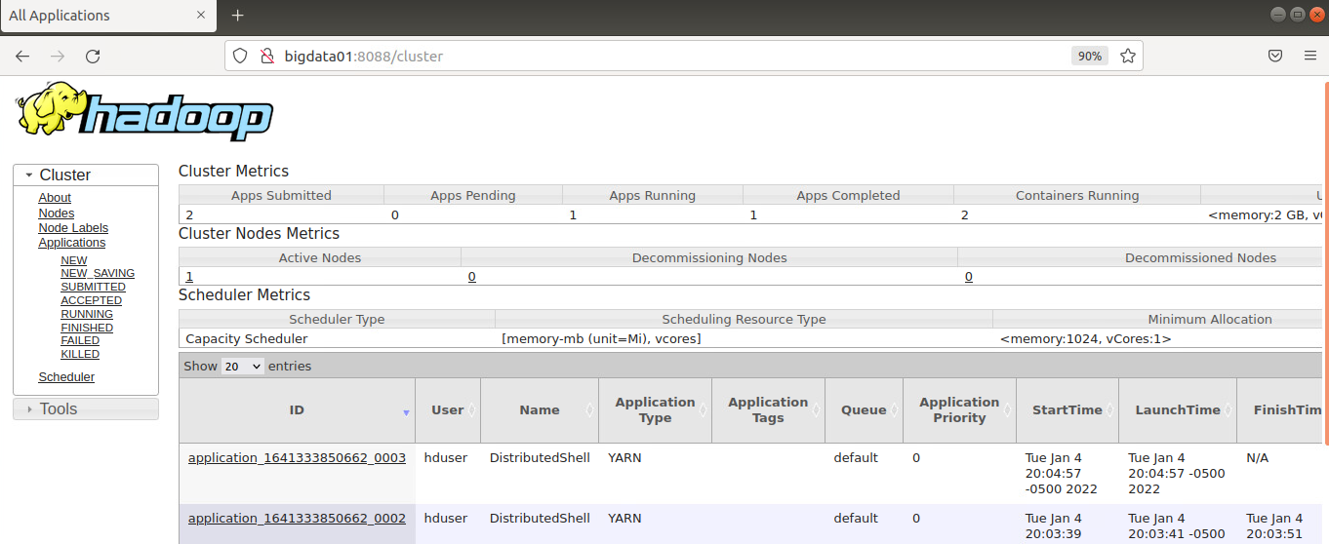
Using the YARN Web Console
Use a web browser to connect to hostname:8088 to monitor the YARN applications

