Slide 1
CIS 2349C
Introduction To Big Data Using Hadoop
Module 4: MapReduce
Textbook (Bahga) Ch. 7.2 pp. 228-233 MapReduce Examples
(White) Ch. 2 MapReduce

Slide 2
MapReduce
MapReduce is a distributed, parallel programming model used to process large datasets.
MapReduce programs can be written in various languages, in Hadoop this is commonly Java, Python, or C++
MapReduce works by breaking processing into two phases: the map phase and the reduce phase.
Mapping is the transformation of the data – extraction and organization of relevant data from the input stream
Reducing is the aggregation of the mapped data
Each phase has key-value pairs as input and output, the types of which may be chosen by the programmer.
The programmer specifies a map function and a reduce function.

Slide 3
Data Flow
A MapReduce job is a unit of work that the client wants to be performed: it consists of the input data, the MapReduce program, and configuration information.
Hadoop runs the job by dividing it into tasks, of which there are two types: map tasks and reduce tasks.
The tasks can be scheduled in Hadoop using YARN and run on nodes in the cluster.
If a task fails, it will be automatically rescheduled to run on a different node.

Slide 4
Data Flow
Hadoop divides the input to a MapReduce job into fixed-size pieces called input splits, or just "splits"
One map task is created for each split
The map task runs a user-defined map function for each record in the split.
The time taken to process each split is small compared to the time to process the whole input.
Splits are usually sized to be the same size as an HDFS block (128MB by default)
Small splits provide better load balancing, since a faster machine will be able to process proportionally more splits over the course of the job than a slower machine.
-But- if splits are too small, the overhead of managing the splits and map task creation begins to dominate the total job execution time.

Slide 5
Data Flow
Map tasks are usually run on the node where the input data resides in HDFS; this is called data locality optimization.
If all the nodes hosting the HDFS blocks for a map task’s input split are processing other map tasks, the job scheduler will look for a free node.
Map tasks write their output to the local disk, not to HDFS.
Since map task output is intermediate output, it is thrown away once the final output is produced.
Storing it in HDFS with replication is overkill
If the node running the map task fails before the map output has been consumed by the reduce task, Hadoop will automatically rerun the map task on another node to re-create the output.

Slide 6
Mapper Details
Blocks of data are assigned to nodes for mapping
Input Data
K1 V1 (Other fields)
K2 V2 (Other fields)
K5 V6 (Other fields)
K4 V4 (Other fields)
K2 V5 (Other fields)
K3 V3 (Other fields)
K1 V2 (Other fields)
Note: duplicate keys are allowed in the input data
K1 V1 (Other fields)
K2 V2 (Other fields)
K5 V6 (Other fields)
K4 V4 (Other fields)
K2 V5 (Other fields)
K3 V3 (Other fields)
K1 V2 (Other fields)
node 1
node 2
node 3

Slide 7
Mapper Details
Mapper output is passed through a "shuffle and sort" operation which aggregates values for each key, sorts the intermediate data by key and transfers it to the reducer.
K1 V1 (Other fields)
K2 V2 (Other fields)
K5 V6 (Other fields)
K4 V4 (Other fields)
K2 V5 (Other fields)
K3 V3 (Other fields)
K1 V2 (Other fields)
node 1
node 2
node 3
K1:V1, V2
K2:V2, V5
K3:V3
K4:V4
K5:V6
Shuffle and Sort: Data Sorted by Keys

Slide 8
Reducing
The reducer is called once for each unique key
Reducers run in parallel
All map values with the same key are assigned to a single reducer
Reducers aggregate data to determine a specified result, e.g. determine maximum or minimum value(s)
Output From Mapper
K1:V1
K2:V2
K3:V3
K1:V2
Shuffle and Sort
(Input To Reducer)
K1:V1, V2
K2:V2
K3:V3
Reducer
Mapper
Reducer
Reducer

Slide 9
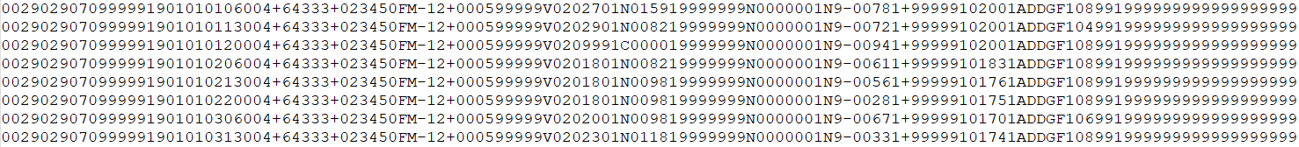
MapReduce Example
National Climatic Data Center (NCDC) data stored as a line-oriented ASCII format, each line is a record
Basic elements such as temperature are always present and are of fixed width
Station
Identifiers
ObservationDate/Time
Air Temp
(Celsius x 10)

Slide 10
Analyzing the Data with MapReduce
MapReduce breaks processing into the map phase and the reduce phase
Each phase has key-value pairs as input and output, the types of which may be chosen by the programmer.
The programmer also specifies two functions: the map function and the reduce function
The input to this problem's map phase is the raw NCDC data

Slide 11
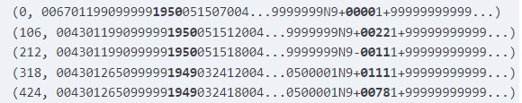
Analyzing the Data with MapReduce
The map function extracts the year and the air temperature from each line
The keys provided to the map function are the line offsets within the file, but in this analysis these keys are not used
(ignored)
year
temp

Slide 12
Analyzing the Data with MapReduce
The map function sets up the data so the reduce function can find the maximum temperature
The map function also drops bad records by filtering out temperatures that are missing, suspect, or erroneous
The output of the map function takes the form of (year, temperature)
(note that in our lab for this module we are only using one file which covers the year 1901)
(1950, 0)
(1950, 22)
(1950, −11)
(1949, 111)
(1949, 78)
...

Slide 13
Analyzing the Data with MapReduce
The output from the map function is processed by the MapReduce framework before being sent to the reduce function
This processing sorts and groups the key-value pairs by key.
The input to the reduce function includes each year with a list of all of that year's temperatures:
The reduce function iterates through the list to determine the max temperature for each year as the final output:
(1949, [111, 78])
(1950, [0, 22, −11])
(1949, 111)
(1950, 22)

Slide 14
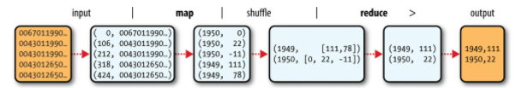
Analyzing the Data with MapReduce
MapReduce logical data flow (White textbook, Fig 2-2)

Slide 15
Java MapReduce: Mapper Class
Three things are needed to run a MapReduce job:
a map function
a reduce function
code to run the job
The mapper is implemented in an extension of the abstract and generic Mapper class, which declares an abstract map() method
The four formal type parameters specify the input key, input value, output key, and output value types of the map function.
Class Mapper<KEYIN,VALUEIN,KEYOUT,VALUEOUT>
public class MaxTemperatureMapper
extends Mapper<LongWritable, Text, Text, IntWritable> {

Slide 16
Java MapReduce: map()
The map method is called once for each key/value pair in the input split
The map method is abstract, designed to be overridden
A key, value, and Mapper Context are passed as parameters (the Context is used for writing output records)
For this problem the input line is converted to a Java String and the substring() method is used to extract the relevant columns (next slide)
protected void map(
KEYIN key,
VALUEIN value,
org.apache.hadoop.mapreduce.Mapper.Context context)
throws IOException,
InterruptedException

Slide 17
Java MapReduce: map()
The overridden map method:
private static final int MISSING = 9999;
@Override
public void map(LongWritable key, Text value, Context context)
throws IOException, InterruptedException {
String line = value.toString();
String year = line.substring(15, 19);
int airTemperature;
if (line.charAt(87) == '+') { // parseInt doesn't like leading +
airTemperature = Integer.parseInt(line.substring(88, 92));
} else {
airTemperature = Integer.parseInt(line.substring(87, 92));
}
String quality = line.substring(92, 93);
if (airTemperature != MISSING && quality.matches("[01459]")) {
context.write(new Text(year), new IntWritable(airTemperature));
}
}

Slide 18
Java MapReduce: Reducer Class
The reducer is implemented in an extension of the abstract and generic Reducer class, which declares an abstract reduce() method
As with the Mapper class, four formal type parameters are declared; these also specify the input and output values, but with different types
Class Reducer<Text, IntWritable, Text, IntWritable>
public class MaxTemperatureReducer
extends Reducer<Text, IntWritable, Text, IntWritable> {

Slide 19
Java MapReduce: reduce()
The input types of the reduce function must match the output types of the map function
reduce() is called once for each key
protected void reduce(
KEYIN key,
Iterable<VALUEIN> values,
org.apache.hadoop.mapreduce.Reducer.Context context)
throws IOException,
InterruptedException

Slide 20
Java MapReduce: reduce()
The overridden reduce method:
@Override
public void reduce(Text key, Iterable<IntWritable> values, Context context)
throws IOException, InterruptedException {
int maxValue = Integer.MIN_VALUE;
for (IntWritable value : values) {
maxValue = Math.max(maxValue, value.get());
}
context.write(key, new IntWritable(maxValue));
}

Slide 21
Java MapReduce: Running the Job
The Hadoop Job object is packaged into a JAR file which is distributed to the cluster when the job is run
The input data is specified by its path and can consist of one or more files
The output path must specify a new folder, if the folder exists the job will fail (as designed to prevent data loss/overwriting existing files)
To execute the MaxTemperature MapReduce program, use the following command after copying the input data file "1901" to the HDFS /data folder (this is slightly different than the textbook example):
hadoop jar hadoop-examples.jar MaxTemperature /data/1901 output

Slide 22
Java MapReduce: Running the Job
public static void main(String[] args) throws Exception {
if (args.length != 2) {
System.err.println("Usage: MaxTemperature <input path> <output path>");
System.exit(-1);
}
Job job = new Job();
job.setJarByClass(MaxTemperature.class);
job.setJobName("Max temperature");
FileInputFormat.addInputPath(job, new Path(args[0]));
FileOutputFormat.setOutputPath(job, new Path(args[1]));
job.setMapperClass(MaxTemperatureMapper.class);
job.setReducerClass(MaxTemperatureReducer.class);
job.setOutputKeyClass(Text.class);
job.setOutputValueClass(IntWritable.class);
System.exit(job.waitForCompletion(true) ? 0 : 1);
}

Slide 23
Java MapReduce: Running the Job
The map and reduce classes are set via setMapperClass() and setReducerClass() methods
setMapOutputKeyClass() and setMapOutputValueClass() set the output types for the reduce() method and must match the implementation in the Reducer class
The Job class's waitForCompletion() method submits the job and waits for it to finish
A single Boolean argument is provided to the method indicating whether verbose output should be generated.
When true, the job writes information about its progress to the console
The return value of waitForCompletion() method is a Boolean indicating success (true) or failure (false), which translates into the program’s exit code of 0 or 1

Slide 24
Java MapReduce: Running the Job
hadoop jar hadoop-examples.jar MaxTemperature /data/1901 output
The hadoop command is invoked with the jar subcommand, an associated JAR file name, and target class contained in the JAR.
A JVM is launched to run the class.
The Hadoop libraries (and their dependencies) are added to the classpath and the Hadoop configuration information is also included

Slide 25
Java MapReduce: Running the Job
The output from running the job provides useful information, including the IDs of the job and of the map and reduce tasks; knowing the job and task IDs can be very useful when debugging MapReduce jobs
The last section of the output, titled “Counters,” shows the statistics that Hadoop generates for each job it runs
These are very useful for checking whether the amount of data processed is what is expected
In this example five map input records produced five map output records (since the mapper emitted one output record for each valid input record), then five reduce input records in two groups (one for each unique key) produced two reduce output records
The output is written to the output directory, which contains one output file per reducer.

Slide 26
Java MapReduce: Running the Job
This example's job had a single reducer, with a single file named part-r-00000:
% cat output/part-r-00000 1949 111 1950 22
This result should be the same that was produced using the awk script.
This output is interpreted as saying that the maximum temperature recorded in 1949 was 11.1°C, and in 1950 it was 2.2°C

Slide 27
Scaling
Using HDFS allows Hadoop to move the MapReduce computation to each datanode using YARN
Hadoop uses data locality to try to run the map task on a node where the input data resides
If all the nodes hosting the blocks for a map task’s split are running other map tasks, the job scheduler will look for a free map slot on a node in the same rack as one of the blocks
If this is not possible, an off-rack node is used
This is why the optimal split size is the same as the block size: it is the largest size of input that can be guaranteed to be stored on a single node.
If a split spans two blocks, it is unlikely that any one HDFS node will store both blocks, so some of the split will be transferred across the network to the node running the map task

Slide 28
Scaling
Reduce tasks don’t have the advantage of data locality; the input to a single reduce task is normally the output from all mappers
In the MaxTemperature example, there is a single reduce task that is fed by all of the map tasks
Therefore, the sorted map outputs have to be transferred across the network to the node where the reduce task is running, where they are merged and then passed to the user-defined reduce function
The output of the reduce is normally stored in HDFS for reliability
For each HDFS block of the reduce output, the first replica is stored on the local node, with other replicas being stored on off-rack nodes for reliability
Writing the reduce output does consume network bandwidth, but only as much as a normal HDFS write pipeline consumes

Slide 29
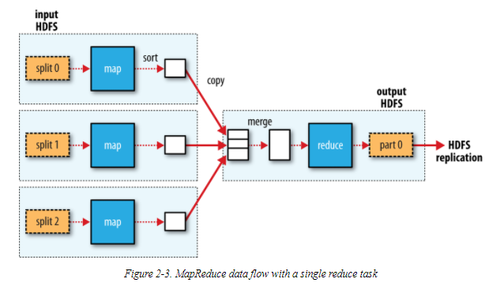
Scaling: Data Flow (Single Reducer)
The data flow with a single reducer is shown below
The dotted boxes are nodes, the dotted arrows are data transfers on a node, and the solid arrows are data transfers between nodes

Slide 30
Scaling
The number of reduce tasks is not governed by the size of the input, but instead is specified independently
When there are multiple reducers, map tasks partition their output, each creating one partition for each reduce task.
There can be many keys (and associated values) in each partition, but records for any given key are all in a single partition
Partitioning can be user-defined, but otherwise is controlled by default values
It is possible to have no reduce tasks when the shuffle (from "shuffle and sort") step is determined to be unnecessary

Slide 31
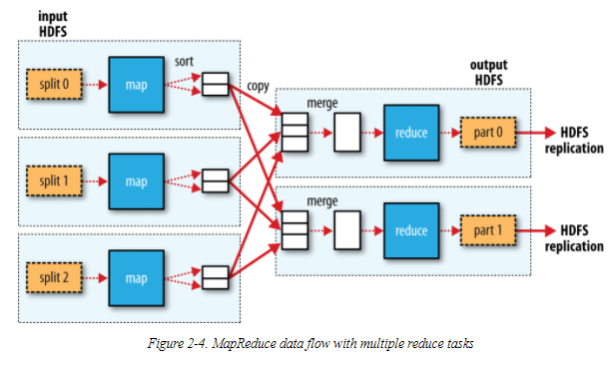
Scaling: Data Flow (Multiple Reducers)
The data flow with a multiple reducers is shown here

Slide 32
Combiner Functions
Many MapReduce jobs are limited by the bandwidth available on the cluster, so minimizing the data transferred between map and reduce tasks can be beneficial.
Hadoop allows the user to specify a combiner function to be run on the map output, and the combiner function’s output forms the input to the reduce function.
Because the combiner function is an optimization, Hadoop does not provide a guarantee of how many times it will call it for a particular map output record, if at all.
Calling the combiner function zero, one, or many times should produce the same output from the reducer.

Slide 33
Combiner Functions
The combiner function is defined using the Reducer class
For the MaxTemperature application, it is the same implementation as the reduce function
The only change needed is to make is to set the combiner class on the Job
public class MaxTemperatureWithCombiner {
public static void main(String[] args) throws Exception {
...
Job job = new Job();
job.setJarByClass(MaxTemperatureWithCombiner.class);
job.setJobName("Max temperature");
...
job.setMapperClass(MaxTemperatureMapper.class);
job.setCombinerClass(MaxTemperatureReducer.class);
job.setReducerClass(MaxTemperatureReducer.class);
...
}
}

Slide 34
Hadoop Streaming
Hadoop provides an API to MapReduce for map and reduce functions in languages other than Java.
Hadoop Streaming uses Unix standard streams as the interface between Hadoop and the application, so any language that can read standard input and write to standard output can be used.
Streaming is naturally suited for text processing.
Map input data is passed over standard input to your map function, which processes it line by line and writes lines to standard output.
A map output key-value pair is written as a single tab-delimited line.
Input to the reduce function is in the same format—a tab-separated key-value pair—passed over standard input.
The reduce function reads lines from standard input, which the framework guarantees are sorted by key, and writes its results to standard output.

