Slide 1
CIS 2349C
Introduction To Big Data Using Hadoop
Module 5: Big Data Patterns
Textbook (Bahga) Ch. 3 Big Data Patterns

Slide 2
Analytics Architecture Components and Design Styles
There are several common design patterns that can be used to alleviate issues raised by problematic traffic patterns
Load leveling with queues: Intermittent heavy loads (high data velocity) can be resolved by load leveling using message queues
Queues act as buffers between producers and consumers to prevent overload
Queues decouple producers and consumers – they do not need to be aware of each other
The components can work asynchronously; even when a consumer is unavailable, the producer can continue adding messages to the queue
Producer
Message Queue
Producer
Consumer
Producer

Slide 3
Load Balancing with Multiple Consumers
Adding more consumers helps to balance the load and make systems more scalable
Producer
Message Queue
Consumer 1
Producer
Consumer 2
Producer
Consumer 3

Slide 4
Leader Election
Coordination is important when multiple distributed nodes are running jobs in parallel
Typically a leader is assigned the role of managing and coordinating node state and activities
Leader election: the "election" of one node as a leader
e.g. elect the node with the highest ID (assuming the assignment of unique IDs to each node)
The Bully algorithm uses leader election to initiate an election when a node detects failure of the current leader
If the node receives no response it declares itself as the leader
If the node receives a response, it waits for another node to declare itself as the leader
If the responding new leader node has a lower ID, then the original node initiates a new election

Slide 5
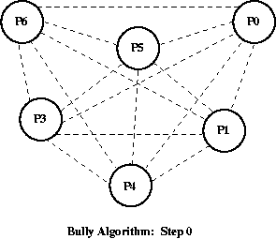
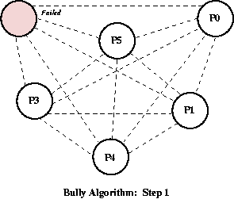
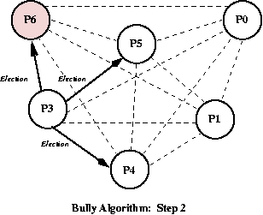
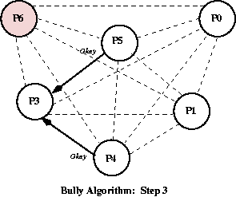
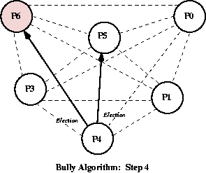
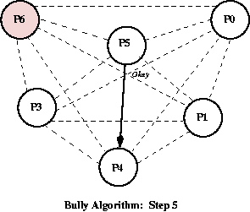
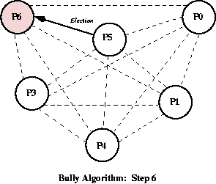
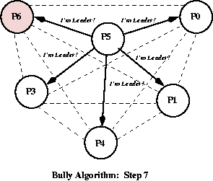
Bully Algorithm
2. Process 3 starts an election after noticing Process 6 is not responding. It notifies processes with IDs greater than 3
3. Both Process 4 and Process 5 respond,
telling Process 3 that they'll take over from here.
0. Start with 6 processes. Process 6 is the leader since it has the highest ID
https://www.cs.colostate.edu/~cs551/CourseNotes/Synchronization/BullyExample.html
1. Process 6 fails
4. Process 4 sends election messages to both Process 5 and Process 6.
5. Only Process 5 answers and takes over the election.
6. Process 5 sends out only one election message to Process 6.
7. When Process 6 does not respond Process 5 declares itself the winner.

Slide 6
Sharding
Vertical scaling -- adding more compute, storage, and memory resources to a single node -- can be beneficial for short term needs, big data problems will eventually generate more data than can be stored in this fashion
Sharding partitions data horizontally across multiple nodes, which improves system performance and response times.
Vertical partitioning divides data tables by column, distributing them on different nodes
Horizontal partitioning divides and distributes the rows across a cluster, reducing the total number of rows in each node's data
Each partition is known as a shard
Sharding can be done at various layers in an architecture, typically in a DB
HDFS uses a form of sharding at a lower level for the file system
MongoDB, Cassandra, and Hive support sharding
Various strategies (e.g. hashing) can be applied to prevent hotspots and maintain data locality
Shards can be replicated for reliability

Slide 7
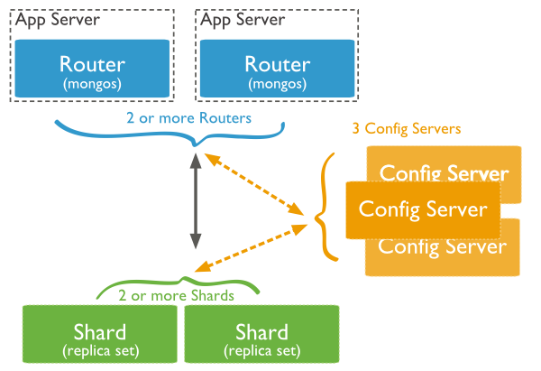
Sharding in MongoDB
Shards store data and provide high availability.
Query Routers are mongo instances which interface with client applications and direct operations to the appropriate shard.
The query router processes and targets the operations to shards and then returns results to the clients.
A sharded cluster can contain more than one query router to divide the client request load.
Config Servers store the cluster metadata, mapping the cluster data set to the shards.
The query router uses this metadata to target operations to specific shards.
https://www.tutorialspoint.com/mongodb/mongodb_sharding.htm

Slide 8
CAP Theorem
CAP (Consistency, Availability & Partition Tolerance): a partitioned, distributed data system can be a combination of any two of the following characteristics, but not all three:
Consistency: all read operations include the most recent write operations
Availability: system responds to all queries, even when some nodes fail
Partition tolerance: system is unaffected by network partitions which occur when two or more sets of nodes cannot communicate with each other, i.e. "split brain"
Some NoSQL databases (e.g. Cassandra) favor availability over consistency and partition tolerance (textbook p.93 is incorrect here)
HBase favors consistency and partition over availability

Slide 9
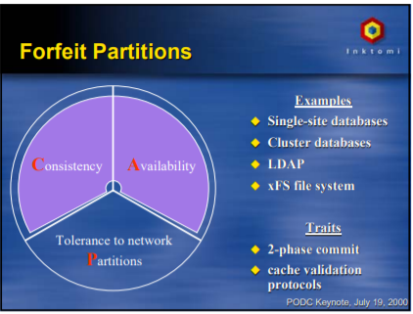
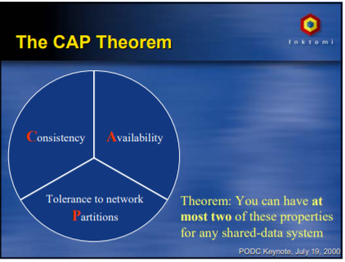
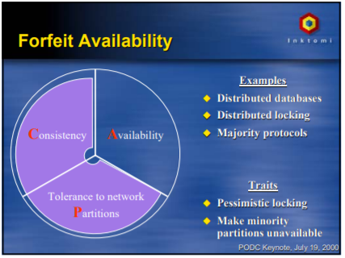
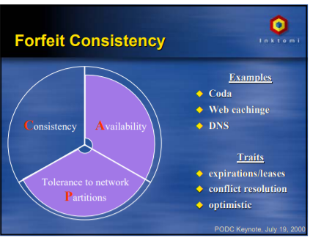
CAP Theorem
https://people.eecs.berkeley.edu/~brewer/cs262b-2004/PODC-keynote.pdf

Slide 10
Lambda Architectures
Lambda Architecture is a data processing architecture designed to handle both batch and stream processing and resolve latencies of MapReduce
Three layers:
Batch Layer: stores the master dataset and pre-computes the batch views
Serving Layer: indexes batch views for fast querying
Speed Layer: processes recent data and generates real-time views
Data model must be immutable (append-only)

Slide 11
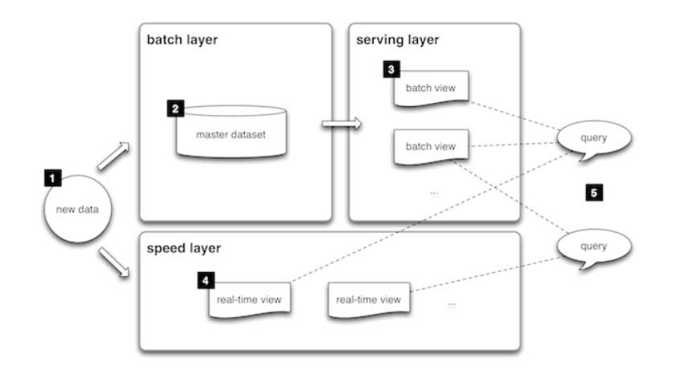
Lambda Architectures
Benefits
No server management required
Flexible and automatic scaling
Automated High Availability – serverless applications have built-in availability and fault tolerance. It represents a guarantee that all requests will
Business Agility – real-time adaptation to changing scenarios
Challenges
Complexity – lambda architectures can be highly complex, typically requires two separate code bases for batch and streaming layers
https://databricks.com/glossary/lambda-architecture

Slide 12
Scheduler-Agent-Supervisor
Scheduler-Agent-Supervisor is a pattern which supports resilience and fault tolerance
Applications submit tasks to scheduler
Scheduler assigns tasks to worker nodes via agents, tracks progress of each task
Maintains state store (e.g. NoSQL) which stores task status information
Agent manages worker nodes
notified by scheduler for new tasks, sends task progress to scheduler
may send task status heartbeats (not "heartbeasts", pg. 96 of text) to scheduler
Supervisor monitors status of each task and notifies scheduler
Can retry failed or timed-out tasks

Slide 13
Scheduler-Agent-Supervisor
Worker Node
Application
Supervisor
Tasks
Agent
Worker Node
Scheduler
Agent
Worker Node
State Store
Agent

Slide 14
Pipes and Filters
The Pipes and Filters pattern describes splitting a complex task into a series of distinct tasks to improve performance, scalability, and reliability
Filters are the processing components
Pipes are the connections between the filters
Useful for processing streams in real-time analytics
Complex
Task
Data Source
Data Sink
Filter
Data Source
Task Component 1
Task Component 2
Task Component 3
Data Sink
Pipe

Slide 15
Pipe and Filter Parallelization
Filters can be parallelized using multiple workers, making the system more reliable in the case of a single failed worker
Task Component 2a
Data Source
Task Component 1
Task Component 2b
Task Component 3
Data Sink
Task Component 2c

Slide 16
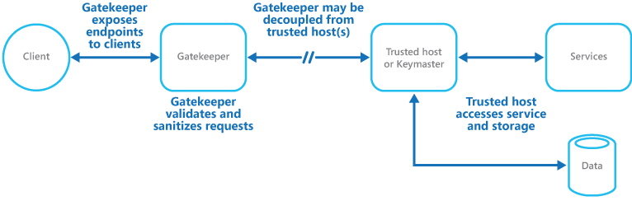
Web Services and the Gatekeeper Pattern
Web services decouple clients from the data processing system
Processing functionality is exposed to client using REST or Graph APIs that encode responses as JSON or XML
The Gatekeeper pattern describes the use of a dedicated host instance that acts as a broker between clients and the application or service
The Gatekeeper increases security by validating and sanitizing requests, and passing requests and data between clients and the application
Client
Gatekeeper
Trusted Host/
Web Service
Analytics Components
Data
https://docs.microsoft.com/en-us/azure/architecture/patterns/gatekeeper

Slide 17
MapReduce Patterns: Numerical Summarization
Numerical summarizations compute summary data such as counts, maximums, minimums, means, and more
For counts:
the mapper uses the key in the key-value pair as the group-by field and the value is used as the counted value
the reducer receives the grouped pairs and calculates the count
e.g. count page visits
Mapper extracts the following key-value pairs from the input data (e.g. web server logs)
key: URL
value: 1
Reducer sums the values to count

Slide 18
MapReduce Patterns: Numerical Summarization
Input => Map
Input | 2020-04-21 10:31:22 http://example1.com/index.html 2020-04-21 11:50:17 http://example1.com/index.html 2020-04-21 13:31:19 http://example2.com/index.html 2020-04-22 10:41:31 http://example2.com/index.html 2020-04-22 15:01:54 http://example3.com/index.html 2020-04-23 14:21:53 http://example1.com/index.html 2020-04-23 14:41:42 http://example2.com/index.html 2020-04-23 16:11:27 http://example1.com/index.html 2020-04-23 16:31:39 http://example3.com/index.html 2020-04-24 08:51:17 http://example1.com/index.html
Map | http://example1.com/index.html 1 http://example1.com/index.html 1 http://example2.com/index.html 1 http://example2.com/index.html 1 http://example3.com/index.html 1 http://example1.com/index.html 1 http://example2.com/index.html 1 http://example1.com/index.html 1 http://example3.com/index.html 1 http://example1.com/index.html 1

Slide 19
MapReduce Patterns: Numerical Summarization
Map => Sort and Shuffle
Map | http://example1.com/index.html 1 http://example1.com/index.html 1 http://example2.com/index.html 1 http://example2.com/index.html 1 http://example3.com/index.html 1 http://example1.com/index.html 1 http://example2.com/index.html 1 http://example1.com/index.html 1 http://example3.com/index.html 1 http://example1.com/index.html 1
Sort and Shuffle | http://example1.com/index.html 1 http://example1.com/index.html 1 http://example1.com/index.html 1 http://example1.com/index.html 1 http://example1.com/index.html 1 http://example2.com/index.html 1 http://example2.com/index.html 1 http://example2.com/index.html 1 http://example3.com/index.html 1 http://example3.com/index.html 1

Slide 20
MapReduce Patterns: Numerical Summarization
Sort and Shuffle => Reduce => Output
Sort and Shuffle | http://example1.com/index.html 1 http://example1.com/index.html 1 http://example1.com/index.html 1 http://example1.com/index.html 1 http://example1.com/index.html 1 http://example2.com/index.html 1 http://example2.com/index.html 1 http://example2.com/index.html 1 http://example3.com/index.html 1 http://example3.com/index.html 1
Reduce | http://example1.com/index.html 5 http://example2.com/index.html 3 http://example3.com/index.html 2
Output | http://example1.com/index.html 5 http://example2.com/index.html 3 http://example3.com/index.html 2

Slide 21
MapReduce Patterns: Numerical Summarization
# Python code to count page visits
from mrjob.job import MRJob
class MRmyjob(MRJob):
def mapper(self, _, line):
# Split the line with tab separated fields
data = line.split('\t')
# Parse line
url = data[2].strip()
yield url, 1 # emit URL and 1
def reducer(self, key, list_of_values):
yield key, sum(list of values)
if __name__ == '__main__':
MRmyjob.run()

Slide 22
MapReduce Patterns: Max/Min
The mapper uses the key in the key-value pair as the group-by field and the value contains a count value to be considered as max/min
the reducer receives the grouped pairs and determines the max/min
e.g. most visited page per month
multiple reduce phases
Mapper extracts the following key-value pairs from the input data (e.g. web server logs)
key: tuple(month, URL)
value: 1
Reducer (phase 1) sums values to generate page count per URL per month
key: month
value: tuple(monthly page visit count, URL)
Reducer (phase 2) computes the maximum visit count from the list of values grouped by month from phase 1

Slide 23
MapReduce Patterns: Max/Min
# Python code to calculate max page visits per month
from mrjob.job import MRJob
class MRmyjob(MRJob):
def mapper(self, _, line):
# Split the line with tab separated fields
data = line.split('\t')
# Parse line
date = data[0].strip()
url = data[2].strip()
# extract year and month
year = date[0:4]
month = date[5:7]
yield url, 1 # emit (month, URL), 1
def reducer1(self, key, list_of_values):
yield key[0], (sum(list of values), key[1])

Slide 24
MapReduce Patterns: Max/Min
def reducer3(self, key, list_of_values):
yield key, max(list_of_values)
# steps method provided by MRJob, override for multi-step jobs
def steps(self):
return [
MRStep(mapper=self.mapper, reducer=self.reducer1),
MRStep(reducer = self.reducer2)
]
if __name__ == '__main__':
MRmyjob.run()

Slide 25
MapReduce Patterns: Other Patterns
Many other MapReduce patterns exist for solving different types of problems
Average
Top-N
Filter
Distinct
Binning
Inverted index
Sorting
Joins (Inner, Full Outer, Left Outer, Right Outer)

