Slide 1
CIS 2349C
Introduction To Big Data Using Hadoop
Module 6: Data Storage with NoSQL Databases
Textbook (Bahga) Ch. 4 NoSQL
(White) Ch. 20 HBase

Slide 2
NoSQL Databases
NoSQL databases are non-relational data stores
Advantages
better suited for very large unstructured data stores
horizontal scalability
real-time performance vs. consistency
schema changes can be made without having to stop the database.
can run on low-resource devices
queries can be optimizated on databases designed for large amounts of data
Disadvantages
operations can impact data integrity
incompatible with some SQL commands
lack of standardization
lack of cross-platform support (improving with maturity of products)
less-than-useful management tools (improving with maturity of products)
https://pandorafms.com/blog/nosql-vs-sql-key-differences/

Slide 3
Key-Value Databases
Key-value are the simplest form of NoSQL databases
Data is stored in key-value pairs
Key determines storage location (distributed architectures)
Hash functions used to partition data evenly
Values can be almost any type, but may be size-limited
Query types are limited, since fast storage and retrieval is more important than providing underlying structure for enhanced queries
Examples of data types stored in key-value databases:
configuration data
user data
transient/intermediate data (e.g. shopping cart)
BLOBs (audio/images)

Slide 4
Key-Value Databases
<Key = CustomerID>
<Value = Object>
Customer
BillingAddress
Orders
ShippingAddress
OrderPayment
OrderItem

Slide 5
Key-Value Database Examples
Amazon DynamoDB: widely used, contributed to initial popularity of NoSQL
Aerospike: open-source, optimized for in-memory storage
Berkeley DB: open-source, high-performance basic database
Couchbase: allows for text searches and SQL-style querying.
Memcached: open-source, optimizes websites by storing cache data in RAM
Redis: also acts as memory cache and message broker
https://www.kdnuggets.com/2021/04/nosql-explained-understanding-key-value-databases.html

Slide 6
Document Databases
Document databases store semi-structured data in the form of documents
Semi-structured: similar keys, fields, attributes, but no strict schema
Encoded in various standards, e.g. JSON, XML, BSON, YAML
Documents are organized as collections, buckets, or tags
Each document has named fields and associated values
Queries are faster than simple key-value databases
Document databases are not normalized
Cannot do joins that are possible in relational databases
All data that must be retrieved is stored in a document
Example: eCommerce data
Each product stored as a separate document
All product features and attributes are stored in the document
All data related to that single product is retrieved together

Slide 7
Document Databases
Collection 1
Books
Collection 2
Movies
Document
Document
Document
Document
Document
{
"ID" : "001",
"Book" : "Dune",
"Genre" : "SciFi/Fantasy",
"Author" : "Frank Herbert",
}
Document
{
"ID" : "101",
"Movie" : "Star Wars",
"Genre" : "SciFi/Fantasy",
"Author" : "George Lucas",
}

Slide 8
Document Database Examples
MongoDB: One of the top NoSQL database engines, uses something similar to JSON and has its own query language.
Elasticsearch: A search engine based on the document-store data model, used for searching and indexing databases.
CouchDB: Used with both Ubuntu and Facebook, uses Javascript, written in Erlang.
BaseX: A lightweight open-source XML-based DBM, uses Java.
https://www.kdnuggets.com/2021/03/understanding-nosql-database-types-document.html

Slide 9
Columnar Databases
Columnar databases organize data into a collection of columns
A column has a name and a value
A collection of columns make up a row, identified by a key
No fixed schema
No fixed number of columns in a row, the number can vary across rows
Only relevant data is read
Columnar databases are not normalized
All relevant information needed to represent an entity can be retrieved by reading a single row
High throughput for reads and writes, well-suited for analytical query processing (e.g. data warehouses)
Distributed, highly available architectures

Slide 10
Columnar Databases
Relational
CustomerID
Name
City
State
Country
001
Smith
Jacksonville
FL
US
Row-based reads
002
Jones
Orlando
FL
US
003
James
Miami
FL
US
Columnar
CustomerID
Name
City
State
Country
001
Smith
Jacksonville
FL
US
002
Jones
Orlando
FL
US
003
James
Miami
FL
US
Column-based reads

Slide 11
Columnar Database Examples
Amazon Redshift: fast, fully managed, petabyte-scale cloud-based data warehouse service
Casandra: distributed, scaleable, fault-tolerant, supports MapReduce, uses Cassandra Query Language (CQL)
Azure Cosmos DB: distributed, scaleable, multi-language/open-source APIs, automatic indexing
Google Cloud Bigtable: compressed, high-performance, proprietary data storage system built on Google File System
Apache HBase: scalable, distributed database that supports structured data storage for large tables

Slide 12
Graph Databases
Graph databases store data as a graph structure with nodes and edges
Nodes represent entities
Nodes have a set of attributes
Edges represent relationships
Edges can also have attributes
Edges can be directed (unidirectional) or undirected (bidirectional)
Useful for modeling entity-relationships social media, finance, network, and some enterprise applications where the primary focus is on querying and analyzing relationships between entities
Querying for related entities is faster than relational databases since complex joins are avoided

Slide 13
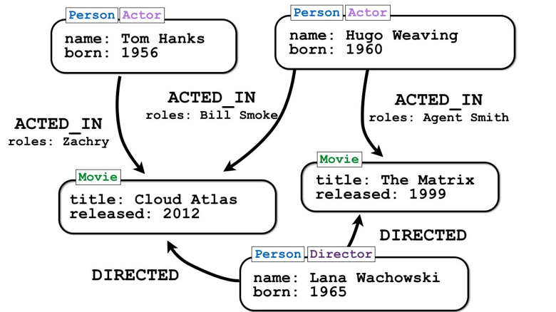
Graph Databases
https://neo4j.com/blog/neo4j-2-0-ga-graphs-for-everyone/

Slide 14
Graph Database Examples
Neo4j
market leader.
community edition is free under GPL v3 license.
ArangoDB
JSON document support, key-value store, full-text search engine
Dgraph
High performance
Open source, hosted, enterprise options
Amazon Neptune
fully-managed service

