Slide 1
CIS 2349C
Introduction To Big Data Using Hadoop
Module 7: Data Acquisition
Textbook (Bahga) Ch. 5 Data Acquisition

Slide 2
Data Acquisition Source Types
Data sources need to be considered when selecting connectors
Sources can publish bulk data in batches or stream real-time data
Batch data source examples:
Files
Logs
Relational databases
Real-time data source examples:
Sensor data
IoT systems
Social media feeds
Stock market feeds

Slide 3
Velocity
Velocity refers to the speed with which data is generated and how frequently it varies
High velocity real-time data requires low latency, low overhead communications, e.g.
WebSocket
Publish-Subscribe protocols and frameworks, e.g.
Apache Kafka
MQTT (originally MQ Telemetry Transport, but since 2013 "MQTT is no longer considered an acronym and is simply the name of the protocol") [https://www.hivemq.com/blog/mqtt-essentials-part-1-introducing-mqtt/]
Message Queues, e.g.
RabbitMQ
AmazonSQS

Slide 4
Ingestion Mechanism
Ingestion involves connecting to various data sources and extracting the data
Ingestion is separated from processing since the requirements for both steps are distinct
Data ingestion can be either push or pull
Push: A data forwarder is installed close to the source of the data, or built into the data generator/collector, and pushes the events to a data store such as SQL Server, Hadoop, or Cassandra.
Pull: data is pulled from a database, file system, queue or API
Publish-Subscribe (next slide) is frequently used for pull systems

Slide 5
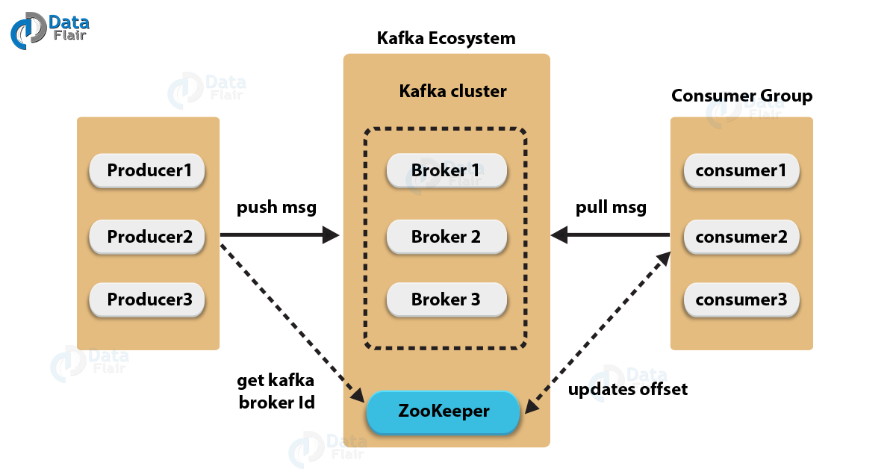
Publish - Subscribe Frameworks - Apache Kafka
Apache Kafka is a high-throughput distributed messaging system
Kafka includes the following components:
Topic: user-defined category to which messages are published
Producer: publishes messages to one or more topics
Consumer: subscribes to one or more topics to process messages
Broker: manages topics, handles persistence, partitioning, and replication of data
https://data-flair.training/blogs/kafka-architecture/

Slide 6
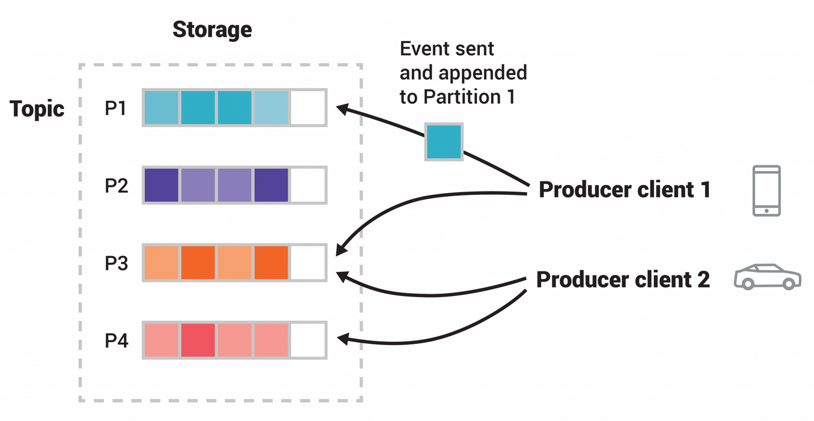
Kafka Topics
Kafka topics are partitioned as ordered and immutable message sequences, stored on disk as commit logs
Partitioning allows the logs to grow in size beyond single disk/servers, and allow parallel consumption by consumers
Brokers are typically assigned to a separate physical server
Partitioned topics can be replicated across multiple brokers for fault tolerance
This example topic has four partitions: P1–P4. Two different producer clients are independently publishing new events to the topic by writing events over the network to the topic's partitions. Events with the same key (denoted by their color in the figure) are written to the same partition. Both producers are permitted to write to the same partition.
https://kafka.apache.org/documentation/

Slide 7
Publish - Subscribe Frameworks - Amazon Kinesis
Amazon Kinesis is a commercial service for ingesting large amounts of real-time streaming data
Kinesis provides automatic scaling for high volume streaming from multiple sources
Kinesis Data Streams applications run on Amazon EC2 virtual servers
Data Streams applications read data from a data stream as data records.
Processed records can be sent to dashboards to generate alerts, dynamically change pricing and advertising strategies, or send data to a variety of other AWS services.

Slide 8
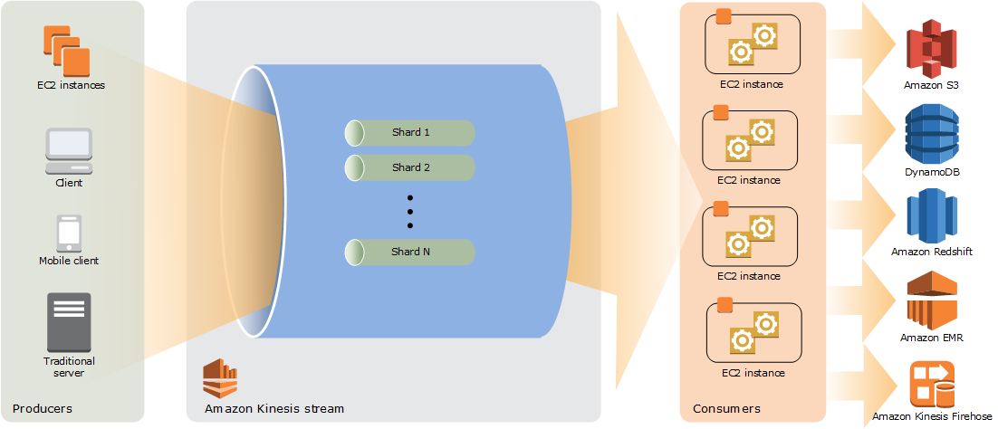
Amazon Kinesis
Producers write to the Kinesis stream using records comprised of a sequence number, partition key, and data blob
Records in a Kinesis stream are distributed in shards of fixed capacity, where a stream can have multiple shards each of which allows 1MB/s capture speeds with read speeds of up to 2MB/s
https://docs.aws.amazon.com/streams/latest/dev/key-concepts.html

Slide 9
Big Data Collection Systems
Apache Sqoop (NOTE: the Apache Sqoop project was retired in June 2021)
Apache Flume
Flume is designed for high-volume ingestion of event-based data into Hadoop
e.g. collect event log files from a bank of web servers and move the events from those files into new aggregated files in HDFS
Flume can be used to transport massive quantities of event data including but not limited to network traffic data, social-media-generated data, and email messages
Flume uses a transactional approach to guarantee the reliable delivery of the events.
Flume can read from many different sources, including http-based sources, JMS (Java Message Service) and exec (Unix commands)
Flume can write to many different destinations such as HDFS, HBase, and Hive
https://flume.apache.org/FlumeUserGuide.html

Slide 10
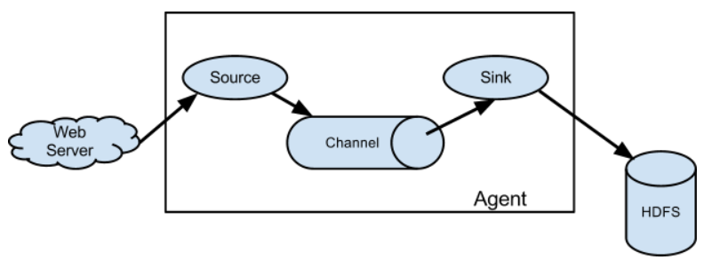
Apache Flume
A Flume event is a unit of data flow consisting of a byte payload and an optional set of string attributes.
A Flume agent is a (JVM) process that hosts the components through which events flow from an external source to the next destination (hop).
A Flume source consumes events delivered to it by an external source like a web server.
When a Flume source receives an event, it stores it into one or more channels.
The channel is a passive store that keeps the event until it’s consumed by a Flume sink.
The sink removes the event from the channel and puts it into an external repository like HDFS.

Slide 11
https://www.baeldung.com/pub-sub-vs-message-queues Queues
Message Queues
Message queues consist of a publishing service and multiple consumer services that communicate via a queue.
This communication is typically one way where the publisher will issue commands to the consumers.
The publishing service will typically put a message on a queue or exchange and a single consumer service will consume this message
Message queueing allows servers to respond to requests quickly instead of being forced to perform resource-heavy procedures on the spot that may delay response time.
Message queueing also helps balance loads between workers.
https://www.cloudamqp.com/blog/part1-rabbitmq-for-beginners-what-is-rabbitmq.html

Slide 12
https://www.baeldung.com/pub-sub-vs-message-queues Queues
Message Queues and Pub-Sub Common Benefits
Both message queues and pub-sub (publish-subscribe) architecture patterns are effective ways to break up an application to make it more horizontally scalable.
For both, communication is more durable than traditional synchronous modes of communication.
If app A communicates to app B via an asynchronous HTTP call then if either of the applications goes down the data is lost and the request must be retried.

Slide 13
https://www.baeldung.com/pub-sub-vs-message-queues Queues
Message Queues: How They Differ from Pub-Sub
With pub-sub, if a subscriber is down, once it recovers, the messages it has missed will be available for consumption in its subscribing queue.
With message queues, if a consumer goes down, another consumer will be able to handle the message instead.
Context is key: choosing whether to use pub-sub or message queue architecture comes down to defining exactly how the consuming service should behave.
The most important factor to keep in mind is asking “Does it matter if every consumer gets every message? (yes: pub-sub, no: message queues)

Slide 14
Message Queues
ZeroMQ
RestMQ
Amazon SQS
RabbitMQ
RabbitMQ is a message-queueing software application also known as a message broker or queue manager.
A message can include any kind of information, including information such as informing a process or task that it should start on another application (possibly on another server), or as simple as a text message.
The messages are stored until a receiving application connects and takes a message off the queue in order to process it.

Slide 15
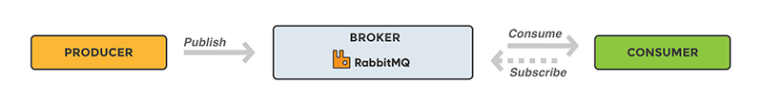
RabbitMQ
A message broker acts as a middleman for various services (e.g. a web application).
They can be used to reduce loads and delivery times of web application servers by delegating tasks that would normally take up a lot of time or resources to a third party that has no other job.
https://www.cloudamqp.com/blog/part1-rabbitmq-for-beginners-what-is-rabbitmq.html

Slide 16
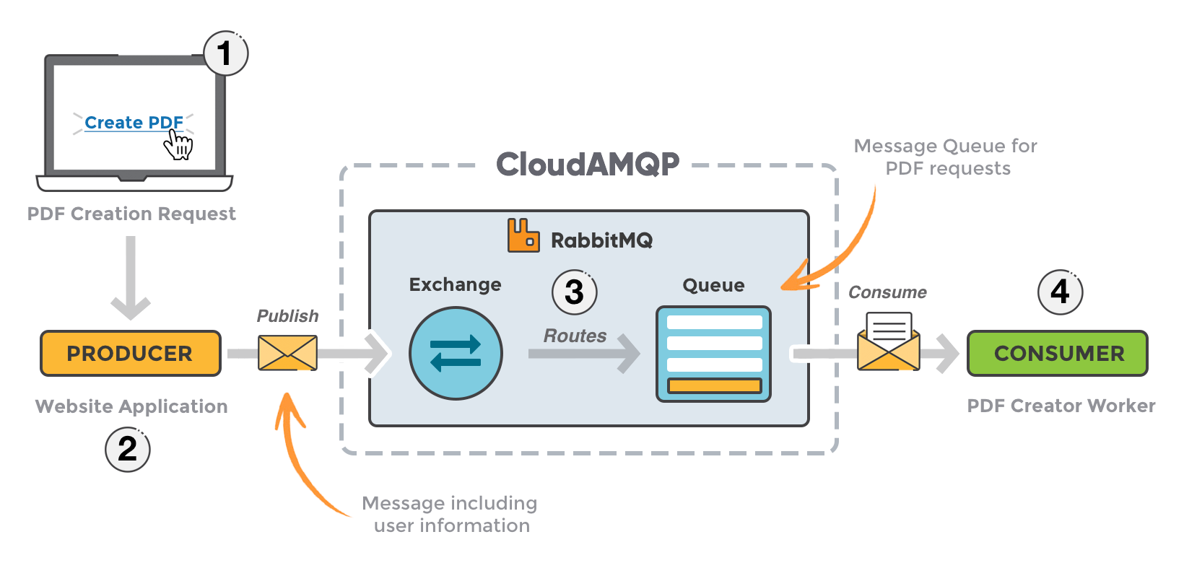
RabbitMQ Web Application Example
User sends a PDF creation request to the web application.
The web application (producer) sends a message to RabbitMQ that includes data from the request such as name and email.
An exchange accepts the messages from the producer and routes them to correct message queues for PDF creation.
The PDF processing worker (consumer) receives the task message and starts processing the PDF.
https://www.cloudamqp.com/blog/part1-rabbitmq-for-beginners-what-is-rabbitmq.html

Slide 17
RabbitMQ Exchanges
Messages in a RabbitMQ system are not published directly to a queue; instead, the producer sends messages to an exchange.
An exchange is responsible for routing the messages to different queues with the help of bindings.
A binding is a link between a queue and an exchange.
https://www.cloudamqp.com/blog/part1-rabbitmq-for-beginners-what-is-rabbitmq.html

Slide 18
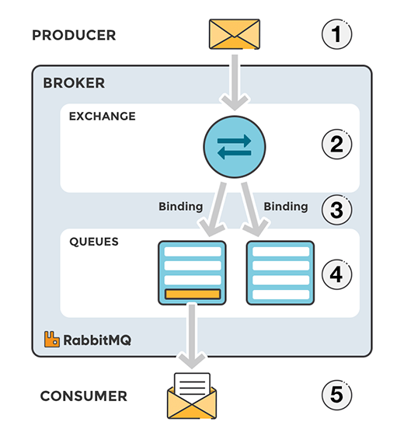
RabbitMQ Exchanges
The producer publishes a message to an exchange. When creating an exchange, the type must be specified. This topic will be covered later on.
The exchange receives the message and is now responsible for routing the message. The exchange takes different message attributes into account, such as the routing key, depending on the exchange type.
Bindings must be created from the exchange to queues. In this case, there are two bindings to two different queues from the exchange. The exchange routes the message into the queues depending on message attributes.
The messages stay in the queue until they are handled by a consumer
The consumer handles the message.
https://www.cloudamqp.com/blog/part1-rabbitmq-for-beginners-what-is-rabbitmq.html

Slide 19
Custom Connectors
REST (Representational State Transfer) API connectors support stateless HTTP data transfer requests; each request carries all required information necessary to process a request.
HTTP headers add to request overhead which makes this method unsuitable for high-throughput/real-time applications.
WebSocket API connectors support WAMP (Web Application Messaging Protocol) patterns which use a persistent TCP connection that does not need to be reset for each message (as is the case for REST)
MQTT is a light-weight publish-subscribe protocol
Amazon IoT and Azure IoT Hub are cloud services which support data collection from IoT (Internet of Things) devices for storage and analysis on their respective platforms.

