Slide 1
CIS2349C Lab 1 Introduction to Hadoop

Slide 2
Lab Overview
In this lab we will access the virtual NetLab-based Hadoop cluster and explore the Hadoop environment.
We will be using Ubuntu and Hadoop command line utilities to navigate the various folders and view the configuration and files.
The Firefox browser will be used to navigate the environment using the Hadoop administrative tool.
Refer to the lecture slides for this module for applicable commands.

Slide 3
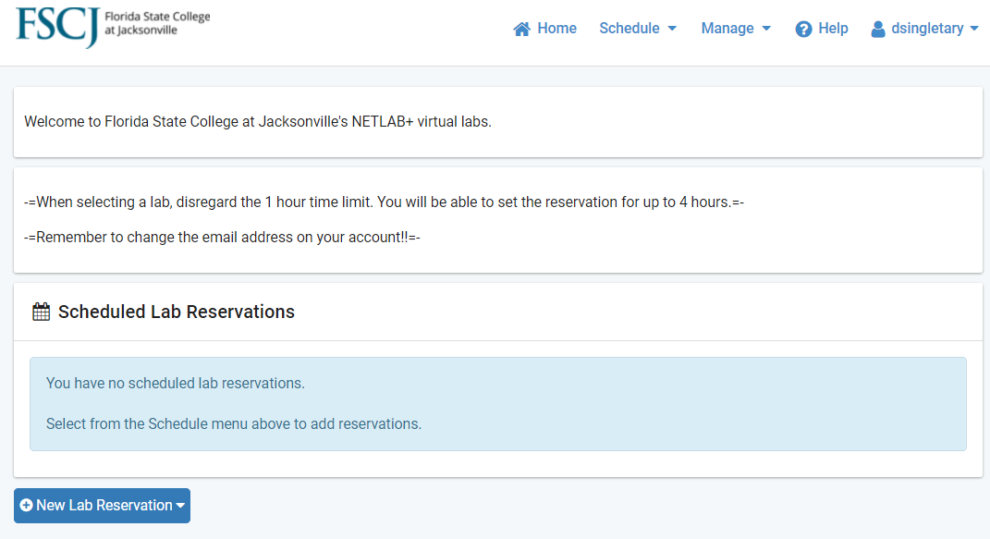
Accessing the NetLab Hadoop Cluster
Open a web browser and navigate to netlab05.fscj.edu
Select New Lab Reservation

Slide 4
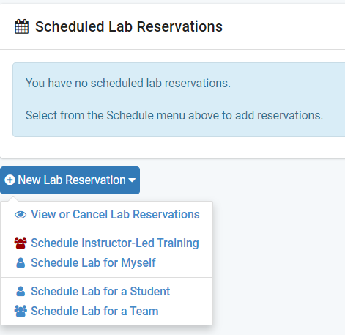
Accessing the NetLab Hadoop Cluster
Schedule a lab session

Slide 5
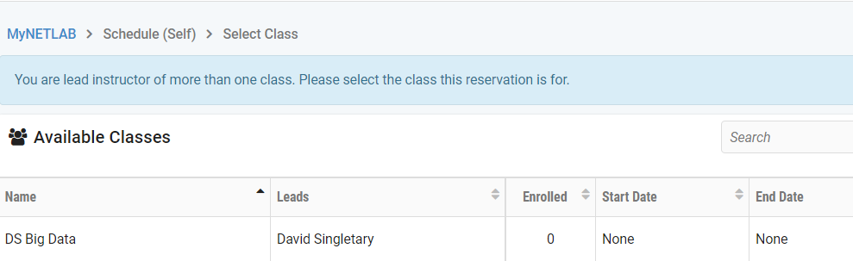
Accessing the NetLab Hadoop Cluster
Select the Big Data class (the name you see may be slightly different)

Slide 6
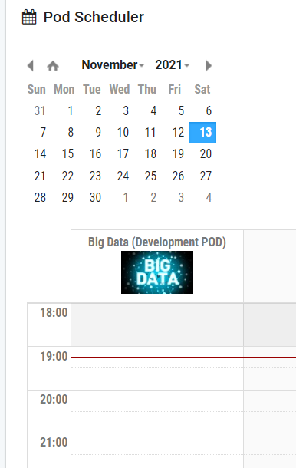
Accessing the NetLab Hadoop Cluster
Select just below the red line

Slide 7
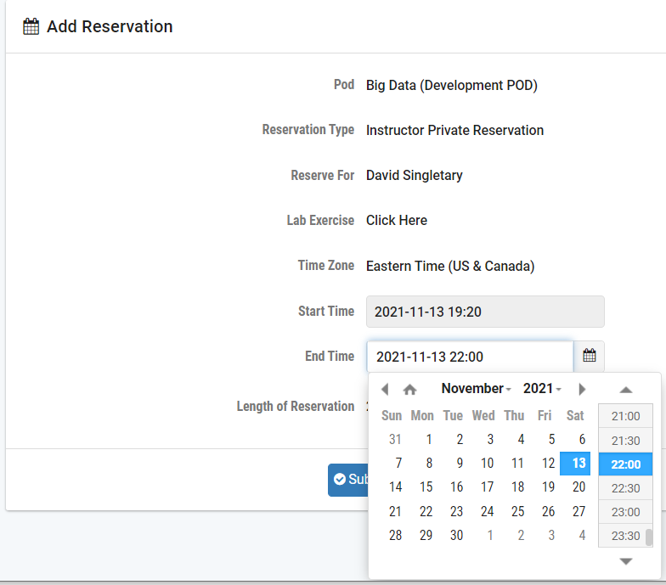
Accessing the NetLab Hadoop Cluster
Adjust the end time as necessary

Slide 8
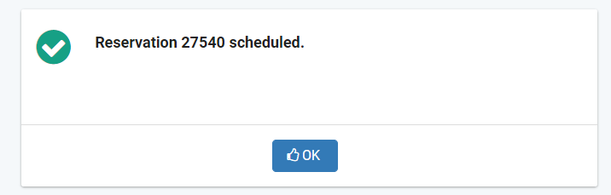
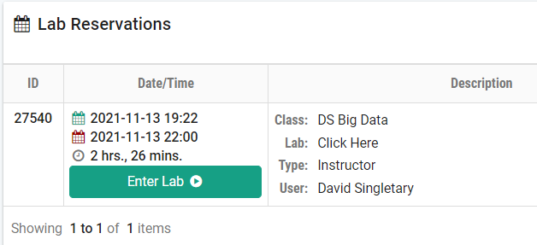
Accessing the NetLab Hadoop Cluster
Click OK, then Enter Lab

Slide 9
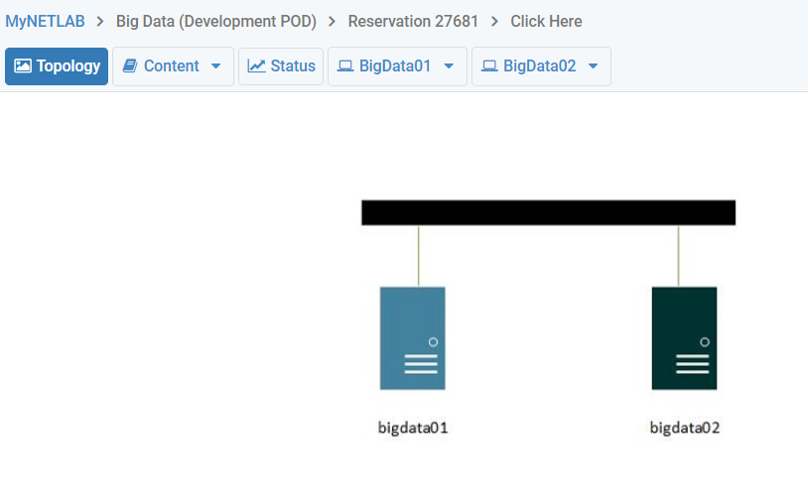
Accessing the NetLab Hadoop Cluster
Select bigdata01. This is the Hadoop cluster's primary and secondary namenode.
This system also serves as the first datanode
bigdata02 is the second datanode in the cluster

Slide 10
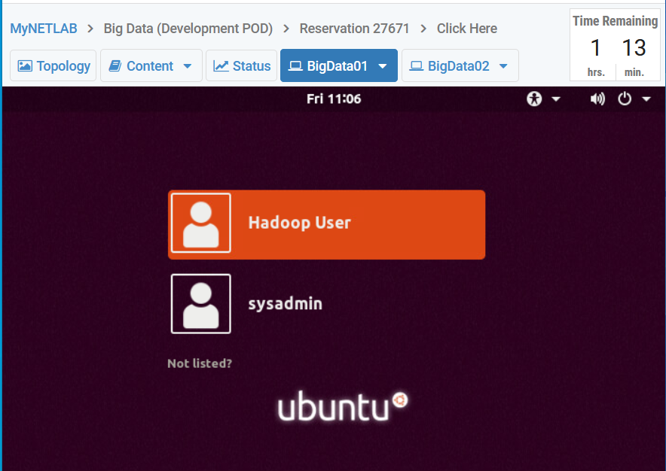
Accessing the NetLab Hadoop Cluster
Wait until the system finishes booting, then select "Hadoop User",
password: hadoop

Slide 11
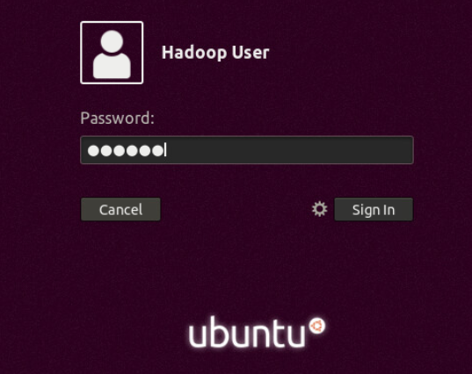
Accessing the NetLab Hadoop Cluster
Sign In as the Hadoop User

Slide 12
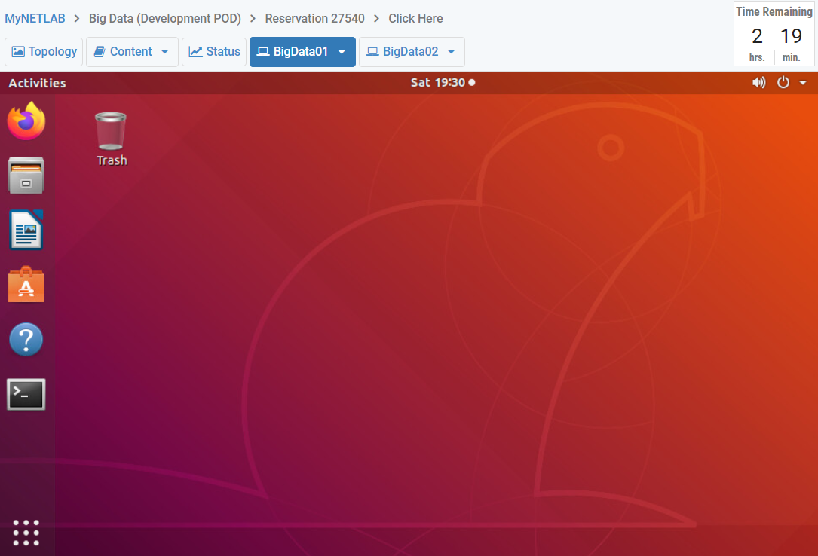
Accessing the NetLab Hadoop Cluster
There may be a delay while the desktop renders.
When the desktop is visible, open a Terminal by single-clicking on the tool

Slide 13
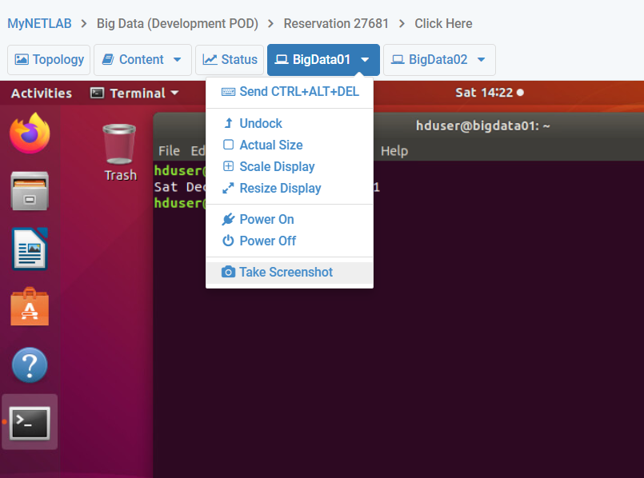
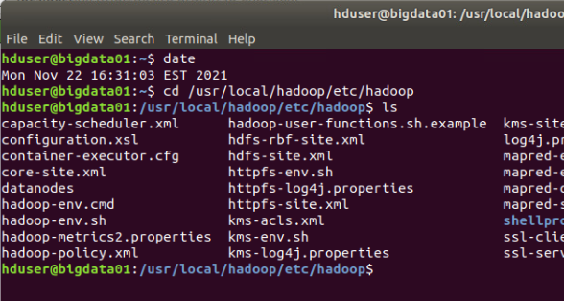
Lab Submissions
Once you have logged in to the name node in the cluster, use the Ubuntu terminal to complete the following exercises from the command line.
Submit screen snips (see image below left) showing the results of commands that are executed
If the date is not displayed by the command you run, run the date command at the top of each terminal before executing the commands so it is visible in the screen snip (below right):

Slide 14
1. What version of Hadoop is running on this cluster?
Use the Hadoop version command to determine the version of Hadoop that is installed on the namenode and on the secondary datanode.
To access the secondary namenode from the primary namenode, use ssh with the secondary namenode's hostname followed by the same command used to check the version on the primary namenode.

Slide 15
2. Verify that IPv6 is disabled on all nodes
Verify IPv6 is disabled on the namenode and use ssh to verify it is disabled on the secondary datanode (same commands as the namenode, but prefixed with ssh and the secondary datanode hostname).

Slide 16
3. Format the HDFS file system
This only needs to be done on the namenode / primary datanode system.

Slide 17
4. Start HDFS
This only needs to be done on the namenode / primary datanode system.
Allow a few minutes for the start-up process to complete – even though the command prompt is waiting for input, the process is still starting in the background.

Slide 18
5. Verify the HDFS processes are running
Show that the appropriate processes are running on the namenode / primary datanode
Show the HDFS processes that are running on the secondary datanode. Does this look correct? Are the same processes running?

Slide 19
6. Show the active namenodes
This only needs to be done on the namenode / primary datanode system.

Slide 20
7. Show the status of the datanodes
What is the configured capacity of the cluster?
What is the configured capacity of each datanode?
How do these two values relate to each other?

Slide 21
8. Create a /data folder on the HDFS file system
This only needs to be done on the namenode / primary datanode system.

Slide 22
9. List the contents of the HDFS file system
Run the appropriate command on the nam node / primary datanode.
Run it again on the secondary namenode using ssh.
Are the results the same for both nodes? Why would you expect this?

Slide 23
10. Use Firefox to connect to the HDFS console
No date command is needed here, just display the web page with the "Started" date stamp displayed on the Overview page
(localhost and port number)

Slide 24
Be sure to stop the cluster with stop-dfs.sh when you are done!

