Slide 1
CIS2349C Lab 2 HDFS

Slide 2
Lab Overview
In this lab we will access the HDFS file system and perform exercises to practice manipulating files.
As with Lab 1, we will be using command line utilities to manipulate the files.
A script has been provided in the Hadoop user's home directory: start-hdfs.sh
Running this script will take care of multiple configuration and startup steps we completed manually in Lab 1
You will still need to run stop-dfs.sh when exiting the lab.

Slide 3
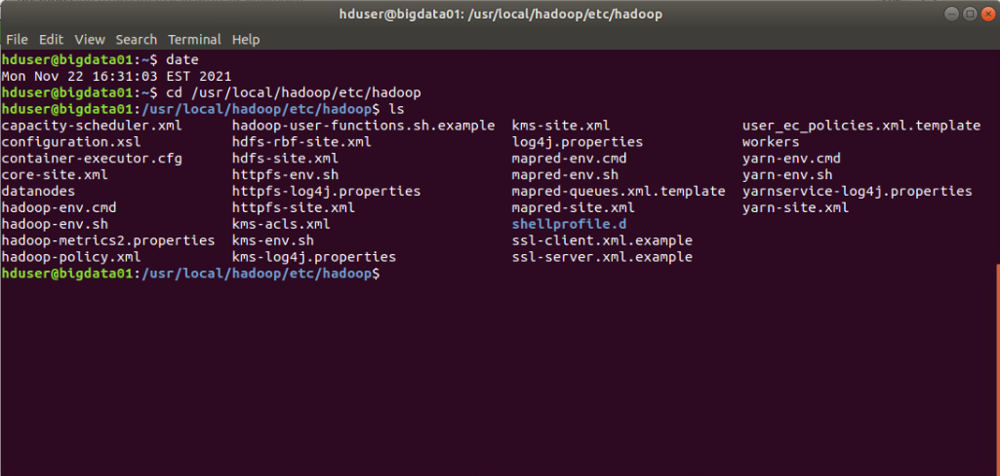
Lab Submissions
Submit screen snips showing the results of commands that are executed
Run the date command at the top of each terminal before executing the commands so your date is visible in the screen snip as shown here:

Slide 4
1. Copy a file from the local file system to HDFS
Log in to the NetLab Hadoop cluster as the Hadoop user.
Run the start-hdfs.sh if you have not already done so already.
Be sure to give the system time to start the daemons, sometimes it can take a few minutes (run hdfs dfsadmin -report to verify datanodes are running).
Use an HDFS command to copy the u.data file from the local file system to the HDFS /data folder.
(the u.data file can be found in the Hadoop user's home folder under the /data subfolder).
Use an HDFS command to list the contents of the HDFS /data folder

Slide 5
2. Copy a file from HDFS to the local file system
Use an HDFS command to copy the u.data file from the HDFS /data folder back to the Hadoop user's /data subfolder as "u2.data"
Run a command to list the contents of the Hadoop user's /data subfolder
Compare the size of the two files
Run "cksum data/u.data data/u2.data" to compare the CRC checksums of the files to verify they are the same

Slide 6
3. Display the contents of a file on the HDFS file system
Use an HDFS command to display the contents of the u.data file in the HDFS /data folder
(It is a big file, pipe the command into the "tail" command to display the last 10 lines)

Slide 7
4. Remove a file from the HDFS file system
Use an HDFS command to remove a file to remove the u.data file from the HDFS /data folder
Use an HDFS command to list the contents of the HDFS /data folder to verify the file has been removed

Slide 8
5. Create a folder in the HDFS file system
Use an HDFS command to create a subfolder named "movie-data" under the HDFS /data folder
Copy the u.data file from the Hadoop user's /data subfolder to the new subfolder
Use an HDFS command to list the contents of the movie-data subfolder

Slide 9
6. Write and Execute a Python/Pydoop Application
Write and execute a Python application which uses Pydoop to do the following:
Displays the size of the u.data file in the movie-data folder.
Displays the contents of the u.date file in the movie-data folder (be sure to use the rt option to open the file)

Slide 10
7. Write and Execute a Python/Pydoop Application
Use an HDFS command to remove the movie-data subfolder and its contents

Slide 11
Be sure to stop the cluster with stop-dfs.sh when you are done!

