Slide 1
CIS2349C Lab 3 YARN

Slide 2
Lab Overview
In this lab we will review the YARN scheduler and perform exercises to verify the configuration of YARN on the netlab cluster, start the daemons, and execute simple applications using the distributed shell.
As with previous labs, we will be using command line utilities to perform the exercises.
A script has been provided in the YARN user's home directory: scripts/start_yarn.sh (NOTE: name uses an underscore _ , not a dash -)
(Be sure the HDFS daemons are started first, this step will be included in the following slides as part of the exercises)
Running the start_yarn.sh script will take care of the YARN startup steps described in the lecture slides
You will need to run stop_yarn.sh when exiting the lab, followed by stop-dfs.sh

Slide 3
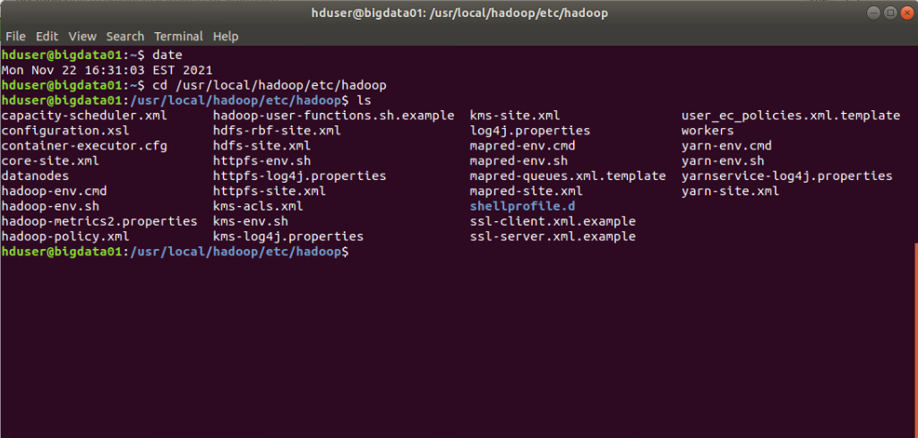
Lab Submissions
Submit screen snips showing the results of commands that are executed
Run the date command at the top of each terminal before executing the commands so your date is visible in the screen snip as shown here:

Slide 4
1. Start the YARN daemons
Open a terminal, then run the scripts/start-hdfs.sh script to start the HDFS daemons
Open a second terminal. In this terminal, "su" to the yarn user (password: hadoop), then "cd" to the yarn user's home directory
In the second terminal, examine the scripts/start_yarn.sh script, note the daemons it starts and in what order they are started
The remaining slides for this lab will refer to the second terminal as the "YARN" terminal where the yarn user is the active user, be sure to use the correct terminal to execute the commands listed for these exercises (hint: look at the windows' title bars)
In the YARN terminal, execute the scripts/start_yarn.sh script to start the daemons

Slide 5
2. Verify the YARN Start State
In the YARN terminal, run "jps" to view the active daemons.
In the original terminal logged in as the Hadoop user (we will refer to this as the HDUSER terminal), run "jps".
Compare the jps outputs for each terminal. Why are they different?

Slide 6
3. Run an Application using the Distributed-Shell
In the YARN terminal, run the following "uptime" command as a YARN application (type this very carefully):
yarn org.apache.hadoop.yarn.applications.distributedshell.Client -jar $YARN_DS/hadoop-yarn-applications-distributedshell-$YARN_VERSION.jar -shell_command uptime
Based on the console output, did the command run successfully? (hint: look at the last few lines
Highlight the line(s) in the console output which show that the command executed successfully
Once this command has run once, you can use the Ubuntu history mechanism and the up-arrow to make minor modifications for more testing

Slide 7
4. Examine the YARN Logs
In the YARN terminal, "cd" to /usr/local/hadoop/logs and note which logs have been recently modified (use "ls -lt" and observe the time stamps).
Note who the owners of these files are
Highlight the log files that were recently modified as the application ran

Slide 8
5. Examine the Application Logs
We ran an uptime command, so where is the output?
In the YARN terminal, cd to /usr/local/hadoop/logs/userlogs, then find and display the output for the command

Slide 9
6. Run a Command with a Command-Line Argument
The "factor" command on Ubuntu finds the factors of a specified number:
$ factor 35
35: 5 7
Run this command using the Distributed-Shell application and display the output

Slide 10
7. Run a Command with Multiple Containers
Run the "ps" command using the Distributed-Shell with 5 containers
Once the application completes, display the output for each container (hint: cat */stdout will display all stdout files under multiple folders using one command)

Slide 11
8. Connect to the YARN Web Console
Use FireFox to connect to the YARN web console

