Slide 1
CIS2349C Lab 4 MapReduce

Slide 2
Lab Overview
In this lab we will examine at some simple MapReduce source code, run the associated applications in local mode, and examine the results

Slide 3
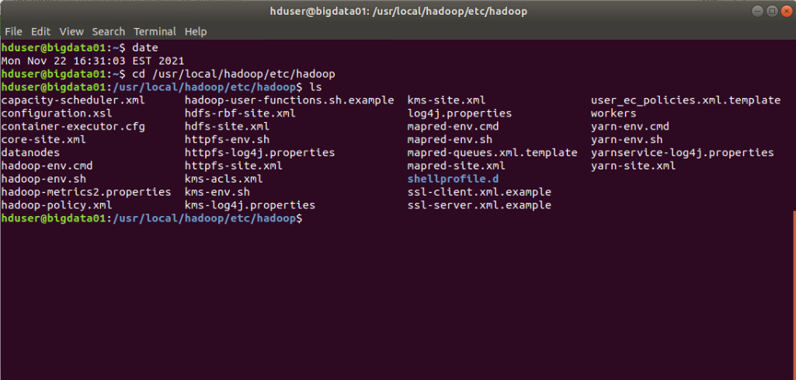
Lab Submissions
Submit screen snips showing the results of commands that are executed
Run the date command at the top of each terminal before executing the commands so your date is visible in the screen snip as shown here:

Slide 4

Step 1: Log in as the MapReduce User
Log in as the MapReduce user (mapred) (password "hadoop")
Change your working directory to hadoop-book-master
The Hadoop source code for the examples in chapters 1-6 can be found in this directory
The Java source code for each chapter is in src/main/java for each chapter
The National Climatic Data Center used in the textbook examples can be found in input/ncdc/all
There are two compressed data files in the all folder, one from 1901 and one from 1902 (the files are truncated on our lab system to save space)
Navigate to input/ncdc/all and use gunzip to unzip one of the data files
Examine the first few lines of the unzipped file and compare them to the detailed breakdown provided in the textbook and lecture slides
When you are done examining the files, use the gzip utility to zip it back up before proceeding with the next step.

Slide 5
Step 2: Use an AWK Script to Analyze the Data
Since this dataset is fairly small we can use a simple shell script to perform the analysis to determine the maximum temperature
This is also an example of how we can use basic shell tools to perform the steps of an exploratory data analysis (EDA) to obtain basic summary statistics and other information about the data
Navigate back to the hadoop-book-master directory
cat the max_temperature.sh script to the console and examine the code that is executed
Execute the script and examine the results

Slide 6
Step 3: Examine the MapReduce Source Code
You will find the MapReduce source code in the ch02-mr-intro directory, under the src/main/java subdirectory
Hadoop is built using the Maven build tool to compile and link the Java source, src/main/java is a standard directory structure for this tool
The compiled code is located under the target directory at the top level
Navigate to the source code directory, maximize your terminal window and cat the MapReduce master source code file (hint: it is not the mapper or the reducer) (you can ignore the combiner, it is not used in this lab)

Slide 7
Step 4: Examine the Mapper Source Code
From the src/main/java directory, maximize your terminal window and cat the mapper source code file

Slide 8
Step 5: Examine the Reducer Source Code
From the src/main/java directory, maximize your terminal window and cat the reducer source code file
Use grep to isolate the line in the reduce which performs the arithmetic comparison operation to determine the max temperature value (you should have room to show the entire source file and the grep results if your terminal is maximized)

Slide 9
Step 6: Execute the MapReduce Application
Navigate back to the hadoop-book-master directory
We will now execute the MapReduce application
First, verify that the output folder does not exist in the current directory by removing it
rm –r output
This directory must be removed each time MapReduce is run or the program will fail
Run the MapReduce program:
hadoop jar ch02-mr-intro/target/ch02-mr-intro-4.0.jar \
MaxTemperature input/ncdc/all output

Slide 10
Step 7: Find the Results
The program results are in the output directory, navigate there for this step and cat the file containing the results

