Slide 1
CIS2349C Lab 8 Using Pig

Slide 2
Lab Overview
In this lab we will use Pig Latin in the interactive grunt shell to determine the popularity of search phrases from the (now mostly obsolete) Excite search engine
The code reads and processes an Excite search query log file and finds search phrases that occur with particular high frequency during certain times of the day
This lab is based on Tutorial 1 from the Pig web site found at https://pig.apache.org/docs/latest

Slide 3
Lab Submissions
Submit screen snips showing the results of commands that are executed

Slide 4
Step 1: Log in and examine the data
Log in as the Hadoop user
Change your current directory to /usr/local/pig/lab
Use the wc command to count the lines in the data file "excite.log"
Use the head command to examine the first few lines of the data file in its original content format
The data records contain 3 fields:
1) an alpha-numeric user ID
2) a numeric timestamp
3) a search phrase

Slide 5
Step 2: Log in and start Pig in local mode
Start Pig in local mode to access the grunt shell:
../bin/pig –x local
Note: you will see many warnings when starting the shell and executing various commands (see next slide)

Slide 6
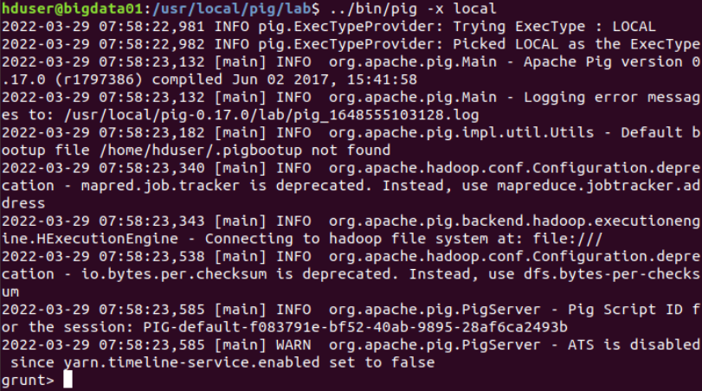
Step 2 Note: Warnings
You will see many warnings and messages when starting the shell and executing various commands, you can ignore anything with WARN or INFO
Don't ignore ERROR notifications, this means you may have entered a command incorrectly

Slide 7
Step 3: Import local functions
The tutorial.jar file contains various user-defined (Java-based) functions that will be used in this lab, use the REGISTER command to import them:
REGISTER ./tutorial.jar;

Slide 8
Step 4: Load the data file
Use the LOAD command and PigStorage function to load the data file ("excite.log") into the “raw” bag as an array of records with the fields user, time, and query
PigStorage() loads and stores data from structured text files
It takes a delimiter parameter which is used to split a line into tuples (defaults to ‘\t’, the tab character)
raw = LOAD 'excite.log' USING PigStorage('\t')
AS (user, time, query);

Slide 9
Step 4 Note: Line continuation
Interactive commands in grunt can be continued on multiple lines, use the Enter key to break the line and you will see a double prompt, continue your command line from there:

Slide 10
Step 5: Clean the data
Call the user-defined function NonURLDetector to remove records with empty query fields and URLs
clean1 = FILTER raw BY
org.apache.pig.tutorial.NonURLDetector(query);

Slide 11
Step 5 Note: Displaying data
Remember that you can call the DUMP command at any point in this process to show data structures, e.g. after the previous step run
DUMP clean1;
You will see many processing steps scroll by, then the content of the filtered bag will then be displayed at the bottom of the output

Slide 12
Step 6: Transform the data (1)
Call the user-defined function ToLower to change the query field to lowercase.
clean2 = FOREACH clean1 GENERATE user, time,
org.apache.pig.tutorial.ToLower(query) as query;

Slide 13
Step 7: Transform the data (2)
The excite query log timestamp format is YYMMDDHHMMSS
The log contains data for one day
For this exercise we are only interested in the hour.
Call the user-defined function ExtractHour to extract the hour (HH) from the time field
houred = FOREACH clean2 GENERATE user,
org.apache.pig.tutorial.ExtractHour(time) AS
hour, query;
Use the DESCRIBE operator to display the schema of the houred bag
If you DUMP the "houred" bag you will see that the timestamp now consists of a 2-digit hour value

Slide 14
Step 8: Transform the data (3)
Call the user-defined function NGramGenerator to compose the n-grams of the query
ngramed1 = FOREACH houred GENERATE user, hour,
FLATTEN(org.apache.pig.tutorial.NGramGenerator(query))
AS ngram;
An n-gram is simply a sequence of n words, e.g.
San Francisco (is a 2-gram)
The Three Musketeers (is a 3-gram)
She stood up slowly (is a 4-gram)
https://blog.xrds.acm.org/2017/10/introduction-n-grams-need/

Slide 15
Step 9: Transform the data (4)
If you displayed the contents of "ngramed1" in the previous step you will notice many duplicated n-grams
Use the DISTINCT operator to coalesce these into unique values
ngramed2 = DISTINCT ngramed1;
After this step executes the number of n-grams is drastically reduced (but there are still a lot of them)

Slide 16
Step 10: Transform the data (5)
Use the GROUP operator to group records by n-gram and hour:
hour_frequency1 = GROUP ngramed2 BY (ngram, hour);
This step creates a relation between a key value of (ngram, hour) and the n-grams containing those values.

Slide 17
Step 11: Analyze the data (1)
Now that we have cleaned and transformed the data, we can start our analysis.
Use the COUNT function to get the count (occurrences) of each unique, flattened n-gram.
hour_frequency2 = FOREACH hour_frequency1 GENERATE
flatten($0), COUNT($1) AS count;

Slide 18
Step 12: Analyze the data (2)
Use the GROUP operator to group records by n-gram only.
uniq_frequency1 = GROUP hour_frequency2
BY group::ngram;
Each group now corresponds to a distinct n-gram and has the count for each hour, e.g. in the snip below, "advertising film" occurs twice, once in the 6:00 hour and once in the 14:00 hour.

Slide 19
Step 13: Analyze the data (3)
For each group, identify the hour in which the n-gram is used with a particularly high frequency.
Call the user-defined ScoreGenerator function to calculate a "popularity" score for the n-gram.
uniq_frequency2 = FOREACH uniq_frequency1
GENERATE flatten($0),
flatten(org.apache.pig.tutorial.ScoreGenerator($1));

Slide 20
Step 13 Note: ScoreGenerator Description
Source code for the ScoreGenerator class can be accessed with this link.
"For each n-gram, we have a set of (hour, count) pairs.
This function reads the set and retains those hours with above
mean count, and calculates the score of each retained hour as the
multiplier of the count of the hour over the standard deviation.
A score greater than 1.0 indicates the frequency of this n-gram
in this particular hour is at least one standard deviation away
from the average frequency among all hours"

Slide 21
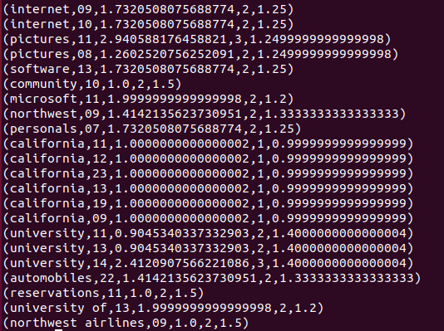
Step 13 Note 2: ScoreGenerator Description
In the snip displayed here, "california" has one occurrence at various hours throughout the day and has a moderate popularity score (1.00…) based on the overall number of occurrences relative to the mean number of occurrences (0.99…)

Slide 22
Step 14: Analyze the data (4)
Use the FOREACH-GENERATE operator to assign names to the fields:
uniq_frequency3 = FOREACH uniq_frequency2
GENERATE $1 AS hour, $0 AS ngram,
$2 AS score, $3 AS count, $4 AS mean;
Using DESCRIBE for uniq_frequency shows that this object has the following columns and data types:
hour ngram score count mean
chararray chararray double long double

Slide 23
Step 15: Analyze the data (5)
Use the FILTER operator to remove all records with a score less than or equal to 2.0:
filtered_uniq_frequency =
FILTER uniq_frequency3 BY score > 2.0;

Slide 24
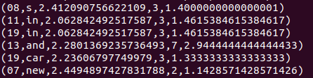
Step 15 Note: Filtered data sample
hour ngram score count mean

Slide 25
Step 16: Analyze the data (6)
Use the ORDER operator to sort the remaining records by hour and score.
ordered_uniq_frequency = ORDER filtered_uniq_frequency
BY hour, score;
Use DUMP to display the final data set

Slide 26
Step 17: Store the data
Use the PigStorage function to store the results.
STORE ordered_uniq_frequency
INTO 'lab-results' USING PigStorage();
Navigate into the "lab-results" folder and display the contents of the output file.

