Slide 1
What is Data Science?
Data Science helps us understand big and complex questions by looking at lots of information. It involves the following steps:
Collecting Data: Data can come from many places: what people buy in stores, the weather, or even what people say on social media.
Cleaning Data: Sometimes data is messy, missing parts, or contains mistakes that need to be cleaned up. It is estimated that data scientists spend as much as 80% of their time cleaning data.
Analyzing Data: Data Scientists use special tools and techniques to look for patterns or trends. For example, they might look at sales data to find out which video games are the most popular. A key initial step in this process is Exploratory Data Analysis (EDA), which involves detective-like work that helps uncover patterns, spot irregularities, and test hypotheses with the data.
Making Predictions: After analyzing the data, Data Scientists can make predictions, like guessing what might happen next.
Helping Make Decisions: The predictions made by analyzing data can be used to make decisions. For instance, a company might use data science to decide what new flavor of ice cream to make based on what flavors are most popular.

Slide 2
Data Science Tools
Data Science uses many tools to help us understand and use data, including statistics, programming, data visualization, and machine learning.
Machine learning refers to the way computers learn from experience; the more examples they are exposed to, the better they understand.
It is a part of Artificial Intelligence (AI), which is about making computers smart enough to solve problems on their own.
There are several types of machine learning:
supervised learning: training a model on a labeled dataset; each training example is paired with an output label
unsupervised learning: training a model on data that does not have labeled responses; system tries to learn the patterns and the structure from the data without any explicit instructions
reinforcement learning: the system learns to make decisions by taking actions in an environment to achieve some goals; it receives rewards or penalties for the actions it takes and learns to maximize the reward

Slide 3
Machine Learning
Machine learning refers to the way computers learn from experience; the more examples they are exposed to, the better they understand.
It is a part of Artificial Intelligence (AI), which is about making computers smart enough to solve problems on their own.
There are several types of machine learning:
supervised learning: training a system on a labeled dataset; each training example is paired with an output label
unsupervised learning: training a system on data that does not have labeled responses; system tries to learn the patterns and the structure from the data without any explicit instructions
reinforcement learning: the system learns to make decisions by taking actions in an environment to achieve some goals; it receives rewards or penalties for the actions it takes and learns to maximize the reward

Slide 4
Examples of How Machine Learning is Used
Video games: Some video games use machine learning to make the game more exciting. The game learns how you play and then changes to make it more challenging and fun.
Music and Movie Recommendations: Ever wondered how Spotify knows what song you might like, or how Netflix suggests movies you enjoy? They use machine learning to learn from what you and millions of others watch or listen to, and then suggest new things you might like.
Social Media: Apps like Instagram and TikTok use machine learning to understand what kind of photos or videos you like to see. They notice what you spend time on and then show you more of that stuff.
Self-Driving Cars: These cars use machine learning to understand the road and make decisions, like when to slow down or how to avoid accidents. They learn from lots of data about driving to get really good at it.
Helping with Homework: There are apps that can help you solve math problems or improve your writing. They use machine learning to understand the problem and suggest solutions

Slide 5
Machine Learning Algorithms
An algorithm is a step-by-step process to perform a task
There are many different algorithms used in machine learning:
Decision Trees
Logistic Regression
K-Nearest Neighbor (KNN)
Support Vector Networks
Artificial Neural Networks
and many more

Slide 6
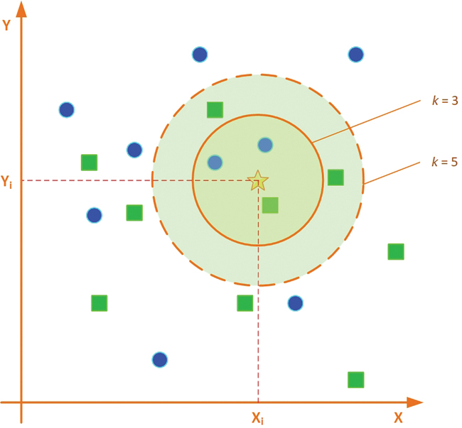
KNN Algorithm for Classification
The object in this example is to assign the new case either to circles or squares, based on its closeness (similarity) to one or the other
If k is 1, the star should be assigned to squares because the closest example to a star is a square
If k is 3, then it should be a circle because there are two circles and one square, and simple majority vote rule means the circle gets assigned the new case
If k is 5 the assignment should be made to the square class

Slide 7
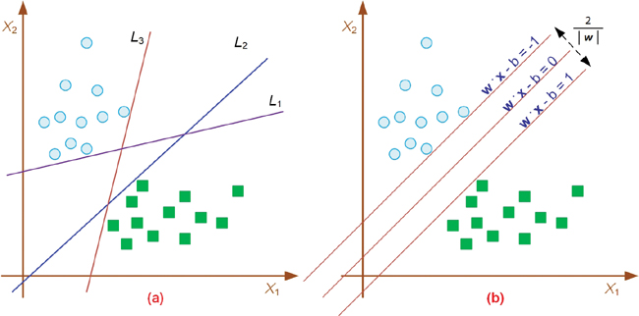
Support Vector Machines

Slide 8
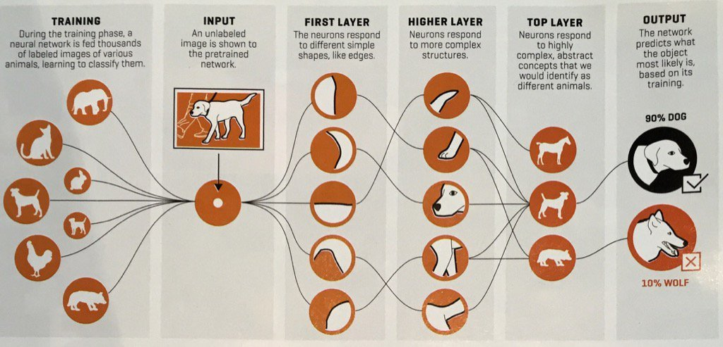
Artificial Neural Networks

Slide 9

KNN IRIS Notebook (on Binder)
https://mybinder.org/v2/gh/FSCJ-Innovation/knn-iris.git/HEAD

