Slide 1
Supervised Learning Example: Recognizing Floobles and Fleebles

Slide 2
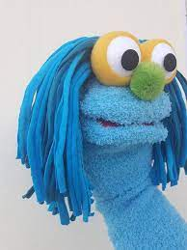
1. Flooble

Slide 3
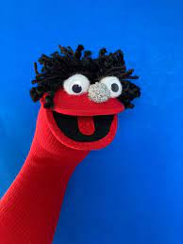
2. Fleeble

Slide 4
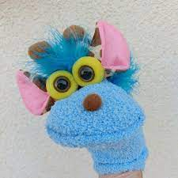
3. Flooble

Slide 5
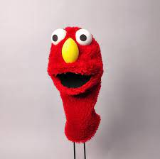
4. Fleeble

Slide 6
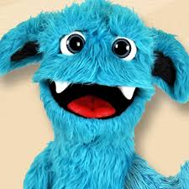
5. Flooble

Slide 7
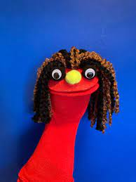
6. Fleeble

Slide 8
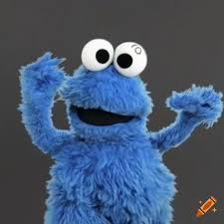
7. Flooble

Slide 9
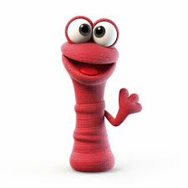
8. Fleeble

Slide 10
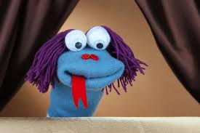
9. ???

Slide 11
9. ???

Slide 12
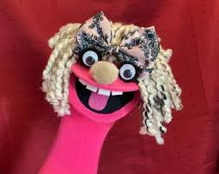
10. ???

Slide 13
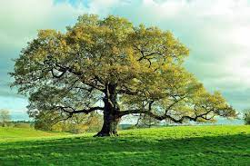
11. ???

