Slide 1
PoVs
1. so many store shops in one place, maybe wider the zipcode
2. Increasing price range
3. no use for the promo_flag
Based on some linear models we have done

Slide 2
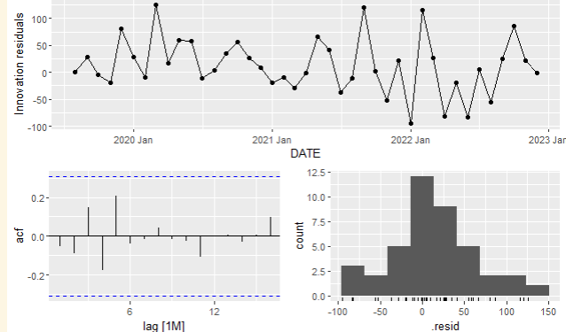
model
Arima(0,1,3) for now, ETS excluded, no seasonality
portmanteau test, train_test_split test for accuracy.
Trying to use auto.arima
Kpss, nsdiff, ndiff

Slide 3
Our question
Do you think those data like texture, and lifestage will be useful to loyalty?
Survey data. Help to construct the model

