Slide 1
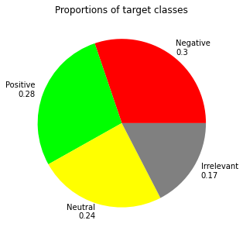
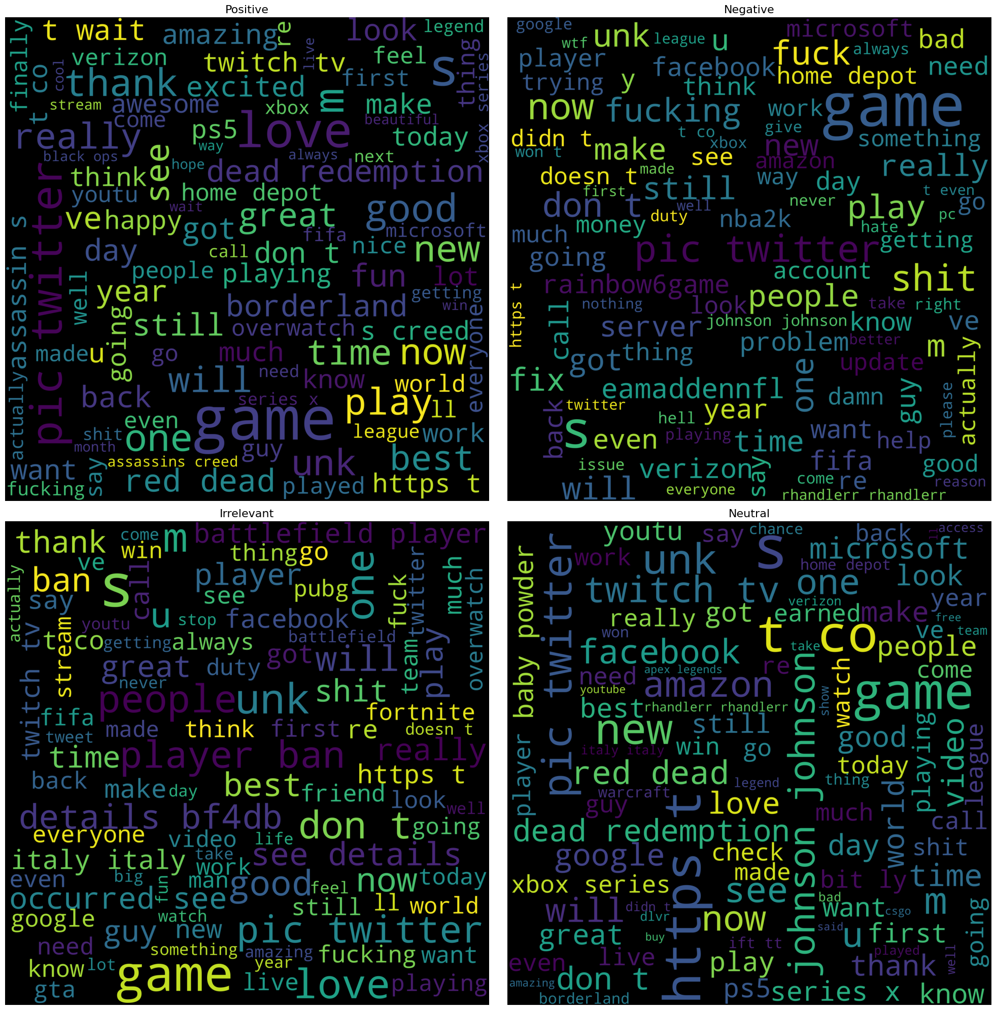
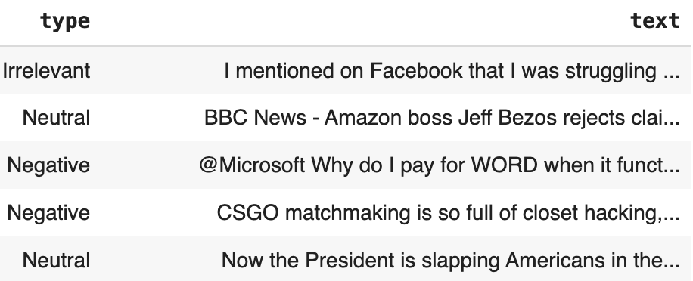
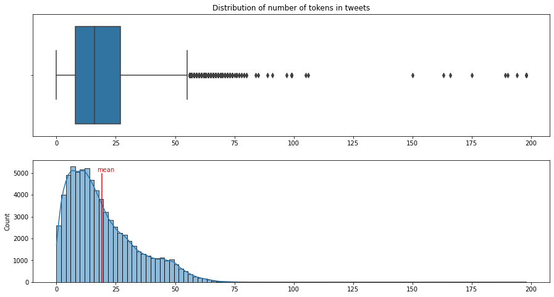
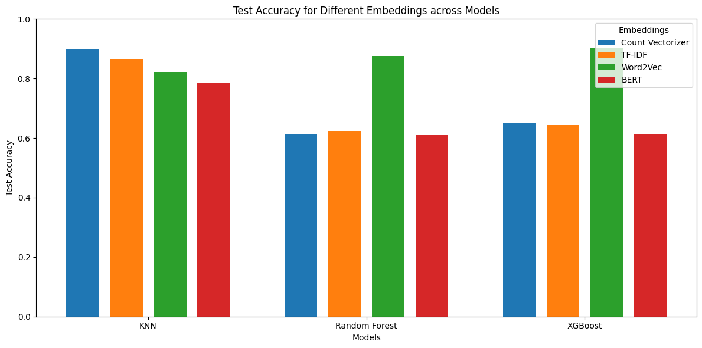
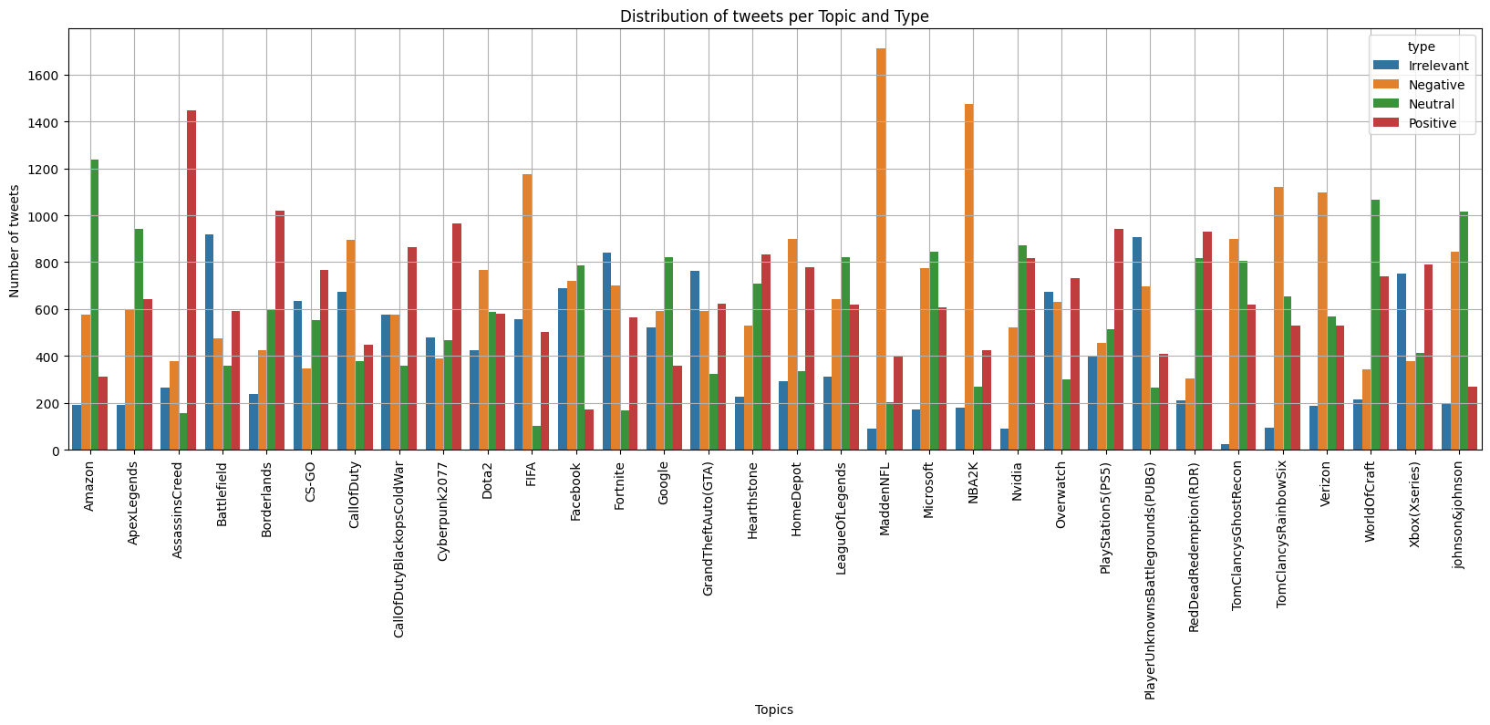
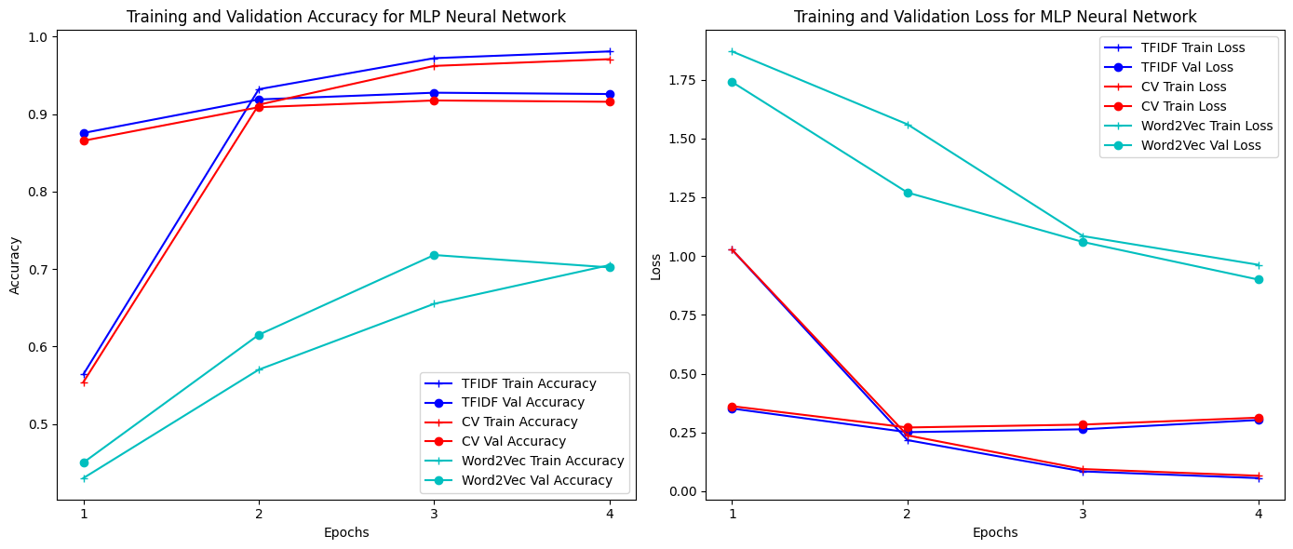

Sentiment Analysis for Twitter
Yuang Guo Boston College
Abstract
This project presents an entity-level sentiment analysis model using a Twitter dataset, aimed at determining the sentiment expressed in messages toward specific entities. The dataset contains three sentiment classes: Positive, Negative, and Neutral, where messages irrelevant to the entity are classified as Neutral.
The model provides insights into public opinion and sentiment towards various topics and entities on Twitter.
Purpose
The purpose of this project is to develop an effective entity-level sentiment analysis model using Twitter data. By accurately analyzing public sentiment toward entities in social media, this project aims to provide insights that can be useful for understanding brand perception, tracking public opinion, and aiding decision-making in areas such as marketing, politics, and customer service. The focus is on creating a robust model that can generalize well to real-world social media data, leveraging techniques like word embeddings (e.g., Word2Vec, GloVe) and state-of-the-art machine learning models (e.g., XGBoost, BERT, RoBERTa).
Result
This sentiment model together with embeddings can have a 98% accuracy on the analysis of emotional data using TF-IDF embeddings and Multi-Layer-Perceptron Neural Networks.
Methods
Data Cleaning
1. Split the sentence based on the space in the sentence
2. Stemmed the vocabulary, together delete the punctuation and the stopwords
3. Lowercase, delete char not in alphabet and number.
Embedding Model
1. Count Vectorizer (based on the count of each word)
2. TF-IDF Vectorizer (based on the frequency in each sentence)
3. Word2Vec (based on the machine learning start from random initialization)
4. BERT pre-trained model (based on open source model)
Prediction Model
1. K Nearest Neighbors Classifier
2. Random Forest Classifier
3. XGBoost Classifier
4. Bert For Sequence Classification
5. Multilayer Perceptron Neural Network
Results
Metric
Based on the accuracy for model comparison.
Performance
Up to now, Multi-layer Perceptron Neural Network with TF-IDF embedding has the highest performance, but it takes the longest time to train.
Explanation
MLP uses non-linear activation functions (like ReLU or sigmoid) that enable it to learn complex boundaries between classes, which is particularly useful for a task like sentiment analysis where the relationships between words and sentiment are not strictly linear. It helps in understanding nuanced differences between Positive, Negative, and Neutral sentiments.
TF-IDF creates a large feature space, representing each document as a vector of weighted terms. While this can be challenging for simpler models (like KNN or logistic regression), MLP thrives in high-dimensional spaces as it has the capacity to model complex decision boundaries.
For other embeddings, Count Vectorizer embedding didn’t consider the frequency of word in sentence, Word2Vec embeddings has a hyperparameter of the dimension of the vector, which can cause significant difference in model performance and takes more resource for training.
Below are some graphs for performance and confusion matrix.
Discussion
Question
1. If the dataset is super big, like the flow from twitter in one day, what is my trade-off based on the model precision and training cost?
2. Does fine-tuning a pre-trained model (e.g., BERT) provide sufficient improvements in precision while saving on training costs compared to training from scratch?
3.How frequently should models be retrained to ensure they remain accurate without incurring excessive computational costs?
4. What methods (grid search, random search, Bayesian optimization) provide the best results in terms of time efficiency and precision?
Improvement
1. Speed-up Training: Consider using techniques like PCA (Principal Component Analysis) or Truncated SVD on the TF-IDF matrix to reduce dimensionality, which can help speed up training and potentially improve generalization.
2. Optimization for Embedding: N-grams: Include bi-grams or tri-grams in your TF-IDF feature extraction to capture context and phrases better.
3. Dealing with unbalance. We can find from graph, the training dataset is unbalanced, we can use some methods to deal with it like SMOTE.
Graph1
Distribution of Label
Graph 2
Word Cloud for dataset
Graph 5
Part of the dataset
Conclusion
1. Pre-trained embeddings maybe not suitable for specific topic sentiment analysis
2. Using N-Gram can improve result significantly, but takes time complexity from O(n) to O(n^2) even more.
3. Neural network still performed the best when solve the complex case.
4. Control the dimension of Word2Vec can significantly lower the cost.
Introduction & Significance
Sentiment analysis is important for several reasons, particularly in today’s data-driven world where understanding public opinion and sentiment is critical for decision-making across various fields.
For governments, sentiment analysis can monitor public opinion on policies, elections, and societal issues, helping shape better decisions and responses. For businesses, it tracks customer feedback, brand reputation, and market trends, driving product improvements and competitive strategies. In customer service, sentiment analysis enhances user experience by detecting emotions in real-time, prioritizing critical feedback, and automating responses to improve satisfaction and retention. Overall, it provides valuable insights for decision-making across various sectors.
With the improvement of technology, cloud computing and big data technologies enable real-time sentiment analysis at scale, allowing organizations to track trends and opinions in real-time and stay responsive in a fast-paced digital landscape.
My twitter dataset contains 69491 unique data sentences with emotion label of Positive, Negative, Irrelevant and Neutral.
Unlike other machine learning fields, sentiment analysis is different in data cleaning, it requires converting words into numerical vectors before applying machine learning algorithms. This transformation allows text data to be processed and analyzed by models later.
Graph 3
Distribution of number of tokens in the twitter data
Graph 6
Different embeddings
Performed on different models
References
Salton, G., & Buckley, C. (1988). Term frequency and weighting approaches in automatic text retrieval. In Information Processing and Management (Vol. 24, No. 5, pp. 513-523). Elsevier. doi:10.1016/0306-4573(88Mikolov, T., Sutskever, I., Chen, K.,
Corrado, G. S., & Dean, J. (2013). Distributed representations of words and phrases and their compositionality. In Advances in Neural Information Processing Systems (pp. 3111-3119). Curran Associates, Inc.)90021-0
Graph 4
Distribution for topic
Graph 7
Performance for MLP Neural Networks

