Slide 1
ASSET LIABILITY MANAGEMENT SYSTEM
Team Members
Kirthika T, Shrreya Balaji, Subikksha Ranganathan, Sandeep Kumaresan, Abhishek G
Date: 08.08.2025
Batch 10

Slide 2


Contents
🔹
Problem statement
Objective of the project
Tools & Technologies
High-level architecture
Key features
ER Diagram and Flow Diagram
Step-by-step process
Implementation Preview
Challenges faced
Learnings & Takeaways

Slide 3
Problem statement
🔹
Financial institutions face risks from mismatches between assets and liabilities.
Key risks include changes in interest rates, liquidity shortfalls, credit defaults, and fluctuations in currency.
Scenario-based analysis and risk forecasting are important for good financial management.
A strong Java-based ALM system is needed to monitor, measure, and report these risks effectively.

Slide 4
Objective
🔹
Design and develop a modular ALM system using Java-based technologies.
Implement core modules for data ingestion, risk calculation, scenario analysis, and reporting.
Integrate risk metrics like gap analysis, duration, NIM, VaR, EVE, and liquidity evaluation.
Provide a user-friendly interface for simulation, visualization, and report generation.

Slide 5
Tools and technologies
🔹
Java 17 & Spring Boot 3.5.4– Backend development.
REST API – Service communication
OJET 18.1.0– Frontend development
MySQL 23.8.0.25.04 & EclipseLink 4.0.7– Database and ORM
JSON – Data exchange format
Maven 3.26.0– Build automation and dependency management
Postman & Swagger 3.1.0 – API testing and documentation

Slide 6
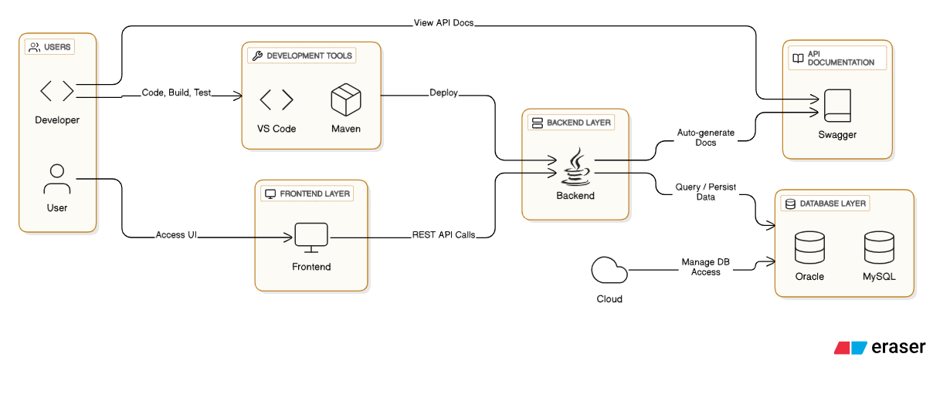
ARCHITECTURE
🔹

Slide 7
Key Features
🔹
Risk Calculation Engine Calculates key metrics like Net Interest Margin (NIM), Value at Risk (VaR), and Economic Value of Equity (EVE) to assess financial risk.
Scenario Analysis Allows simulation of various interest rate and liquidity scenarios to evaluate potential impacts on balance sheet and profitability.
Gap & Duration Analysis Identifies mismatches in asset and liability maturities and computes duration-based risk exposure.
Reporting Module Generates comprehensive reports with charts and tables for risk metrics, trends, and scenario outcomes.
User Interface Provides interactive dashboards for visualizing results, running simulations, and accessing reports.
API Integration Enables smooth data exchange with external systems and supports interoperability across modules

Slide 8
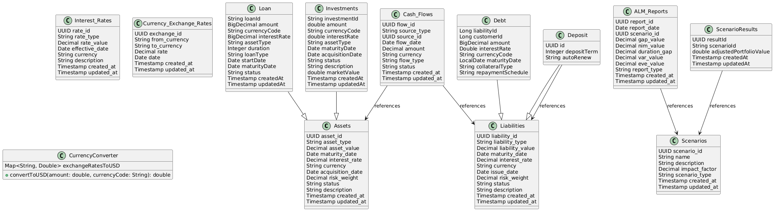
Class Diagram
🔹

Slide 9
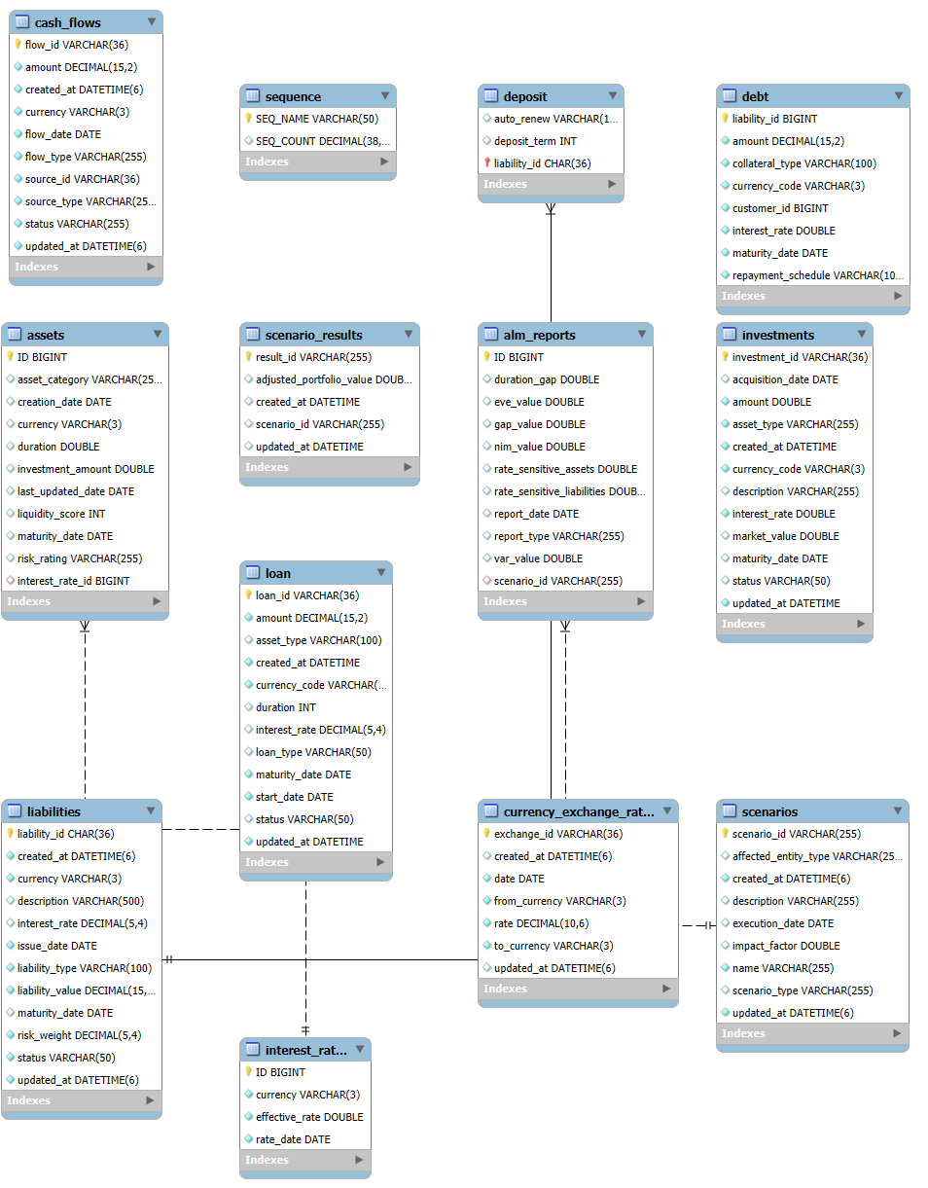
ER Diagram
🔹

Slide 10
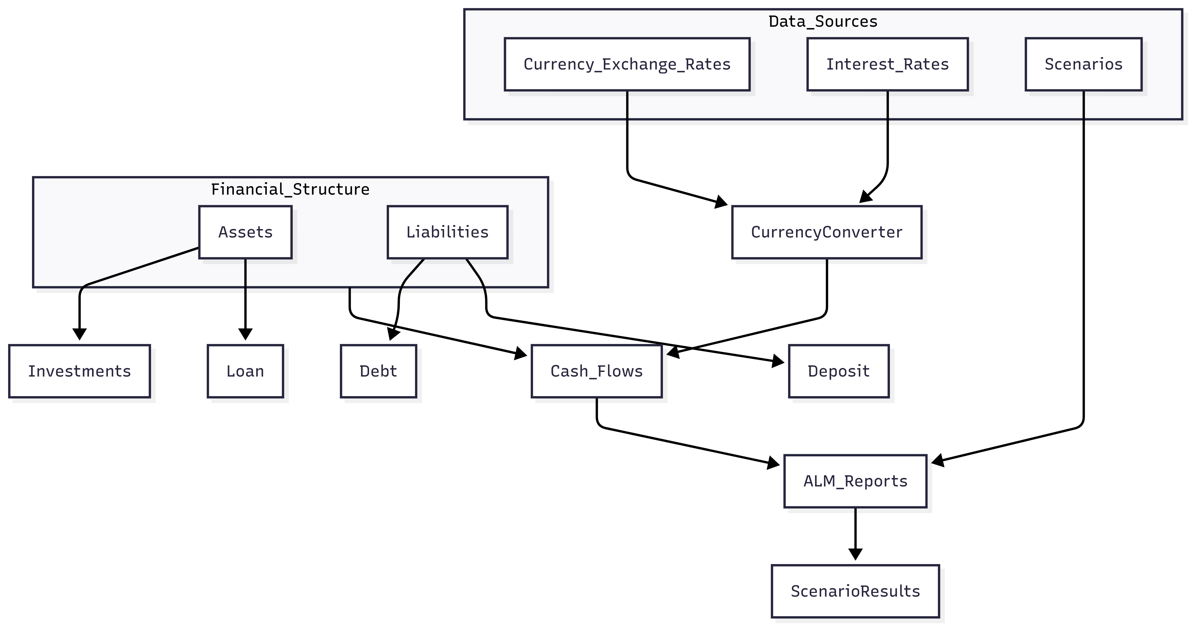
Entity Classes Relationship Diagram
🔹
10

Slide 11
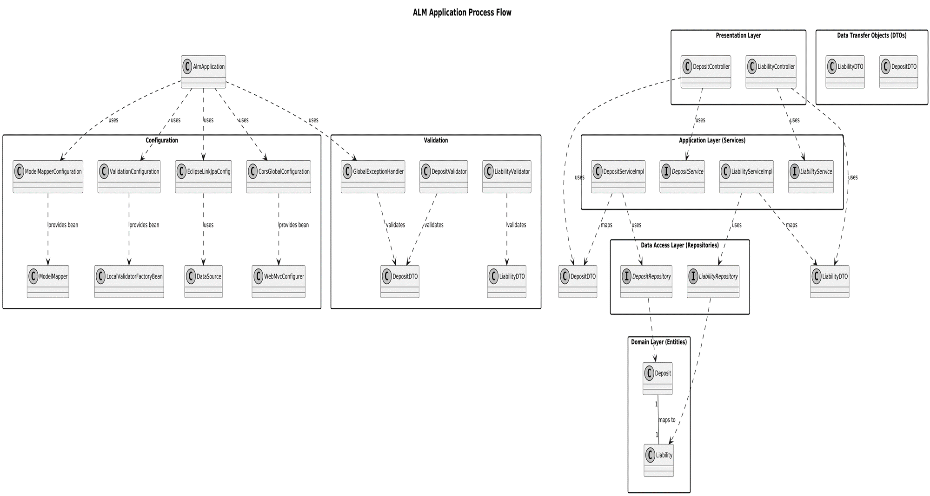
System Flow Diagram
🔹

Slide 12
Step by Step Process
🔹
Requirement Gathering Identified business needs, risk metrics, and reporting expectations.
Technology Stack Finalization Selected tools and frameworks based on scalability and integration needs.
System Design Defined architecture, entities, module boundaries, and data flow.
Backend & API Development Built core services using Java 17, Spring Boot 3.5.4, and REST APIs.
Frontend Implementation Developed UI using OJET V18.1.0.
Integration & Testing interaction between modules, validated APIs, and tested risk calculations.
Documentation & Deployment Open API Specification documentation using Swagger , endpoint testing with Postman

Slide 13
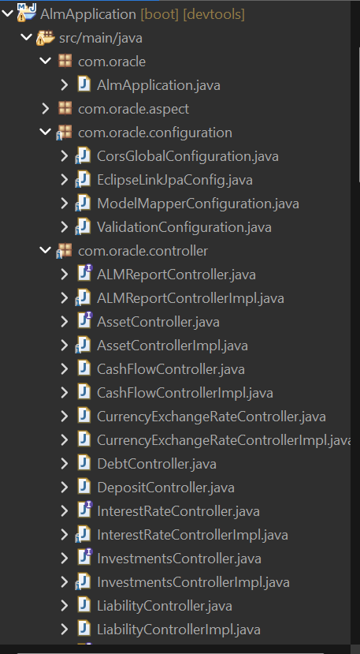
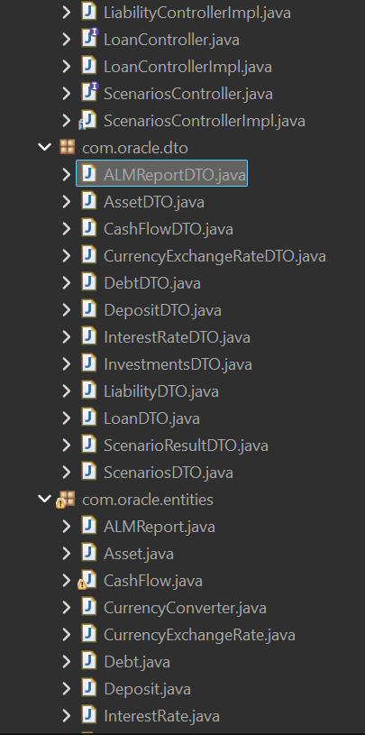
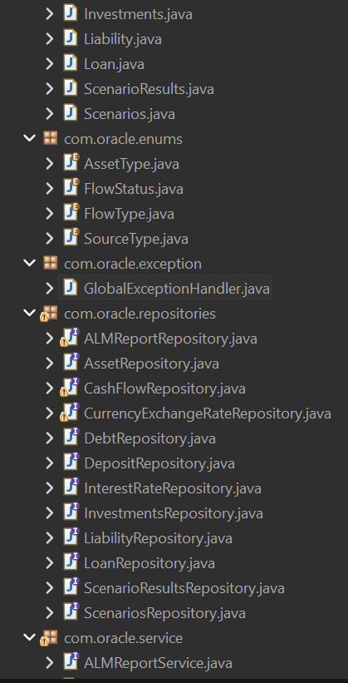
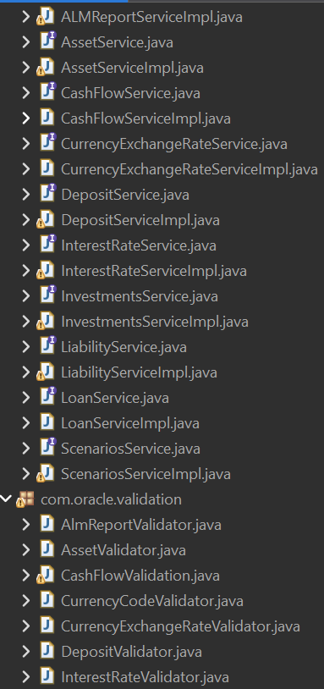
Backend Application Structure
🔹

Slide 14
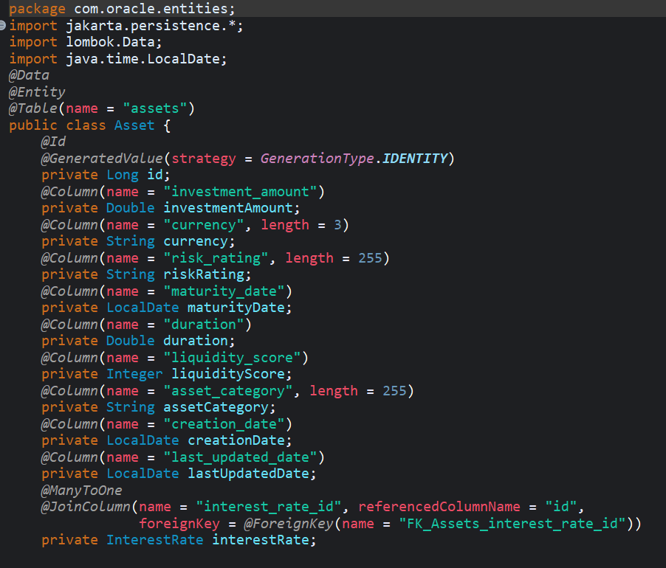
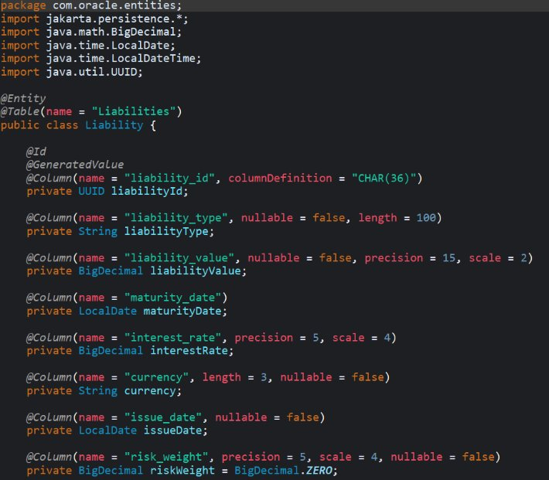
ORM Mapping
🔹

Slide 15
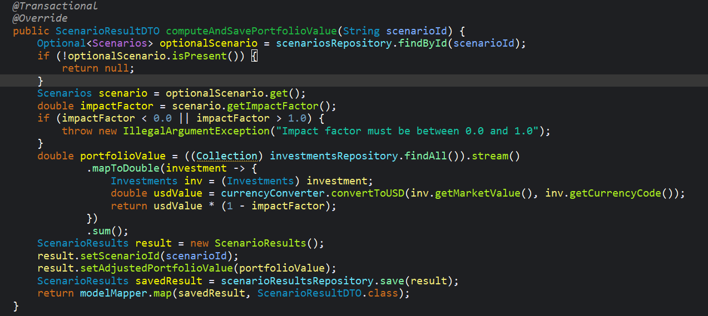
Scenario - Portfolio Calculation using Java Stream API
🔹

Slide 16
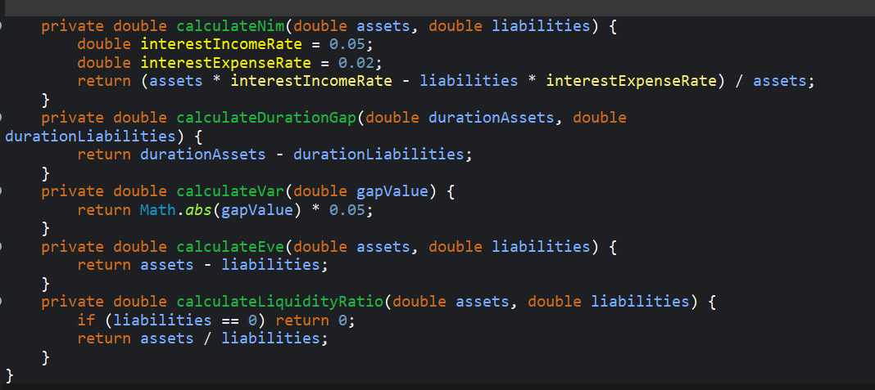
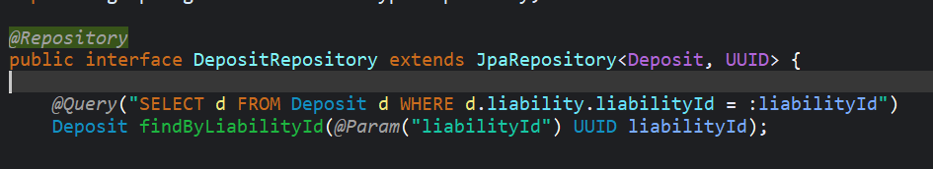
Risk analysis computations
🔹
Custom JPA Query

Slide 17
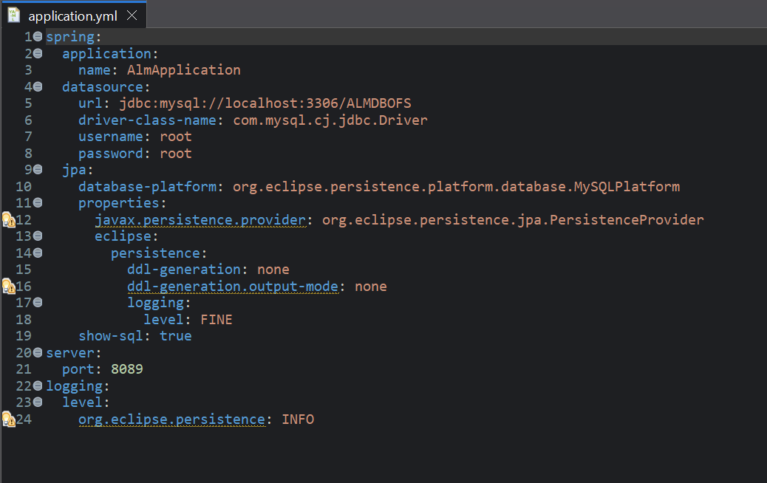
Spring Boot Configuration using application.yml
🔹

Slide 18
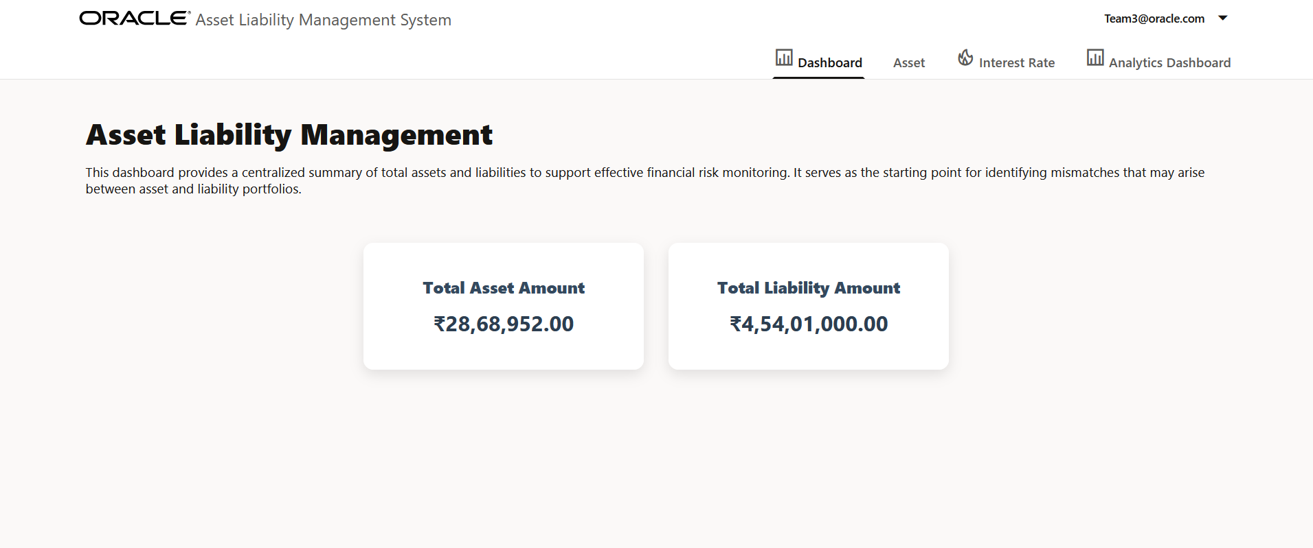
User Interface Preview
🔹
Dashboard

Slide 19
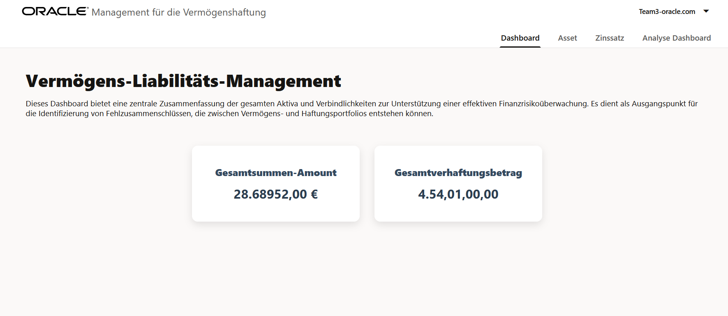
Internationalization (German)

Slide 20
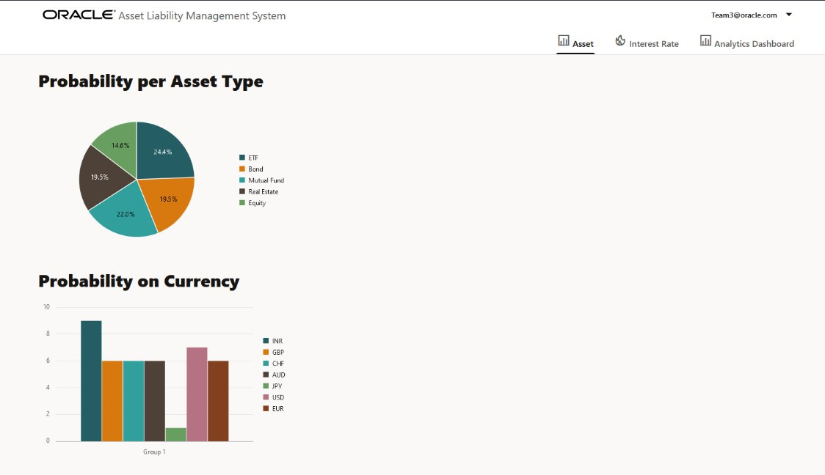
Useful insights on Assets
🔹

Slide 21
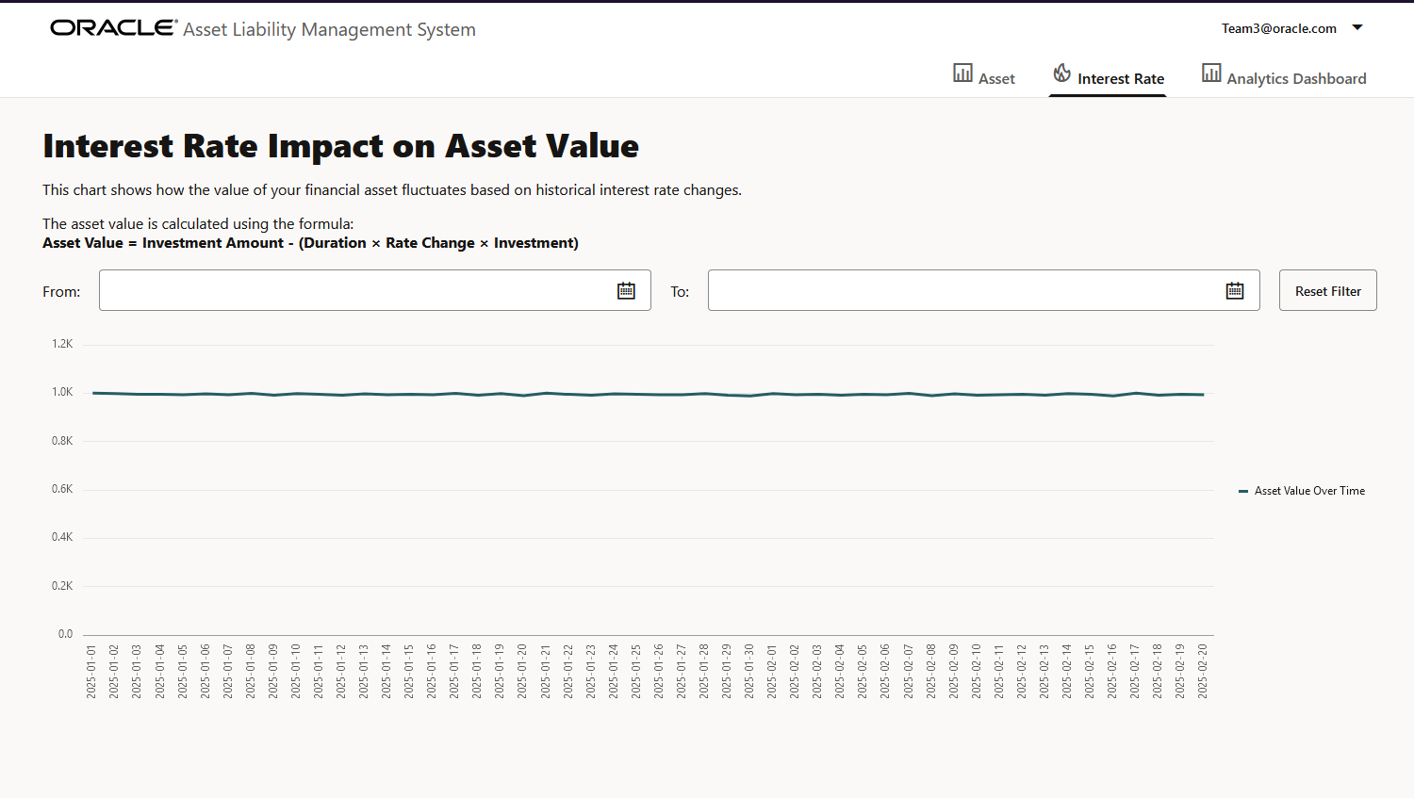
Interest Rate Impact on Asset value
🔹

Slide 22
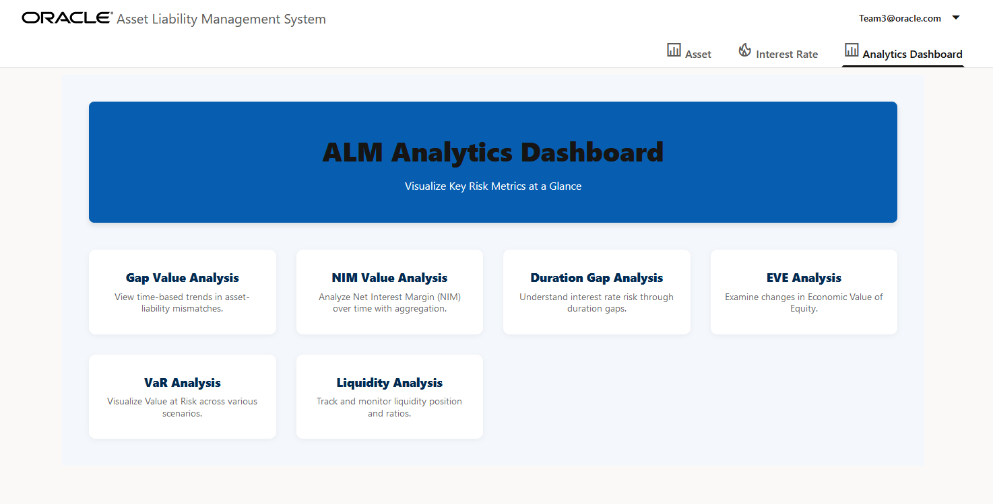
Analytics Dashboard
🔹

Slide 23
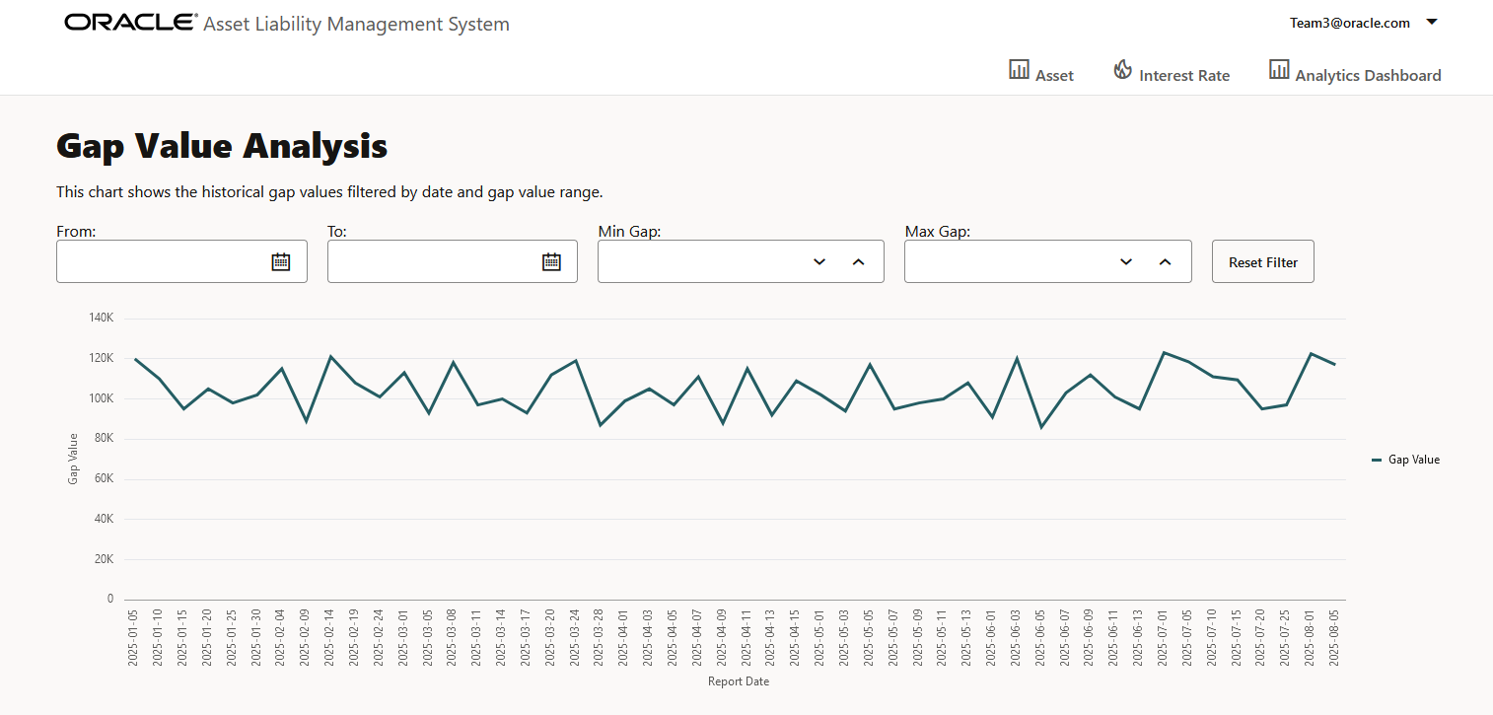
Gap Value Analysis
🔹

Slide 24
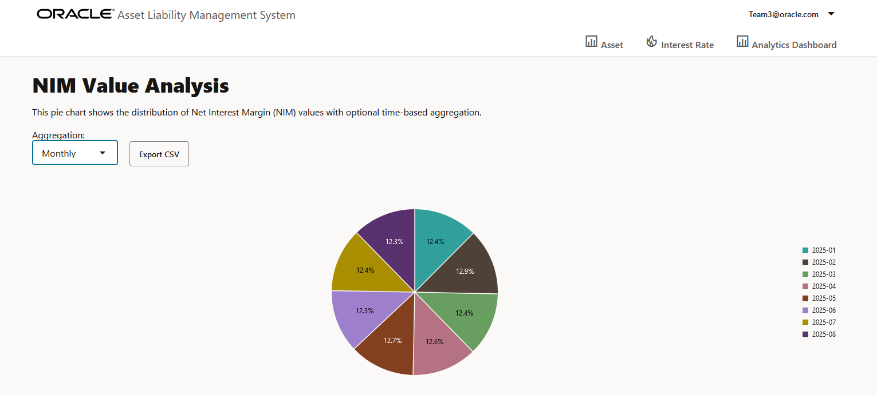
NIM value analysis
🔹

Slide 25
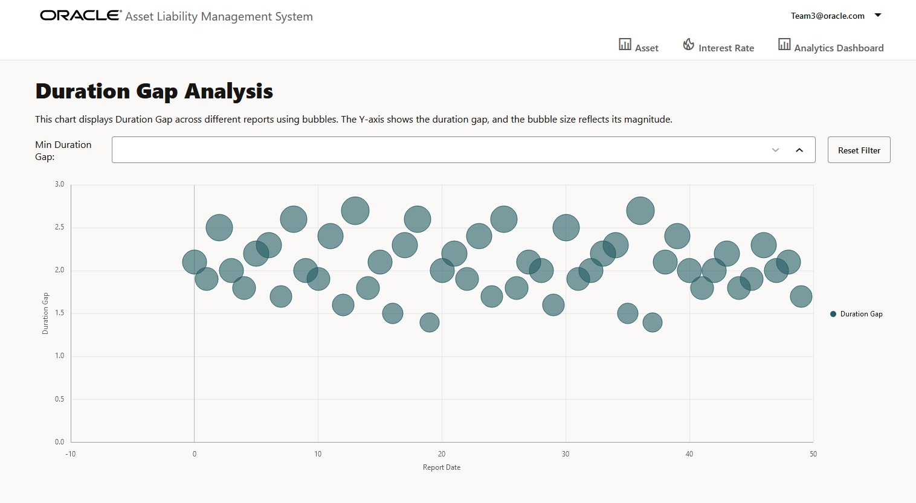
Duration Gap Analysis
🔹

Slide 26
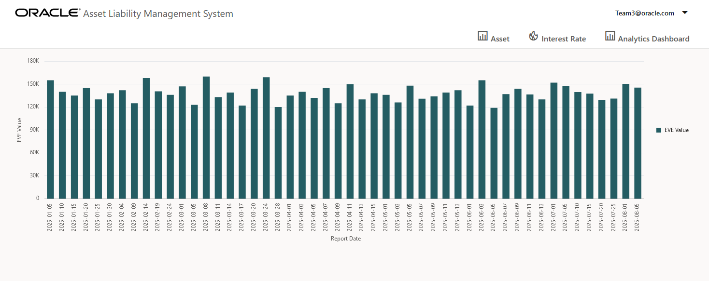
EVE analysis
🔹

Slide 27
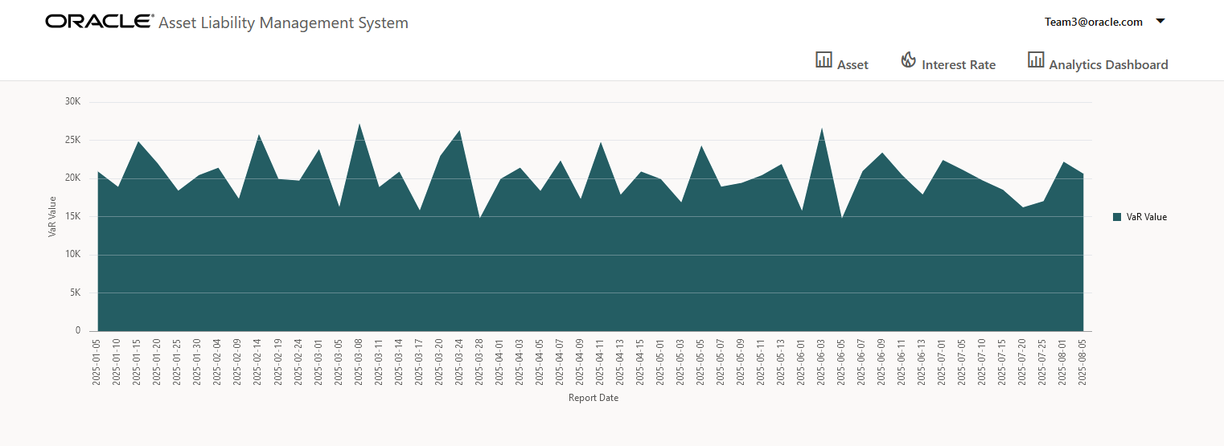
VaR analysis
🔹

Slide 28
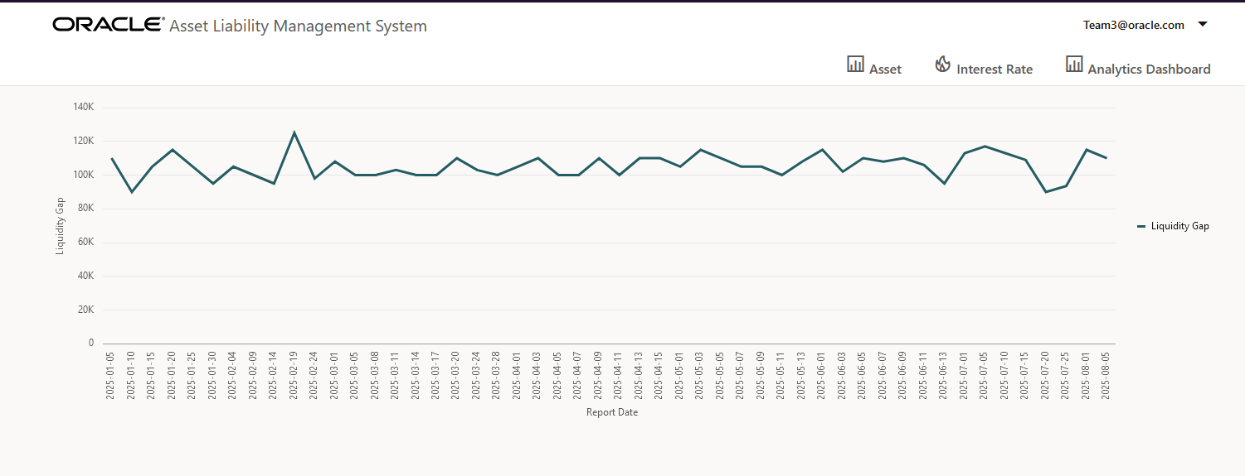
Liquidity Analysis
🔹

Slide 29
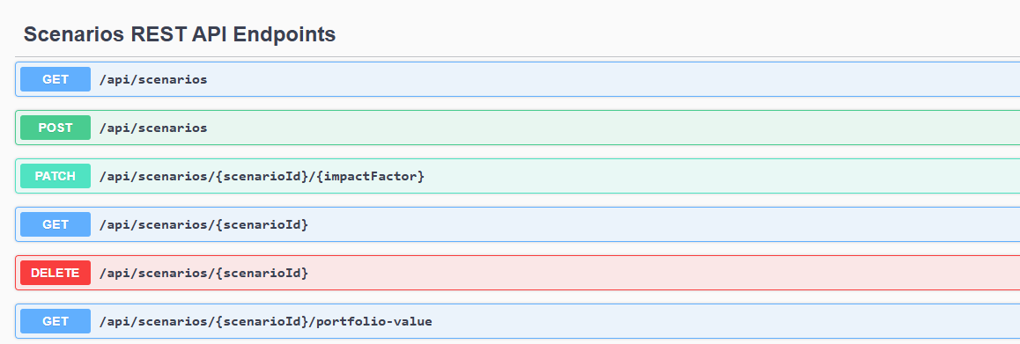
Open API Specification documentation using Swagger
🔹

Slide 30
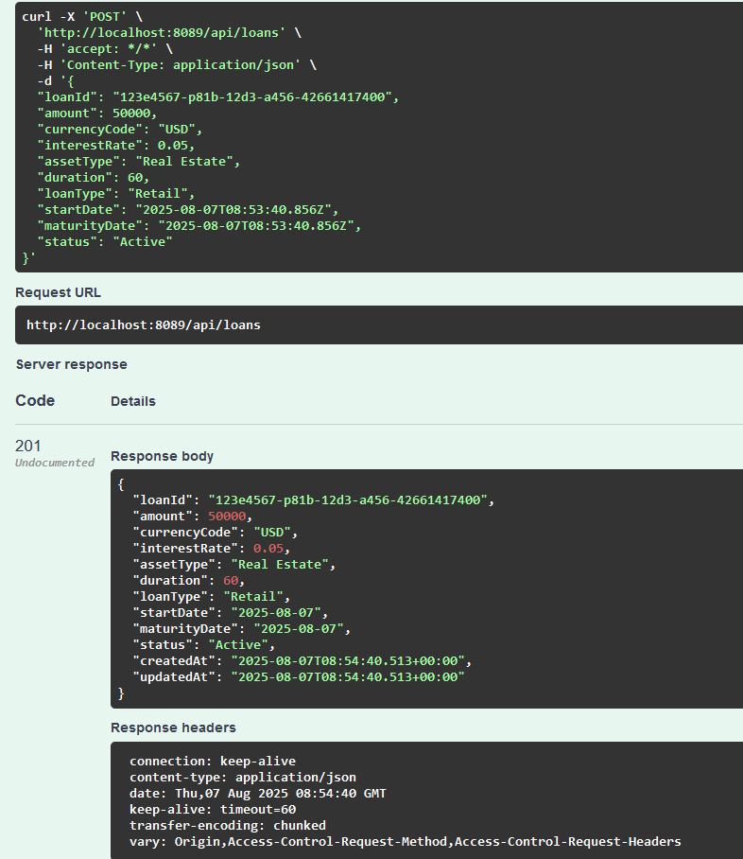
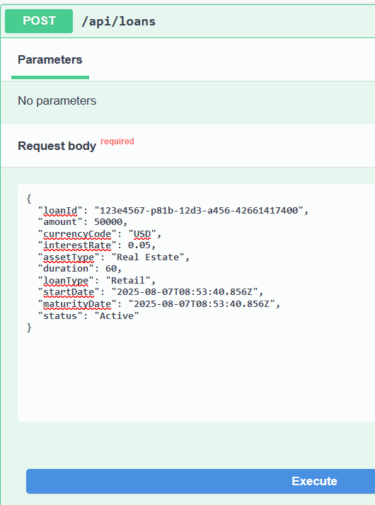
🔹

Slide 31
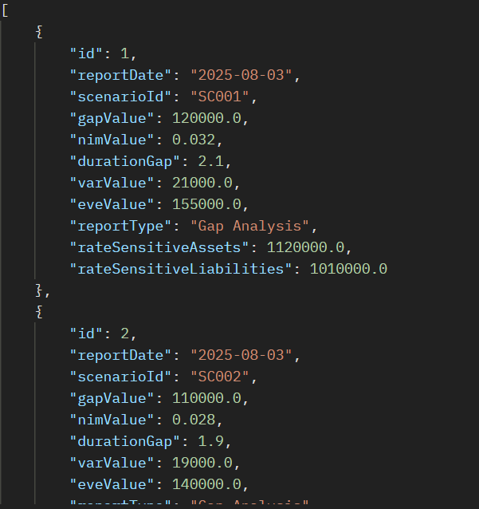
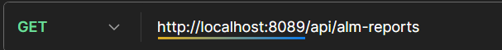
Endpoint testing using Postman
🔹

Slide 32
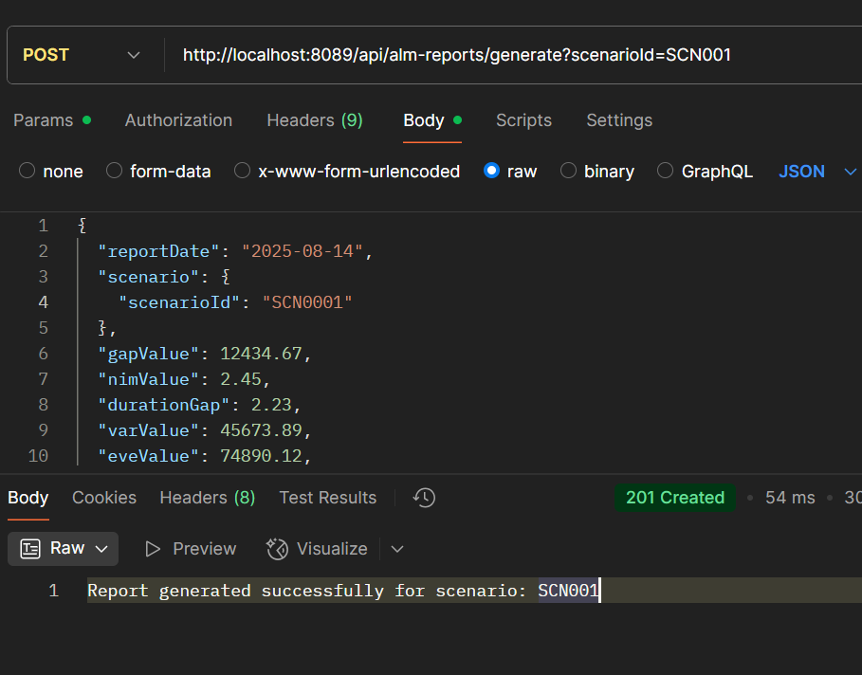
Generate Report for the Scenario ID
🔹

Slide 33
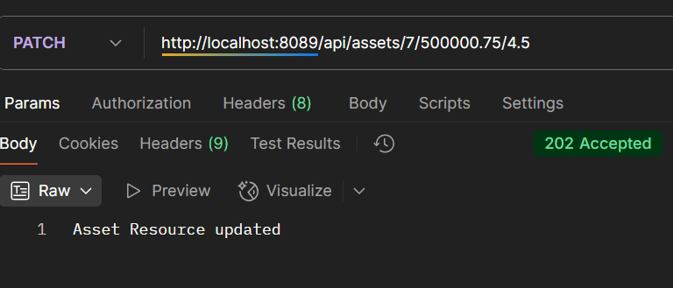
Asset updating Endpoint Testing
🔹

Slide 34
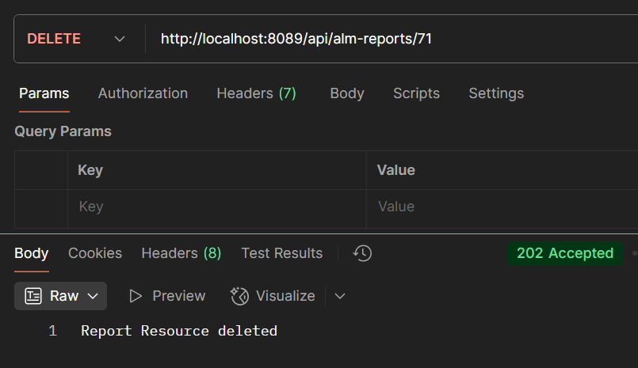
Deletion of Report
🔹

Slide 35
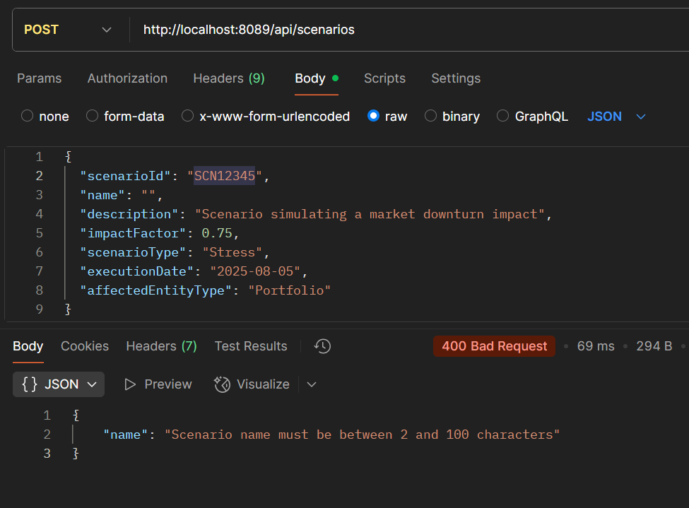
Scenario Payload Validation
🔹

Slide 36
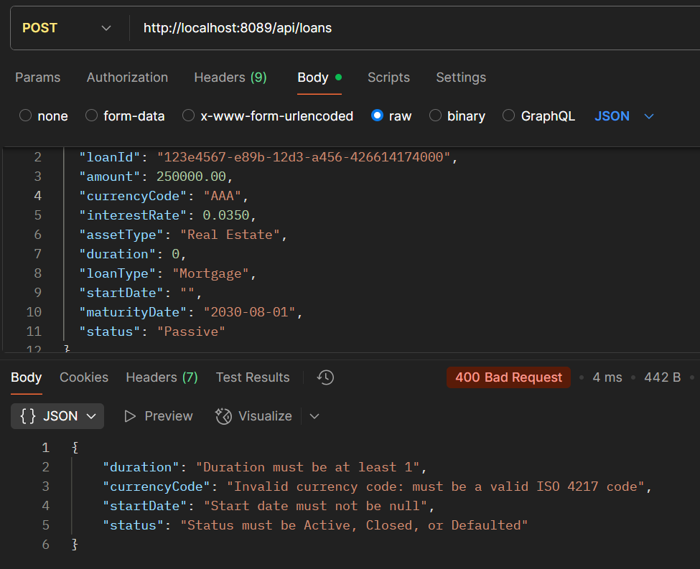
Loan Payload validation

Slide 37
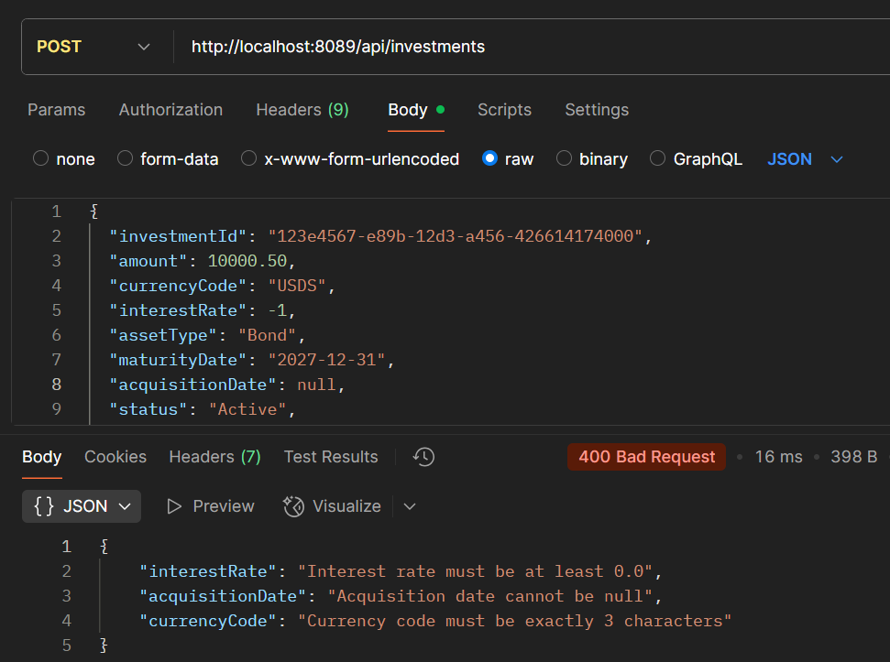
Investment Payload Validation

Slide 38
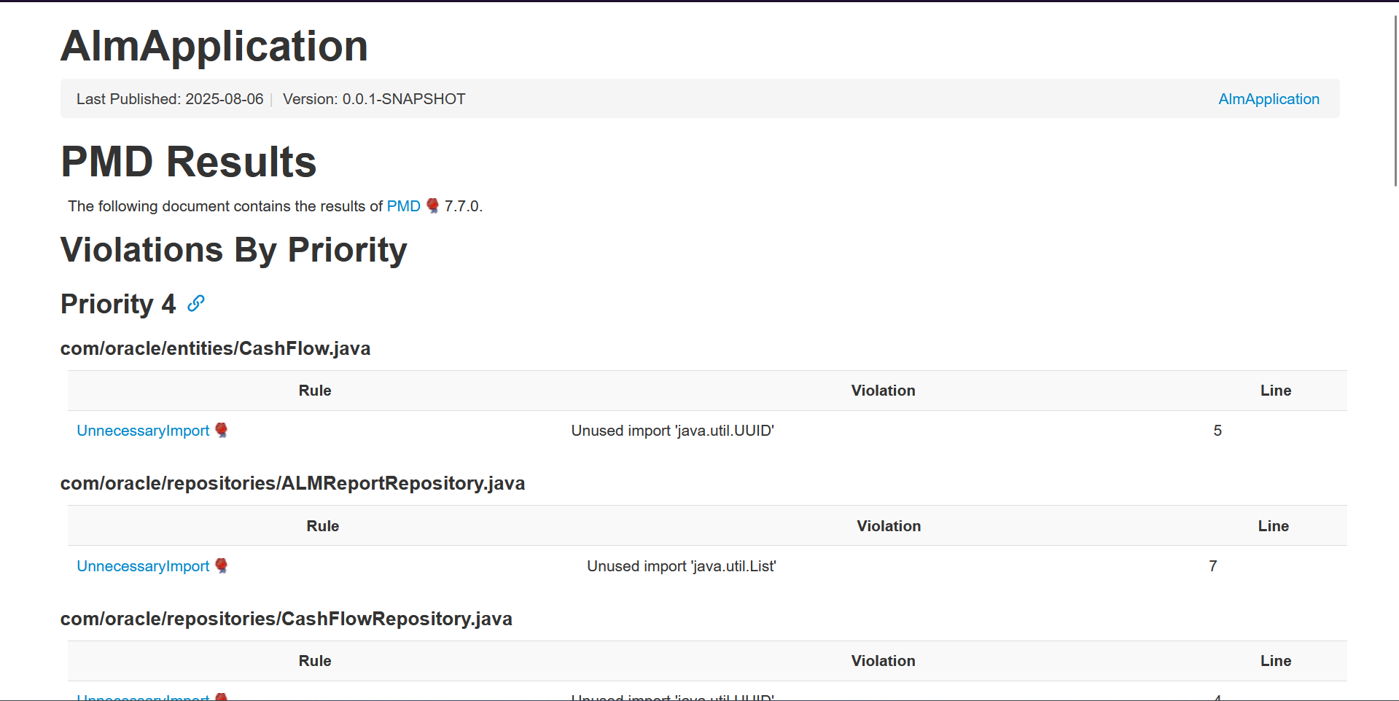
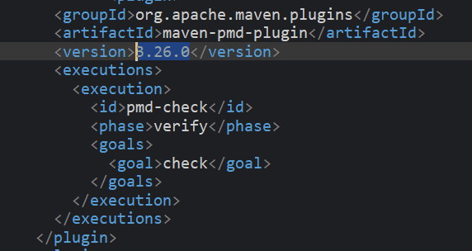
Static code analysis tools - PMD
🔹

Slide 39
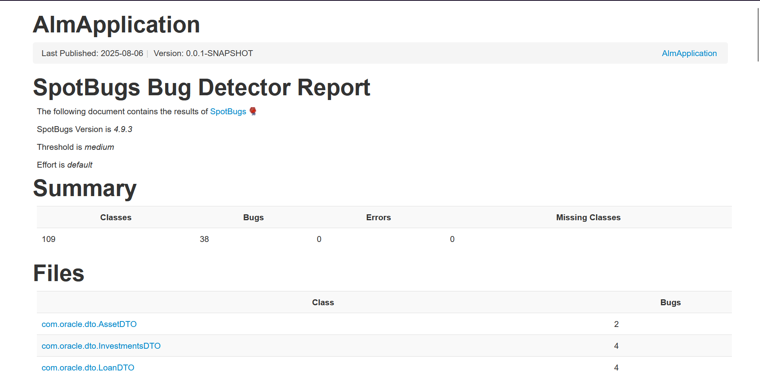
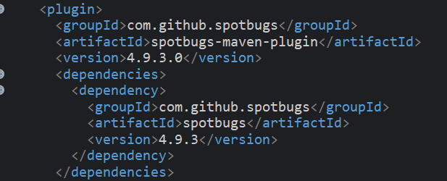
Spotbugs
🔹

Slide 40
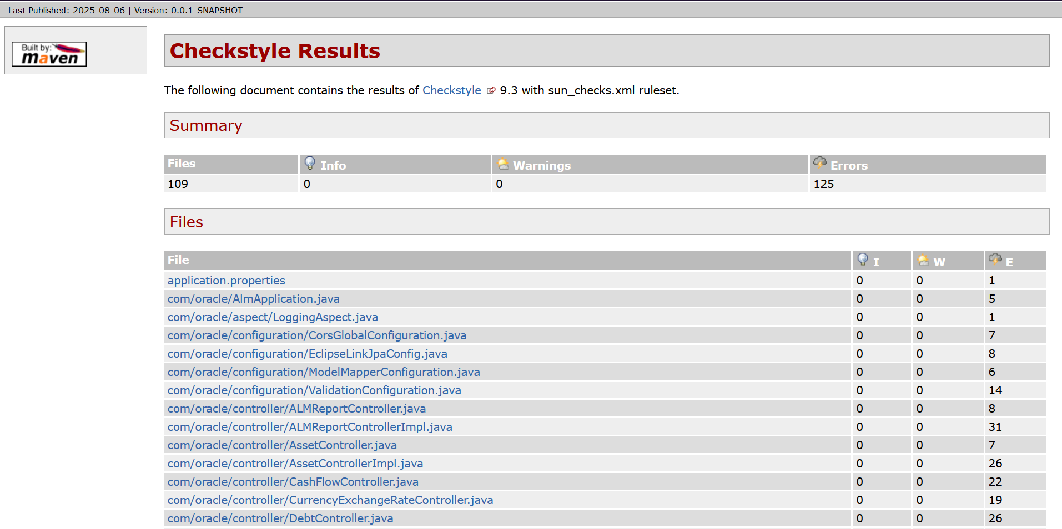
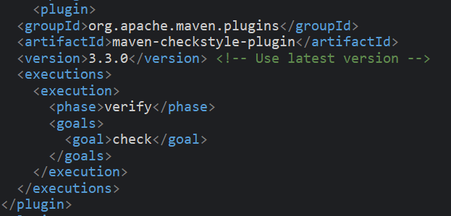
Checkstyle
🔹

Slide 41
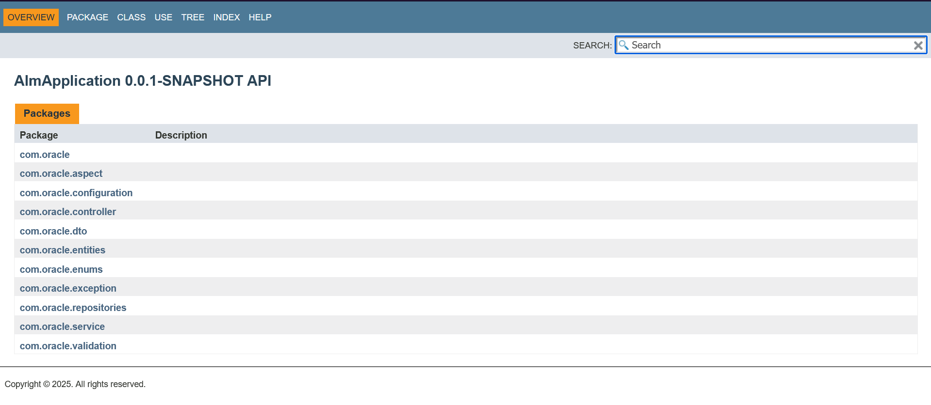
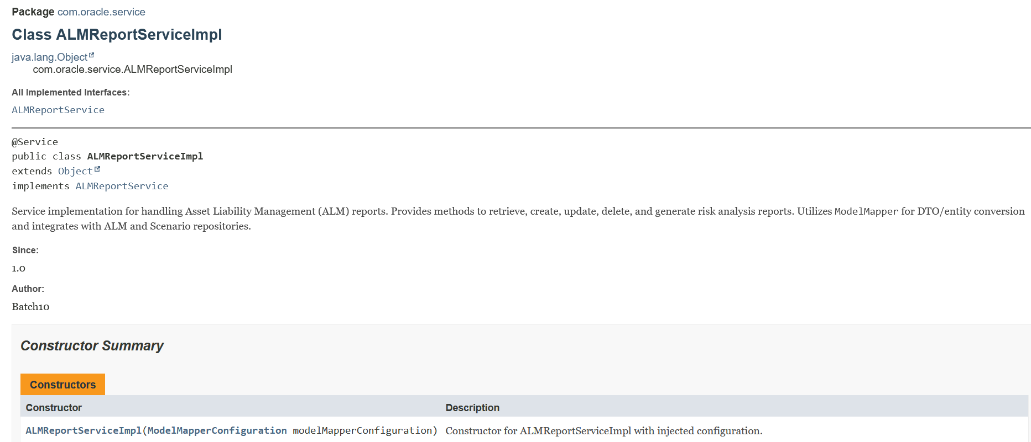
Documentation of Java codes using Maven Javadoc Plugin
🔹

Slide 42
Challenges Faced
🔹
Converting complex financial models like VaR and EVE into clean, efficient code
Understanding banking domain concepts like risk metrics and regulations
Understanding Oracle JET to create responsive user interfaces while adjusting to its preset component structure and data binding patterns
Fixing mismatches between backend API data and frontend rendering
Updating Swagger documentation in accordance with API versioning

Slide 43
Learnings And Takeaways
🔹
Gained hands-on experience building a full-stack app with Spring Boot, JPA (EclipseLink), MySQL, and Oracle JET
Learned to design and implement financial models like Gap Analysis, NIM and Var analysis
Documented and tested APIs using the OpenAPI specification, leveraging tools like Swagger and Postman to maintain clean architecture and integration standards
Learned to maintain code quality and consistency using static analysis tools like PMD, SpotBugs, and Checkstyle, identifying potential bugs, style violations, and performance issues early in development

Slide 44

THANK YOU

