Slide 1
Research on Software development
BRIDG is a Platform Independent Model that can be used to create a variety of implementation-specific styles with the same semantics and guarantee that programs will work with each other. Scalable harmonization methods have been developed in order to incorporate information from additional use cases and expand the model. CTMS applied storyboards and task diagrams to the BRIDG model for each use case.
The scope and variety of OSS applications in science computing and fitness were the subject of this exploratory study. The large number of active project sponsors indicates a flourishing open source software development community. The adoption of open source software (OSS) holds promise, but more research is required to comprehend the specifics of enhancement and the technical and social obstacles to acceptance.
From the provider's perspective, this literature review examines software development projects' successes and failures. It adheres to the challenge success and PM success criteria that are used in various challenge success assessments. The benchmarks for project success are customer contentment, short-term business success, and long-term provider success. On the other hand, six studies mention enterprise success standards in addition to PM success criteria, either implicitly or explicitly. limiting the lookup perspective to internal projects or the consumer's perspective.

Slide 2
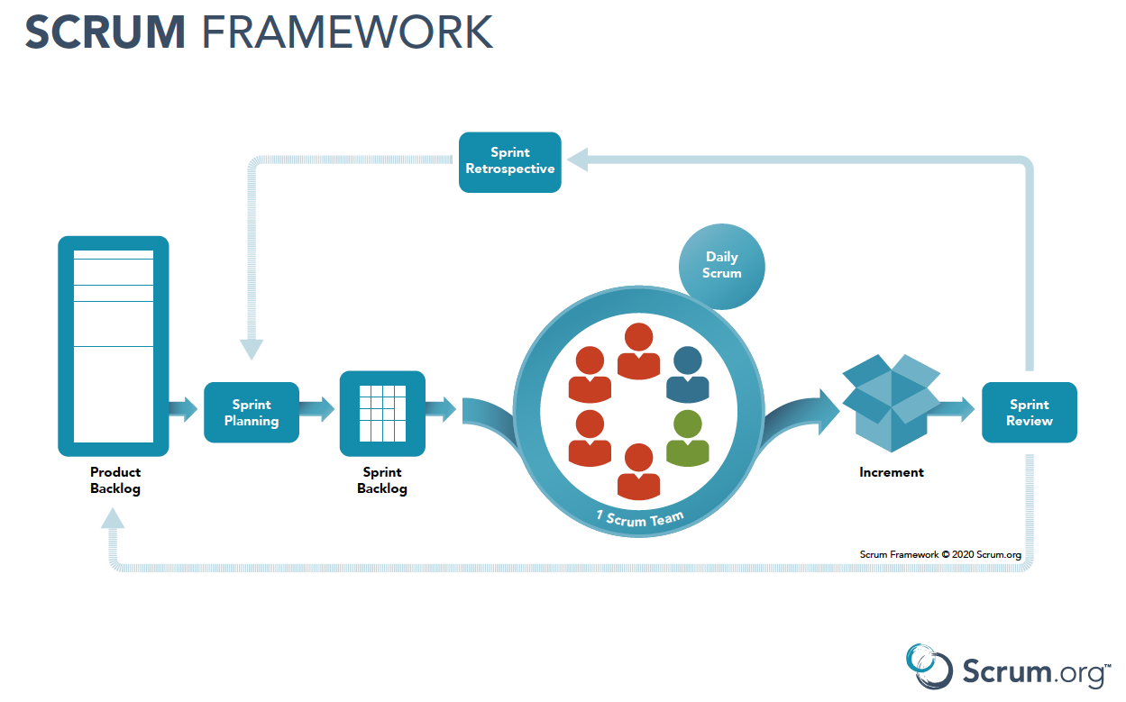
Scrum
Scrum is an agile project management framework used for software development that emphasizes collaboration, flexibility, and continuous improvement. It involves a team of cross-functional members working together in short sprints to deliver high-quality products or features. The process includes planning, daily stand-up meetings, review and retrospective meetings, and prioritization of work based on the product backlog. The Scrum framework also includes various roles such as the scrum master, product owner, and development team.

Slide 3
AGILE FOR BUSINESS
Agile development is not limited to a few specific practices and methods. Agile development is defined as having the following types: the ability to think strategically, the ability to initiate and respond to change, the ability to strike a balance between flexibility and structure, the ability to inspire creativity and innovation in a development team, and the ability to guide organizations through uncertainty and change.
In an organization, teams may develop their own agile requirements as business rules, and functions and guide them to the production process.
The product or service must pass the criteria of each agile requirement to meet the needs of the user.
Customer satisfaction plays a key role in a business. Opting for the Agile methodology for an organization improvises products and their products and increases customer satisfaction.
It clearly defines the goals of the project according to the requirements.

Slide 4
Requirement & System Engineering
To get a business’s attention, organizations demand the system. All organizations should plan differently. These modifications can make much arise in demand at any time. Even though the development and the ideology of the past business process will remain the same without any changes. This agile methodology will help to solve and support many other features including agility.
The process of collecting, explaining, negotiating, specifying, validating, and maintaining requirements is known as requirement engineering for a system.
System Engineering: For instance, the System engineering approach is considered or developed by all life cycles issues than focusing on the requirements. Because it is used to detect the system's complexity and manage the development risk process. It is basically of 3 planning steps:
The idea behind the operations: ‘What we do ‘
Program management plan: ‘how we get there ‘
Model design: ‘how we keep it going further

