Slide 1
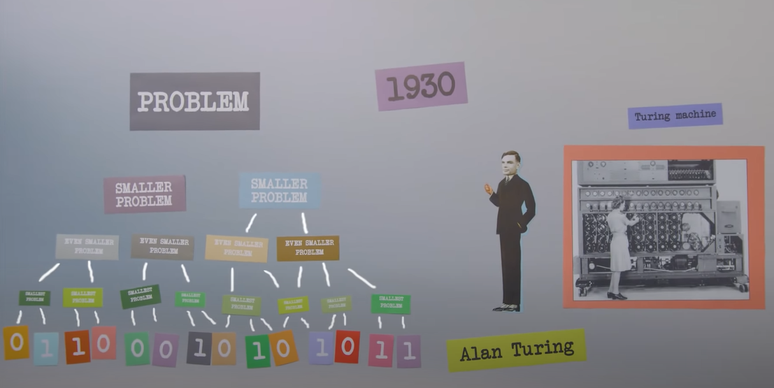
History of Software Engineering
Software Engineering is the Youngest field when compared to computer Science and some other disciplines.
When did this Software Engineering Start: During the apollo 11 mission which is around 1963 are early days of the space program software and coding were not seen as a big component of that mission.
Intern Margeret Hamilton a young mathematician who was working at NASA saw things differently and worked very hard and diligently to change that in fact she is credited with the coined the term software engineering.
The History of Software Engineering has evolved from creating small-size calculators to attempting to recreate human intelligence in 1's and 0's. In the 1930s Alan Turing invented the concept of programming by breaking a big problem into smaller problems all the way until each one is a byte size Yes/No. We take it all the way today and see that software now has entered every domain.

Slide 2
What is SDLC
A software development lifecycle is the process that a piece of software goes through from conception, to design and implementation, to eventual use. There are a number of steps in this process, and it is arguably the most important aspect of building successful software. "software development lifecycle" in its broadest sense. This includes any process where you make something new. For example, software development lifecycles are used by companies to create websites and web applications, create business process automation software for business management, design and build mobile apps for Android or iOS devices, and so on. The Software Development Lifecycle (S/L)
Different Phase of SDLC
- Planning - Development
- Defining - Testing
- Designing - Deployment
Models of SDLC
Waterfall – In this model, every phase should be complete before starting with the next phase.
Iterative – In this Model starts with simple implementations taking different aspects when requirements are not yet finalized, working on a different aspect, and combining them at the final stage
Spiral- It is a combination of a waterfall module and an iterative module where every phase is started by completing the previous phase alongside implementing the different aspects of the project
V- Unlike in Different models where testing is done once the total development is completed in this model each phase is developed and tested and then will be moving on to the next phase.
Big bang- In This Module, there is no process flow as the requirements come in the development happens and implementation is done, Highly risky
Agile- In the module it happens in different phases where it’s called sprint, in this, the requirements are separated and allocated to different sprints all the above-mentioned phases are in every sprint and then move on to the next sprint(Sprint Duration may be between 1-4 weeks.

Slide 3
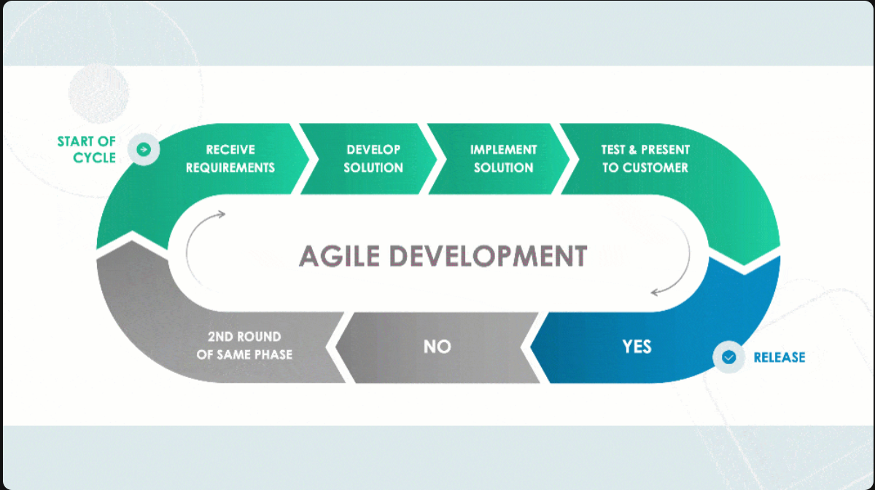
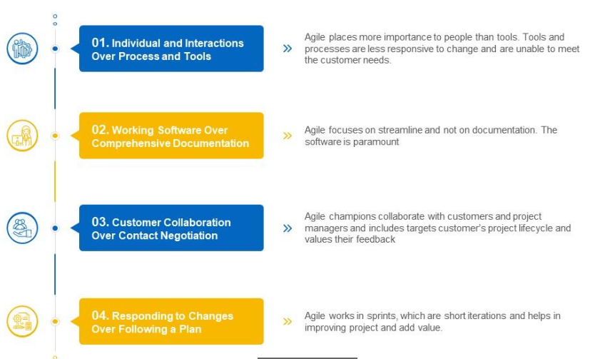
Agile & Agile manifesto
Agile: Agile methodology is path to build a project by breaking it up into different classifications to deliver high quality code in less time. It involves constant collaboration with stakeholders and continuous improvement at every stage. it deals with end-to-end flow of project description. In this, we need to know the client requirements, then we must follow the flow of agile methodology.
Agile Manifesto: Agile manifesto is a document built with four values and twelve principles for Agile software development. It is developed due to the increasing need of heavyweight software development process. There are no defined agile processes, procedures, or best practices described in the Agile Manifesto. Principles of Agile manifesto can be created according to the customer requirement.

Slide 4
Fundamental Software Engineering and System Engineering:
Software engineering is the study and application of engineering to the design, development, implementation, and maintenance of software in a systematic manner.
It is also an engineering branch associated with the development o software products using well-defined principles, methods, and procedures with functionalities such as reliability, usability, efficiency, maintainability, and portability.
Systems engineering is an interdisciplinary field of engineering and engineering management that focuses on how to design and manage complex systems over their life cycles. At its core, systems engineering utilizes systems thinking principles to organize this body of knowledge. Issues such as requirements engineering, reliability, logistics, coordination of different teams, testing and evaluation, maintainability, and many other disciplines necessary for successful system development, design, implementation, and ultimate decommission become more difficult when dealing with large or complex projects.

