Slide 1
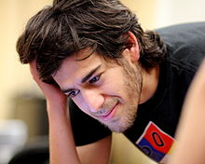
???
Aaron Swartz
He died on January 11 2013
He committed suicide

Slide 2


What did he do?
At 14
At 19

Slide 3
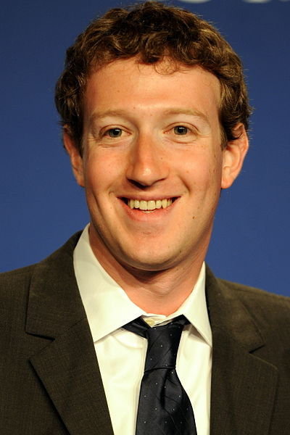
SO...
IS LIKE
???

Slide 4



Not really..what else did he do?
Open Library
Creative Commons
Wikimedia Foundation

Slide 5


Geeky..but, so what?
Pacer
Demand Progress

Slide 6
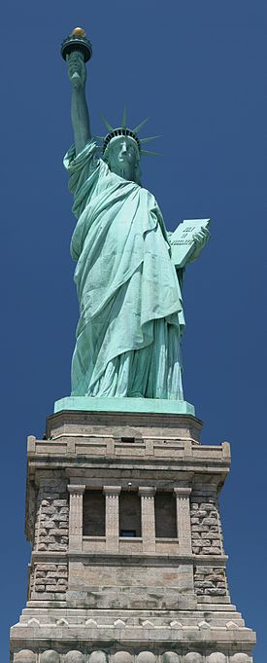
And then....
vs

Slide 7
Too Geeky?

Slide 8
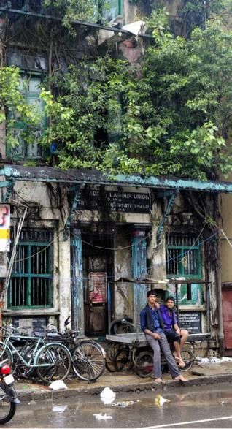
The curious case of the missing..
Where/Who/What
Why and When?
Courtesy: The Hindu

Slide 9


Depths of information
http://en.wikipedia.org/wiki/FC_Barcelona_B
http://en.wikipedia.org/wiki/List_of_Naruto:_Shippuden_episodes_(season_14)

Slide 10

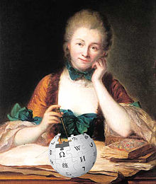
Wiki Warps?

Slide 11
So what does one do?
It's about community – in education
It's about community – in governance

Slide 12
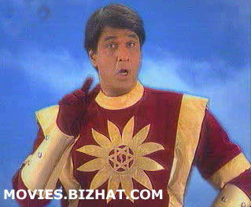
Join FSFTN in our activities
The How,
Is
next

