Slide 1


The TOR Proxy service-Stay anonymous over Internet
Karthic Rao,5th sem CSE

Slide 2
Content of Presentation
Threats over Internet
Problems in Existing Proxy Technologies
What is TOR?? Whats makes TOR a better alternative ??
Conclusion

Slide 3
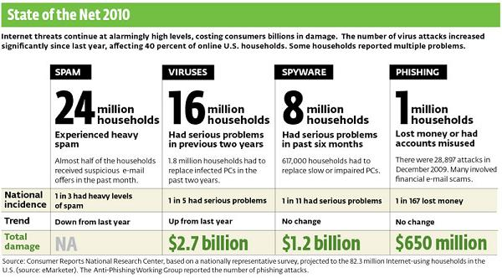
How safe is Internet ??

Slide 4
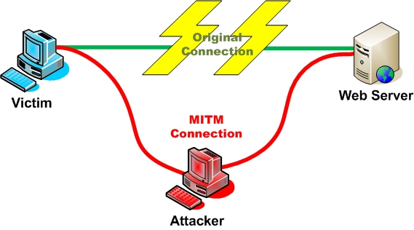
Data Interception
Inadequately secured data that is routed over the Internet, leaving your data exposed to interception and illegitimate use.

Slide 5

Computer Viruses

Slide 6
Threats from viruses
Delete modify the data and make it unusable
Steal your personal Information
Bring down your system
THEY SPREAD!!!

Slide 7
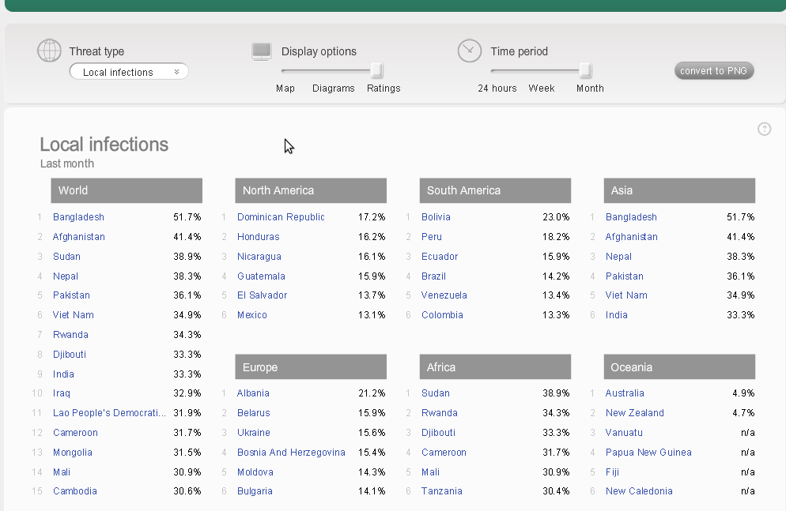

Slide 8
Internet Censorship Laws
Censorship Laws are threating the democracy of internet
Hundreds in India have been penalized and jailed for expressing their views
Warantless monitoring by government agencies
No one owns Internet , but Governments all over the world impose ridiculous laws without any concent from people

Slide 9
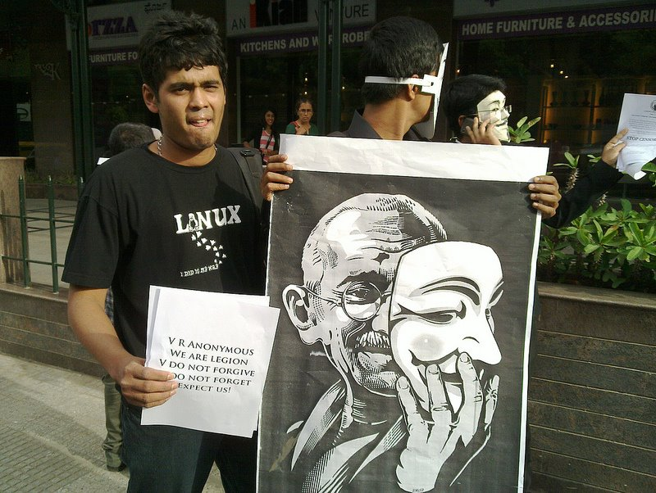
Well!!!I raised my voice !!

Slide 10
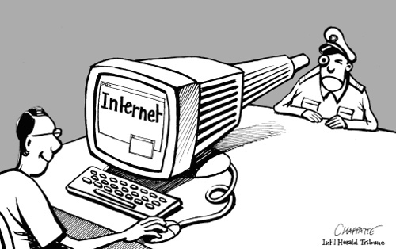
How often are we being SPYIED??

Slide 11
Giants like GOOGLE , FACEBOOK use your locational Identity and data like your status updates to show us the relevant ads.
In a world where we are handing our personal data to internet giants privacy of users is tending to ZERO

Slide 12
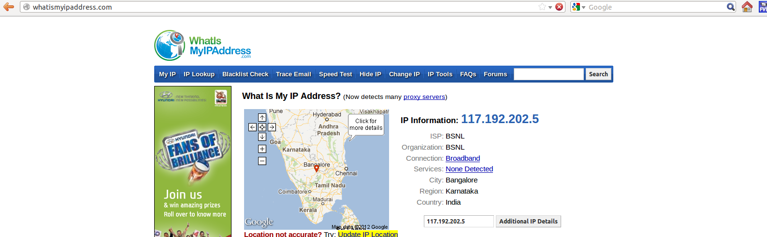

Slide 13



Slide 14

What do we need ??How to protect internet Users ??

Slide 15
To protect Internet users We need a Technology ........
Which Shouldnot be owned by anyone
Which is relaible and can be accessed from any part of the world
Which can conceal your identity , that is your IP address for protection from viruses and Censorship laws and spying.
Which uses a very efficient and hard to decrypt Encryption and routing technology to avoid data being intercepted and interpreted.

Slide 16
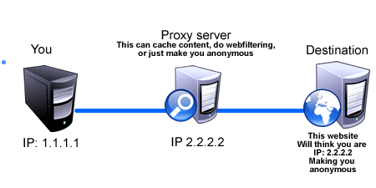
Problems with the existing technologies??Why do we need a new solution ??

Slide 17
The Big question??Do we have a solution??
Can the internet users be protected against Virus andmalware attacks ??
Can they be protected from being compromised on their security and privacy??
Can the democracy of internet be re-established ??

Slide 18


Slide 19
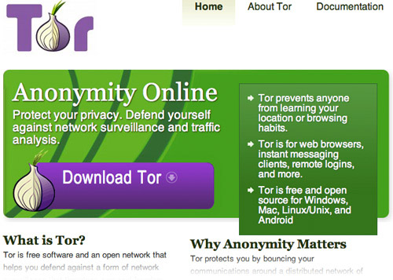
What is TOR ??Why is TOR the best available technology to serve the purpose ??

Slide 20
WHAT IS TOR??
Tor is free software and an open network that helps you defend against a form of network surveillance that threatens personal freedom and privacy, confidential business activities and relationships, and state security known as traffic analysis

Slide 21
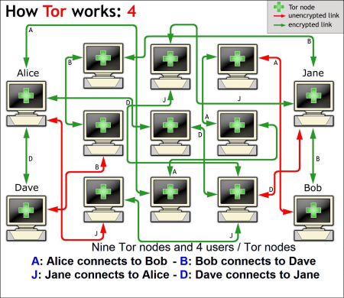
How does TOR function and Why is effiecient ??
No one owns computers on TOR network

Slide 22
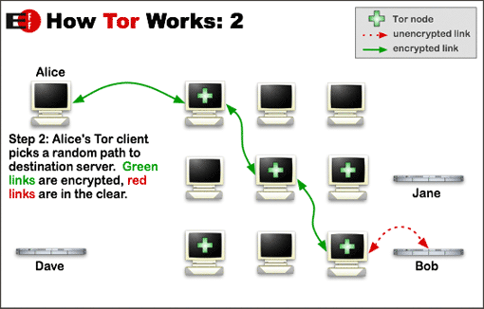
Data is 5 layer Encrypted

Slide 23
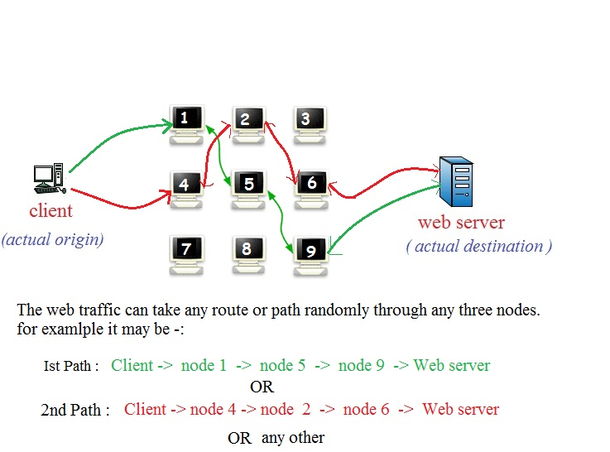
Onion routing

Slide 24
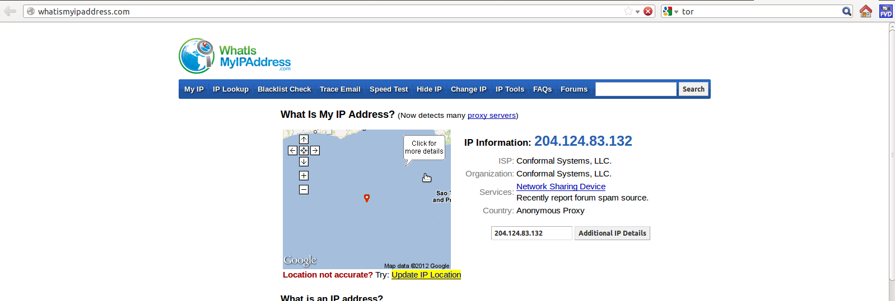
IP Address is concealed

Slide 25

TOR is a free software

Slide 26
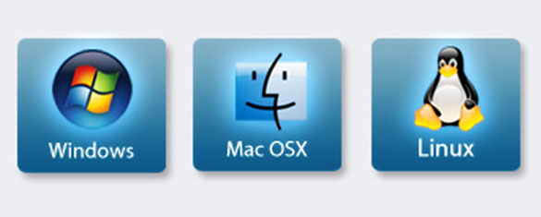
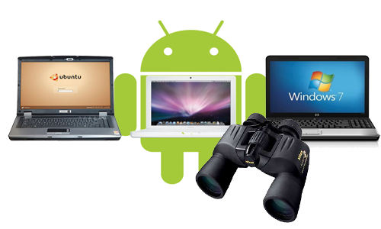
Available for all platforms

Slide 27

Our role
Use the technology and help making Internet safe , democratic and a wonderful site .
Contribute
Spread the word!!

Slide 28

THANK YOU

