Slide 1
Cloud Computing

Slide 2
What do you need to run a website?

Slide 3
Take a computer (Infrastructure)
Boot an OS, Make ready to use (Provisioning)
Configure the OS (Configuration Management)
Create the website (Software Development)
Upload and run the website (Deployment)
24/7 Network, Power, Cooling, Maintenance, Monitoring

Slide 4
Purchase a domain: www.mysite.com
Point it to this computer (DNS)
Go to browser: www.mysite.com

Slide 5
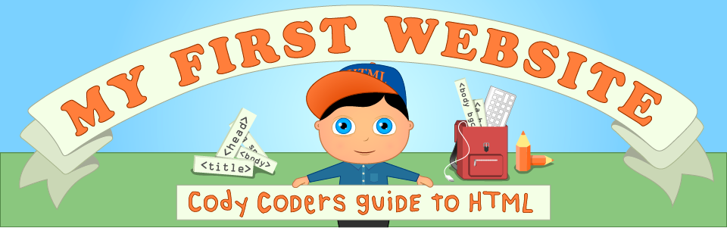

Slide 6
Where does this happen?

Slide 7
Data Center
Facility (space, power, cooling, etc)
Infrastructure (machines, hard disks, RAM, network, etc)
Provisioning (bring up an OS)
Configuration Management (configure software)
Development (develop software)
Deployment (run software)
Notes:
That’s all! Go start buying some real estate…

Slide 8
Co-Located Data Center
Facility
Infrastructure
Provisioning
Configuration Management
Development
Deployment

Slide 9
Managed Data Center
Facility
Infrastructure
Provisioning
Configuration Management
Development
Deployment

Slide 10
Hosting
Facility
Infrastructure
Provisioning
Configuration Management
Development
Deployment

Slide 11
Managed Hosting
Facility
Infrastructure
Provisioning
Configuration Management
Development
Deployment

Slide 12
One-click Hosting
Facility
Infrastructure
Provisioning
Configuration Management
Development
Deployment
Notes:
cPanel

Slide 13
Cloud

Slide 14
IaaS
Facility
Infrastructure
Provisioning
Configuration Management
Development
Deployment
Hosting +
Pooled Hardware
Virtualization
Elasticity
Metered Billing

Slide 15
IaaS Demo

Slide 16
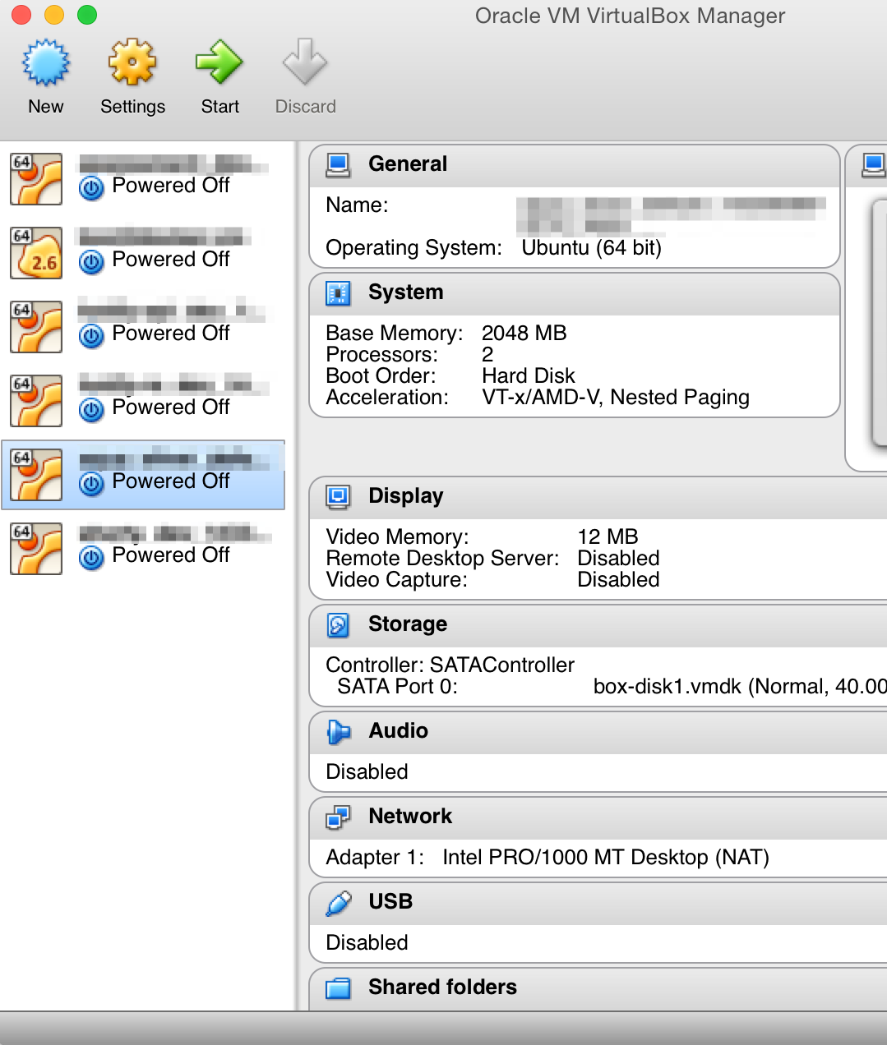
Virtualization
Boot multiple OS in a single machine
No need to buy commodity servers
Share memory, CPU across OSes
Needs Hardware support

Slide 17
PaaS
Facility
Infrastructure
Provisioning
Configuration Management
Development
Deployment
One-click Hosting +
Pooled VMs
Containers
Elasticity
Metered Billing

Slide 18
PaaS Demo

Slide 19

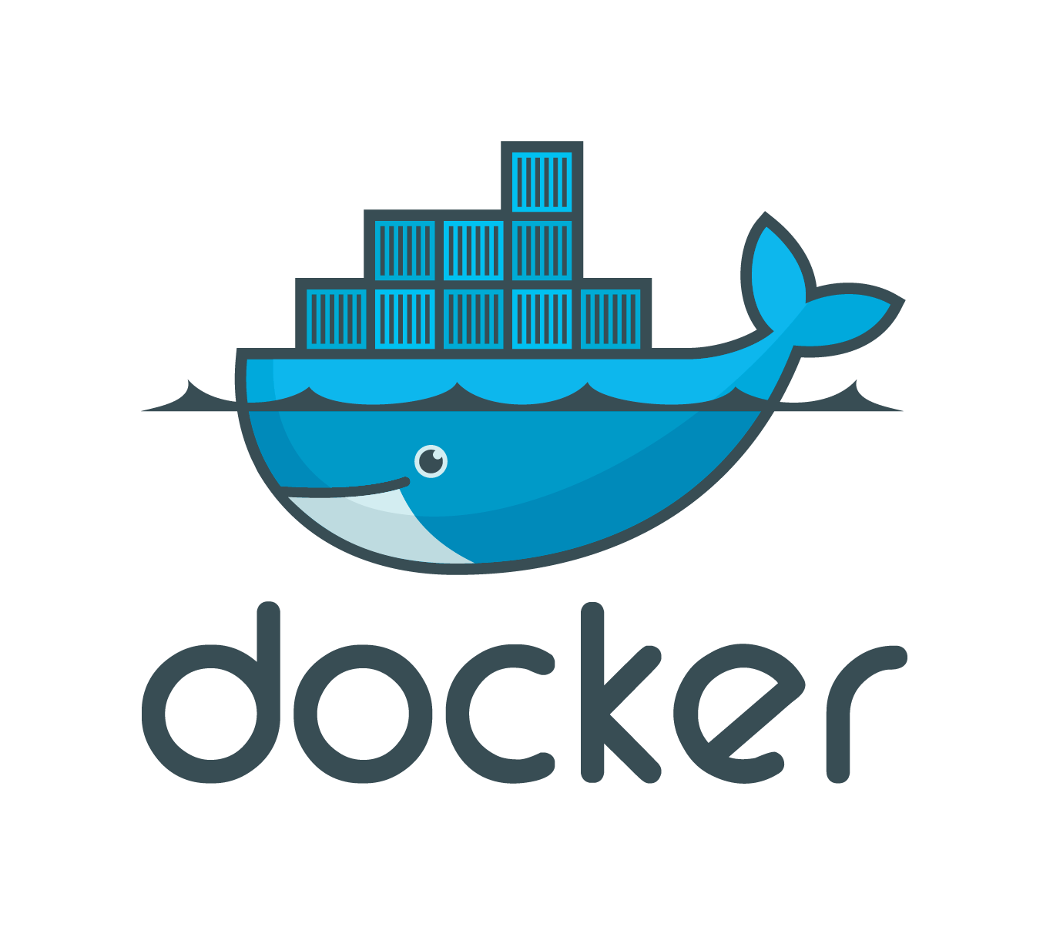

Containers
Application + All necessary dependencies as one single package
Provision once, Deploy anytime
Does not conflict with host OS
Mini server-inside-server
Only needs OS support
LXC

Slide 20
SaaS
Facility
Infrastructure
Provisioning
Configuration Management
Development
Deployment
Just sign up
Maybe customize

Slide 21
SaaS Demo

Slide 22
Advantages
Fully managed infrastructure
Scale up in minutes
Elasticity
Pay for what you use
Infrastructure is pooled, you don’t own any
Works as long as you don’t need physical security

Slide 23

IaaS
Effort
Effort
Control
Cost
PaaS
SaaS

