Slide 1
Reproducible Research
Dave Kent
10/21/2016

Slide 2
Remember our core values?
Constant improvement
Reproducible research
Team work
Excellence in execution

Slide 3
Remember our core values?
Constant improvement
Reproducible research
Team work
Excellence in execution

Slide 4
What is reproducible research?
Reproducibility is the degree to which an experiment can be duplicated
A complete and truthful description of methods
Ambiguity → less reproducible

Slide 5
What is reproducible research?
Not reproducible:
“Each BT raw milk samples was tested for mesophilic spores.”
Reproducible:
“Aliquots of each BT raw milk sample were spore pasteurized at 80°C for 12 min, followed by rapid cooling to ≤6°C. Spore pasteurized samples were spiral plated onto brain heart infusion agar in duplicate and incubated at 32°C for 48 h for a mesophilic spore count.”
Notes:
Reproducing the data collection

Slide 6
What is reproducible research?
Not reproducible:
“A linear model was fit to the data to investigate the effect of temperature on bacteria count.”
Reproducible:
“Using the lm function in R, a linear model was fit to the data with log-transformed bacteria count as the response, temperature as a main effect, and test day as a blocking effect. Effect of temperature on log bacteria count was assessed with the lsmeans package in R.”
Notes:
Reproducing the analysis

Slide 7
Why is reproducible research important?
…that’s kind of the essence of the scientific method…
If I want to test a claim I find in a paper, I need to know how to test it.
If I want to test a hypothesis, I need to know the conditions where the hypothesis is supposed to hold
Practically, it makes our lives easier
When Martin thinks your results are weird, and you know exactly what happened, you can blame the weirdness on the method or the samples! (ok yeah sure, now you have to justify why you chose a weird method)

Slide 8
A (mostly fictional) anecdote
You’re in a meeting with Martin, and in your manuscript he reads:
“The geometric mean MS level for samples with spores detected by direct plating (≥10 spores/mL) was 3400 spores/mL. The geometric mean TS level for samples with spores detected by direct plating (≥10 spores/mL) was 14 spores/mL.”

Slide 9
A (mostly fictional) anecdote
“The geometric mean MS level for samples with spores detected by direct plating (≥10 spores/mL) was 3400 spores/mL. The geometric mean TS level for samples with spores detected by direct plating (≥10 spores/mL) was 14 spores/mL.”
Martin says “That 590 spores/mL seems too high. I need you to double check these numbers.”
Seems like a reasonable request – he’s probably right, as usual. Maybe I made a transcription error.

Slide 10
A (mostly fictional) anecdote
“The geometric mean MS level for samples with spores detected by direct plating (≥10 spores/mL) was 3400 spores/mL. The geometric mean TS level for samples with spores detected by direct plating (≥10 spores/mL) was 14 spores/mL.”
I go back to the spreadsheet and check.
A-ha! The geometric mean MS level is 33.6 spores/mL. I probably rounded and missed a decimal place or something.
I’ll just go ahead and check the TS level for kicks. Oh. Oh, no. 16.3 spores/mL?

Slide 11
A (mostly fictional) anecdote
At this point, we’ve already produced the data
We are having trouble reproducing the analysis

Slide 12
A (mostly fictional) anecdote
At this point, we’ve already produced the data
We are having trouble reproducing the analysis
Even though we are the ones that did it in the first place!

Slide 13
Ugh, what’s the problem?
We adjust the raw data by correcting, transforming, normalizing
We don’t always keep good track of the age or succession of our data files.

Slide 14
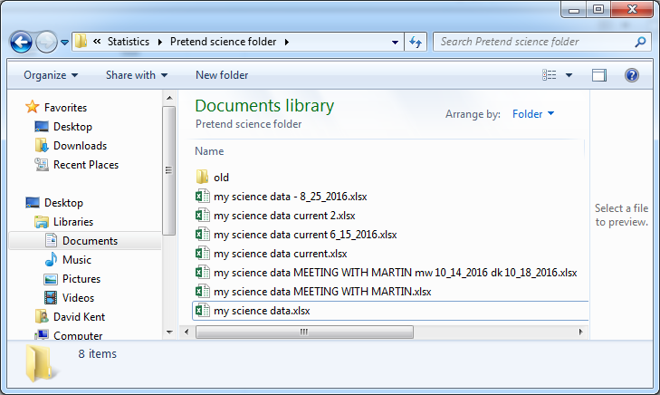
Ugh, what’s the problem?
We often don’t know what we did:

Slide 15
Ugh, what’s the problem?
We often don’t know what we did:
file 1
file 2
file 3
file 4
file 7
file 5
file 6

Slide 16
Ugh, what’s the problem?
We often don’t know what we did:
file 1
file 2
file 3
file 4
file 7
file 5
file 6

Slide 17
Constant improvement
Let’s do better!
There are solutions for someone of any technical proficiency

Slide 18
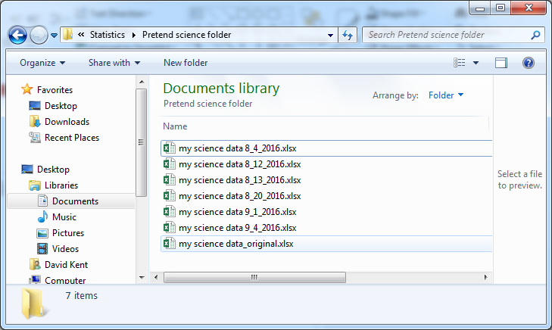
Low-tech
Take control of the succession of your files:

Slide 19
Low-tech
Take control of the succession of your files:
Always save-as before you start editing
Always date the files
Now the most recent file ought to be the “most correct,” and we have a snapshot of the history
file 1
file 2
file 3
file 4
file 5

Slide 20
Medium-tech (this is what I usually do)
Retain exactly ONE copy of your raw data
Write an R script which does all of the corrections, normalization, and transformation
The data itself is never changed, and corrections are made to the script
R script to process data and do calculations/analysis
results
raw data

Slide 21
High-tech
Just like medium-tech, but keep the data and script in “version control”
This tracks all changes that have been made to the files, along with (mandatory) comments
Most useful for more complicated analysis, multiple scripts

Slide 22
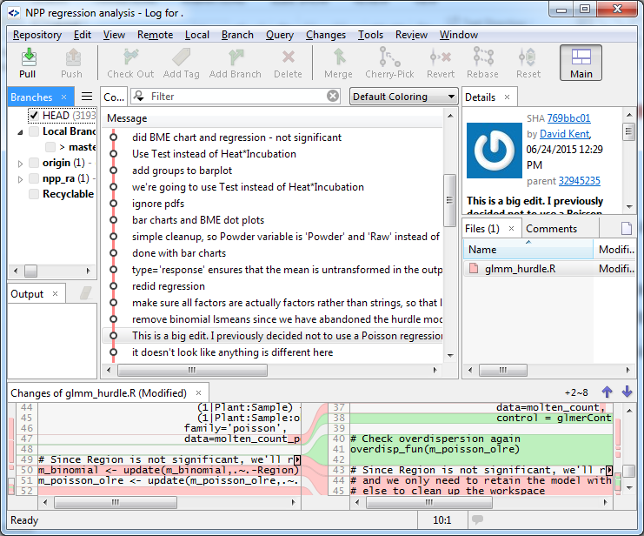
High-tech

Slide 23
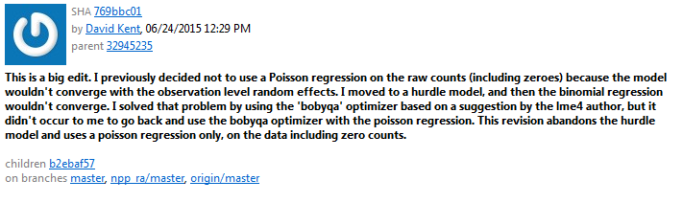
High-tech
Real life example
When I look back, I don’t have to wonder why I made certain changes, large or small.

Slide 24
Publishing the process
Medium- and high-tech solutions yield an explicit description of the analysis process
This can be published along with the text to remove any ambiguity about the analysis

Slide 25
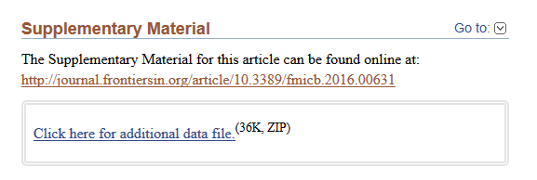
Publishing the process
Tom recently published a paper with the analysis script in the supplemental
The analysis is fully reproducible

Slide 26
On another note
Statistics only provides the right answer when we ask the right question
We need to make explicit three things
What can we take for granted?
What information did the experiment collect?
What do we want to quantify?
Sometimes I only know the answer in my gut, rather than my brain
If we get counterintuitive results from the statistics, it’s important to go back and make sure we’re asking the right question.

Slide 27
Questions?

