Slide 1
FPO Integrated OS
POWERED BY FINDABILITY SCIENCES
FPO INTEGRATED OS
Agent-led operating system for FPOs
A walkthrough of the unified platform for registry, fulfillment, market execution, communication, approvals, and carbon readiness.

Slide 2
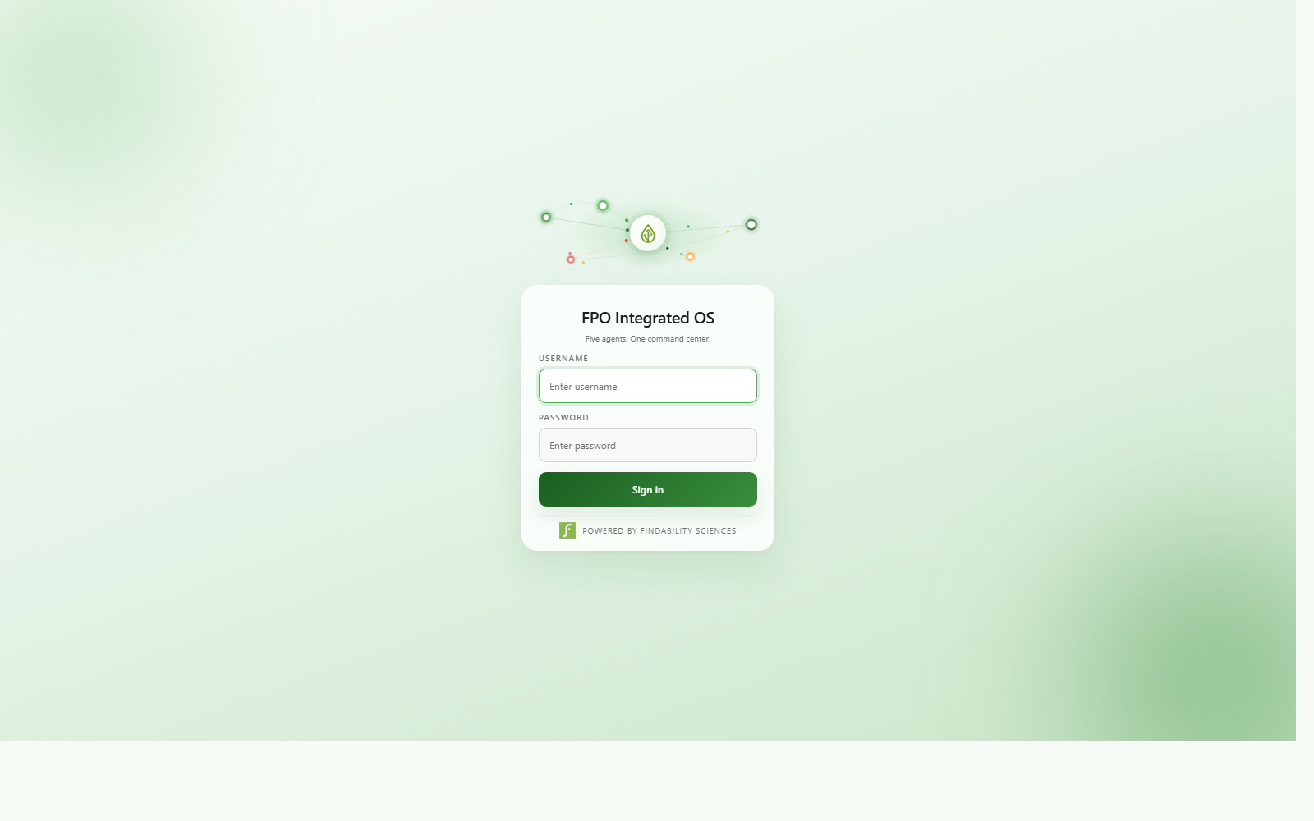
ENTRY POINT
Five agents. One command center.
The demo opens with a clear operating promise: specialist agents coordinate work while the FPO office steps in only where judgement is needed.

Slide 3
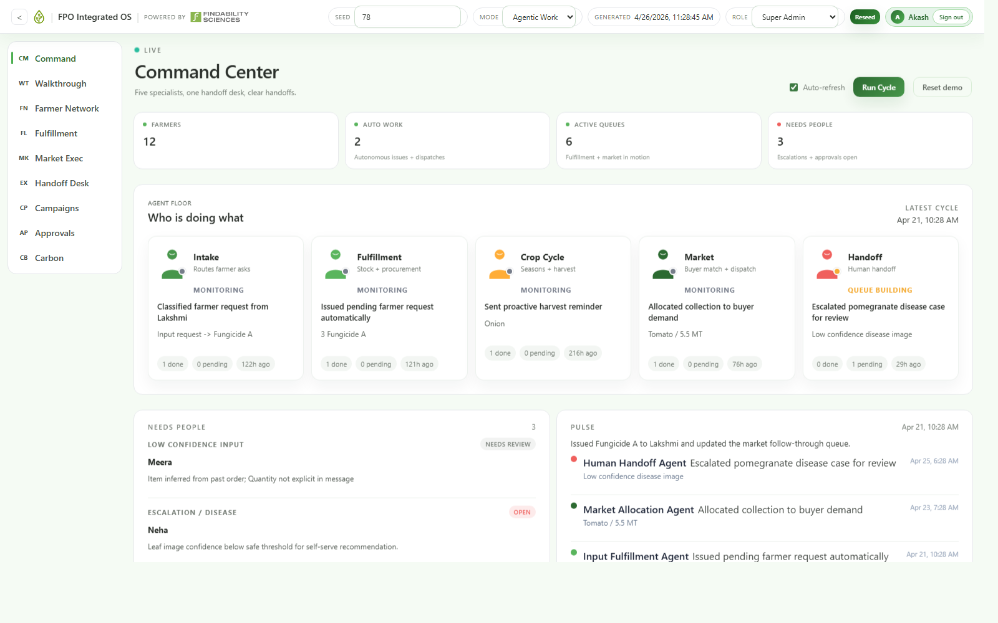
COMMAND CENTER
One operating surface for the autonomous state
Managers can see active queues, recent agent runs, work done automatically, and the exact items that still need people.

Slide 4
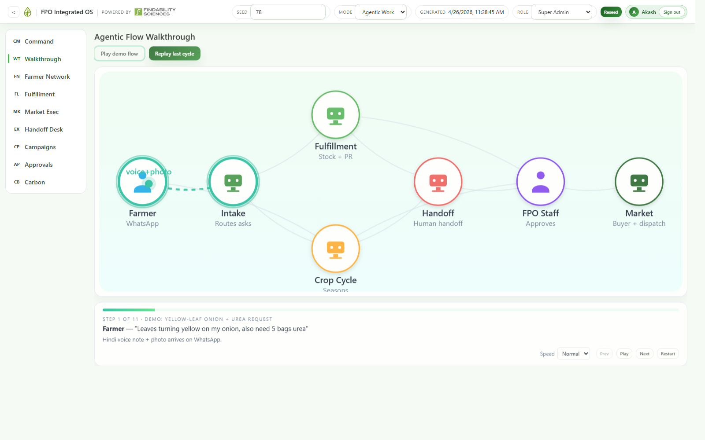
FLOW WALKTHROUGH
Message-to-execution through specialist agents
Farmer intake routes the signal, fulfillment and crop-cycle agents act on it, and market or staff only enter when confidence or policy requires it.

Slide 5
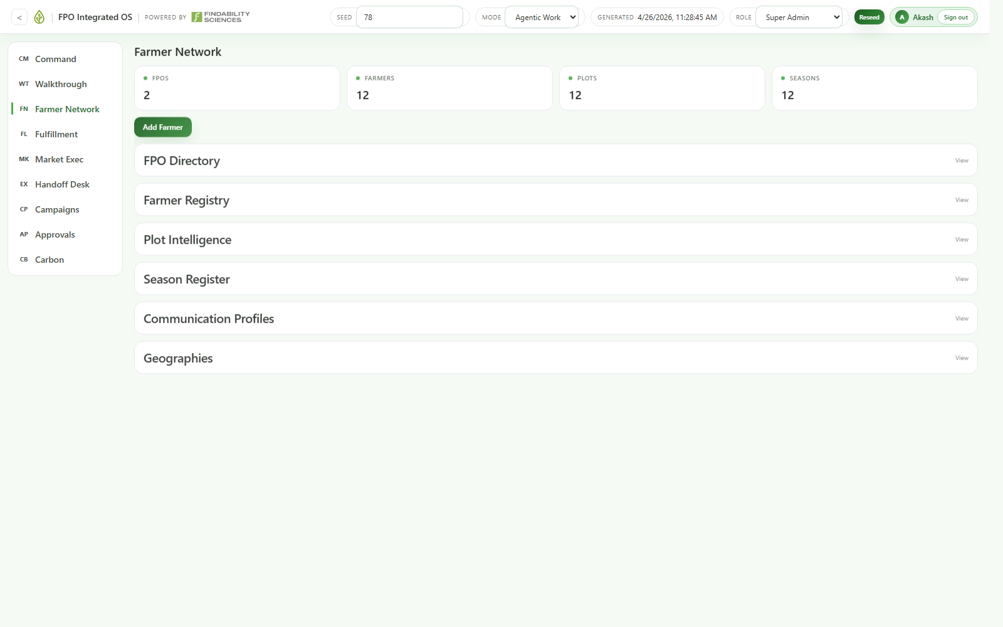
FARMER NETWORK
One source of truth for members, plots, and seasons
The registry keeps FPOs, farmers, geographies, communication profiles, and plot-season records connected in the same operating spine.

Slide 6
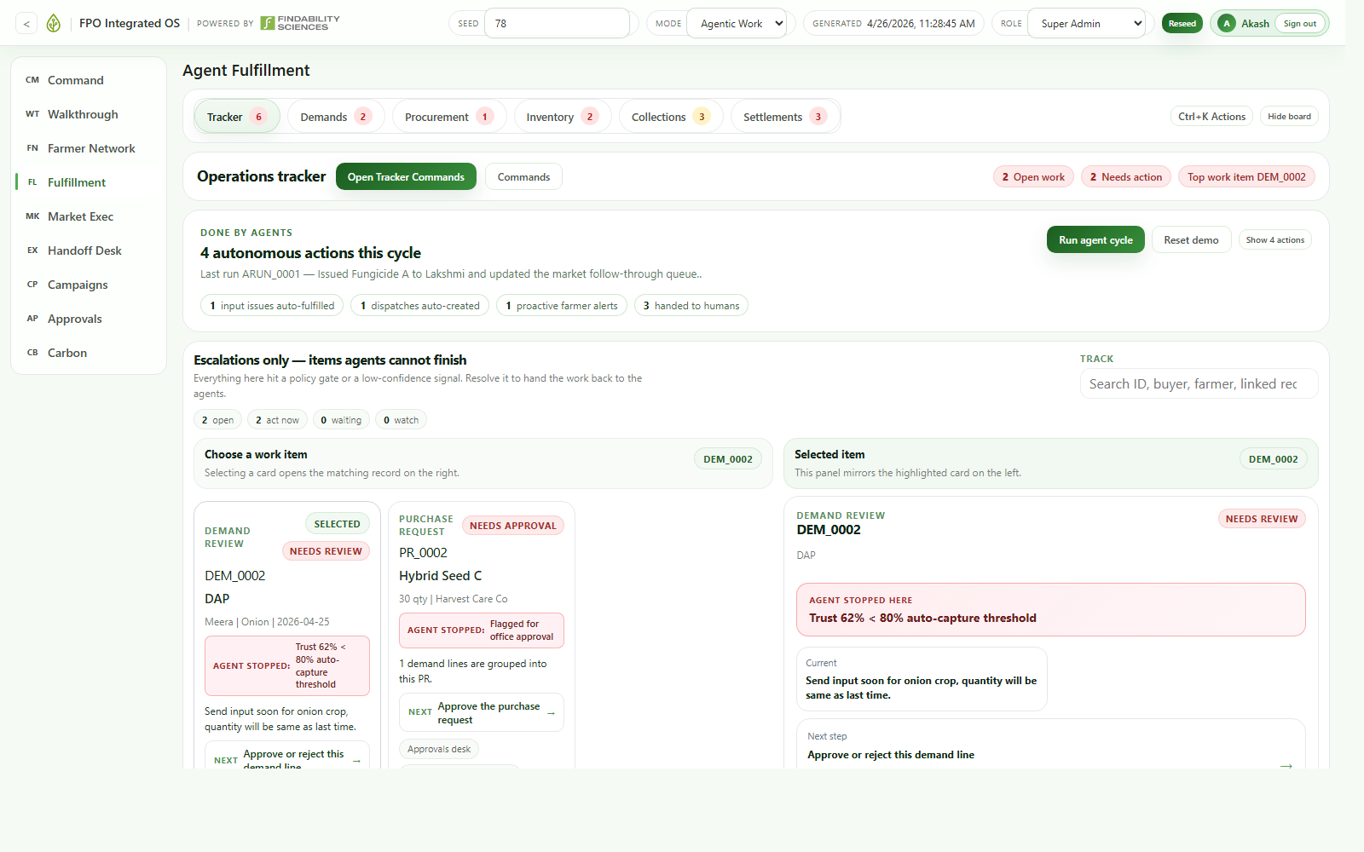
FULFILLMENT
Input demand, procurement, stock, collections, settlements
Operations is where the system turns demand capture into procurement, inventory movement, produce intake, and downstream cash flow.

Slide 7
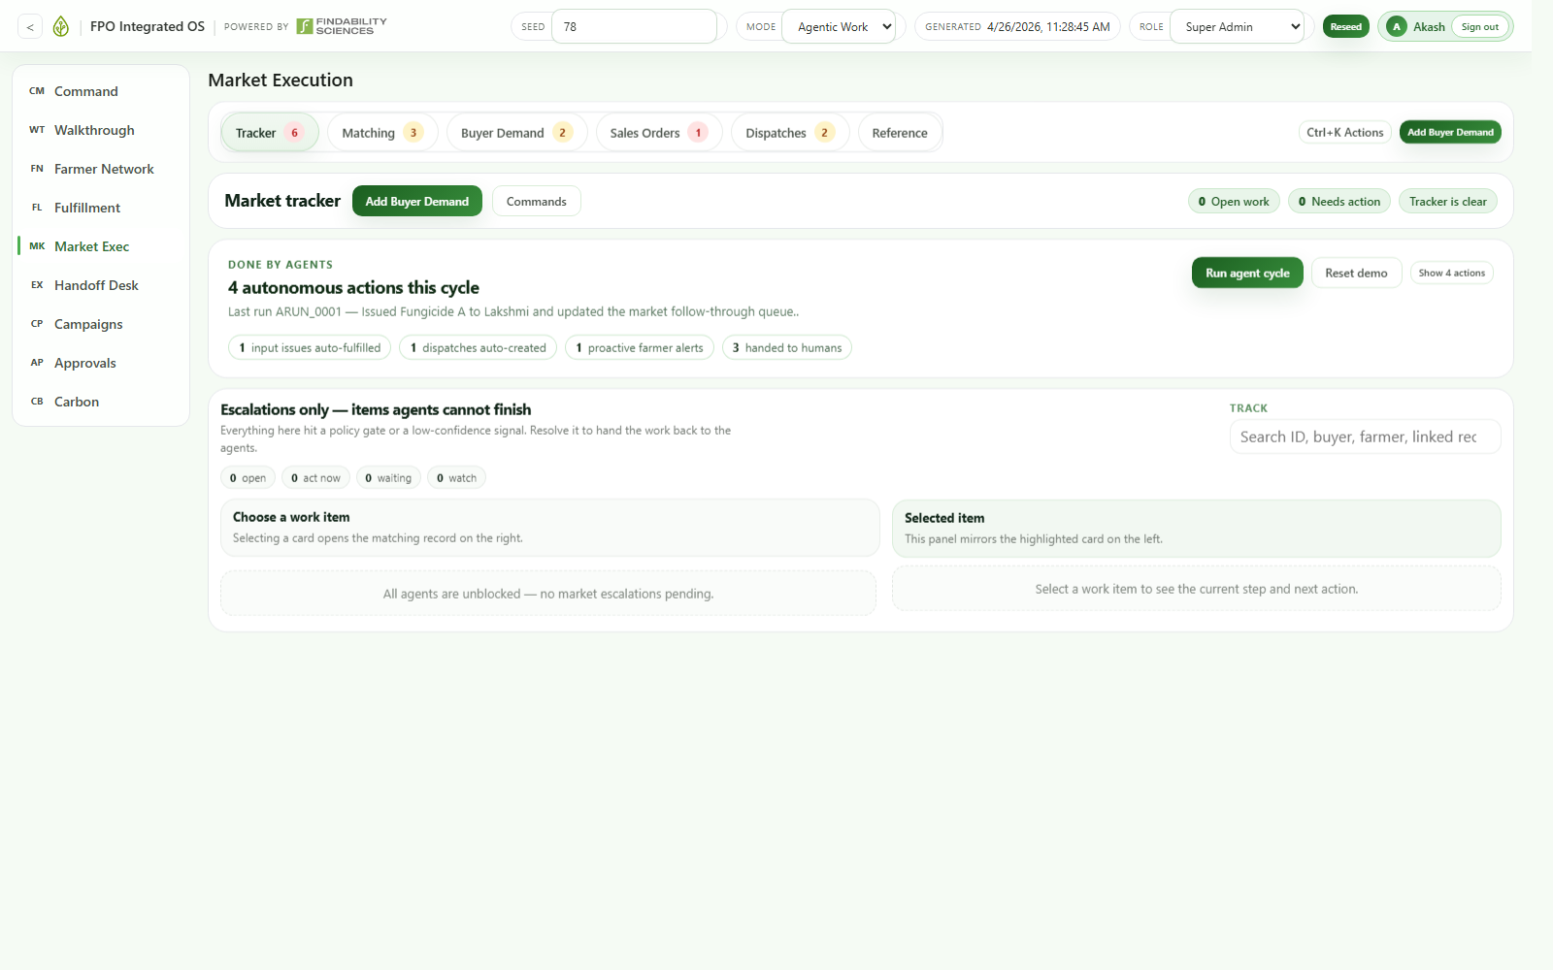
MARKET EXECUTION
Collections matched to buyer demand
The market layer surfaces the best current fit, converts it into sales orders, and keeps dispatch follow-through visible until money is collected.

Slide 8
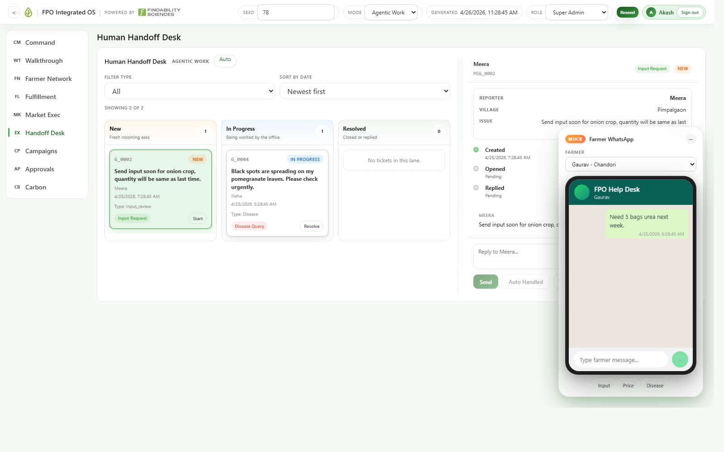
HUMAN HANDOFF DESK
Low-confidence work lands in one review queue
The handoff desk concentrates escalations, while the floating farmer phone shows the conversation thread that triggered the next action.

Slide 9
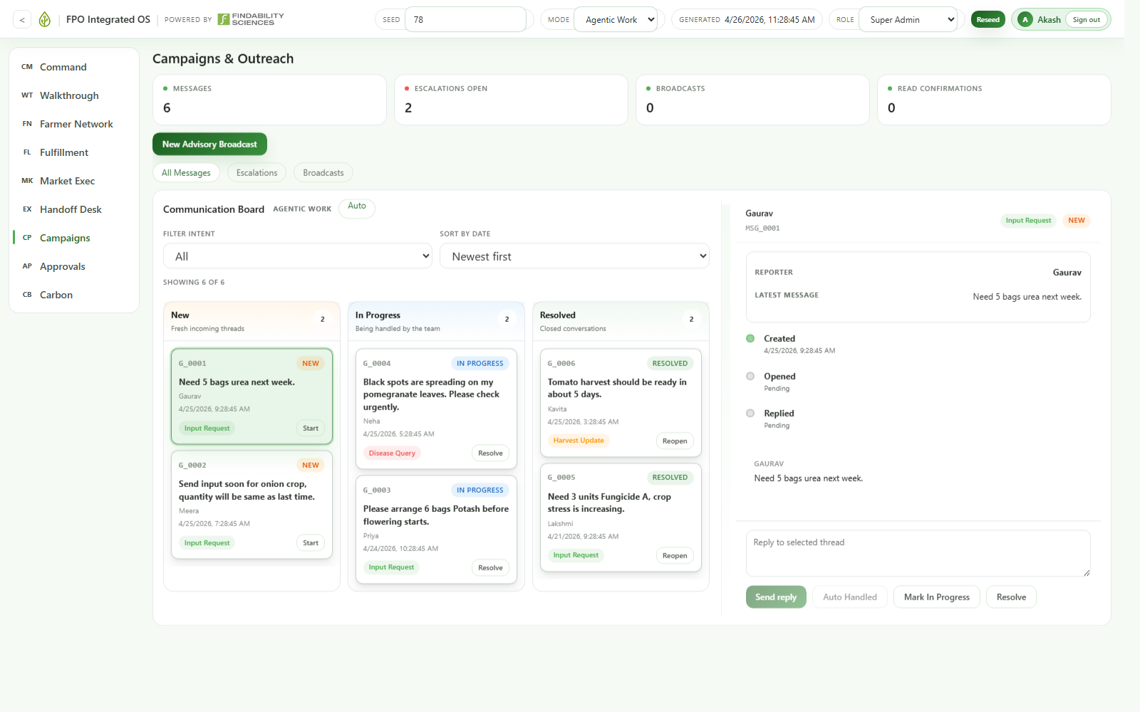
CAMPAIGNS AND OUTREACH
Inbox, advisories, and broadcast in one place
The same platform handles inbound asks, outbound nudges, and campaign communication without moving teams into separate tools.

Slide 10
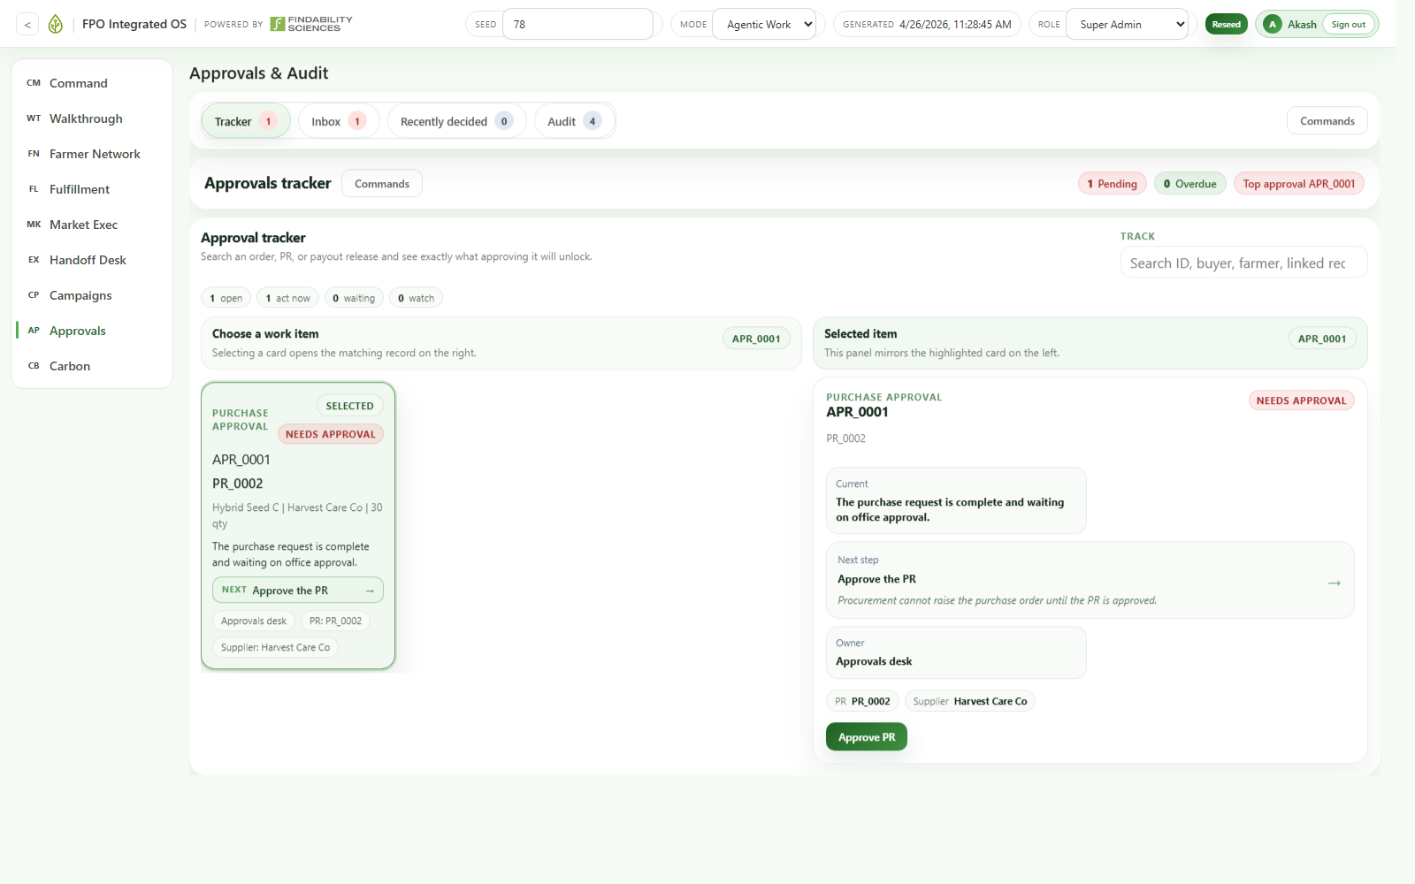
APPROVALS AND AUDIT
Governed autonomy keeps the operating model safe
Thresholds route purchase requests and other sensitive actions into a single approval desk, with a clear audit trail behind every agent and human decision.

Slide 11
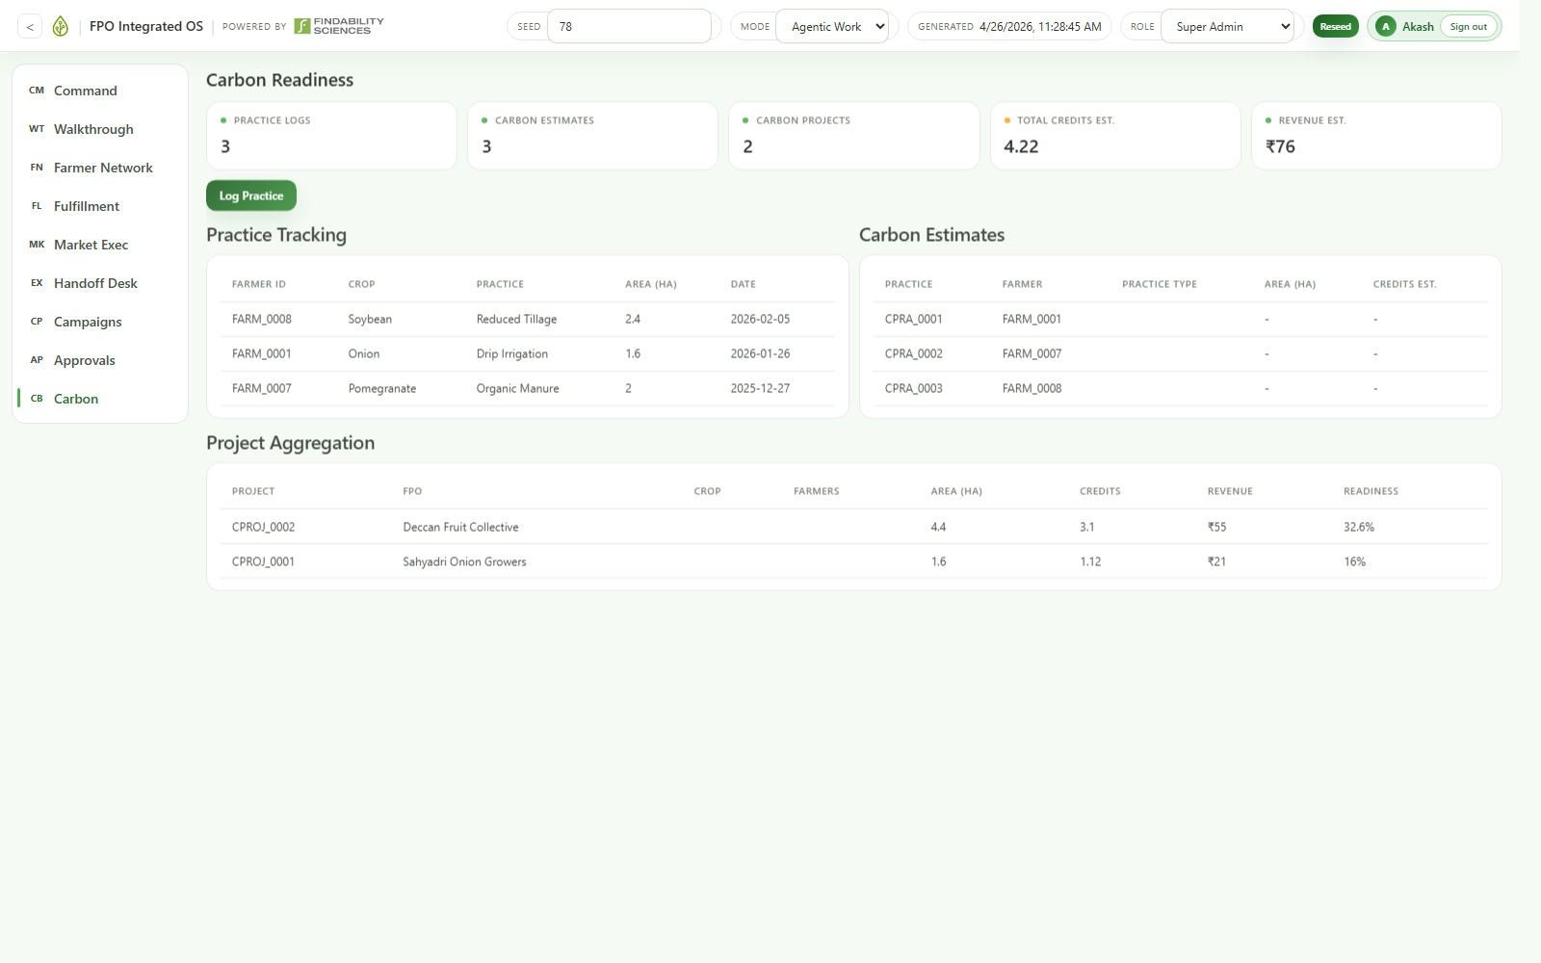
CARBON READINESS
The same data spine extends into climate workflows
Registry, plot, and practice data make it possible to layer carbon readiness on top of the core operating system over time.

Slide 12
FPO Integrated OS
POWERED BY FINDABILITY SCIENCES
CLOSING NOTE
Autonomous by default. Human only by exception.
One operating system instead of many disconnected workflows.

