Slide 1
Selective Laser Sintering 3D Printer
Muchen He ()
Leo Liu (18800152)

Slide 2
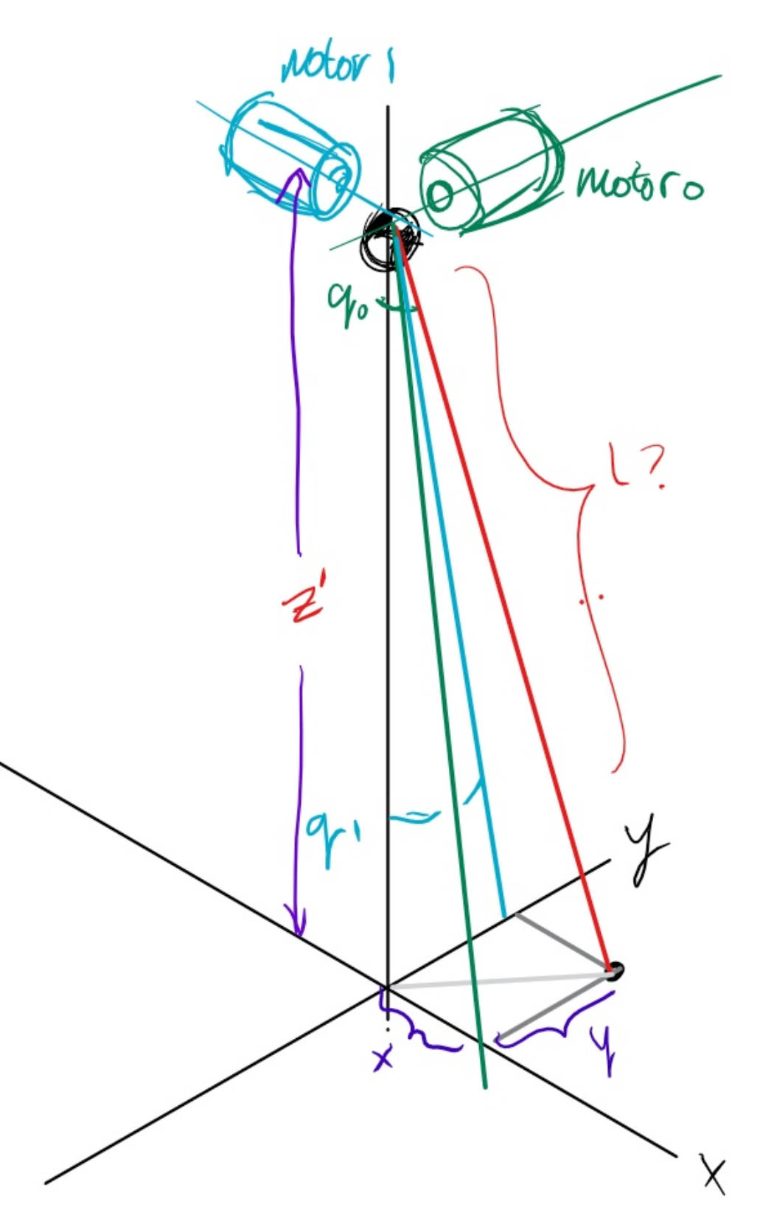
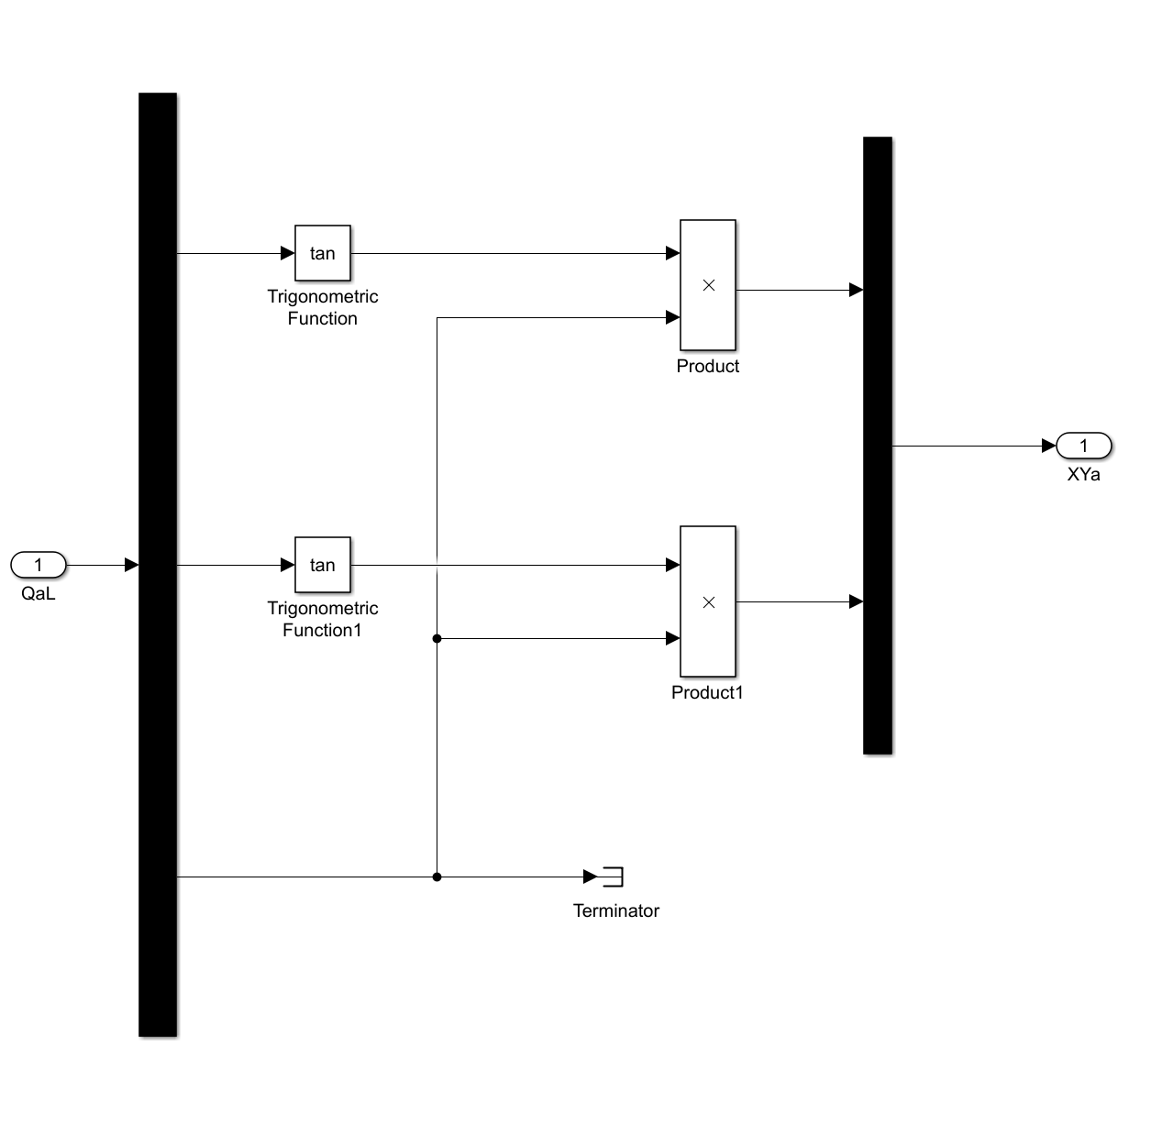
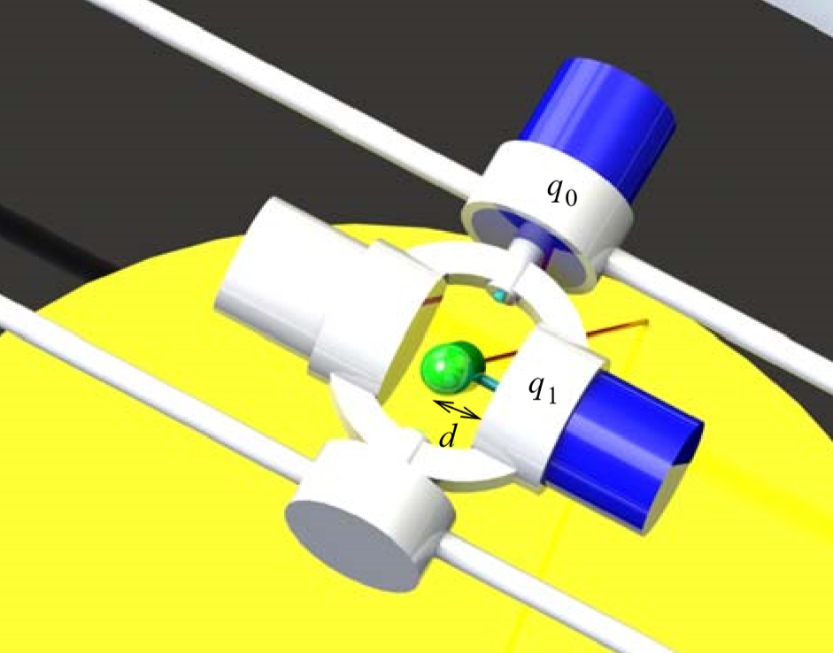
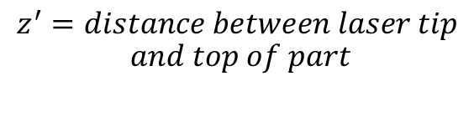


Direct Kinematics
$$x=\tan\left(q_{0}\right)×z^{′}$$
$$z^{′}=distance between laser tip$$
$$and top of part$$
$$y=\tan\left(q_{1}\right)×z^{′}$$

Slide 3
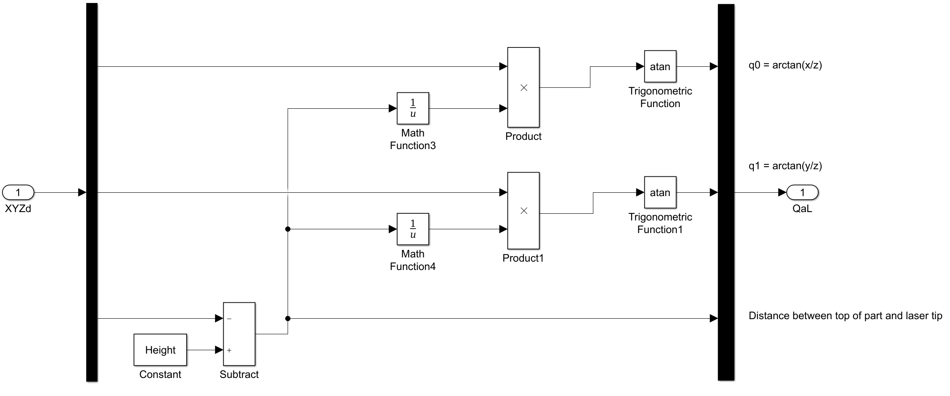


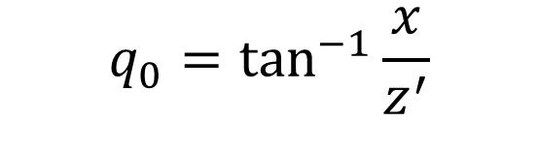
Inverse Kinematics
$$q_{0}=\tan^{−1}{\frac{x}{z^{′}}}$$
$$q_{1}=\tan^{−1}{\frac{y}{z^{′}}}$$
$$z^{′}=laser height(h)−part height(z)$$

Slide 4
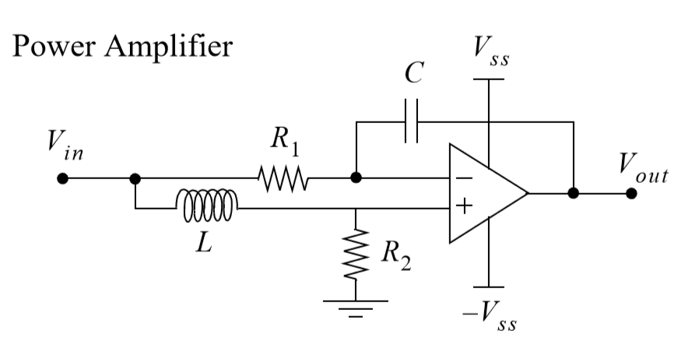
Amplifier Transfer Function

Slide 5
Electrical Motor Dynamics

Slide 6
Mechanical Motor Dynamics

Slide 7
Sensor Dynamics

Slide 8
Static Friction

