Slide 1

Selective Laser Sintering 3D Printer
ELEC 341 Design Project
Part 1
Muchen He 44638154
Leo Liu 18800152

Slide 2
System Overview

Slide 3









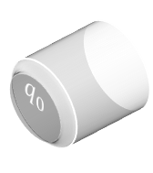

System Overview
$$z$$
$$q_{1}$$
$$q_{0}$$
$q_{0}$: angle of motor 0
$q_{1}$: angle of motor 1
$z′$: Distance between laser and top of part
Desired $x$
Desired $y$
Desired $z$
$$−y$$
$$x$$

Slide 4
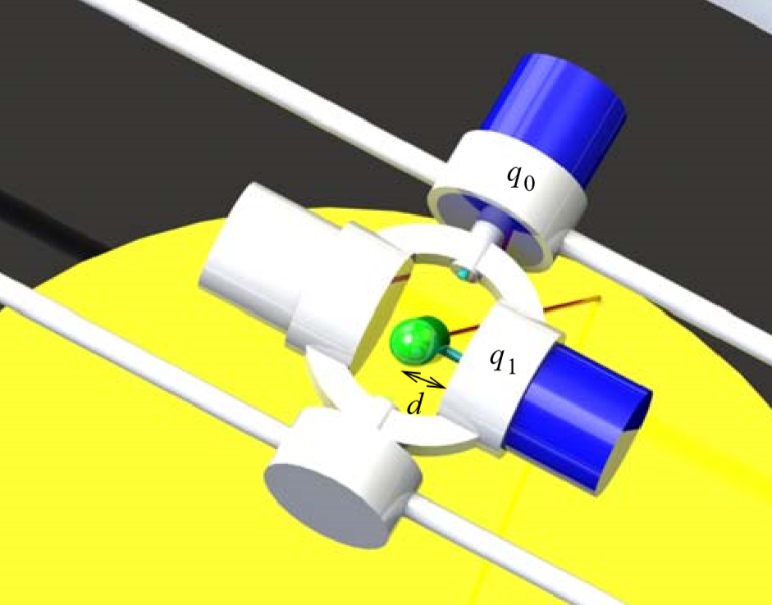
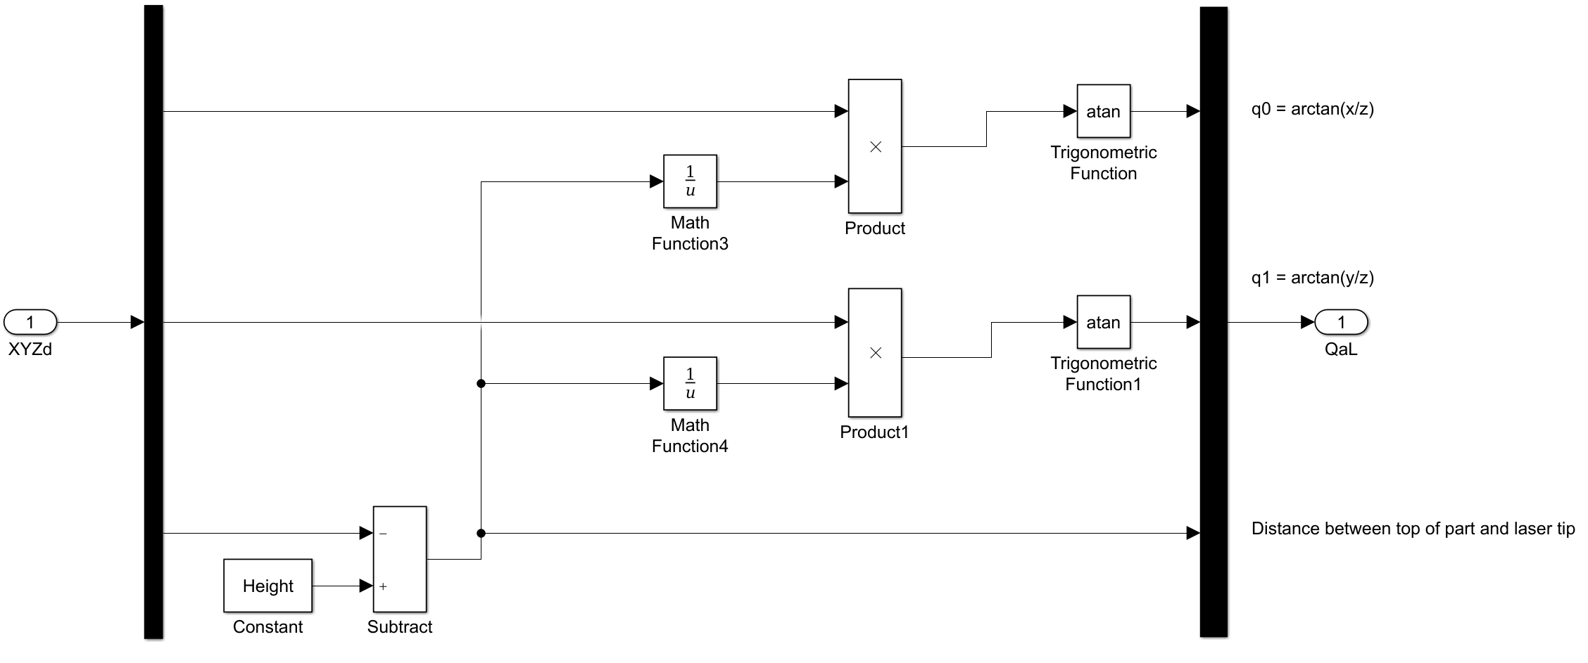


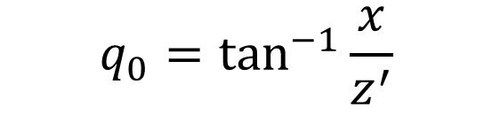
Inverse Kinematics
$$q_{0}=\tan^{−1}{\frac{x}{z^{′}}}$$
$$q_{1}=\tan^{−1}{\frac{y}{z^{′}}}$$
$$z^{′}=laser height(h)−part height(z)$$

Slide 5
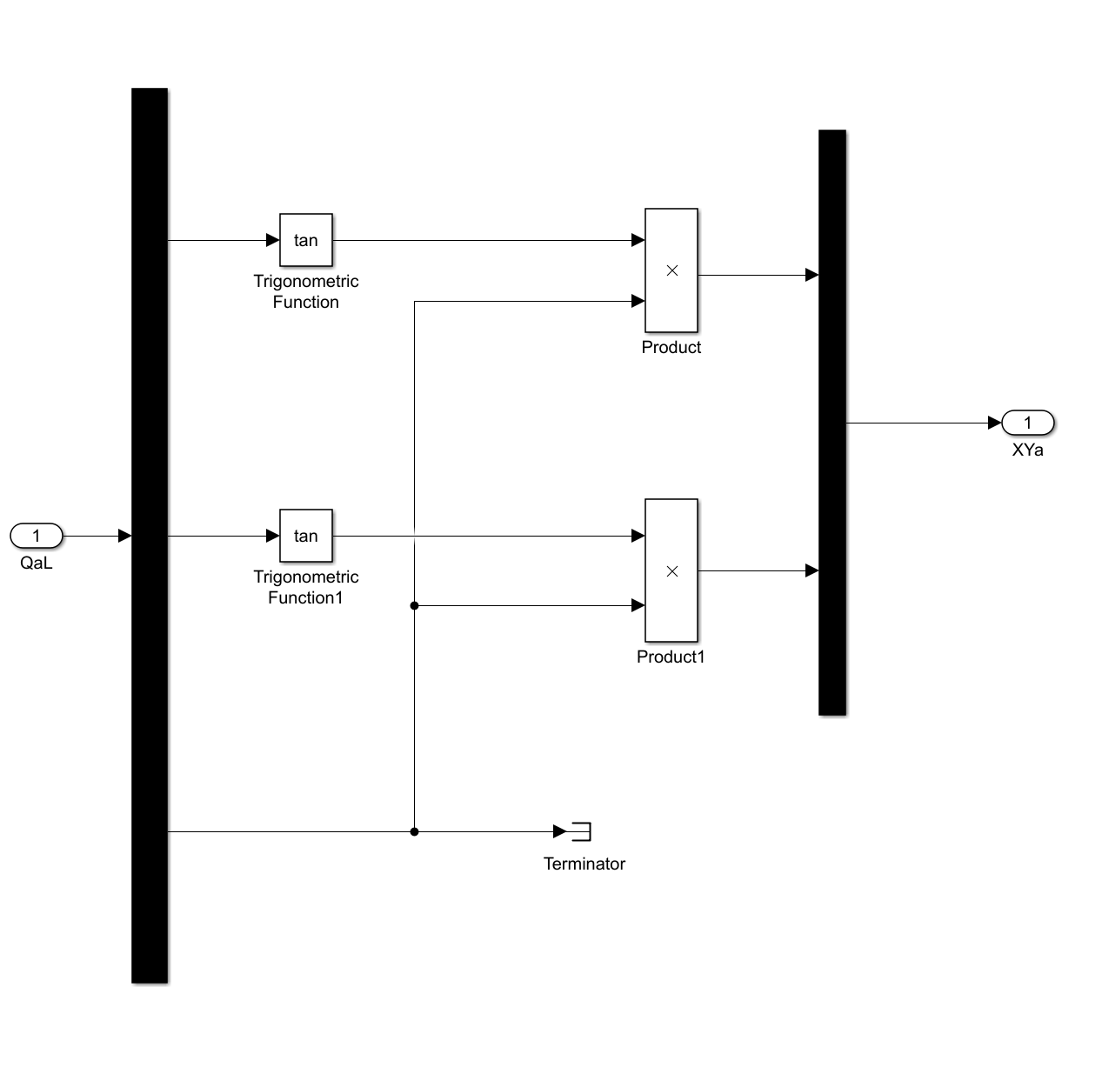
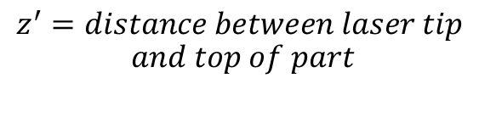


Direct Kinematics
$$x=\tan\left(q_{0}\right)×z^{′}$$
$$z^{′}=distance between laser tip$$
$$and top of part$$
$$y=\tan\left(q_{1}\right)×z^{′}$$

Slide 6
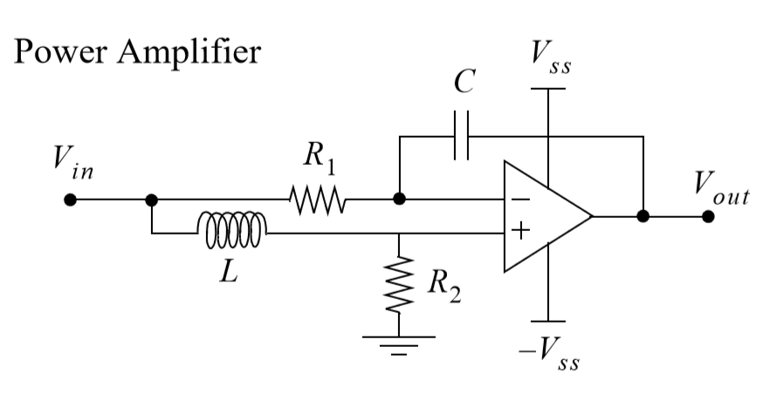
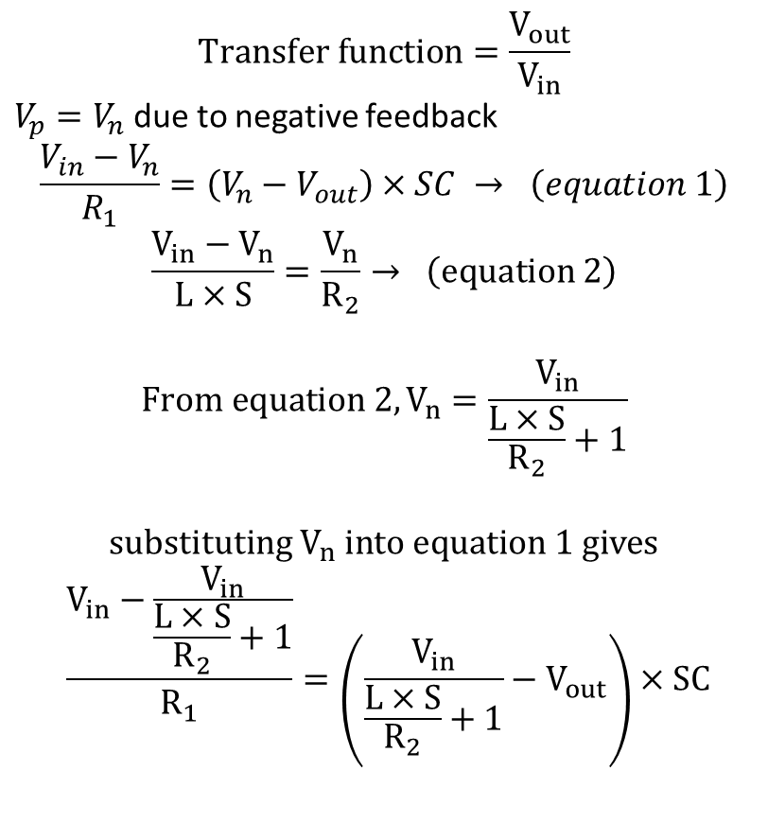
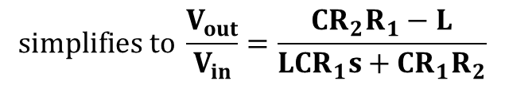


Power Amplifier
$$Transfer function=\frac{V_{out}}{V_{in}}$$
$V_{p}=V_{n}$ due to negative feedback
$$\frac{V_{in}−V_{n}}{R_{1}}=\left(V_{n}−V_{out}\right)×SC → \left(equation 1\right)$$
$$\frac{V_{in}−V_{n}}{L×S}=\frac{V_{n}}{R_{2}}→ \left(equation 2\right)$$
$$From equation 2,V_{n}=\frac{V_{in}}{\frac{L×S}{R_{2}}+1}$$
$$substituting V_{n} into equation 1 gives$$
$$\frac{V_{in}−\frac{V_{in}}{\frac{L×S}{R_{2}}+1}}{R_{1}}=\left(\frac{V_{in}}{\frac{L×S}{R_{2}}+1}−V_{out}\right)×SC$$
$$V_{n}$$
$$V_{p}$$
$$simplifies to \frac{V_{out}}{V_{in}}=\frac{CR_{2}R_{1}−L}{LCR_{1}s+CR_{1}R_{2}}$$

Slide 7
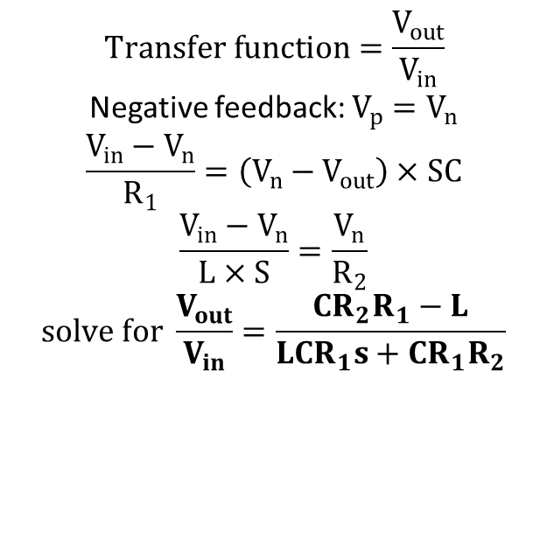


Power Amplifier
$$V_{n}$$
$$Transfer function=\frac{V_{out}}{V_{in}}$$
Negative feedback: $V_{p}=V_{n}$
$$\frac{V_{in}−V_{n}}{R_{1}}=\left(V_{n}−V_{out}\right)×SC$$
$$\frac{V_{in}−V_{n}}{L×S}=\frac{V_{n}}{R_{2}}$$
$$solve for \frac{V_{out}}{V_{in}}=\frac{CR_{2}R_{1}−L}{LCR_{1}s+CR_{1}R_{2}}$$
$$V_{p}$$

Slide 8


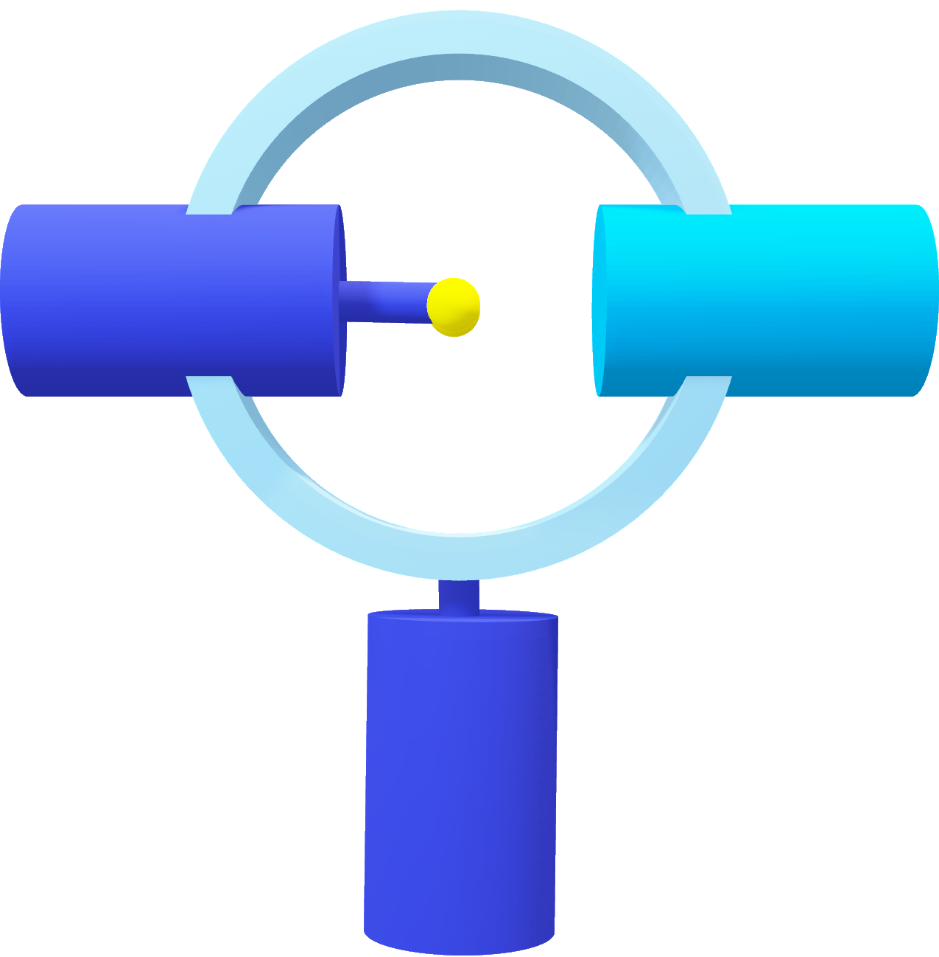

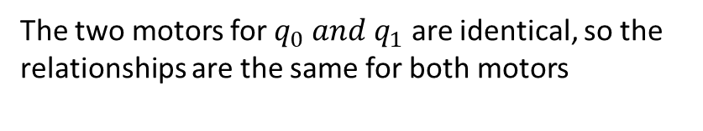
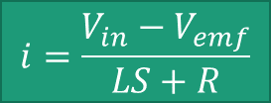
Electric Motor Dynamics
The DC motor has the following relationships
$$τ=k_{τ}i$$
$$V_{emf}=k_{b}ω$$
$$i=\frac{V_{in}−V_{emf}}{LS+R}$$
The two motors for $q_{0} and q_{1}$ are identical, so the relationships are the same for both motors

Slide 9
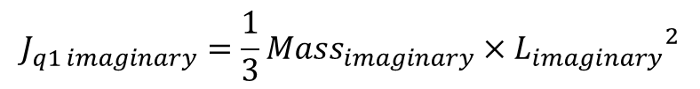


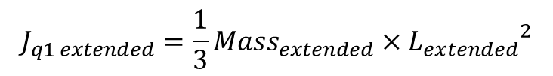



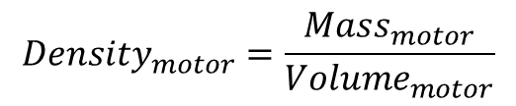

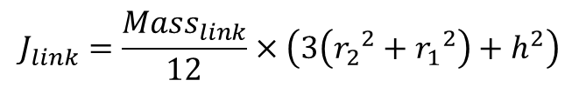
Mechanical Motor Dynamics ($q_{0}$)
Insert drawing here
$J_{q0}=$ $J_{link}+J_{rotor}+J_{q1 weight}+J_{counter weight}$
$J_{q0}=J_{link}+J_{rotor}+{2J}_{q1 weight}$
$$J_{link}=\frac{{Mass}_{link}}{12}×\left(3\left({r_{2}}^{2}+{r_{1}}^{2}\right)+h^{2}\right)$$
$$J_{rotor}=RotJ$$
$$J_{q1 weight}=J_{q1 extended}−J_{q1 imaginary}$$
$$J_{q1 extended}={\frac{1}{3}Mass}_{extended}×{L_{extended}}^{2}$$
$$J_{q1 imaginary}={\frac{1}{3}Mass}_{imaginary}×{L_{imaginary}}^{2}$$
$${Mass}_{extended}={Density}_{motor}×{Volume}_{extended}$$
$${Mass}_{imaginary}={Density}_{motor}×{Volume}_{imaginary}$$
$${Density}_{motor}=\frac{{Mass}_{motor}}{{Volume}_{motor}}$$
$${Volume}_{extended}=πr^{2}L_{extended}$$
$${Volume}_{imaginary}=πr^{2}L_{imaginary}$$

Slide 10
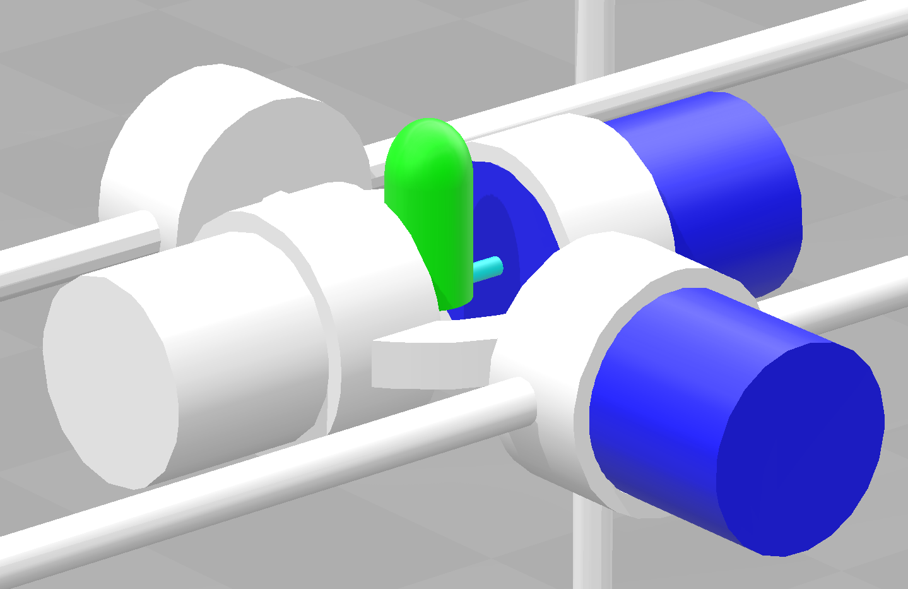
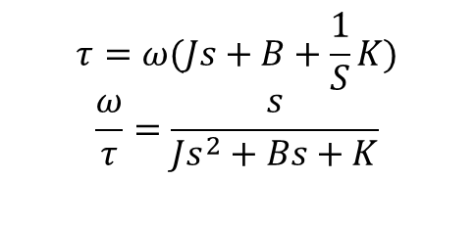
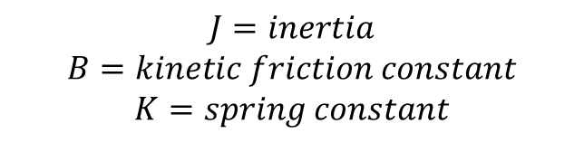
Mechanical Motor Dynamics
$$τ=ω(Js+B+\frac{1}{S}K)$$
$$\frac{ω}{τ}=\frac{s}{Js^{2}+Bs+K}$$
$$J=inertia$$
$$B=kinetic friction constant$$
$$K=spring constant$$

Slide 11























Mechanical Motor Dynamics
$$J_{counter weight}$$
$$J_{motor weight}$$
$$l$$
$$h_{Link}$$
$$q_{1}$$
$$r_{2}$$
$$h_{motor}$$
$$J_{rotor}$$
$$r_{1}$$
$$d$$
$$l$$
$$d$$
$$J_{rotor}=RotJ$$
$$J_{rotor}$$
$$q_{1}$$
$$h_{motor}$$
$$center of link$$
$$J_{link}$$
$J_{q1 weight}=J_{counter weight}=\frac{1}{3}\frac{{Mass}_{motor}}{h_{motor}}$(${{(h}_{motor}\text{+}l)}^{3}−l^{3}$)
$$q_{0}$$
$J_{q0}=$ $J_{link}+J_{rotor}+J_{q1 weight}+J_{counter weight}$
$$J_{link}=\frac{{Mass}_{link}}{12}×\left(3\left({r_{2}}^{2}+{r_{1}}^{2}\right)+{h_{Link}}^{2}\right)$$
$J_{q1}=$ $J_{rotor}$

Slide 12
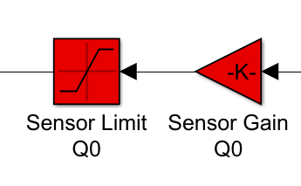


Sensor Dynamics
$$Voltage$$
$$rad$$

Slide 13
Static Friction

