Slide 1
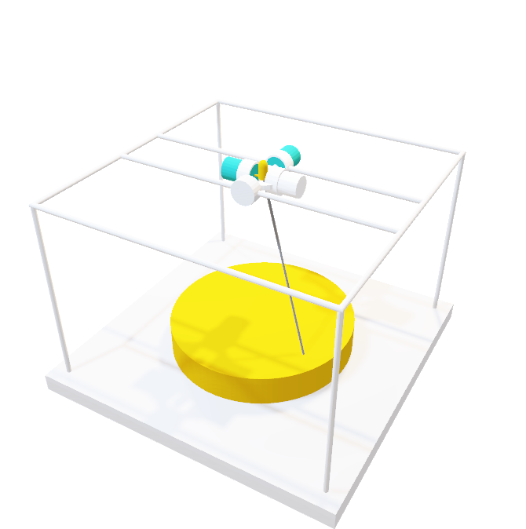
Selective Laser Sintering 3D Printer
ELEC 341 Design Project
Part 1
Muchen He 44638154
Ou Liu 18800152

Slide 2
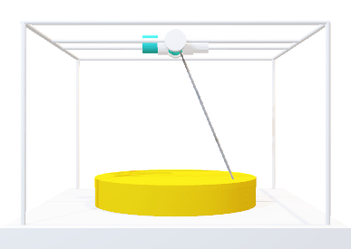
System Overview
Coordinates (X, Y, Z)
The 3D printer uses a laser to build parts. The laser is oriented using a two-axis motor assembly.
Inverse Kinematic
The inverse kinematic module converts the Cartesian coordinates to the desired motor angle.
The joint controller module handles the system response and controller.
Controller
The direct kinematic converts actual motor angles back to Cartesian coordinates
Direct Kinematic
The laser control module adjusts the intensity of the laser based on how far the target is
The motors control the orientation of the laser
Laser Control
Motors
Sensor & Feedback

Slide 3
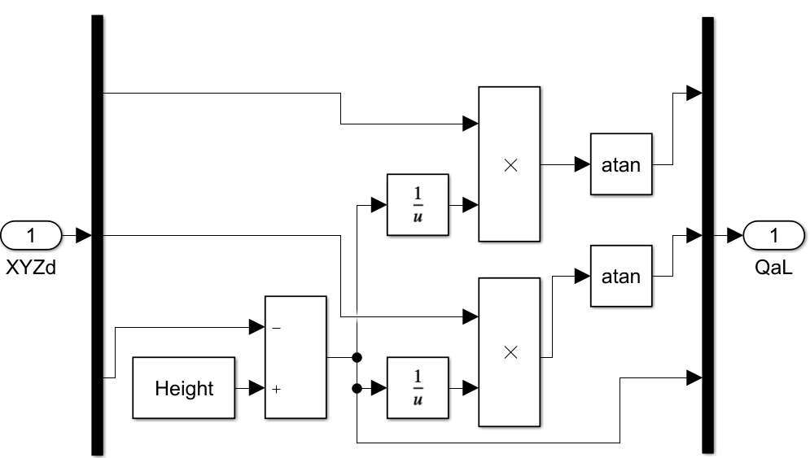
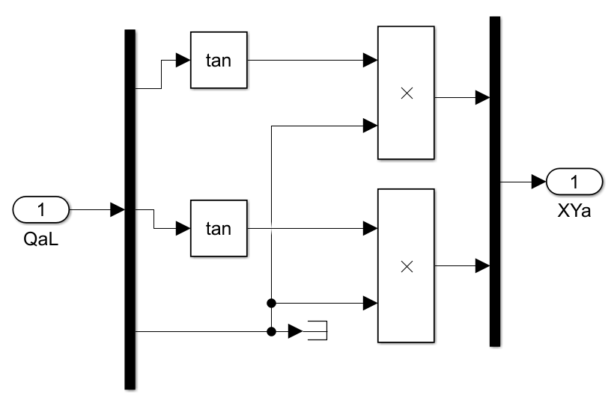







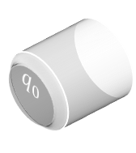








$$z$$
Inverse & Direct Kinematic
$$q_{1}$$
$$q_{0}$$
The inverse kinematic module converts the Cartesian coordinates to the desired motor angle.
$q_{0}$: angle of motor 0
$$q_{0}=\tan^{−1}{\frac{x}{z^{′}}}$$
$$q_{1}=\tan^{−1}{\frac{y}{z^{′}}}$$
$$z^{′}=\text{he}\text{ight}−z$$
$q_{1}$: angle of motor 1
$z′$: Distance between laser and top of part
Desired $x$
The direct kinematic converts actual motor angles back to Cartesian coordinates
Desired $y$
$$x=z′\tan\left(q_{0}\right)$$
Desired $z$
$$−y$$
$$y=z′\tan\left(q_{1}\right)$$
$$x$$
I.K. implementation in SimuLink
D.K. implementation in SimuLink

Slide 4
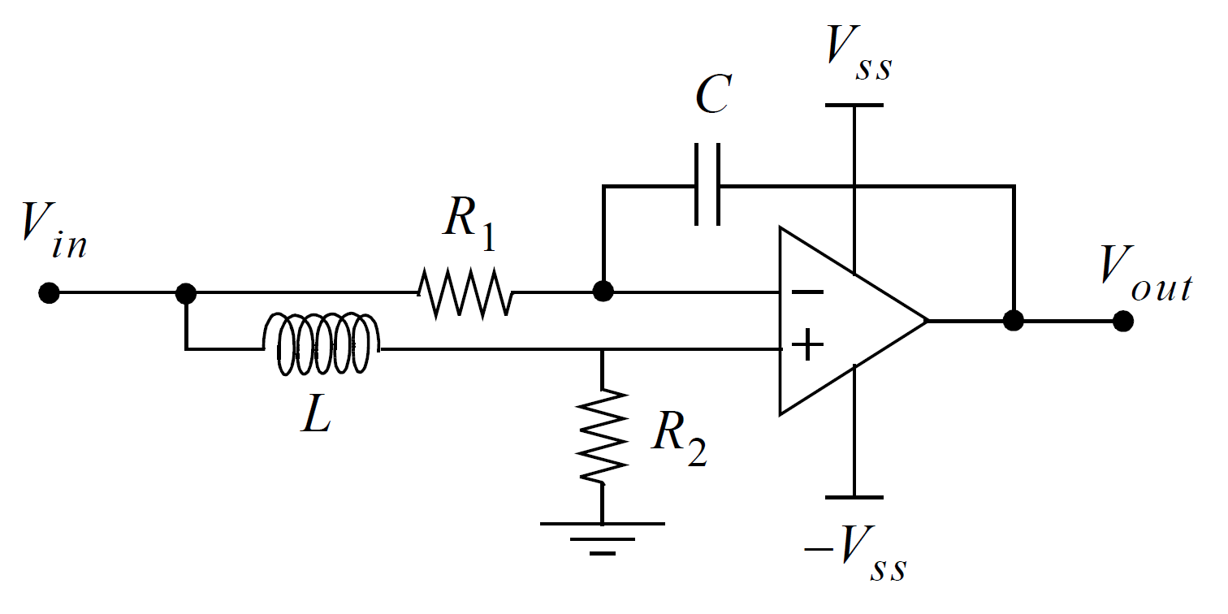
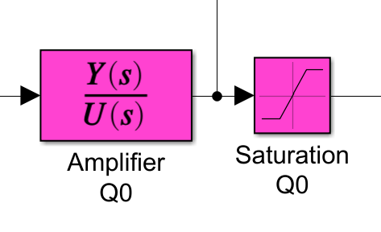
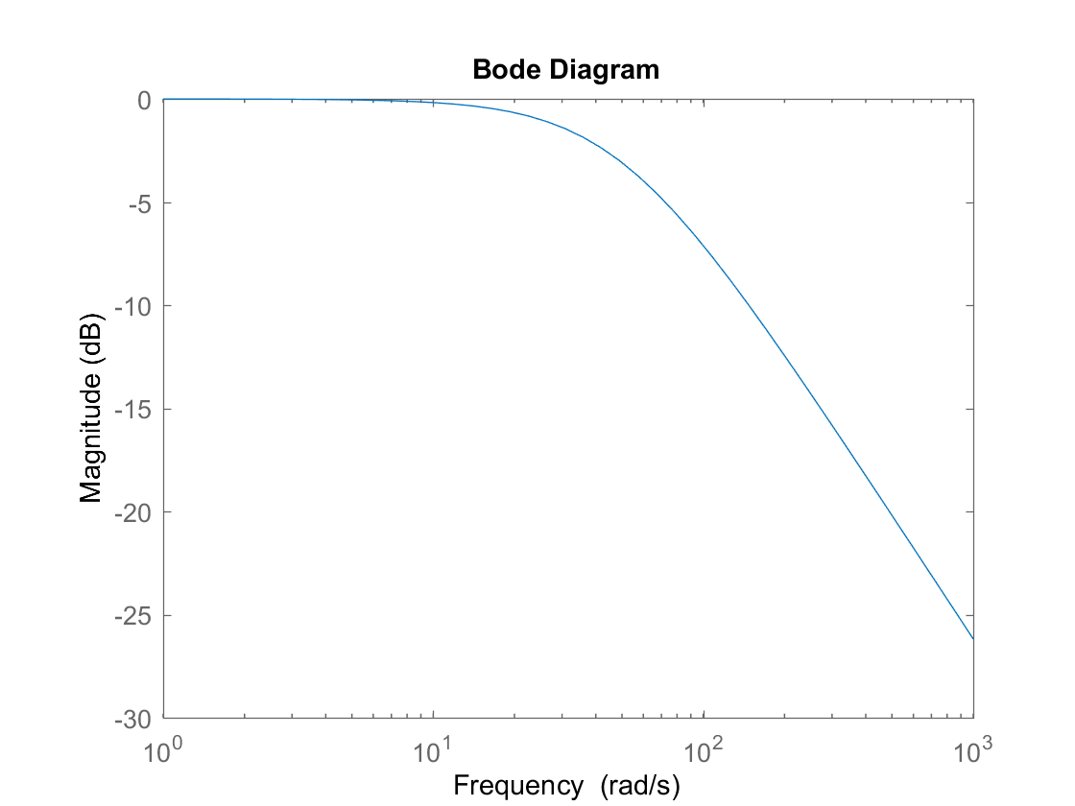
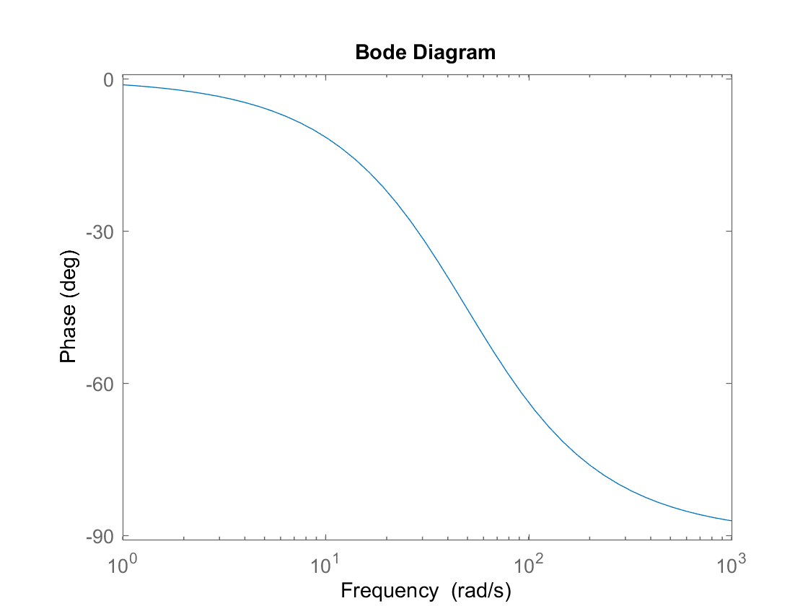





Power Amplifier
$$V_{n}$$
The power amplifier takes the role of a filter and a voltage follower.
The transfer function is the output divided by input.
Since there is negative feedback coupled by the capacitor, $V_{n}=V_{p}$.
MNA is used to solve the circuit
$$V_{p}$$
Amplifier circuit
SimuLink implementation
MNA:
$$\frac{V_{in}−V_{n}}{Ls}=\frac{V_{n}}{R_{2}}$$
$$\frac{V_{in}−V_{n}}{R_{1}}=\left(V_{n}−V_{out}\right)×sC$$
Transfer Function: $\frac{Y(s)}{U(s)}=\frac{V_{out}}{V_{in}}$ $=\frac{CR_{2}R_{1}−L}{LCR_{1}s+CR_{1}R_{2}}$

Slide 5

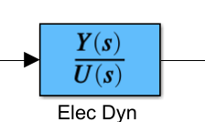

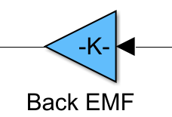

















Electric Motor Dynamics
Response
Implementation
Torque Gain
Back EMF Gain
The DC motor has relationships between the torque and the current
$$I$$
$$τ$$
$$V$$
$$ω$$
$$τ=K_{τ}i$$
$$V_{i}$$
$$V_{o}$$
The current is given by Ohm’s law
$$i=\frac{V_{in}−V_{emf}}{Ls+R}$$
The back-EMF is proportional to the motor speed
$$V_{emf}=K_{b}ω$$
The two motors for $q_{0} and q_{1}$ are identical, so the relationships are the same for both motors
Motor 0
$$L$$
$$R$$
$$V_{in}$$
$$V_{emf}$$
Equivalent circuit
Motor 1
$$\frac{Y(s)}{U(s)}=\frac{1}{Ls+R}$$

Slide 6
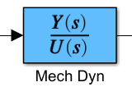

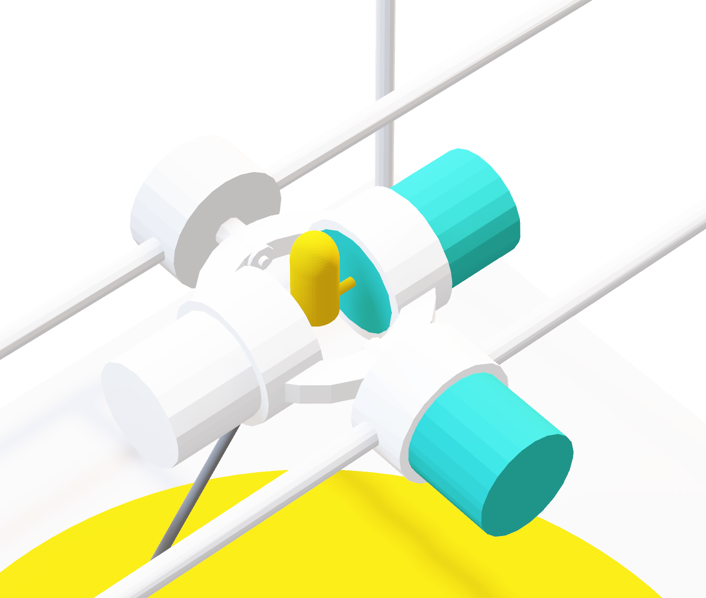








Mechanical Motor Dynamics
Mechanical motor dynamics is a transfer function that converts torque to angular speed. It is given as:
$$\frac{Y(s)}{U(s)}=\frac{ω}{τ}=\frac{s}{Js^{2}+Bs+K}$$
Where $J$ is moment of inertia, $B$ is the kinetic friction constant, and $K$ is the spring constant.
Kinetic friction is the due to the mass imposed on the motion given as
$$B=\frac{I_{\text{noLoad}} K_{τ}}{ω_{\text{noLoad}}}$$
Spring constant is 0 for motor 1 and positive for motor 0
Implementation
Moment of inertia for motor 1 is $J_{\text{rotor}}$ since the laser has negligible mass
$$τ$$
$$ω$$
$J_{q1}=$ $J_{\text{rotor}}$

Slide 7


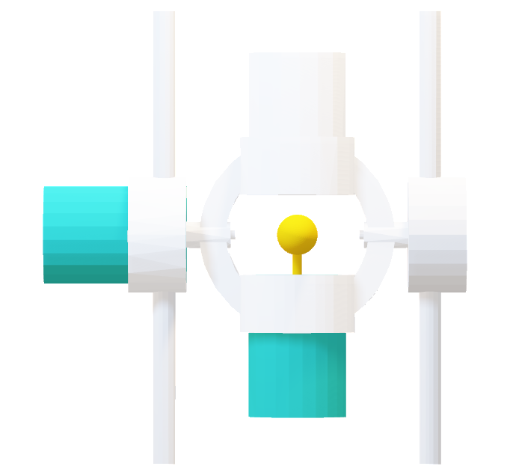





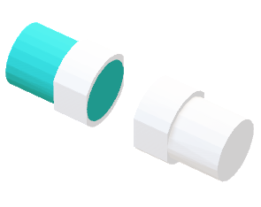




Mechanical Motor Dynamics
$${\text{mas}\text{s}}_{c.w.}$$
The moment of inertia component for motor 1 is the superposition of four parts
$$h_{\text{motor}}$$
$$r_{\text{2}}$$
$$l$$
Motor 0 rotor: Inertia due to the internal rotor of the outer motor
$$r_{\text{1}}$$
Aluminium link: Hollow cylinder. Mass is its volume multiplied by 6061 aluminium density
$$J_{\text{link}}=\frac{{\text{m}\text{ass}}_{\text{link}}}{12}\left(3\left({r_{2}}^{2}+{r_{1}}^{2}\right)+{h_{\text{l}\text{ink}}}^{2}\right)$$
$${\text{mas}\text{s}}_{q1}$$
Motor 1 & counter weight: $\text{mas}{\text{s}}_{c.w.}=\text{mas}{\text{s}}_{q1}$
Motor 1
Imaginary
Extended
$$h_{\text{link}}$$
Counter weight
$$J_{q1 \text{weight}}+J_{\text{counter} \text{weight}}=J_{\text{extended}}−J_{\text{imaginary}}$$
$$∅d$$
$J_{q0}=$ $J_{\text{link}}+J_{\text{rotor}}+\left(J_{q0 \text{weight}}+J_{\text{counter} \text{weight}}\right)$

Slide 8
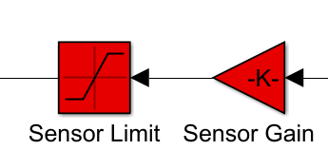
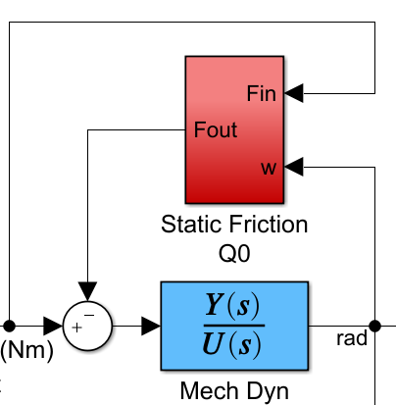









Sensor
Static Friction
Sensor Feedback
The sensor maps the actual angle of the motors to voltage linearly
Static friction works against the applied force and turns into dynamic friction after motor starts moving. It is given by:
$$F_{static}=μ_{sF}F_{N}$$
$$F_{static}=μ_{sF}g(mass_{\text{link}}+{mass}_{q1}+{mass}_{c.w.})$$
voltage
angle
Implementation
Gain: $\left[−π,π\right]→[−5,5]$
$5$V
$$π$$
If $τ_{\text{applied}}<τ_{\text{static}}$ then $τ_{\text{net}}=0$
$2.5$V
$$\frac{π}{2}$$
Motor 1 does not experience any noticeable static friction since $\text{mas}{\text{s}}_{\text{rotor}}≅0$

Slide 9
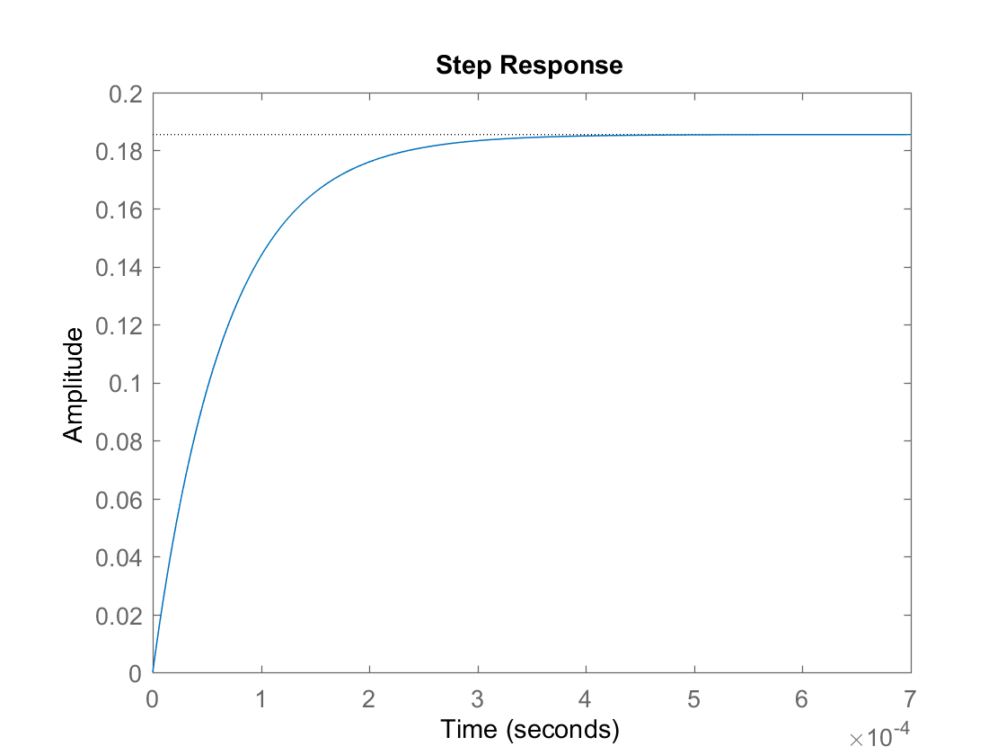
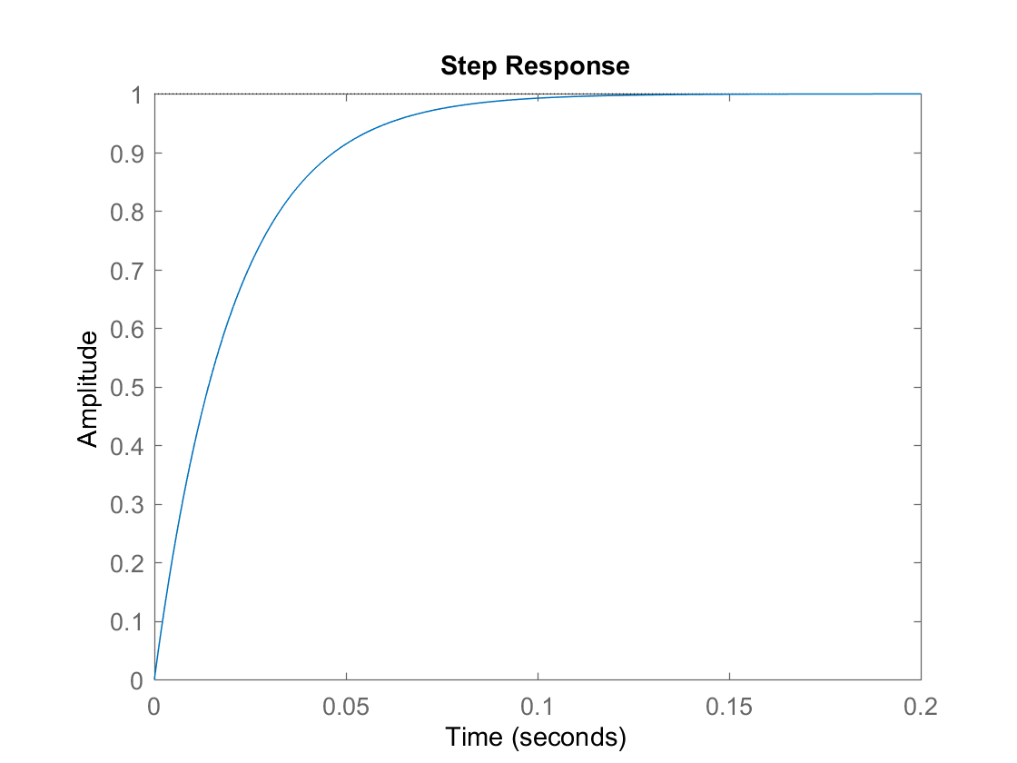
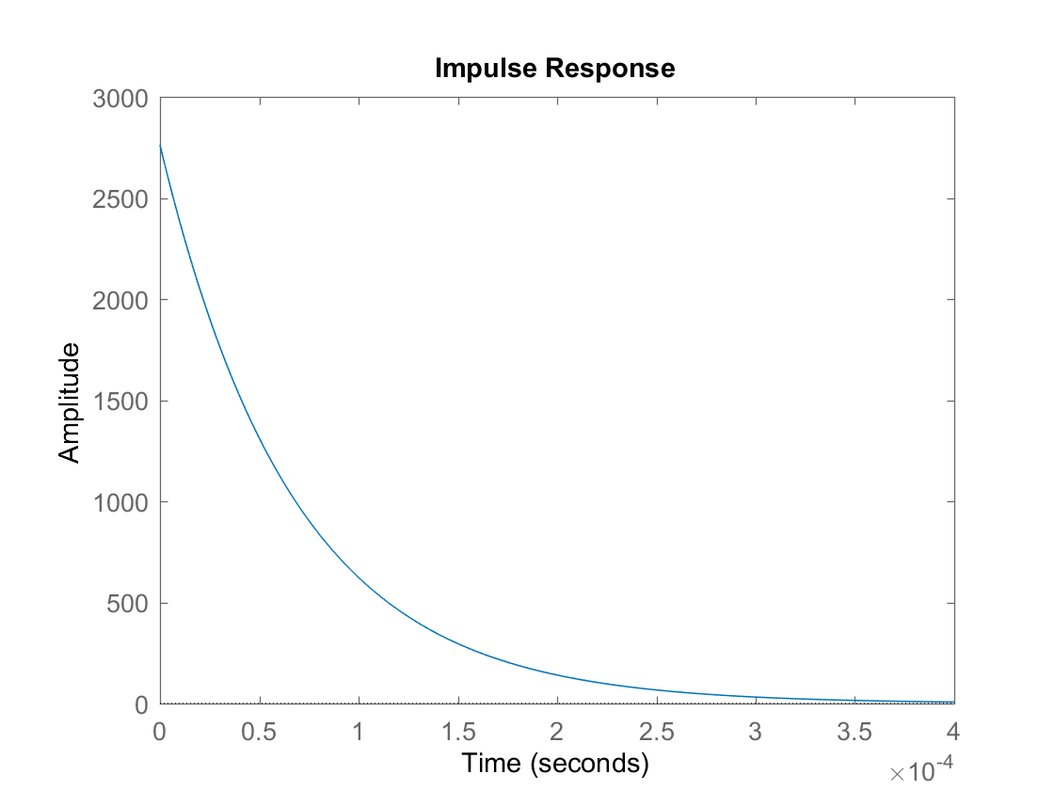
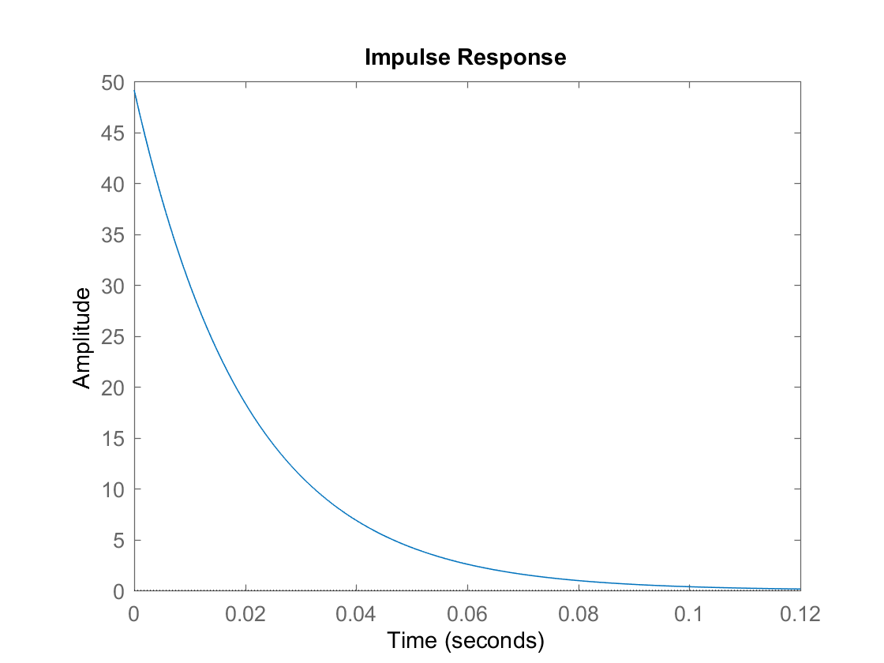


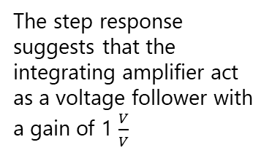


Electrical Response
Amplifier Response
$$\frac{Y(s)}{U(s)}=\frac{2762.4}{s+1.489×{10}^{4}}$$
$$\frac{Y(s)}{U(s)}=\frac{49.14}{s+41.17}$$
Performance
Rise time: $3×{10}^{−4}$s
Performance
Rise time: $0.1$s
The electrical system produces current given a voltage
The step response suggests that the integrating amplifier act as a voltage follower with a gain of 1 $\frac{V}{V}$
Internal inductances of the motors causes exponential behavior
Given a sudden jolt of voltage, the current spikes, but quickly dissipates

Slide 10
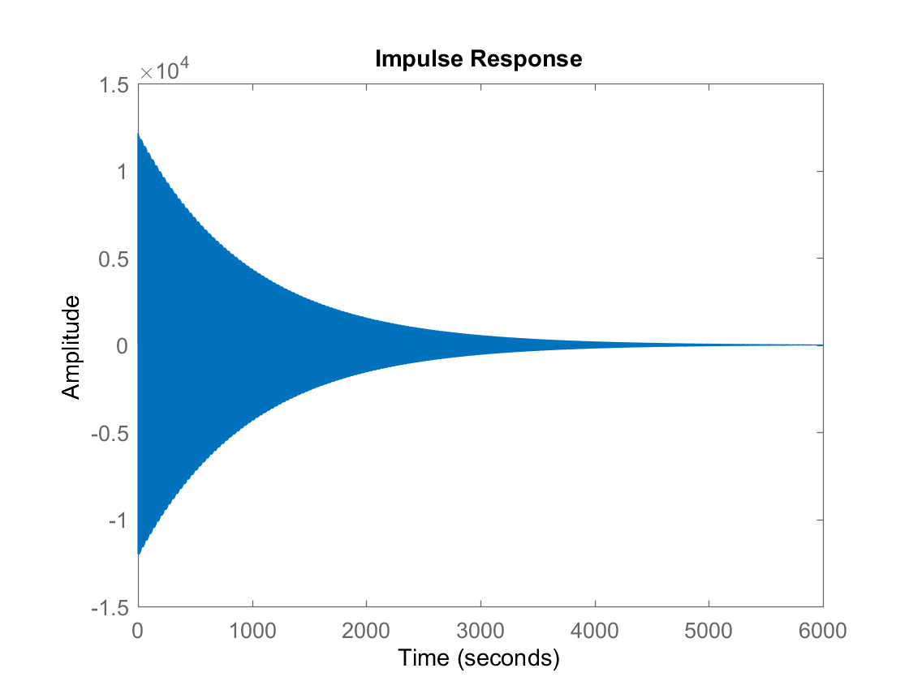
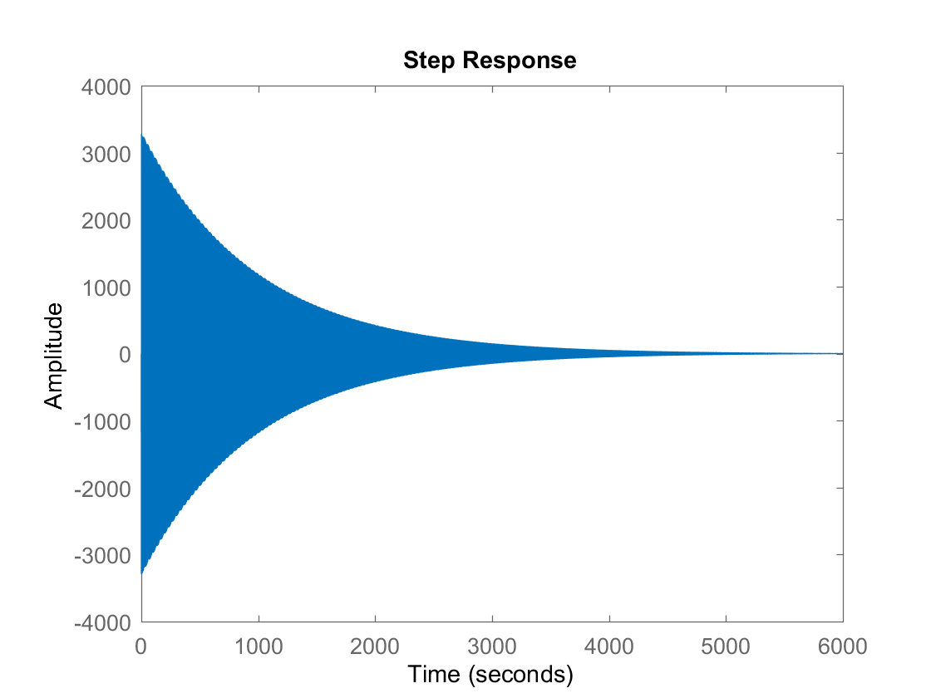
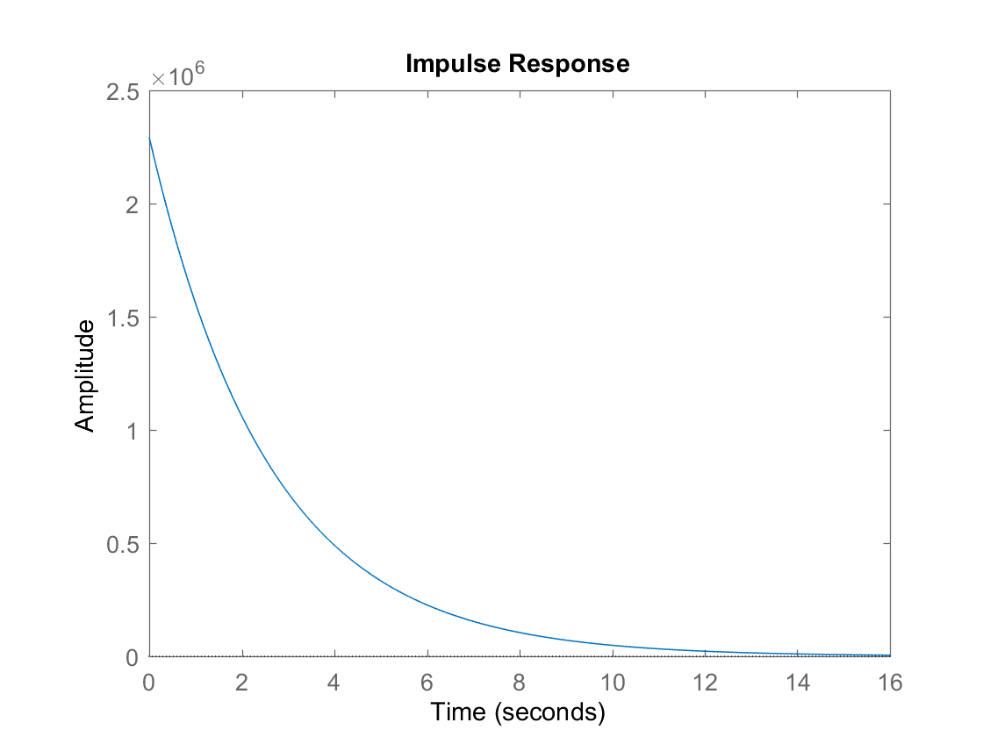
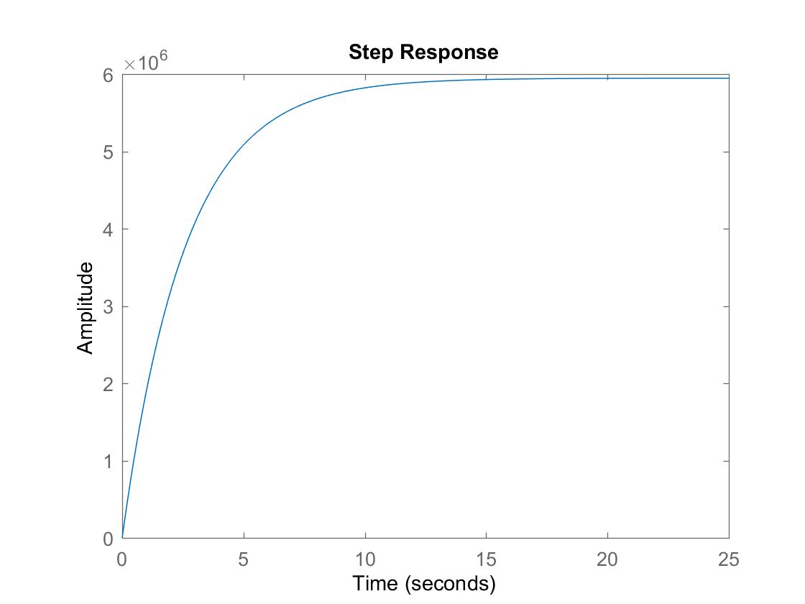


Motor 0 Response
$$\frac{Y(s)}{U(s)}=\frac{12644s}{s^{2}+0.00213s+14.11}$$
Motor 0 transfer function outputs angular velocity given some torque
Oscillation occurs due to the spring behavior
Angular velocity decays to 0 due to friction
Motor 1 Response
$$\frac{Y(s)}{U(s)}=\frac{2.294×{10}^{6}s}{s(s+0.3856)}$$
Given a impulse torque, the motor 1 angular velocity decays exponentially due to friction
With a constant torque, motor 1 speeds up to its maximum angular velocity

Slide 11
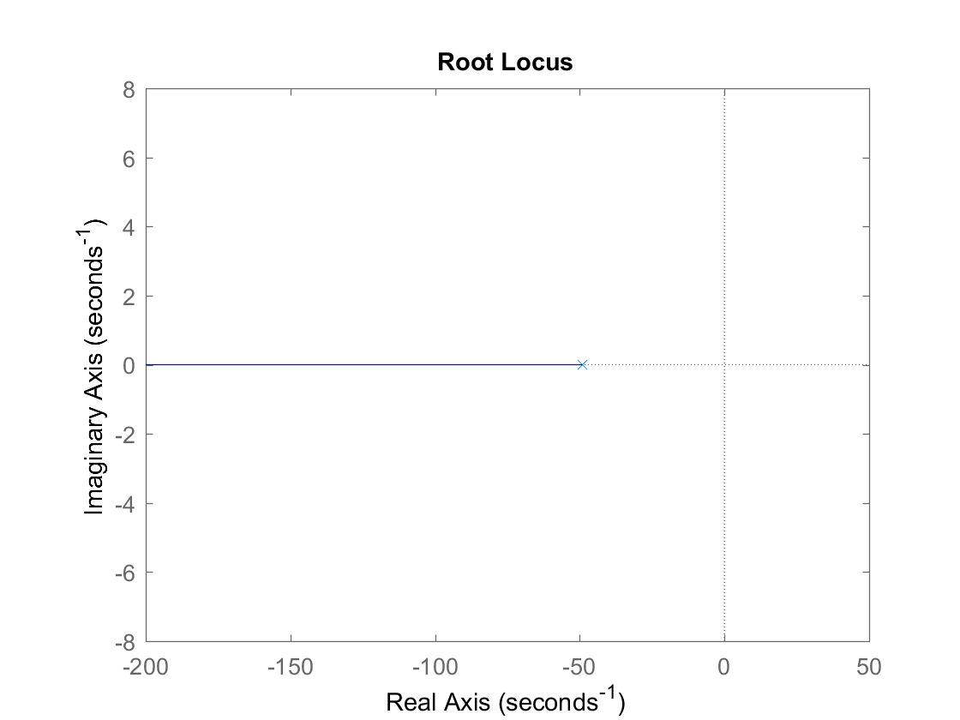
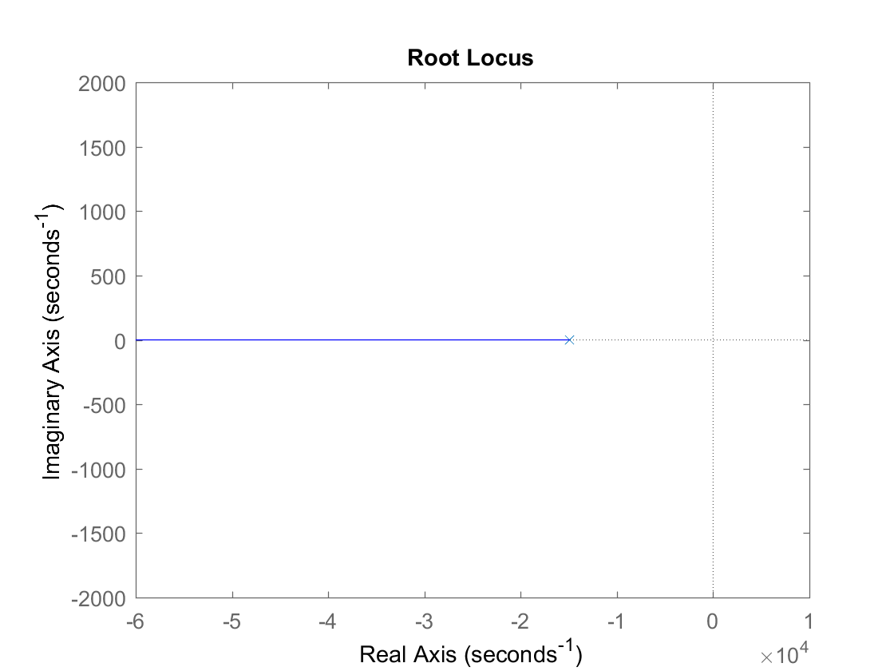
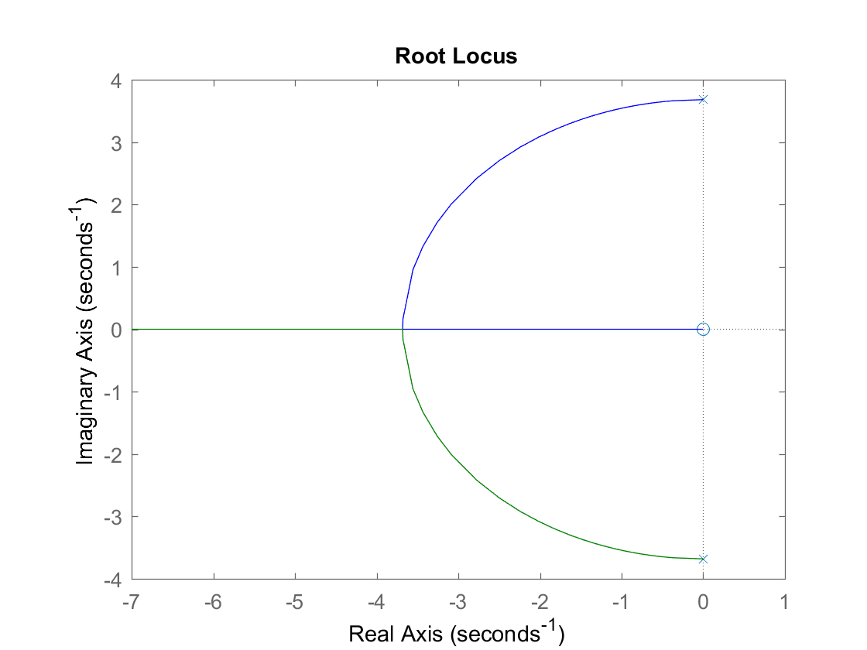
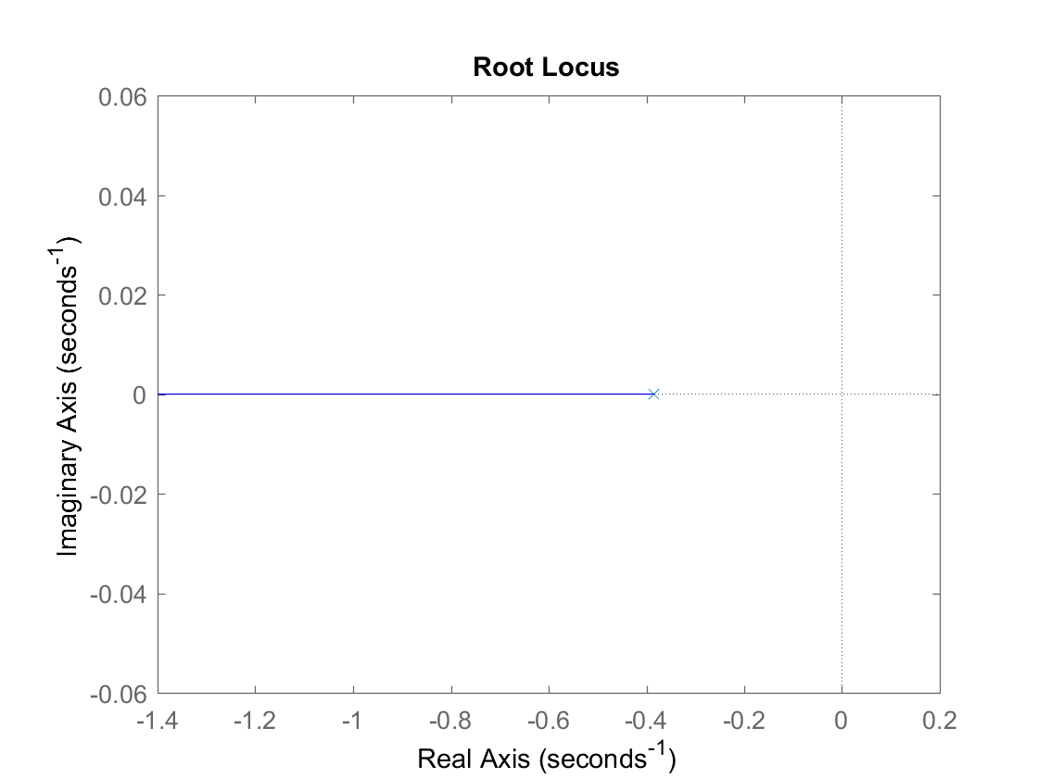
Root Locus
The electrical system, amplifier , and motor 1 are stable according to the root locus
Motor 0 has complex root locus, which explains the damped oscillation
Power amplifier
Electrical
Motor 0
Motor 1
To be continued in part 2 (PID Control)

Slide 12
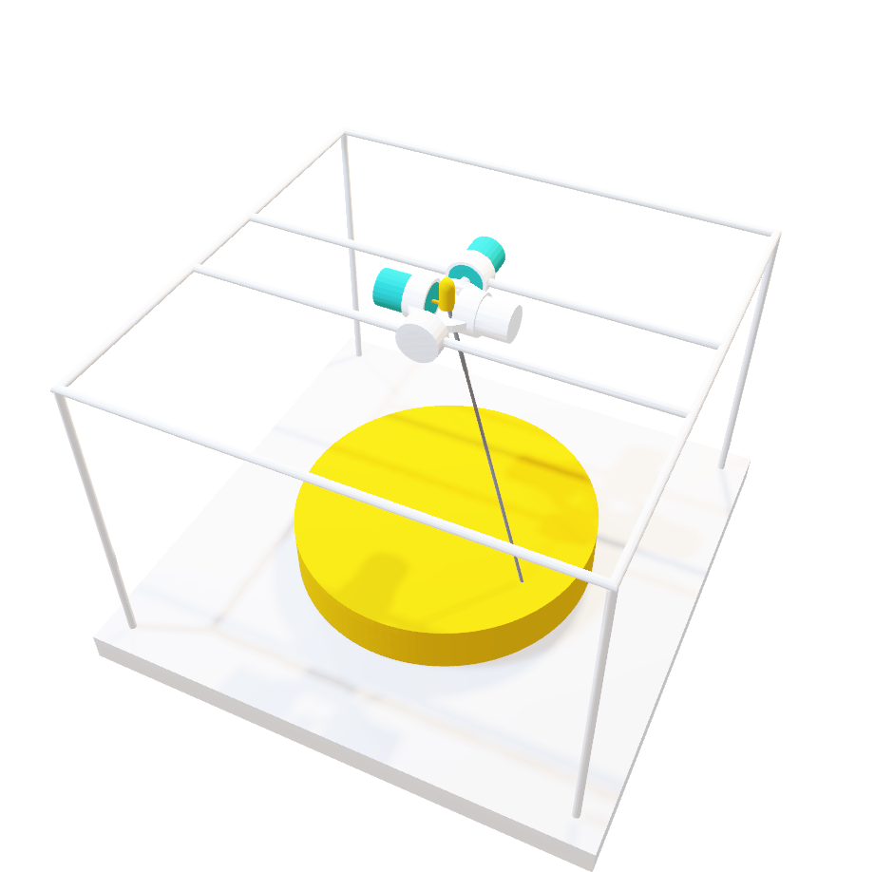
Selective Laser Sintering 3D Printer
ELEC 341 Design Project
Part 2
Muchen He 44638154
Ou Liu 18800152

Slide 13
Control Overview
PID overview
PID strategy

Slide 14
System Review
Transfer function
Poles and zeroes
Root Locus

Slide 15
Motor Selection

Slide 16
Obtaining PID
Placing zeroes
How we obtained Kp, Ki, and Kd

Slide 17
PID Gains
KGH with PID
Root locus with PID

