Slide 1
Selective Laser Sintering 3D Printer
ELEC 341 Design Project
Part 1
Muchen He 44638154
Leo Liu 18800152

Slide 2
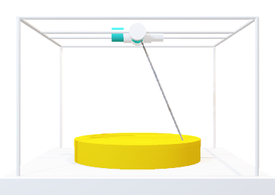
System Overview
Coordinates (X, Y, Z)
The 3D printer uses a laser to build parts. The laser is oriented using a two-axis motor assembly.
The inverse kinematic module converts the Cartesian coordinates to the desired motor angle.
Inverse Kinematic
The joint controller module handles the system response and controller.
The direct kinematic converts actual motor angles back to Cartesian coordinates
Joint Controller
The laser control module adjusts the intensity of the laser based on how far the target is
Direct Kinematic
The motors control the orientation of the laser
Laser Control
Motors

Slide 3
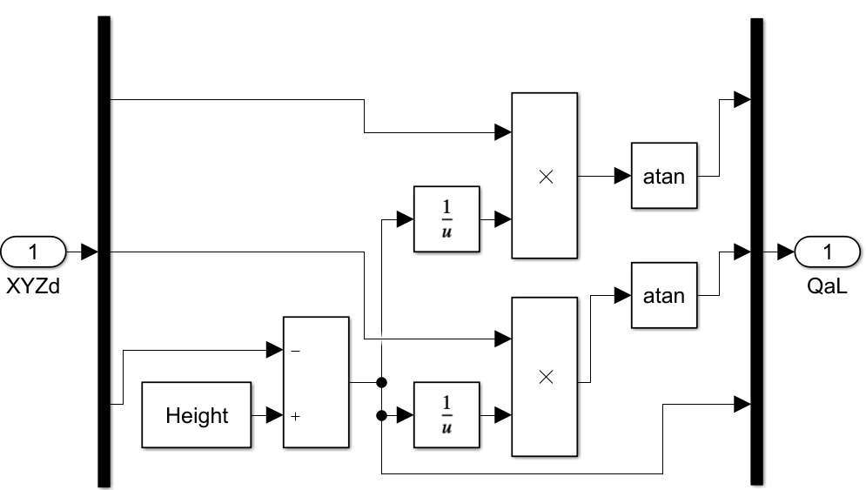








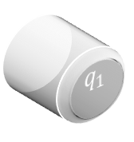


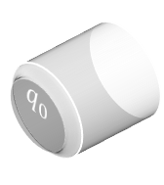


Inverse Kinematic
$$z$$
The inverse kinematic module converts the Cartesian coordinates to the desired motor angle.
$$q_{1}$$
$$q_{0}$$
$q_{0}$: angle of motor 0
$q_{1}$: angle of motor 1
$z′$: Distance between laser and top of part
Desired $x$
Desired $y$
Desired $z$
$$−y$$
$$x$$
Implementation in SimuLink
$$q_{0}=\tan^{−1}{\frac{x}{z^{′}}}$$
$$q_{1}=\tan^{−1}{\frac{y}{z^{′}}}$$
$$z^{′}=\text{he}\text{ight}−z$$

Slide 4
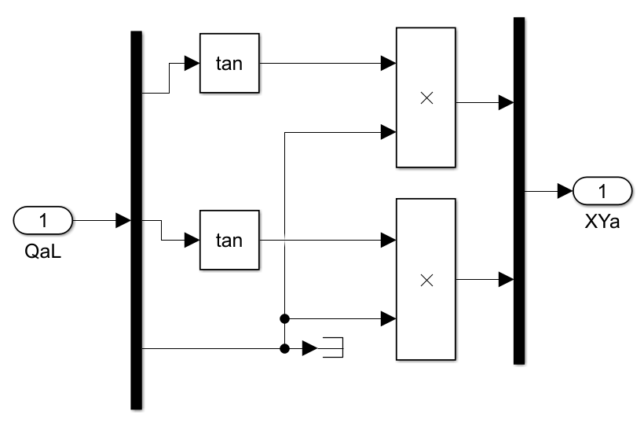


Direct Kinematics
The direct kinematic converts actual motor angles back to Cartesian coordinates
$$x=\tan\left(q_{0}\right)×z^{′}$$
$$y=\tan\left(q_{1}\right)×z^{′}$$
$$z^{′}=\text{distance} \text{between} \text{laser} \text{tip} \text{and} \text{top} \text{of} \text{part}$$

Slide 5
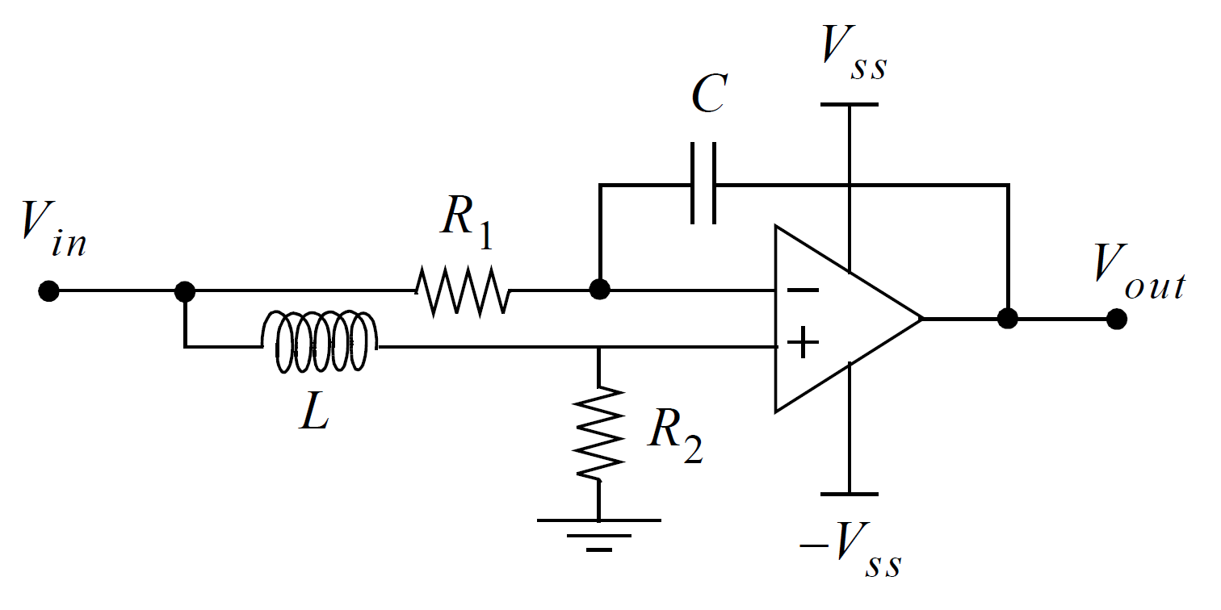
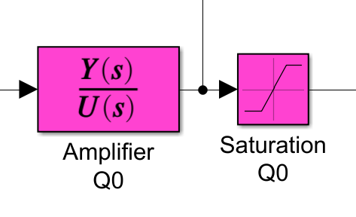
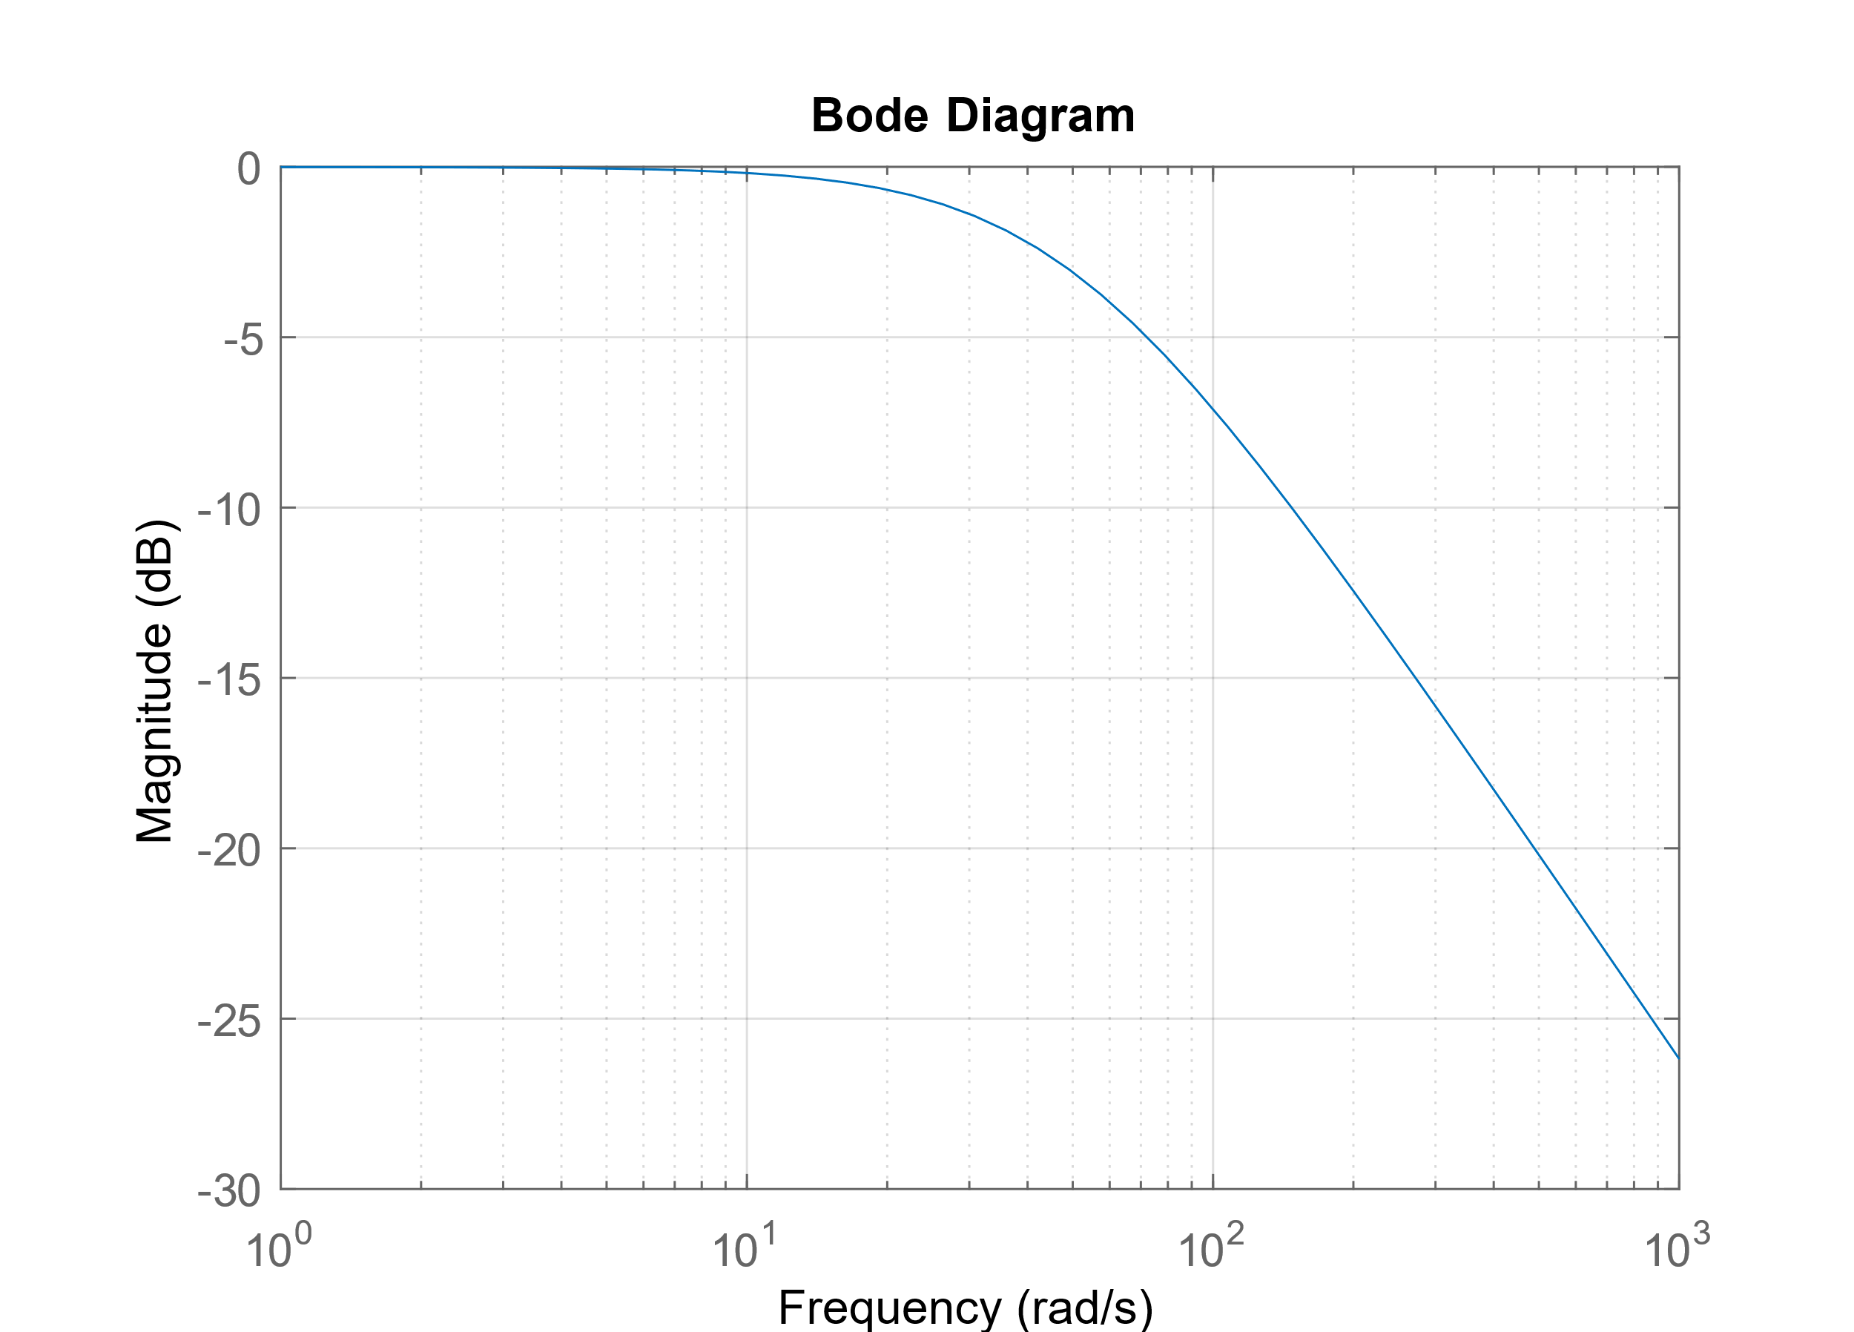
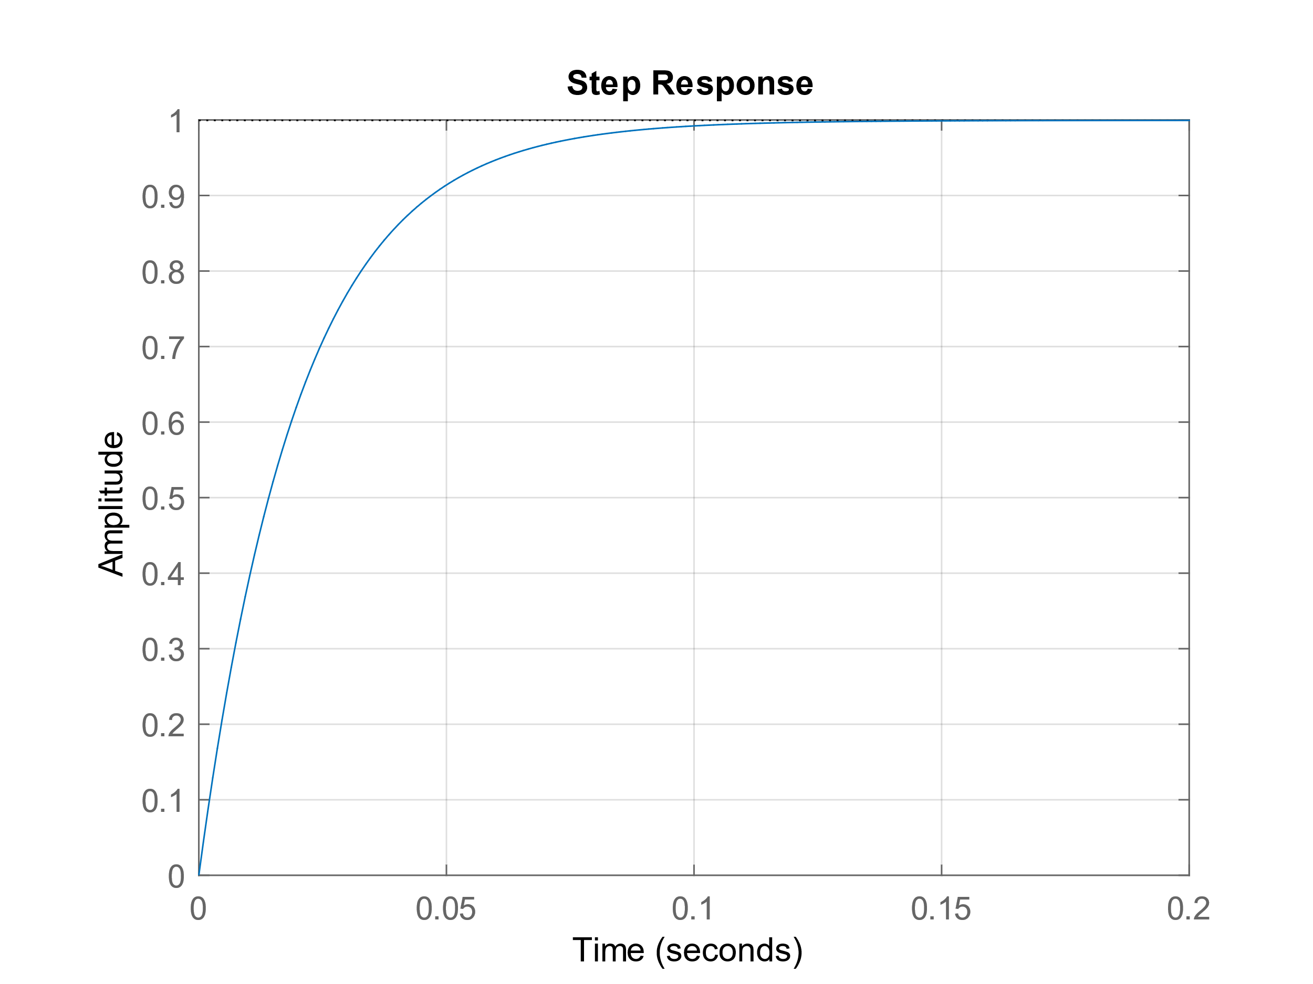





Power Amplifier
$$V_{n}$$
The power amplifier takes the role of a filter and a voltage follower.
The transfer function is the output divided by input.
Since there is negative feedback coupled by the capacitor, $V_{n}=V_{p}$.
MNA is used to solve the circuit
$$V_{p}$$
Amplifier circuit
SimuLink implementation
MNA:
$$\frac{V_{in}−V_{n}}{Ls}=\frac{V_{n}}{R_{2}}$$
$$\frac{V_{in}−V_{n}}{R_{1}}=\left(V_{n}−V_{out}\right)×sC$$
Transfer Function: $\frac{V_{out}}{V_{in}}$ $=\frac{CR_{2}R_{1}−L}{LCR_{1}s+CR_{1}R_{2}}$

Slide 6

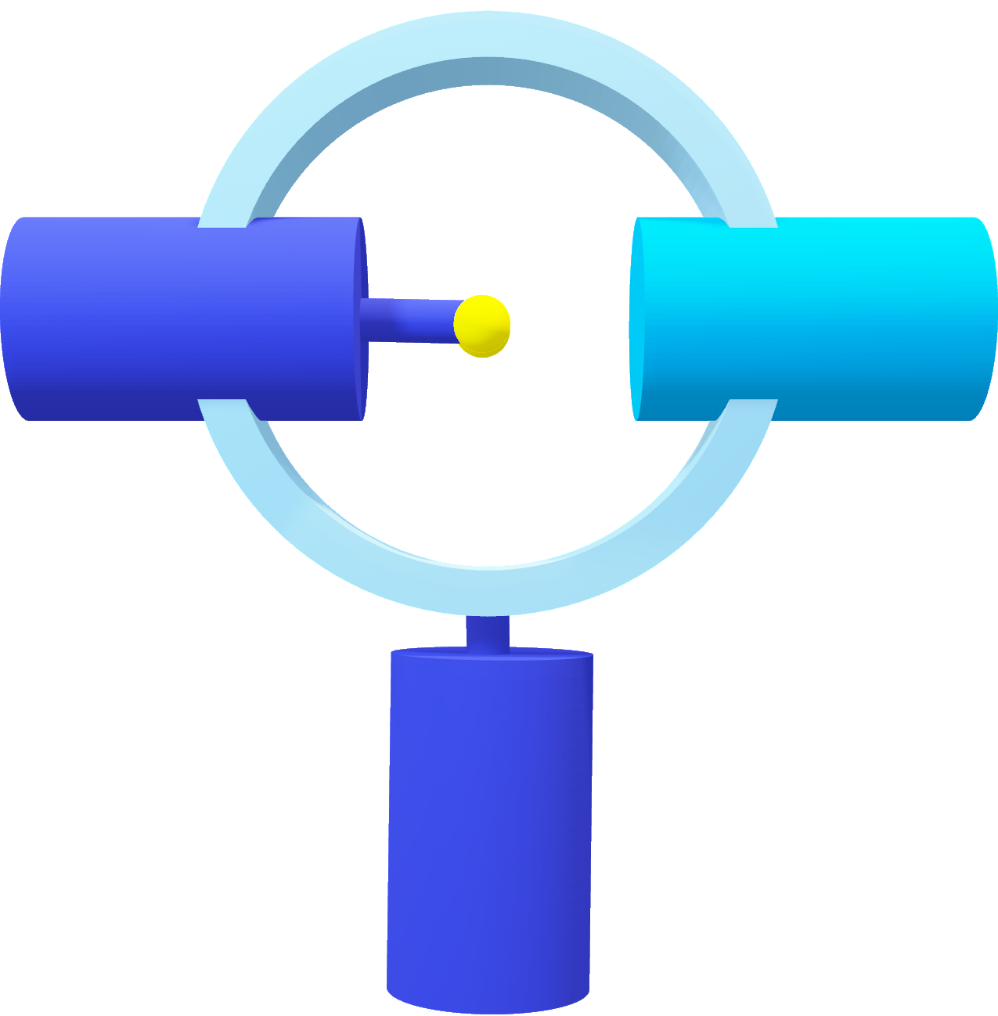


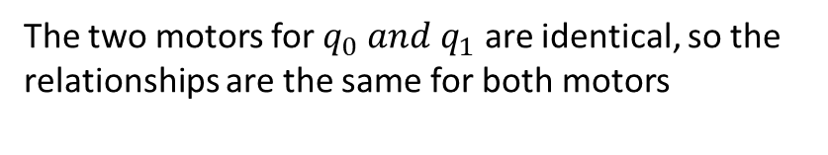

Electric Motor Dynamics
The DC motor has the following relationships
$$τ=k_{τ}i$$
$$V_{emf}=k_{b}ω$$
$$i=\frac{V_{in}−V_{emf}}{Ls+R}$$
The two motors for $q_{0} and q_{1}$ are identical, so the relationships are the same for both motors

Slide 7
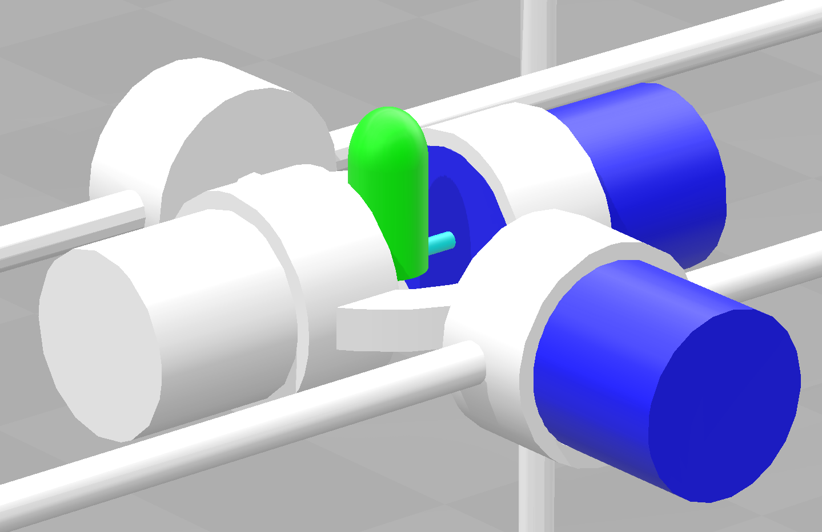

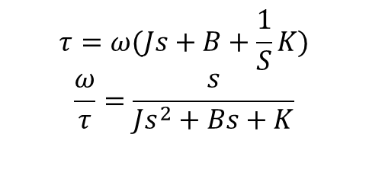
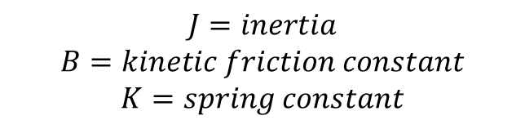
Mechanical Motor Dynamics
$$τ=ω(Js+B+\frac{1}{S}K)$$
$$\frac{ω}{τ}=\frac{s}{Js^{2}+Bs+K}$$
$$J=inertia$$
$$B=kinetic friction constant$$
$$K=spring constant$$

Slide 8























Mechanical Motor Dynamics
$$J_{counter weight}$$
$$J_{motor weight}$$
$$l$$
$$h_{Link}$$
$$q_{1}$$
$$r_{2}$$
$$h_{motor}$$
$$J_{rotor}$$
$$r_{1}$$
$$d$$
$$l$$
$$d$$
$$J_{rotor}=RotJ$$
$$J_{rotor}$$
$$q_{1}$$
$$h_{motor}$$
$$center of link$$
$$J_{link}$$
$J_{q1 weight}=J_{counter weight}=\frac{1}{3}\frac{{Mass}_{motor}}{h_{motor}}$(${{(h}_{motor}\text{+}l)}^{3}−l^{3}$)
$$q_{0}$$
$J_{q0}=$ $J_{link}+J_{rotor}+J_{q1 weight}+J_{counter weight}$
$$J_{link}=\frac{{Mass}_{link}}{12}×\left(3\left({r_{2}}^{2}+{r_{1}}^{2}\right)+{h_{Link}}^{2}\right)$$
$J_{q1}=$ $J_{rotor}$

Slide 9
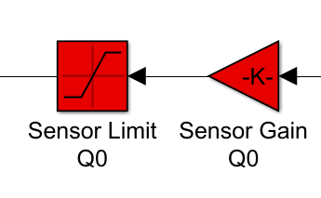


Sensor Dynamics
$$Voltage$$
$$rad$$

Slide 10
Static Friction

