Slide 1
Hello world
EECE 570 Project Report

Slide 2
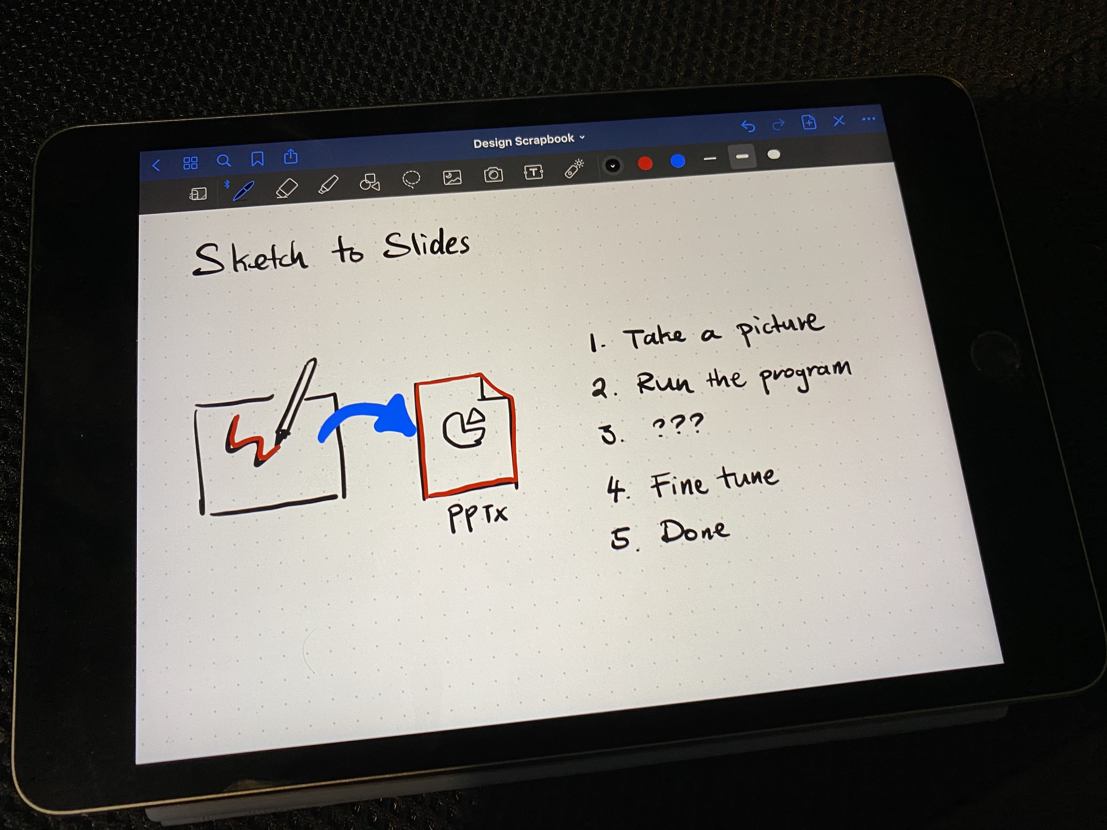
Image

