Slide 1
Hello world
EECE 570 Project Report

Slide 2









Slide 3
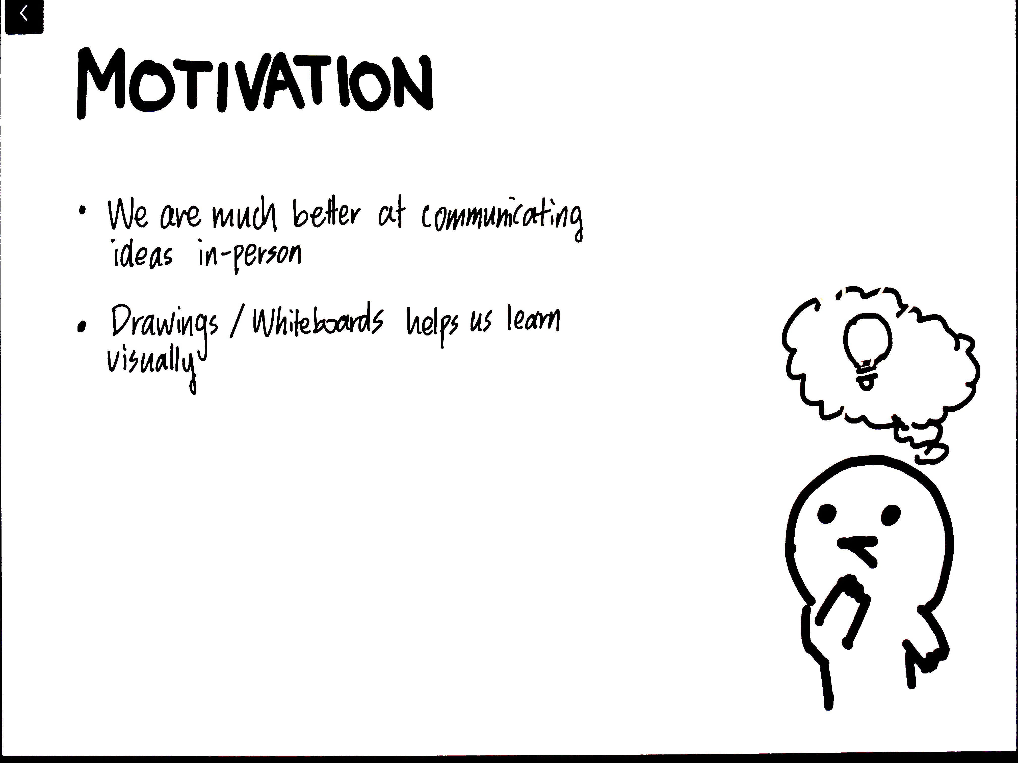



Slide 4
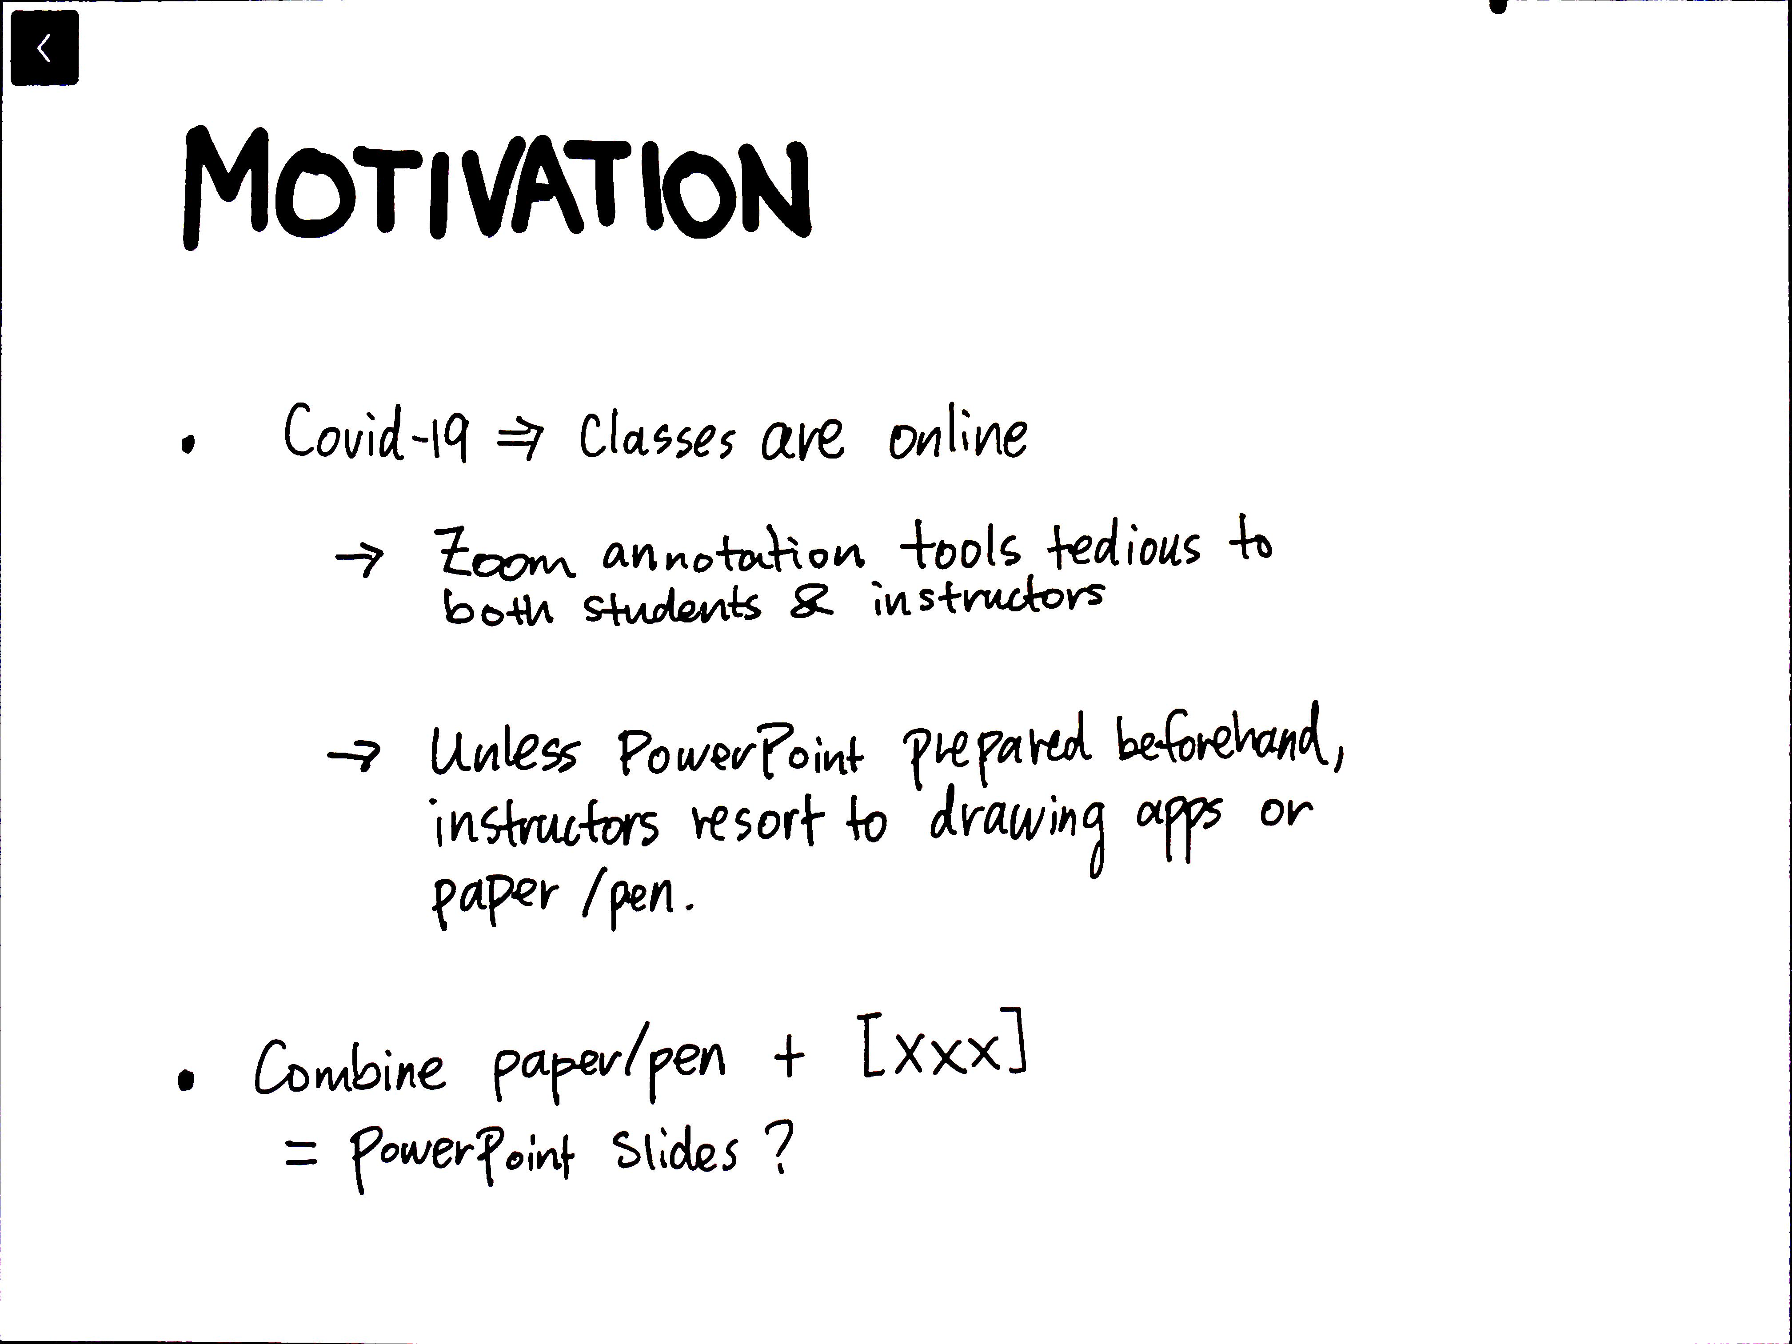






Slide 5
