Slide 1
RENEWABLE ENERGY FOR AN AVERAGE HOUSEHOULD IN EDMONTON
MECH 431 :: ENGINEERING ECONOMIC ANALYSIS
MUCHEN HE (44638154)

Slide 2
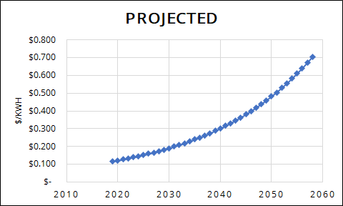
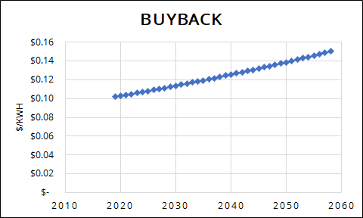
Introduction
There will be a non-renewable energy crisis and the projected price for electricity is increasing, fast!
Renewable energy is appealing
Solar is extra appealing in Edmonton
Edmonton is one of the most sunniest cities in Canada!
Notes:
Increasing in electrical costs have made renewable energy more appealing
This analysis explore the viability of these renewable option
Edmonton being the sunniest place is the perfect testing ground

Slide 3
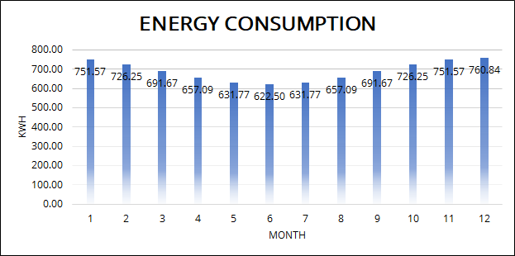
Energy Consumption
The average Albertan household consumes 7900 kWh each day
Using 8300 kWh as benchmark
Higher usage during winter (darker and colder)
Notes:
First start with average energy consumption
The average Albertan household consumes 7900 kWh each day
Using 8300 kWh as benchmark for safety
Higher usage during winter (darker and colder) because heating and lighting is used more

Slide 4
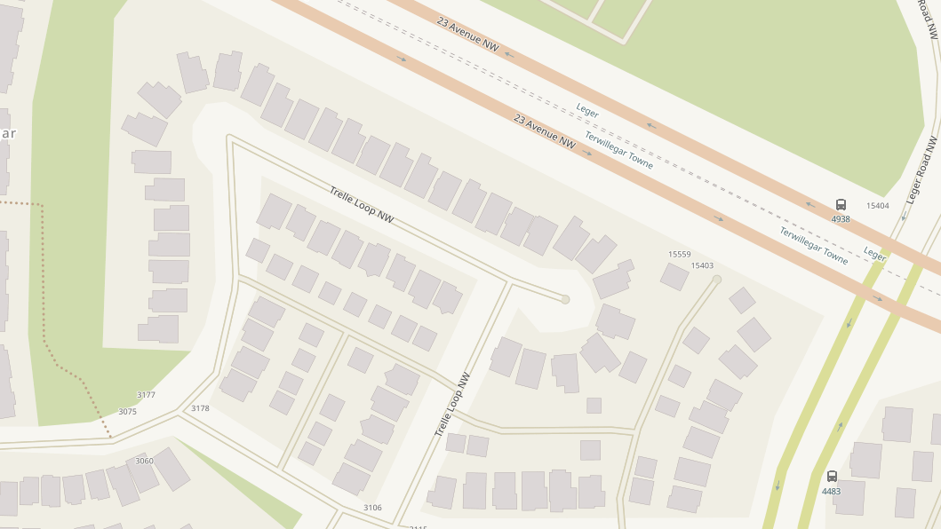
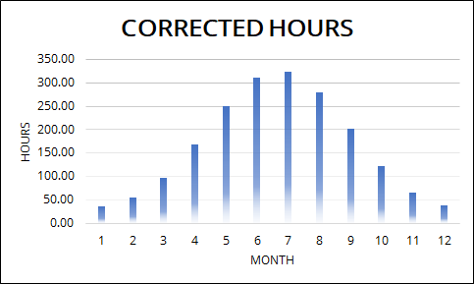
Weather
The most uncertain aspect of the analysis
Luckily not as sensitive to outcome
Modelled and simulated using real data
Notes:
The most uncertain aspect of the analysis at 17% according to one study
Luckily not as sensitive to outcome because it does not affect the nominal IRR by a significant amount
The weather is modelled and simulated using real data such as minimum day light and sun light times. Python scripts are written to simulate the sinusoidal characteristics of sun from days, to months, to years.

Slide 5
Grid Electricity
Projected cost expected to rise dramatically
Solar systems can act as microgenerators to contribute to the grid
Buyback rate for excess generated energy is appealing
Notes:
Analysis of grid electricity rates of the future
The projected cost will increase at 5.1% annually
The buyback rate is projected to be at only 1%. However in the near future, this is still appealing
Solar systems can act as microgenerators to contribute to the grid and will act as extra income

Slide 6

Source of Capital
Assume $10,000 in cash in savings
Anything cost more than that to install will be taken from loans
Loans have 5 or 15 year terms
Loan has prime rate (3%) + 2% interest rate
Some installation services take bitcoins
Government Incentives:
Rebate for residential up to $10,000 or 30% of investment
Rebate for Businesses up to $500,000 or 25% of investment
Additional $0.15/W rebate from the city
Notes:
If project is below $10000, the project can be purchased using cash
Otherwise loan is taken
Loan has interest 2% above prime interest rate of 3%
There are also government incentives

Slide 7
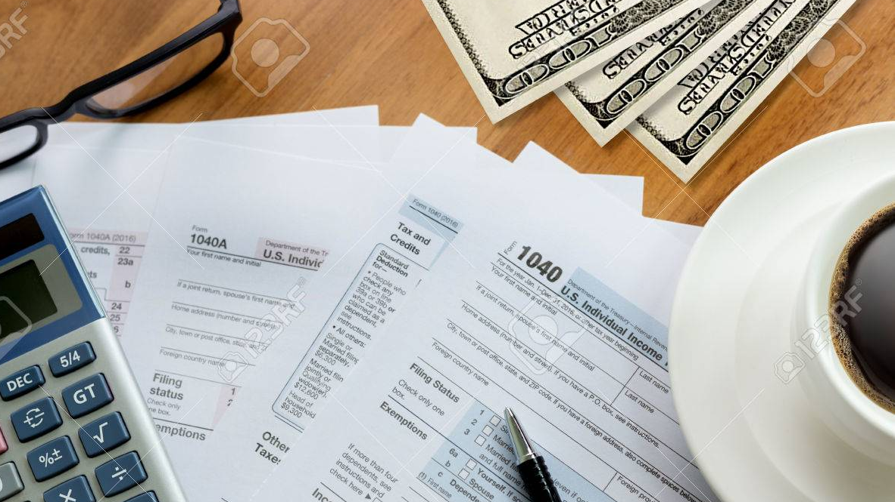
Taxes and Depreciation
CCA class 43 or class 8 for most equipment
30% depreciation rate for solar panels
UCC book value at the end of analysis period used as salvage value
10% corporate tax
Notes:
CCA class 43 or class 8 for most electrical equipment
Exception is the mechanical stuff which is class 17
30% depreciation rate for solar panel equipment
Replacements will add to the UCC account
UCC book value at the end of analysis period used as salvage value
10% corporate tax

Slide 8
Maintenance and Salvage
Estimated $0.01/W maintenance per year (for cleaning and care)
Solar cells lose 0.5% efficiency each year
Salvage value is the UCC book value
Notes:
$100 per year for 10kW system
After 40 years the solar efficiency is still at 82%

Slide 9
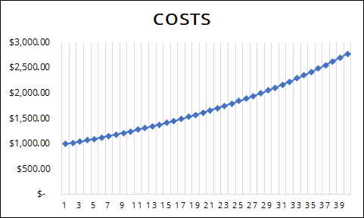
Alternative 0: Do nothing
Doing nothing means not installing any solar
Paying the electric price as they rise even if the energy used is the same
A reference where we can gauge other alternatives

Slide 10
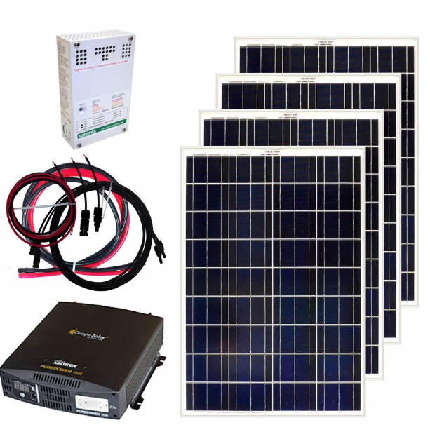
Alternative 1: Small scale 400W
A 400W is very easy to setup
Don’t require professionals
Cheap
Long lasting

Slide 11
Alternative 1 Outcome
400W is too small
Breakeven period is 26 years!
IRR 3.67% or NPV $235.4 in 40 years (already accounted for 2% inflation rate)
Replacement analysis shows solar panels needs replacement every 28 years
Notes:
The replacement of the solar panel is actually not needed
Due to high installation cost being so late into the analysis (analysis period is finite)
We won’t consider replacing solar panels for all alternatives

Slide 12
Alternative 2: Medium scale 5kW
Provides much more energy (12.5x of alternative 1)
Can generate extra energy during the summer and be sold for extra income
Downside: very expensive to install; requires professionals
Downside: cannot sustain power demand completely in winter
Notes:
Much larger, therefore extra cost needs to be inquired to hire professionals, engineering, and permitting
Provides much more energy (12.5x of alternative 1)
Can generate extra energy during the summer and be sold for extra income
Downside: very expensive to install; requires professionals
Downside: cannot sustain power demand completely in winter

Slide 13
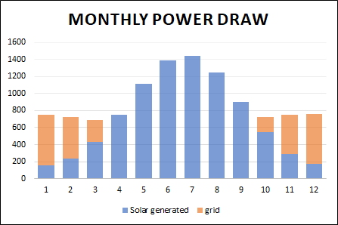
Alternative 2 Outcome
15 year loan repayment is better than 5 year loan repayment because it avoids taxes
Breakeven point is 24 years (only worth doing if lifetime is longer than this)
Maximum of nominal IRR 7.89% or NPV of $7310 (already accounted for inflation rate)
Has excess energy generated in the summer to sell
Notes:
The blue region is the power from solar panels
The orange region is the power from the grid
We want to minimize the orange region and maximize the extended part (excess power)

Slide 14
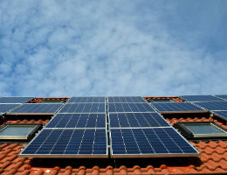
Alternative 3: Massive scale 10kW
Largest capacity and production
Lowest dollars per watt ratio
Highest rate of return in 40 years
Nearly unlimited supply of energy in the summer
Notes:
Even larger, therefore even more extra cost needs to be inquired to hire professionals, engineering, and permitting

Slide 15
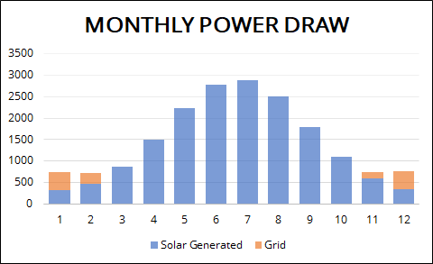
Alternative 3 Outcome
15 year loan repayment is better than 5 year loan repayment also
Breakeven point is 24 years
Maximum of nominal IRR 7.95% or NPV of $10573 (already accounted for inflation rate)
Even more excess energy in summer
Less reliance on grid in winter
Notes:
We minimized the orange region and increased the blue base line significantly

Slide 16
Verdict
If considering long term (28 years+) alternative 3 is the best
Generally it’s better to go with larger capacity systems
Do nothing if period is shorter than 25 years
Notes:
Choose solar
Choose alternative 3
Live at least 25 years

