Slide 1
FP-GROWTH
01157152 巫侑霖
01157123 胡家豪

Slide 2
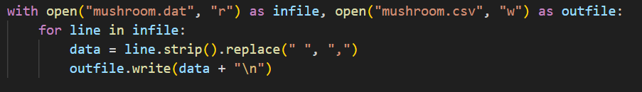
Convert data to CSV file

Slide 3
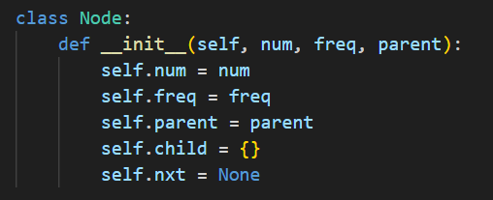
Tree Node

Slide 4
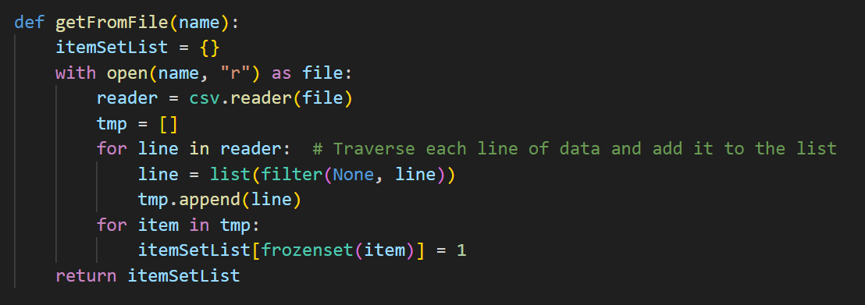
Read data

Slide 5
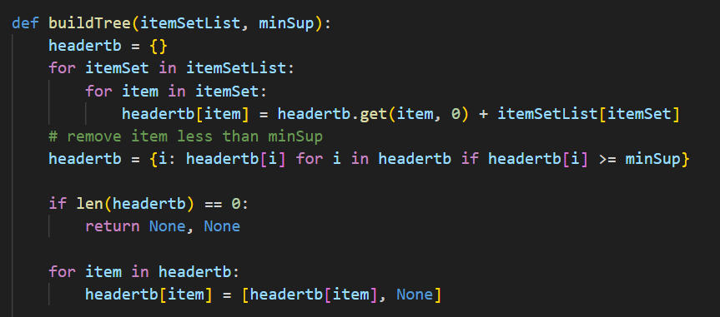
Build FP Tree

Slide 6
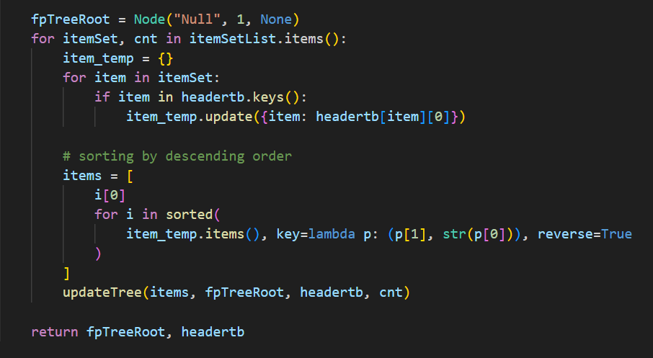
Build FP Tree

Slide 7
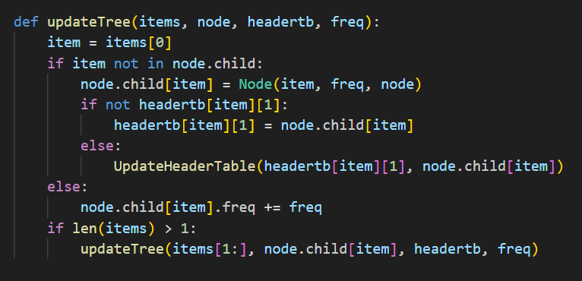
Insert data into FP Tree

Slide 8
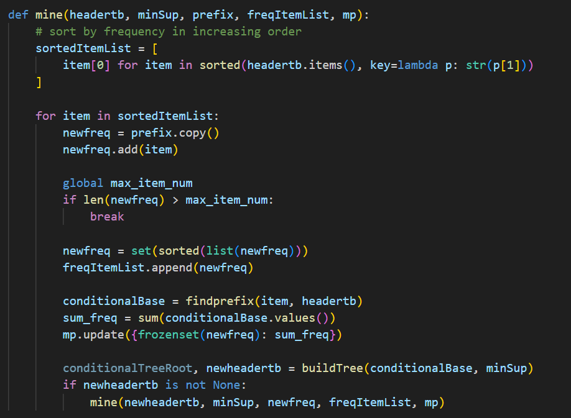
Mine

Slide 9
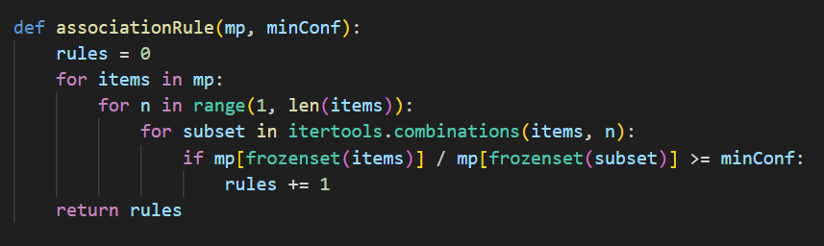
Count Association Rule

Slide 10
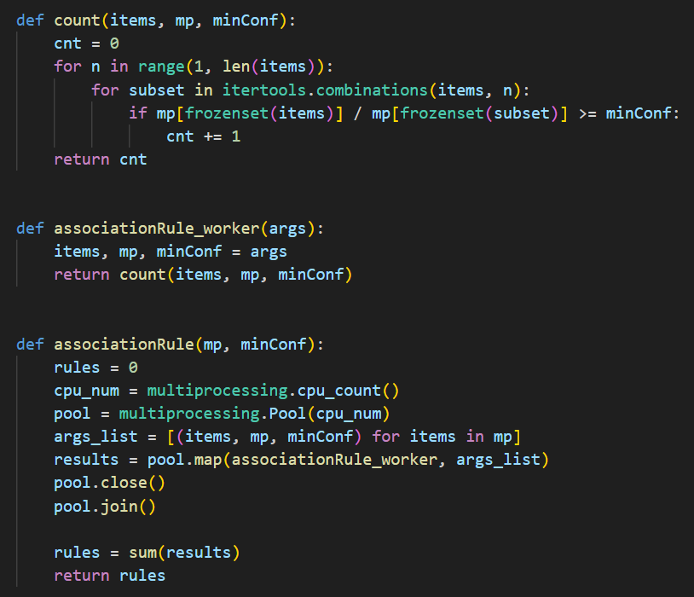
Count Association Rule (Use Multiprocess)

Slide 11
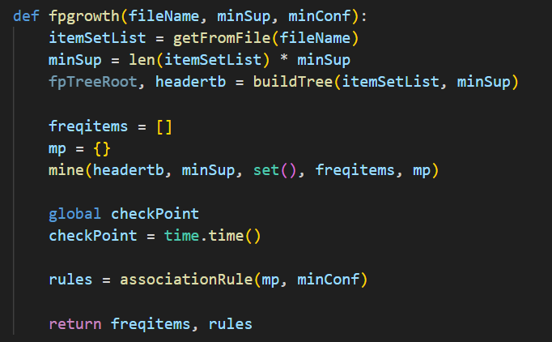
Main Code

Slide 12
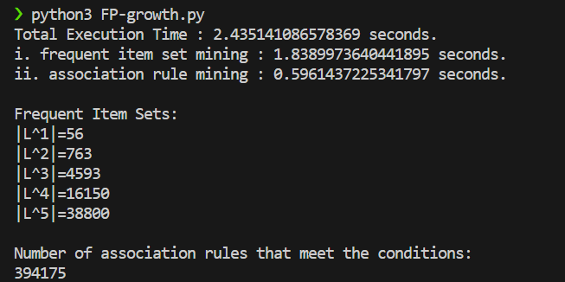
Execution Result ( max item size = 5)

Slide 13
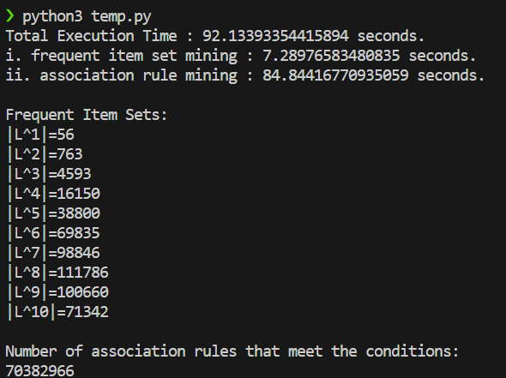
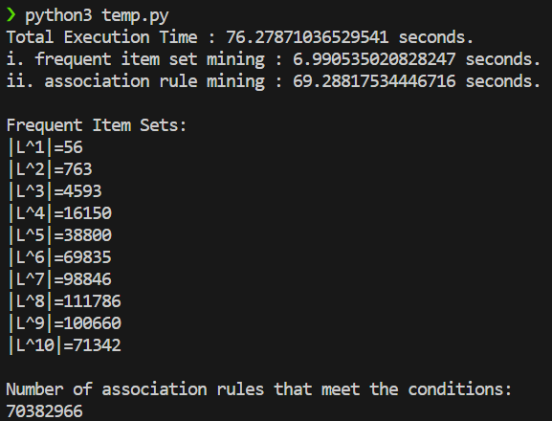
Execution Result ( max item size = 10)
Before multiprocessing After multiprocessing

Slide 14
Source Code
Github

Slide 15
Thank you
For
Listening

