Slide 1

ClubFinder
Group 82 The Clueless Four

Slide 2

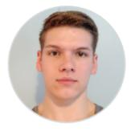


Team Members
Francisco Sanchez
Project Manager
Brandon Corbin
Scrum Master
Rohith Vellore
Developer
Joshua Garrett
Developer

Slide 3

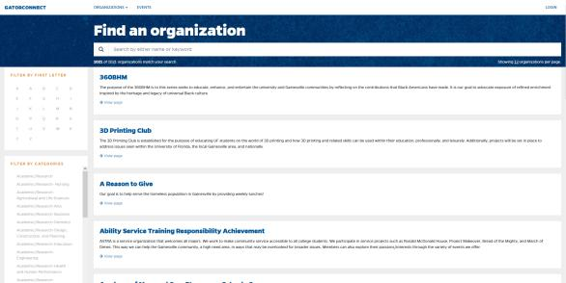
Problem Statement
The University of Florida promotes involvement in clubs. However, current club search does not aid the student in finding the best club for them.

Slide 4


Product Solution
This app will help students become more easily involved since the number of clubs can be overwhelming. It helps by allowing students to filter clubs based on their interests.

Slide 5
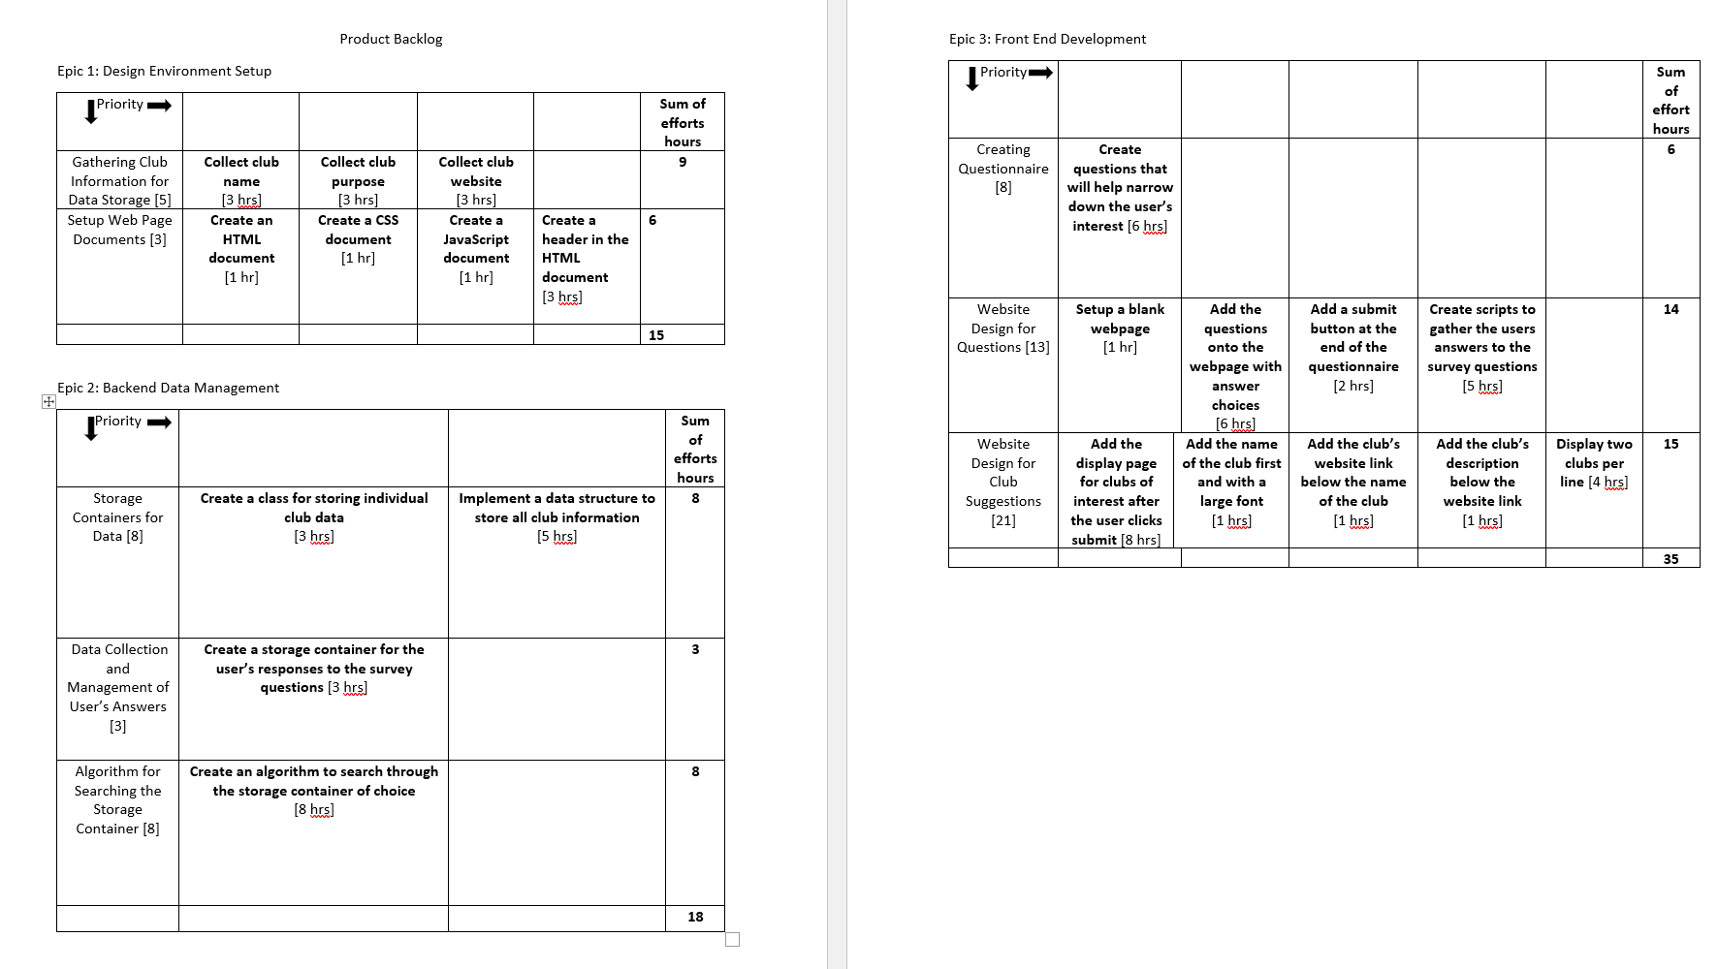
Original Product Backlog Review

Slide 6
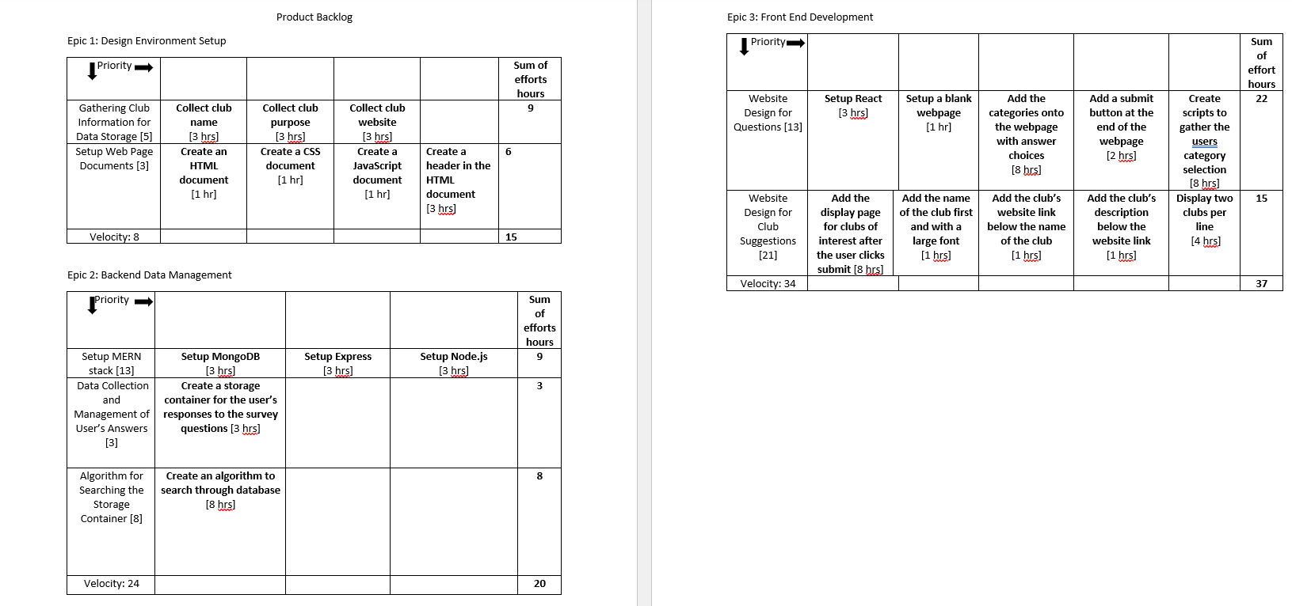
Modified Product Backlog Review

Slide 7

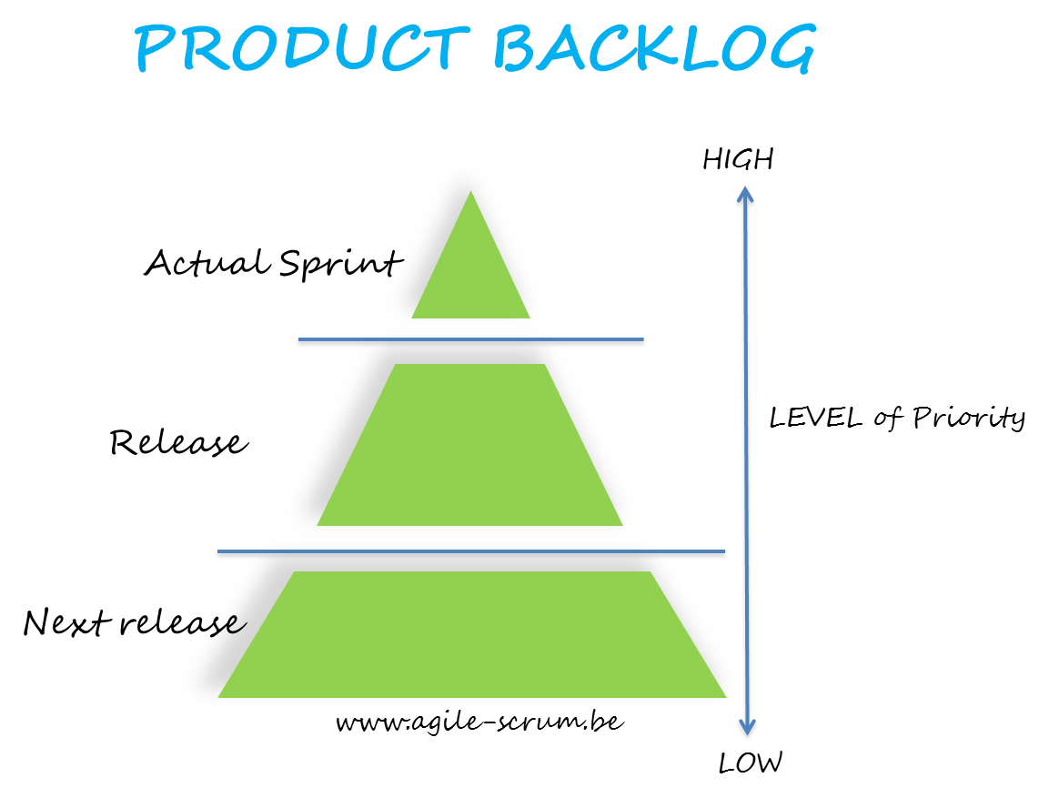
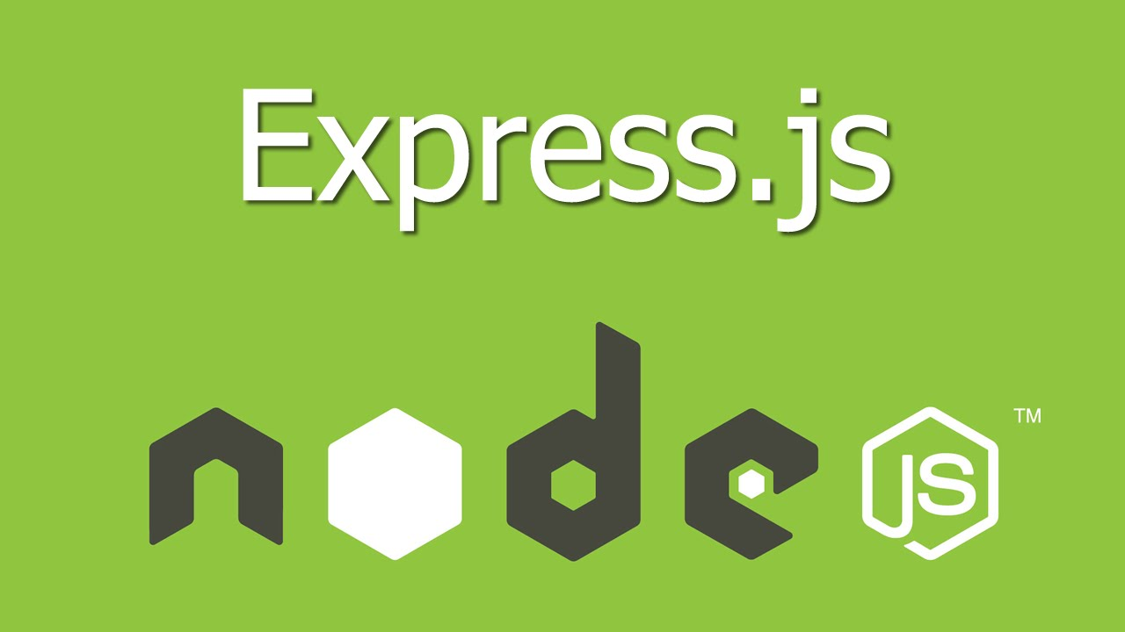
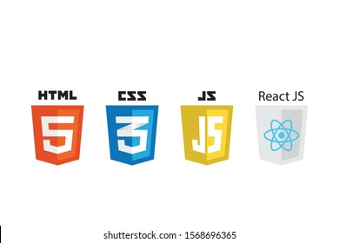
Review of Artifacts
MongoDB will be used as a database to store club names, description of clubs, and website if available.
Product backlog will be used to guide the design process.

Slide 8
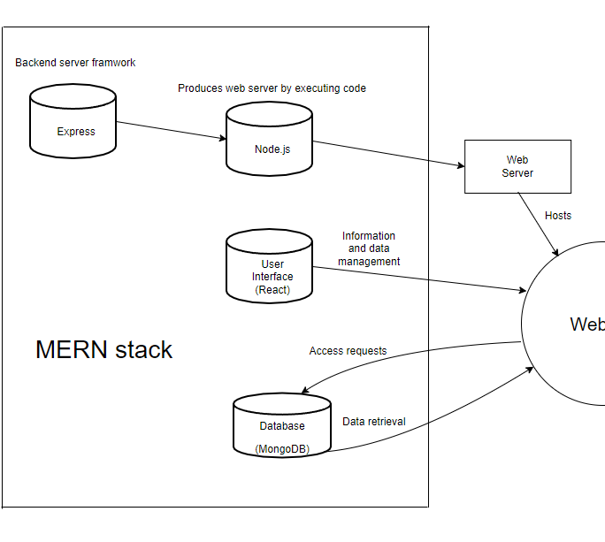
Work Completed
Express setup
Node.js setup
MongoDB database
Use case diagram
Use case narrative

Slide 9
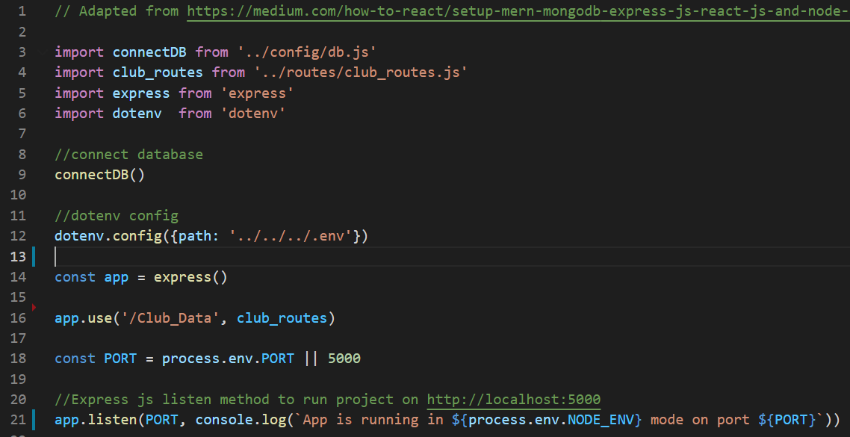
Code Review
Server.js

Slide 10
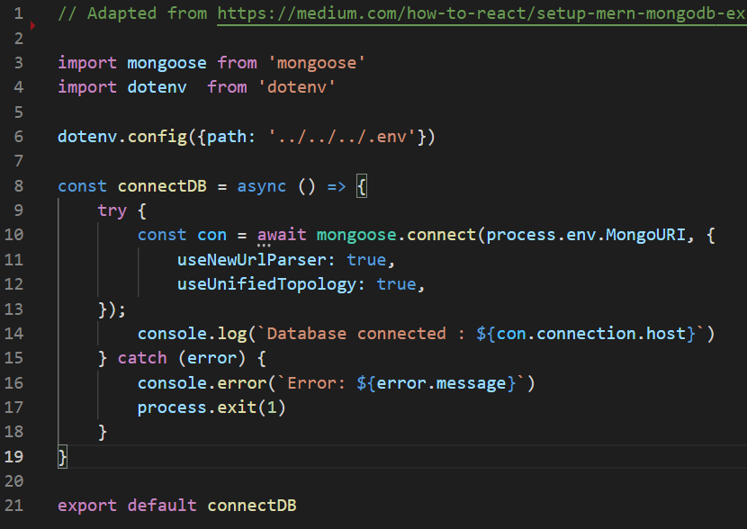
Code Review
DB.js

Slide 11
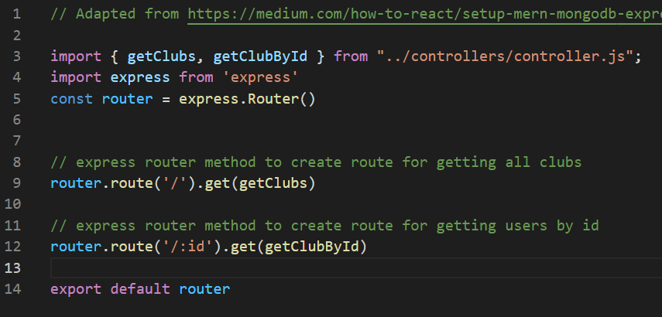
Code Review
Club_Routes.js

Slide 12
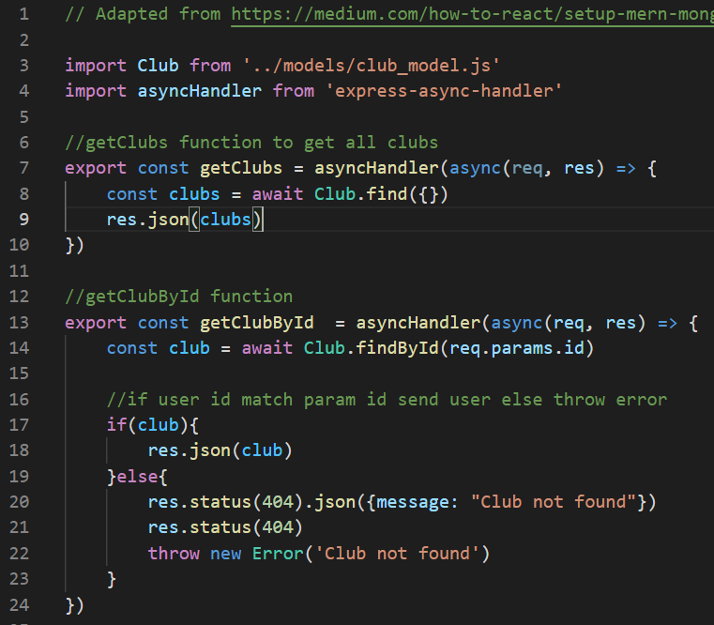
Code Review
Controller.js

Slide 13
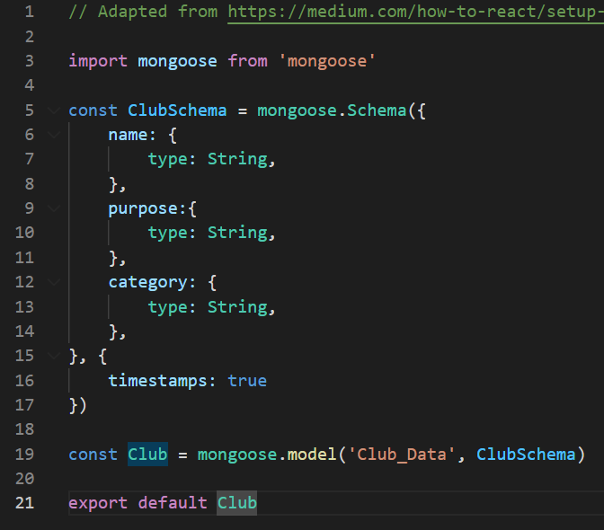
Code Review
Club_Model.js

Slide 14
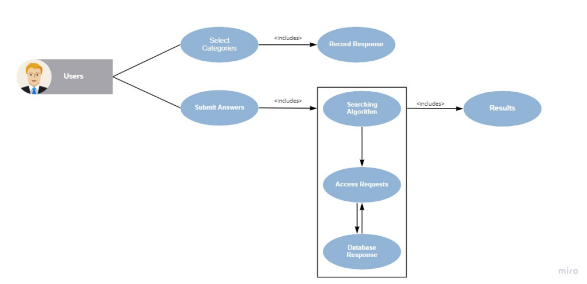
Use Case Model

Slide 15

Future Plans
Setup React to complete the MERN stack
Design searching algorithm for clubs
Begin front end development
User interests page
Results page

Slide 16

Demo Functionality

Slide 17
Issues Encountered
None so far

Slide 18

Thank you
Questions?

