Slide 1
Flicker Fusion Threshold Timing Results
Embedded Systems 2020

Slide 2
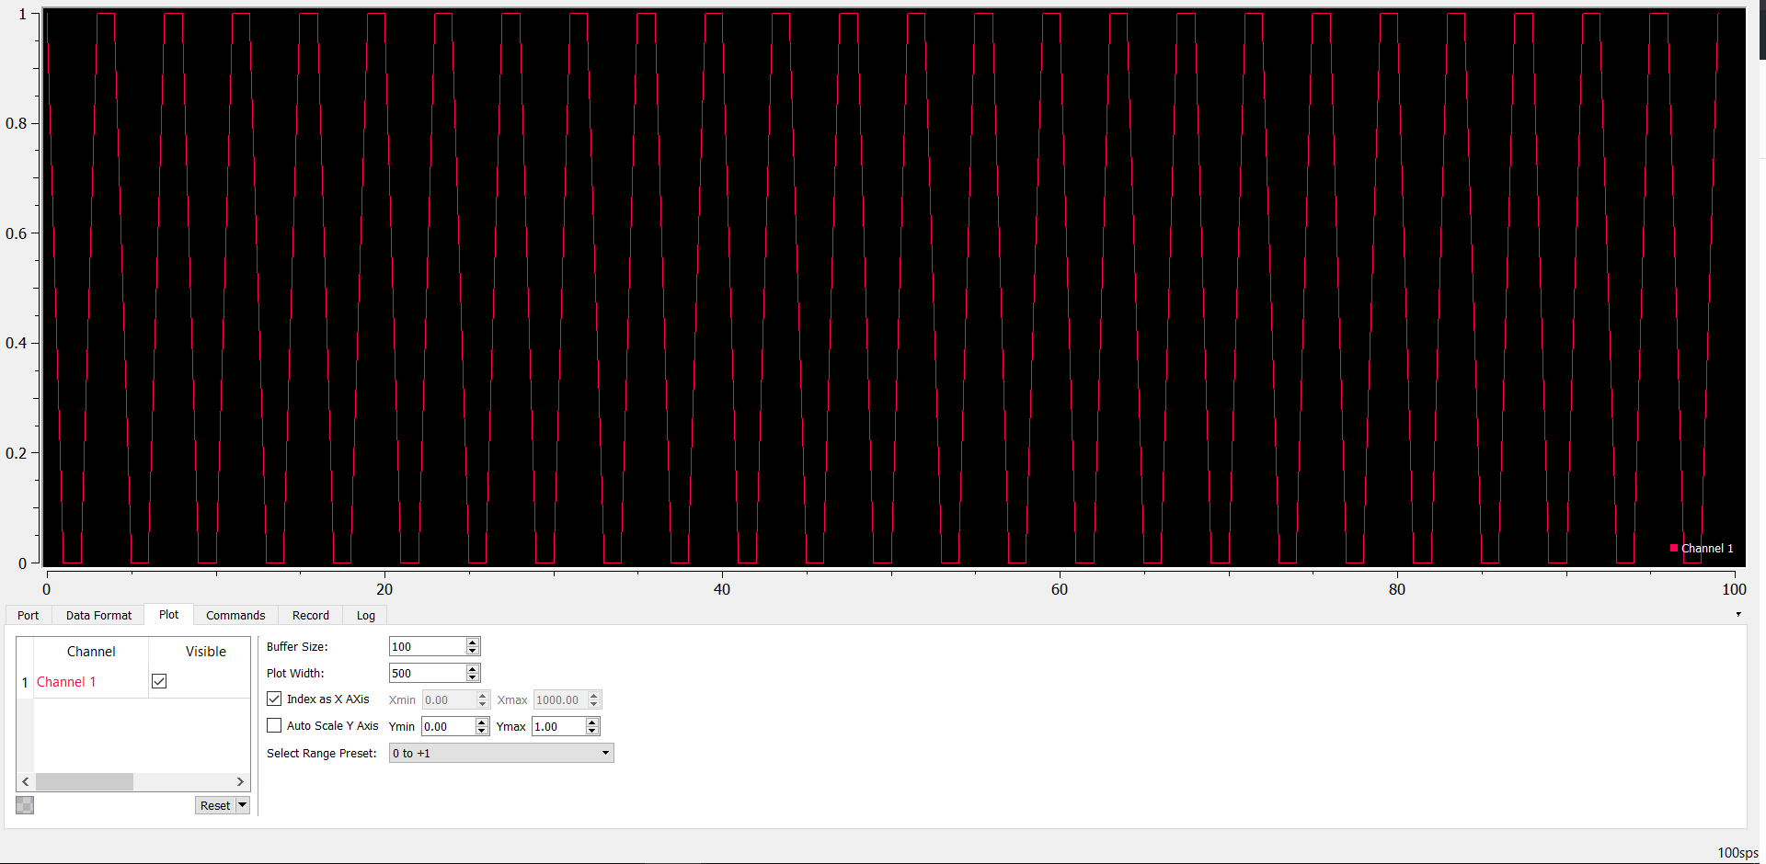
Plotter at 25.24Hz, 100sps
Full Plot

Slide 3
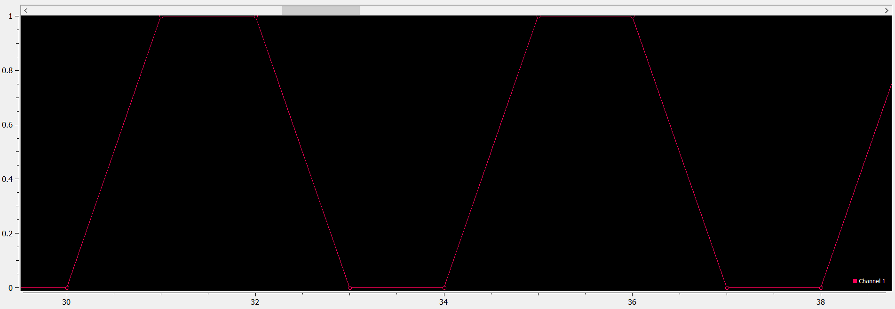
Plotter at 25.24Hz, 100sps
Zoomed Plot

Slide 4
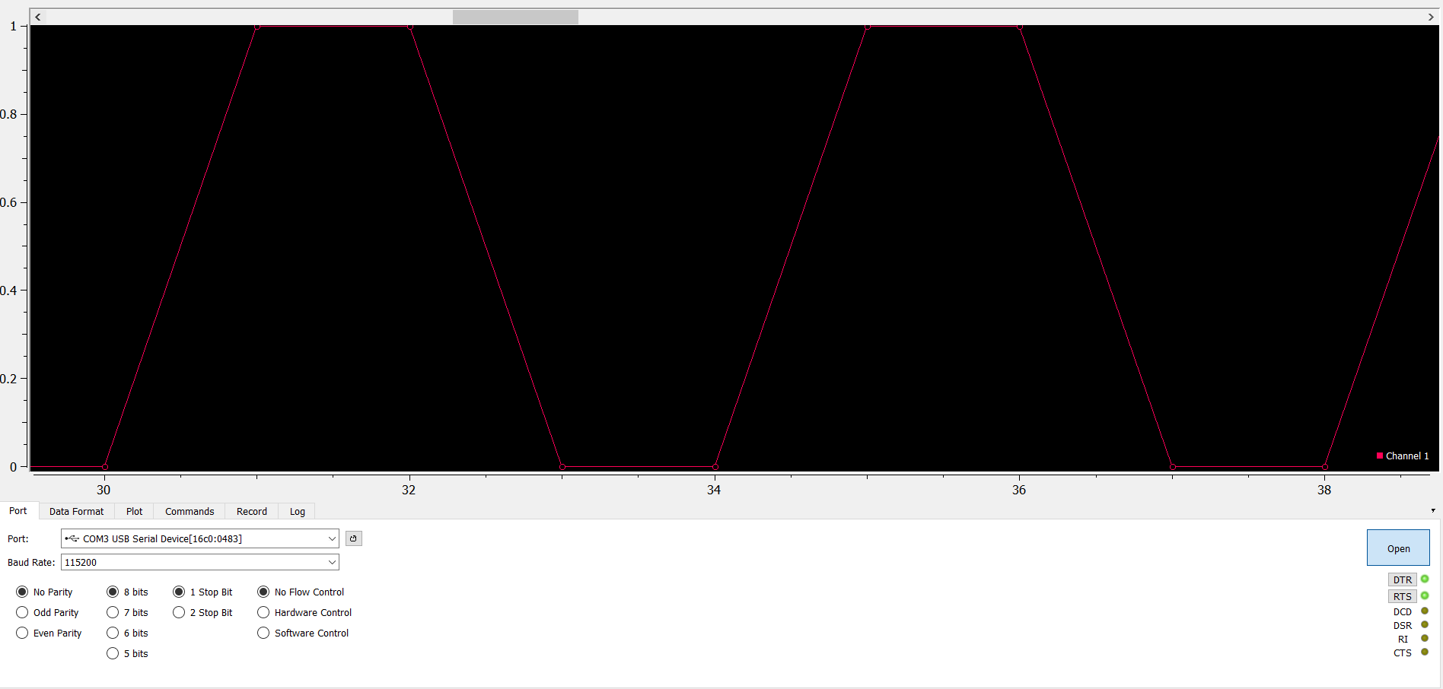
Plotter at 57.22Hz, 229sps
Zoomed Plot

Slide 5
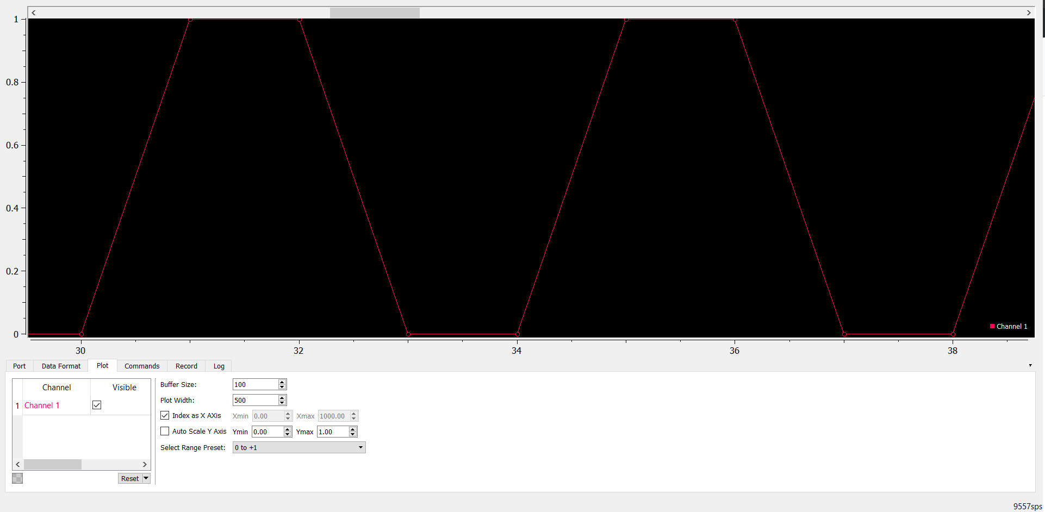
Plotter at 2557.54Hz, 10155sps
Zoomed Plot

Slide 6
Plotter at 2557.54Hz, 10155sps
Zoomed Plot

